Slide 1

Java Server Pages(JSP)

Slide 2
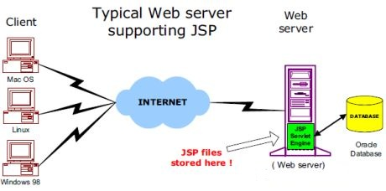

Slide 3

JavaServer Pages (JSP) allow you to select a dynamic part of your pages from static HTML. You, as usual, write the normal code in HTML, using for this purpose any program to create Web pages. Then you enter into the dynamic of the code in special tags, most of which begin with "<%" and finished with "%>".

Slide 4
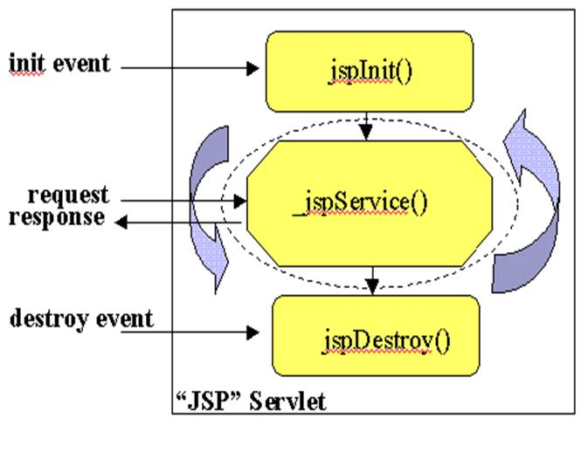
Life cycle jsp

Slide 5
First jsp
<html>
<head>
<title>
Hello World Sample
</title>
</head>
<body>
<h1>
<%
String name = request.getParameter("name");
if (name == null || name.length() == 0) {
%>
Hello, world !
<% } else {
%>
Hello, world ! I'm <%= name%>
<%
}
%>
</h1>
</body>
</html>

Slide 6
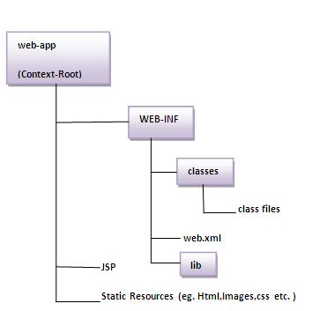
Структура каталога web-app в каталоге src.

Slide 7
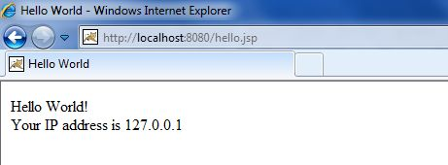
Синтаксис jsp.
The Scriptlet:<% code fragment %>
<html>
<head>
<title>Hello World</title></head> <body> Hello World!<br/> <% out.println("Your IP address is " + request.getRemoteAddr()); %> </body>
</html>

Slide 8
JSP Declarations:
<%! declaration; [ declaration; ]+ ... %>
<%! int i = 0; %>
<%! int a, b, c; %>
<%! Circle a = new Circle(2.0); %>

Slide 9
JSP Expression:
<%= expression %>
<html>
<head>
<title>A Comment Test</title></head>
<body>
<p> Today's date: <%= (new java.util.Date()).toLocaleString()%> </p>
</body> </html>
Today's date: 21-Sep-2015 21:24:25

Slide 10
JSP Comments:
<%-- This is JSP comment --%>
<html>
<head>
<title>A Comment test</title></head> <body>
<h2>A Test of Comments</h2>
<%-- This comment will not be visible in the page source --%>
</body>
</html>

Slide 11
JSP Directives:
<%@ directive attribute="value" %>
<%@ page ... %>Defines page-dependent attributes, such as scripting language, error page, and buffering requirements.
<%@ include ... %>Includes a file during the translation phase.
<%@ taglib ... %>Declares a tag library, containing custom actions, used in the page

Slide 12
JSP Actions:
<jsp:action_name attribute="value" />
jsp:include Includes a file at the time the page is requested
jsp:useBean Finds or instantiates a JavaBean
jsp:setProperty Sets the property of a JavaBean
jsp:getProperty Inserts the property of a JavaBean into the output
jsp:forward Forwards the requester to a new page
jsp:plugin Generates browser-specific code that makes an OBJECT or EMBED tag for the Java plugin
jsp:element Defines XML elements dynamically.
jsp:attribute Defines dynamically defined XML element's attribute.
jsp:body Defines dynamically defined XML element's body.
jsp:text Use to write template text in JSP pages and documents.

Slide 13
JSP Implicit Objects:
request This is the HttpServletRequest object associated with the request.
response This is the HttpServletResponse object associated with the response to the client.
out This is the PrintWriter object used to send output to the client.
session This is the HttpSession object associated with the request.
application This is the ServletContext object associated with application context.
config This is the ServletConfig object associated with the page.
pageContext This encapsulates use of server-specific features like higher performance JspWriters.
page This is simply a synonym for this, and is used to call the methods defined by the translated servlet class.
Exception The Exception object allows the exception data to be accessed by designated JSP.

Slide 14
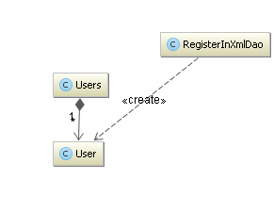
Простой проект с xml-базой данных и jsp

Slide 15
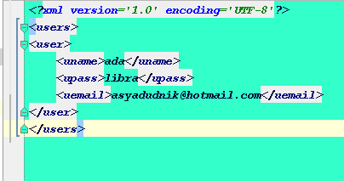
Database in xml-file

Slide 16
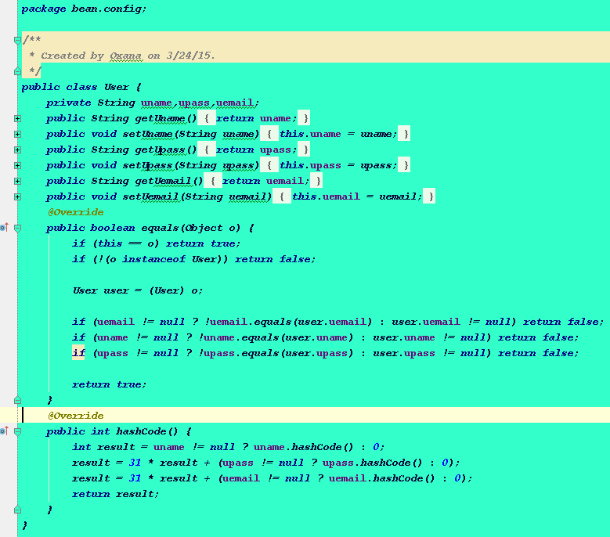

Slide 17
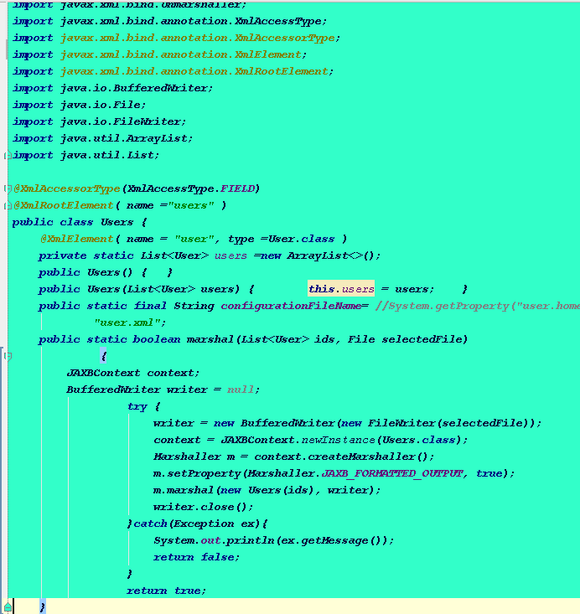

Slide 18
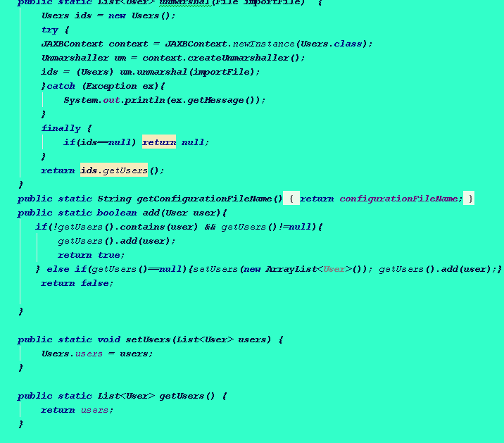

Slide 19
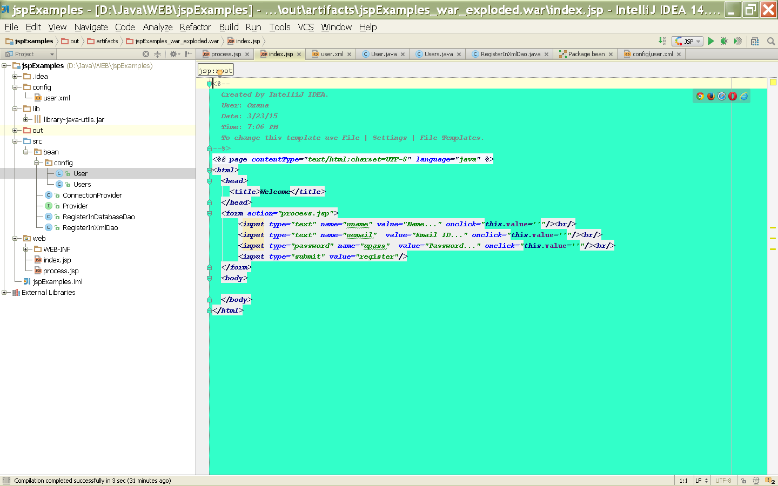

Slide 20
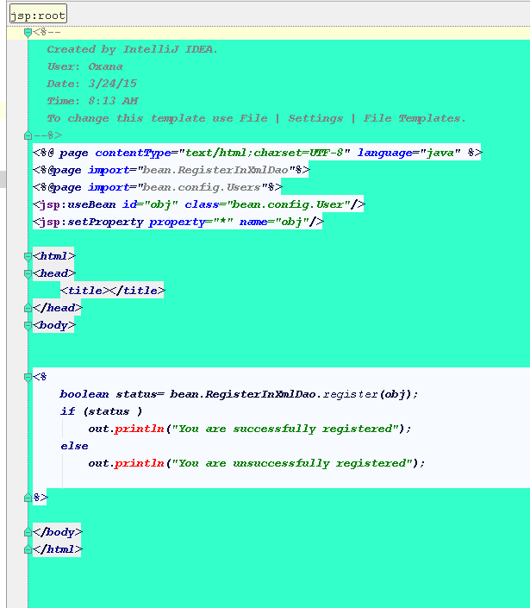

Slide 21
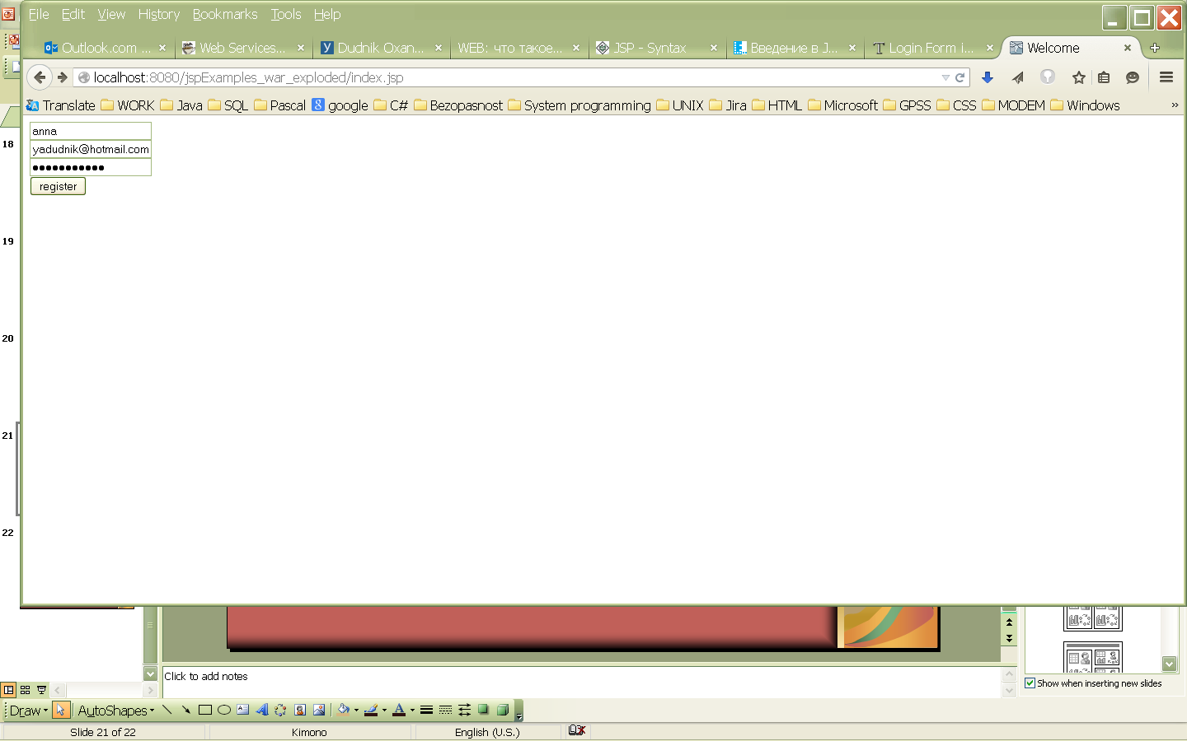
Result

Slide 22
Link on project
https://sourceforge.net/p/jspexamplelogin/code/HEAD/tree/

Slide 23
Literature
http://www.javatpoint.com/login-form-in-jsp#
http://java-course.ru/student/book1/jsp/
http://www.tutorialspoint.com/jsp/jsp_syntax.htm
http://www.codenet.ru/webmast/java/jsp.php

