Slide 1
Interim Report
TPJ452
Yu Chen
Huang Zheng

Slide 2
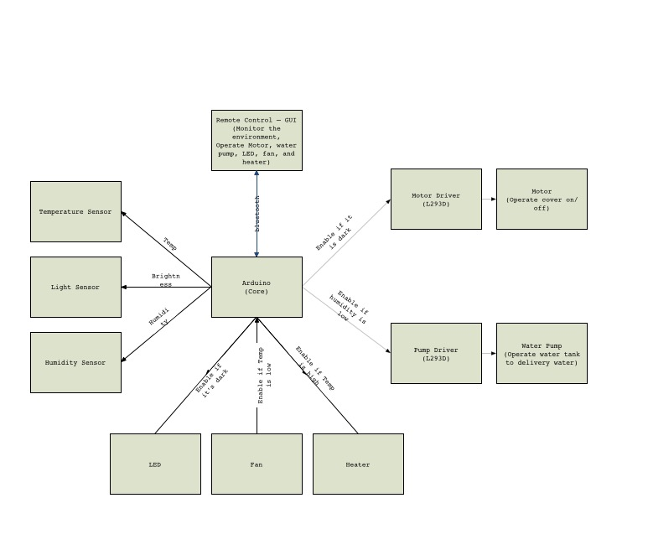
What we achieved…
System Requirement Analysis – 10%
Workflow – 20%
30%

Slide 3
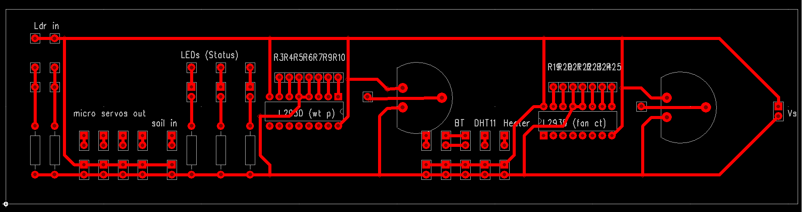
What we achieved…
Hardware – 30%
Soil Moisture Sensor | ✔️
Temperature Sensor | ✔️
Light Sensor | ✔️
Water Pump | ✔️
Motor | ✔️
Fan | ✔️
Heater | ✔️
LED | ✔️
Servo | ✔️
Components Testing – 10%
PCB Design – 15%
25%

Slide 4
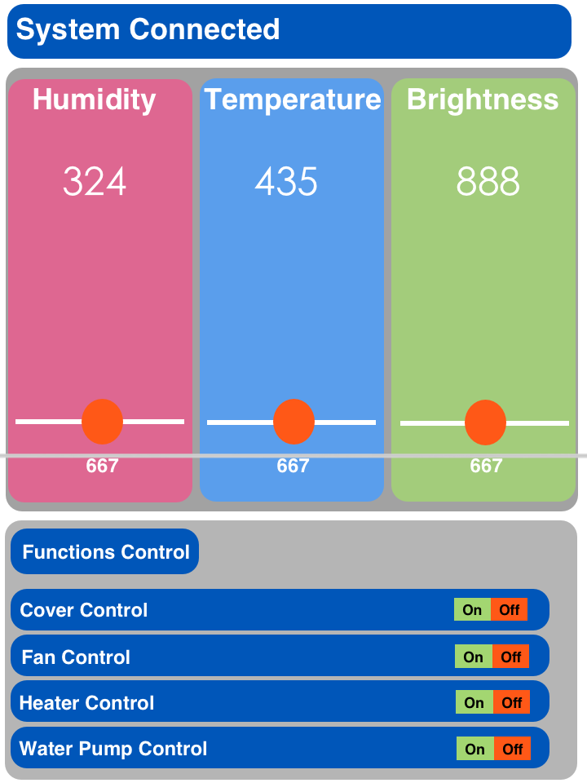
What we achieved…
Software – 25%
Layout Design – 5%
Components Testing – 10%
TextView | ✔️
ProgressBar | ✔️
Switch | ✔️
ImageView | ✔️
Bluetooth | ✔️
Button | ✔️
15%

Slide 5
What we will do…
Software – Functional Integration - 10%
System Integration - 5%
Hardware – Soldering - 5%
Debugging - 10%
30%

Slide 6


