Slide 1
Automatic Green House System
TPJ452NBB
Gal Messinger
Yu Chen, Jayden
2016/09/21

Slide 2
Introduction
In present day, most people are busy to working on carrier, and enjoy their life. But, when they go out for vacation and no one take care of the plants.
Therefore, in this course we’re going to design a green house system.
In the house, the system will automatically watering the plant when moisture of soil is low.
The cover will be open when morning is coming.
This house has climate control function.
The heater and cooler will control the house’s temperature.

Slide 3
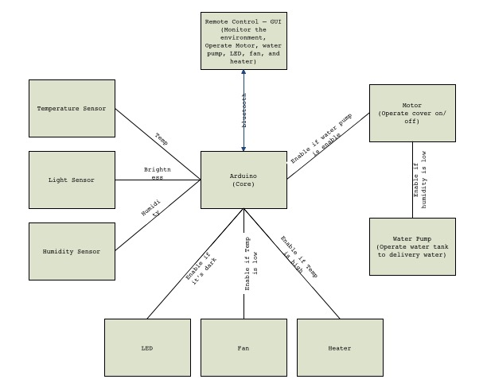
Block Diagram

Slide 4
GUI - draft

Slide 5
Cost

