Slide 1
microrefugia review

Slide 2
Outline
General context
Definition
Aspects of vulnerability
Sensitivity
Exposure
Adaptive capacity
How are microrefugia acutally quantified?

Slide 3
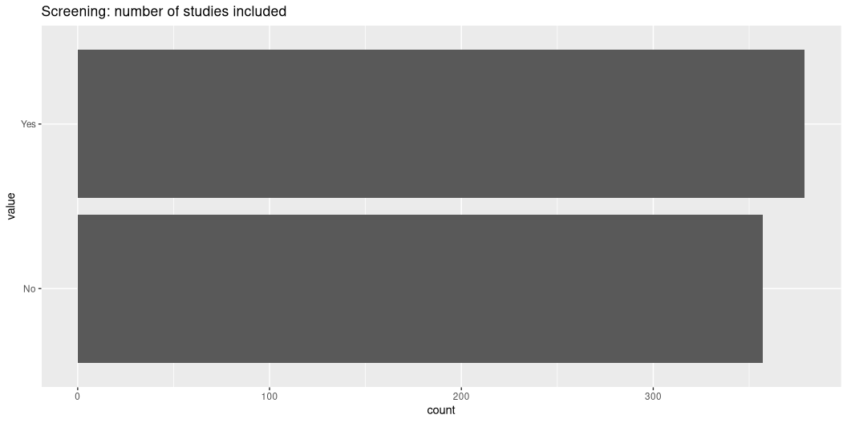
screening

Slide 4
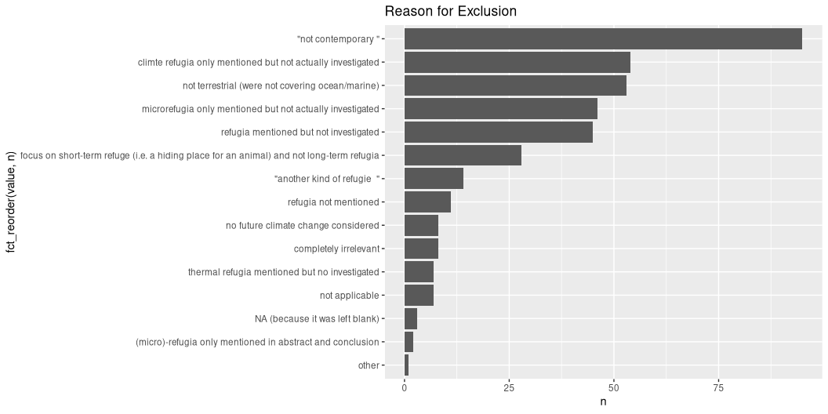
reasons for exclusion

Slide 5
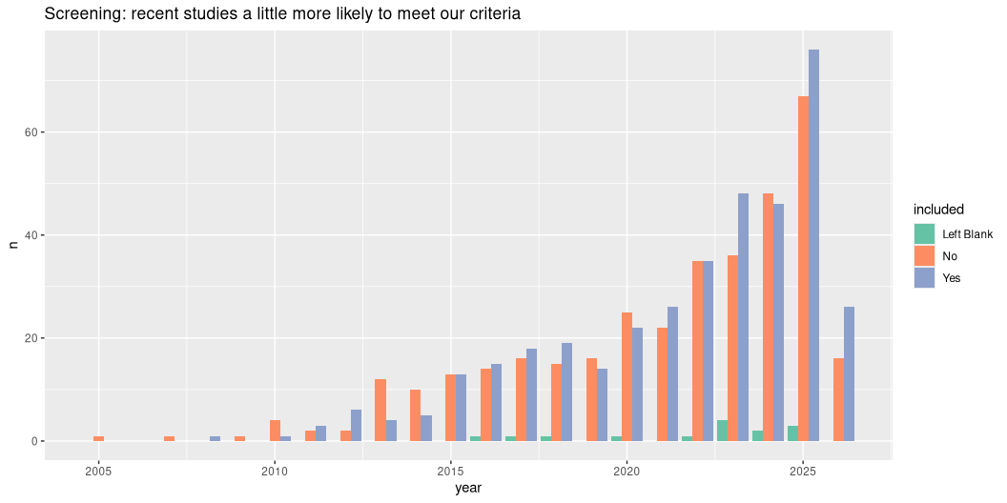
included by year

Slide 6
locations
Could be a map figure for the paper if we get coordinates
[1] "242 locations"

Slide 7
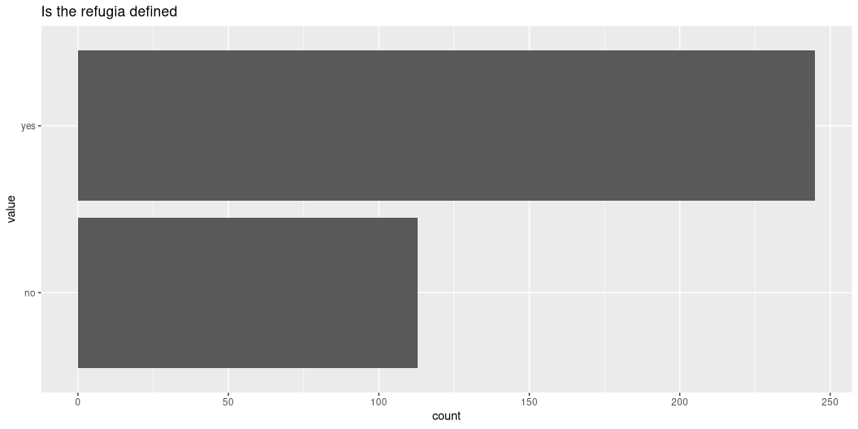
Refugia mostly defined

Slide 8
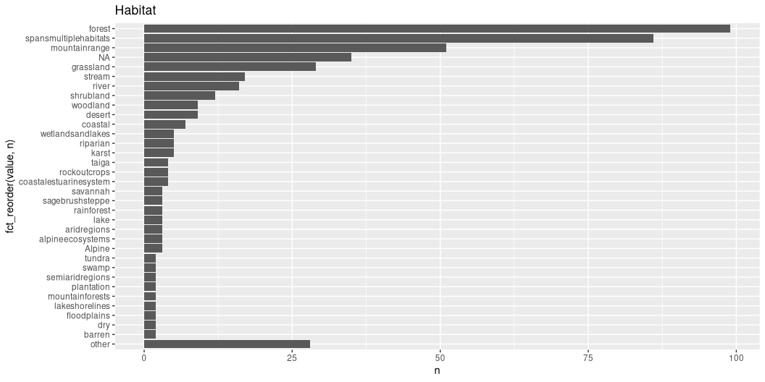
habitats

Slide 9
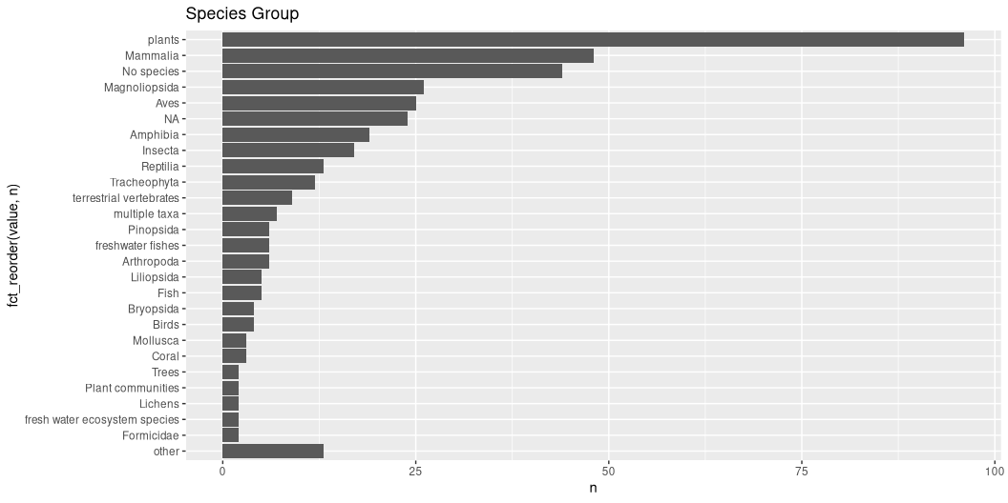
species groups

Slide 10
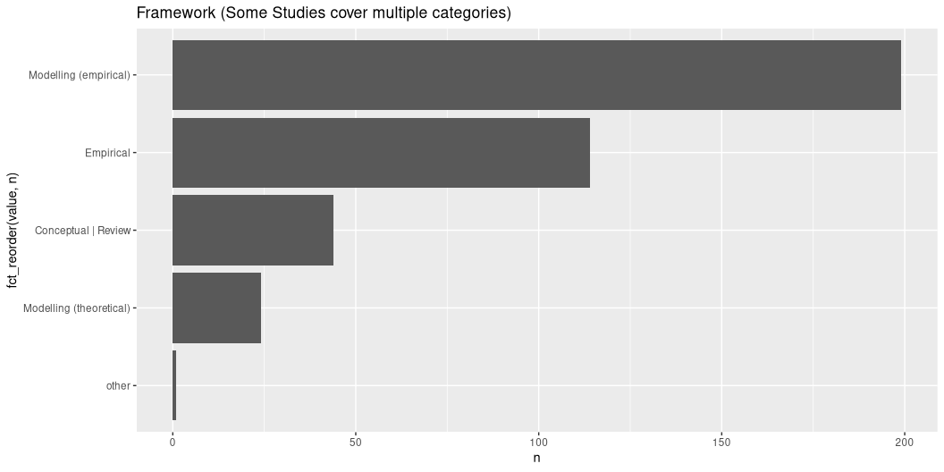
framework

Slide 11
Outline
General context
Definition
How are microrefugia defined: Temporally
Short-term vs millennial stability vs not at all defined?
How are microrefugia defined: Spatially
Size or structure defined?
Minimum size for viable populations Microrefugia networks - metapopulation dynamics

Slide 12
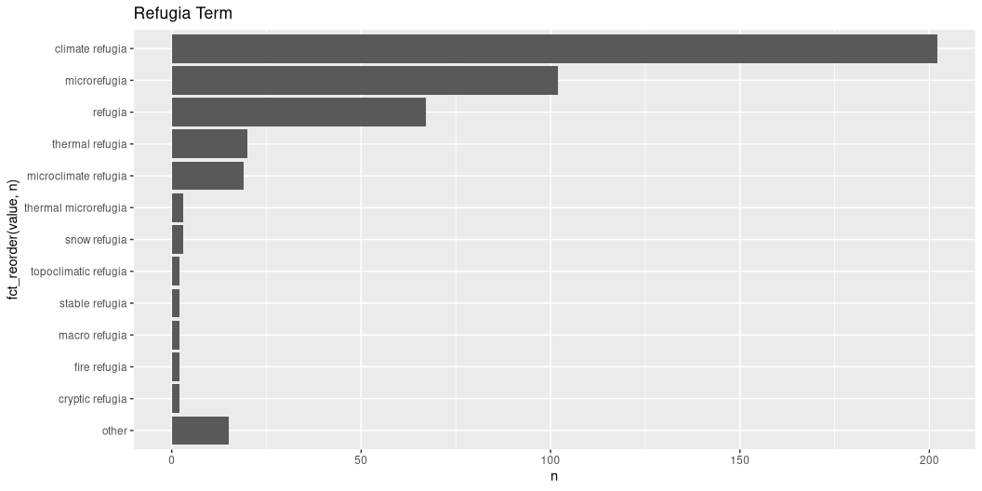
refugia term

Slide 13
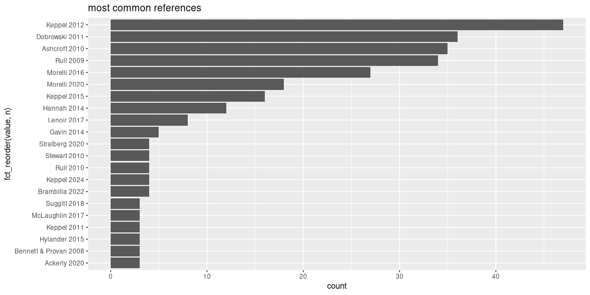
reference for definition

Slide 14
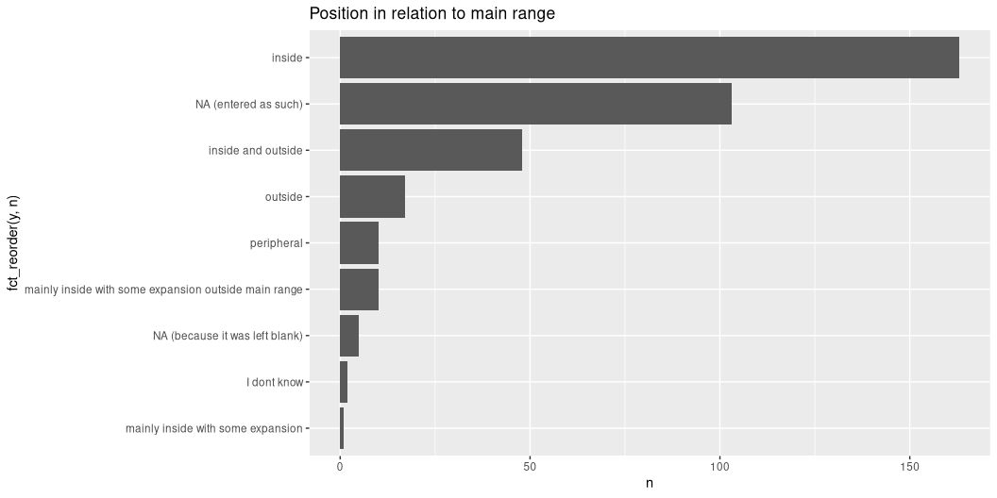
position in relation to main range

Slide 15
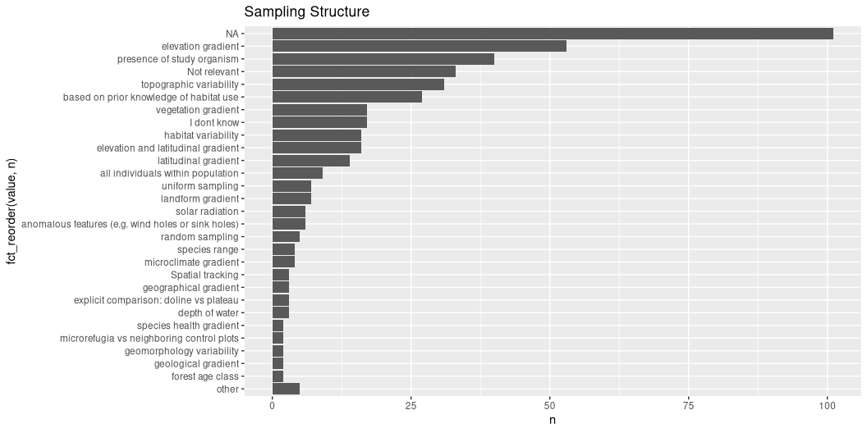
sampling structure

Slide 16
Outline
General context
Definition
Aspects of vulnerability
Exposure
Sensitivity
Adaptive capacity

Slide 17
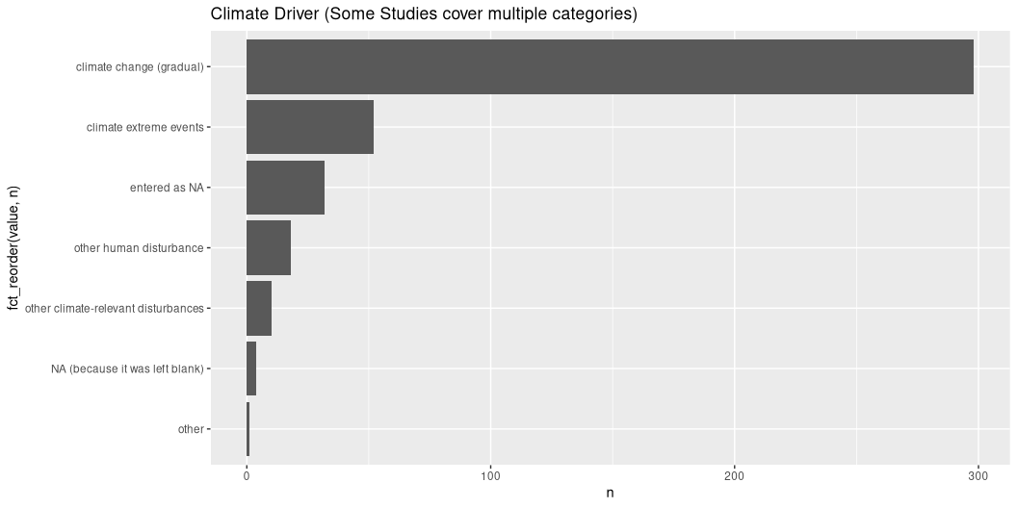
climate driver

Slide 18
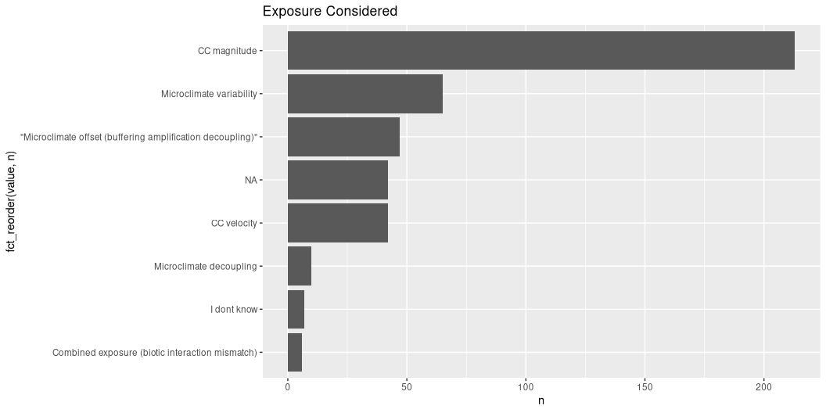
exposure_considered

Slide 19
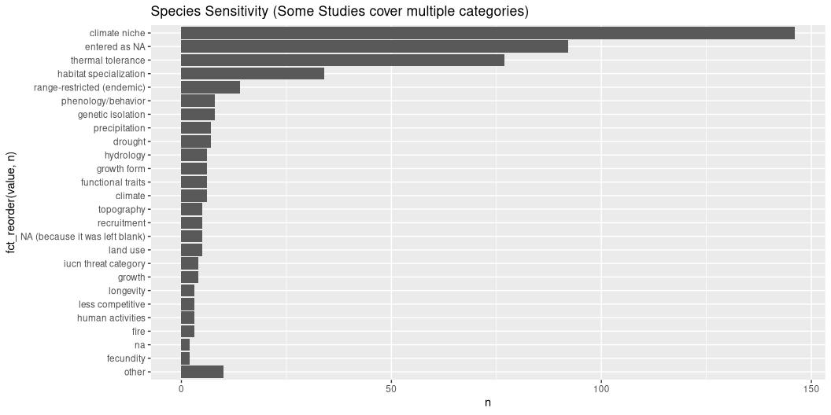
species_sensitivity
ie_what_is_the_vulnerable_part_of_the_species

Slide 20
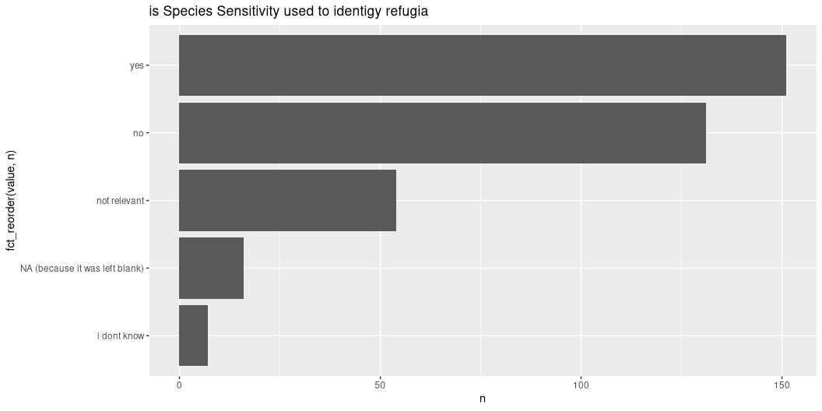
Species sensitivity used to ID refugia

Slide 21
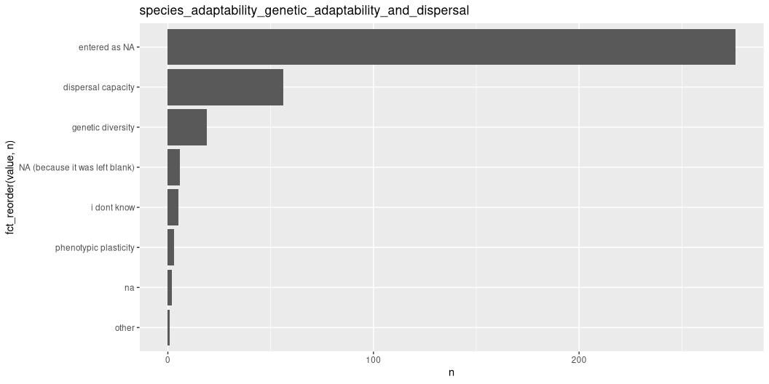
Species adaptablity

Slide 22
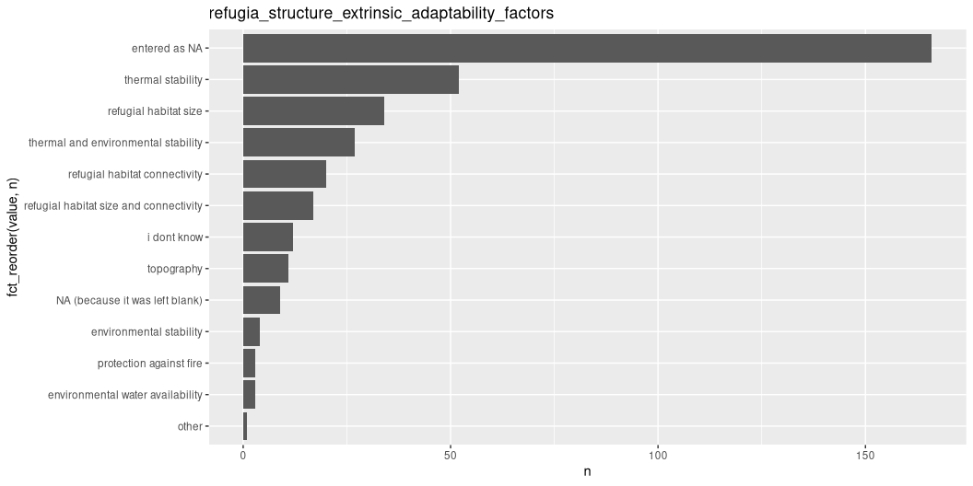
refugia_structure

Slide 23
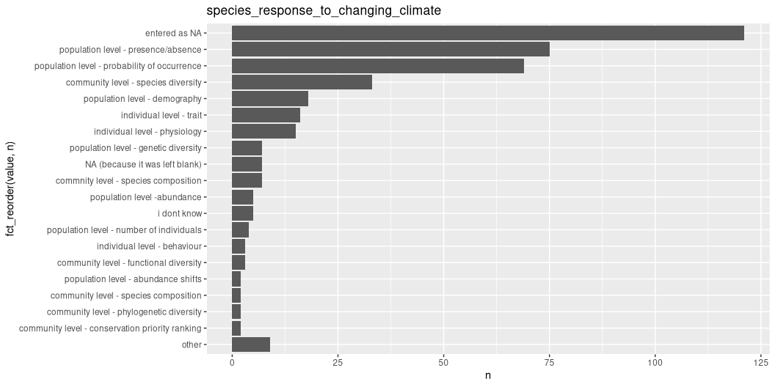
species response to changing climate

Slide 24
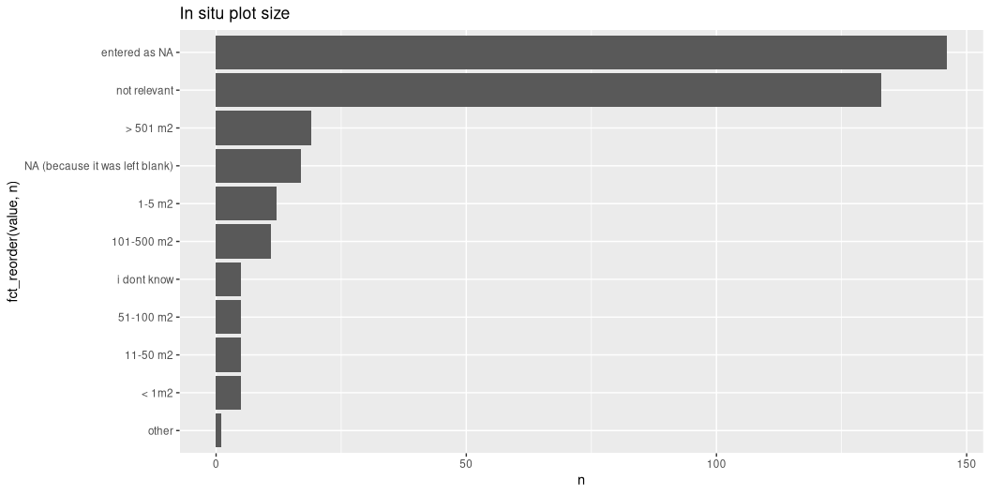
plot size

Slide 25
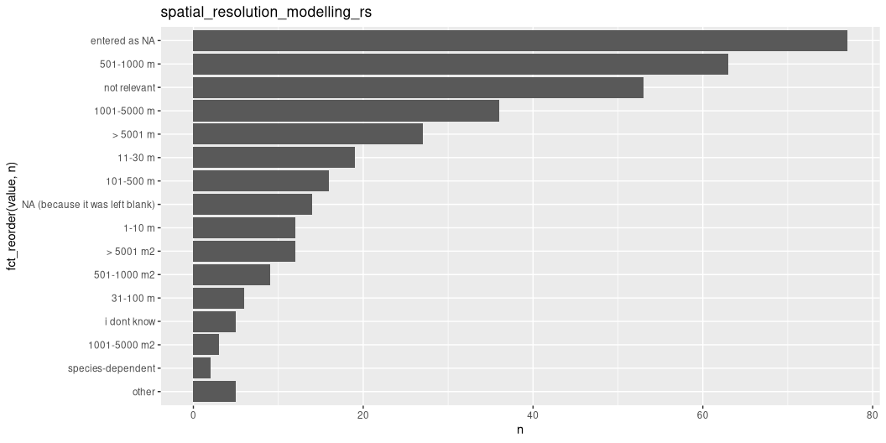
spatial resolution

Slide 26
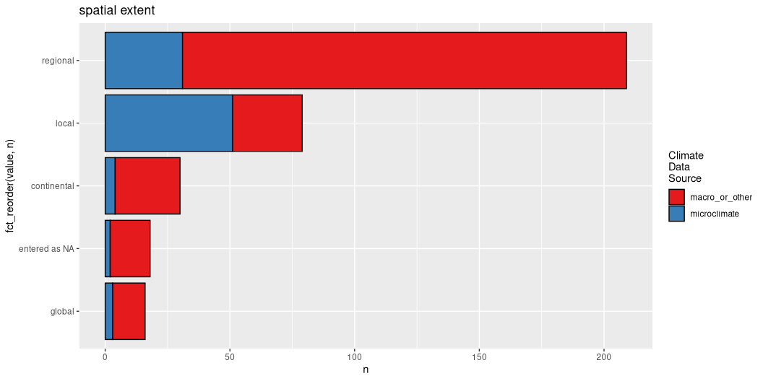
spatial extent

Slide 27
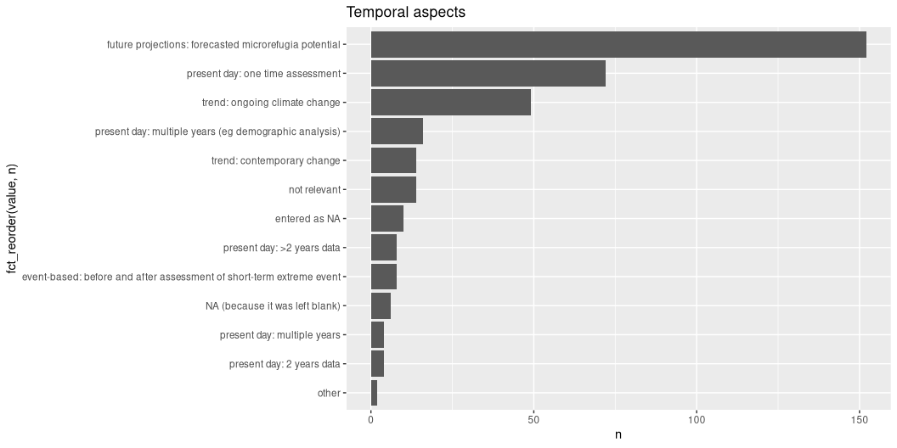
temporal aspects

Slide 28
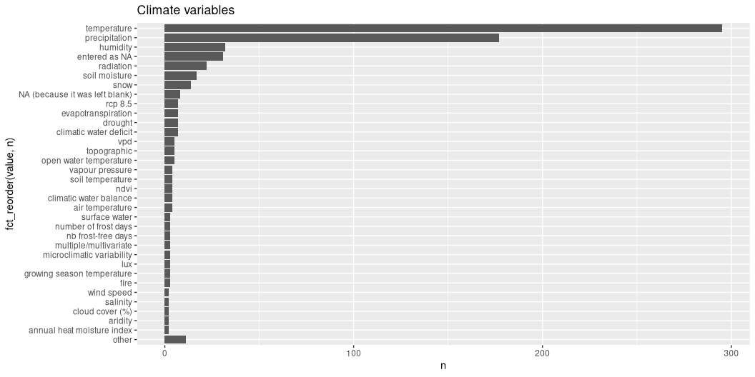
climate variables

Slide 29
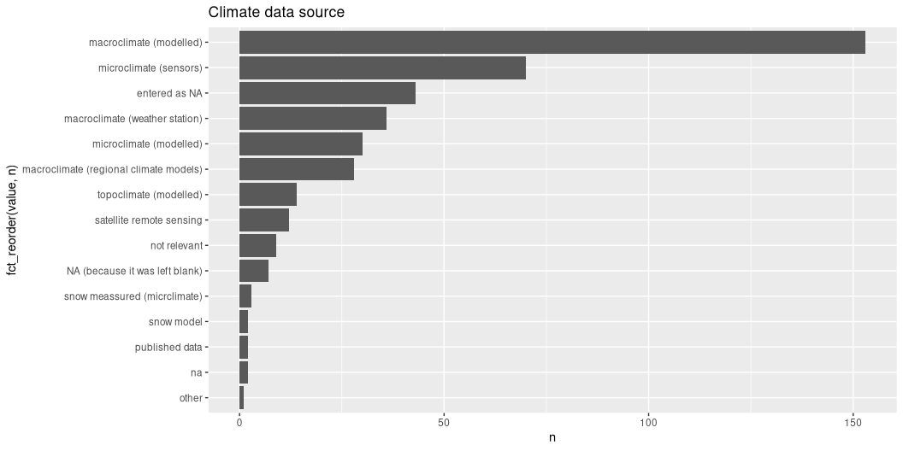
climate data source

Slide 30
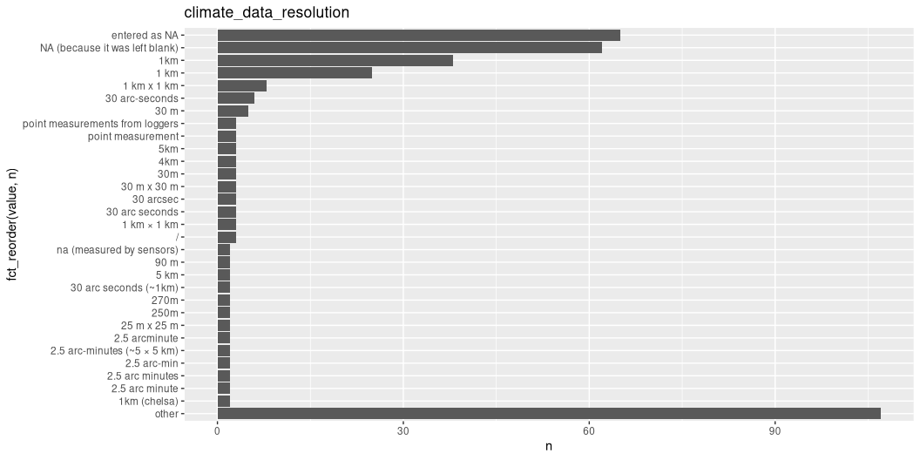
climate data resolution

Slide 31
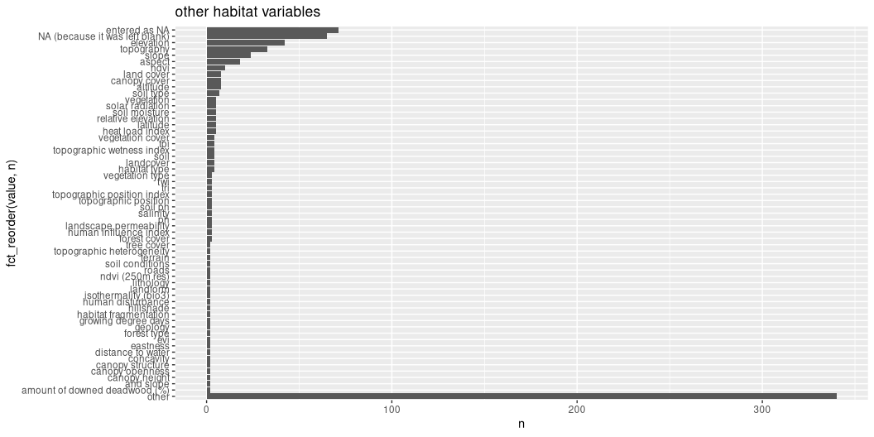
Other habitat variables

Slide 32
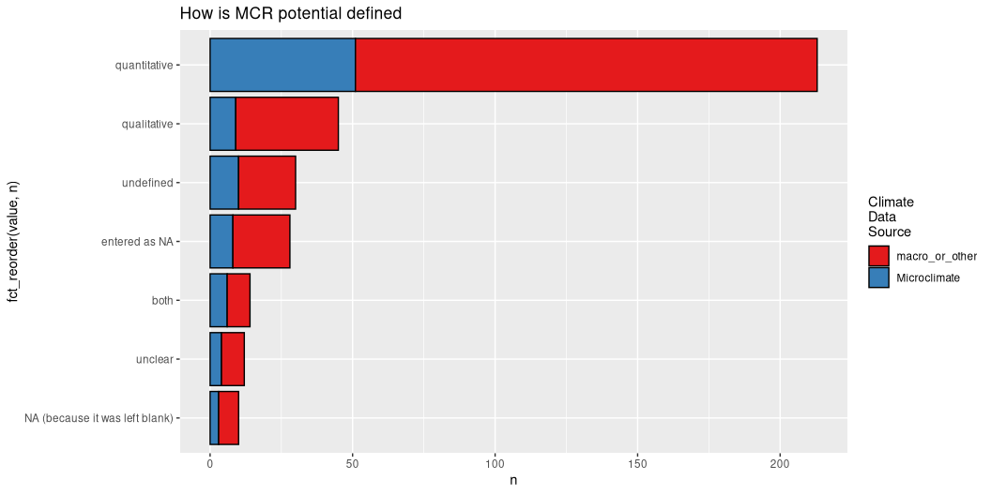
specific quantification

Slide 33
[1] "119 descriptions entered"

