Slide 1
NYC PAYROLL Data Engineering Project
Presented by: Manoj Adhikari
Course : Data Engineering
Training: LeapFrog Connect
Date: May 15, 2026
Dataset: NYC Citywide Payroll Data (2014-2017)

Slide 2
PROBLEM STATEMENT & OBJECTIVES
THE PROBLEM
NYC government generates millions of payroll records every year Raw data is unstructured, messy and hard to analyze directly Salary columns have $ signs, columns have NULL values and duplicate records exist No proper data warehouse exists for fast analytical queries Decision makers cannot get quick insights from raw payroll data
MY OBJECTIVES
Perform data profiling to understand data quality using SQL queries Design a Star Schema for analytical data warehouse Build a complete ETL pipeline following clean structure Transform and clean 2.1 million payroll records Generate KPIs and business insights from payroll data

Slide 3
Dataset Overview & Data Profiling
2.1M
16
Columns
2014-2017
Fiscal Years
165
Agencies
NULL Values Found During Profiling
Data Quality Issues Found
Column | Null Count | Action Taken
Mid Init | 890,008 (40.56%) | Kept as NULL
Work Location | 506,214 (23.07%) | → UNKNOWN
First Name | 952 (0.04%) | → UNKNOWN
Last Name | 942 (0.04%) | → UNKNOWN
Title Description | 21 (0.00%) | → UNKNOWN
$ Sign in Salary Used REPLACE() to remove $
Leading Spaces Used TRIM() on all columns
13 Duplicates Used SELECT DIST INCT
Wrong Data Types Cast to INT, DATE, NUMERIC
Negative Salaries Kept as-is (corrections)
All profiling queries written in SQL and executed in pgAdmin — saved in profiling/profiling.sql

Slide 4
STAR SCHEMA DESIGN
dim_agency
WHICH
agency_name
dim_employee
WHO
first_name, last_name
leave_status
dim_title
WHAT
title_description
fact_payroll
base_salary, regular_hours
regular_gross_paid, ot_hours
total_ot_paid, total_other_pay
dim_date
WHEN
fiscal_year
dim_location
WHERE
work_location_borough
dim_pay_basis
HOW
pay_basis
Why Star Schema? Fast queries | Easy to understand | Industry standard | Minimal joins needed

Slide 5
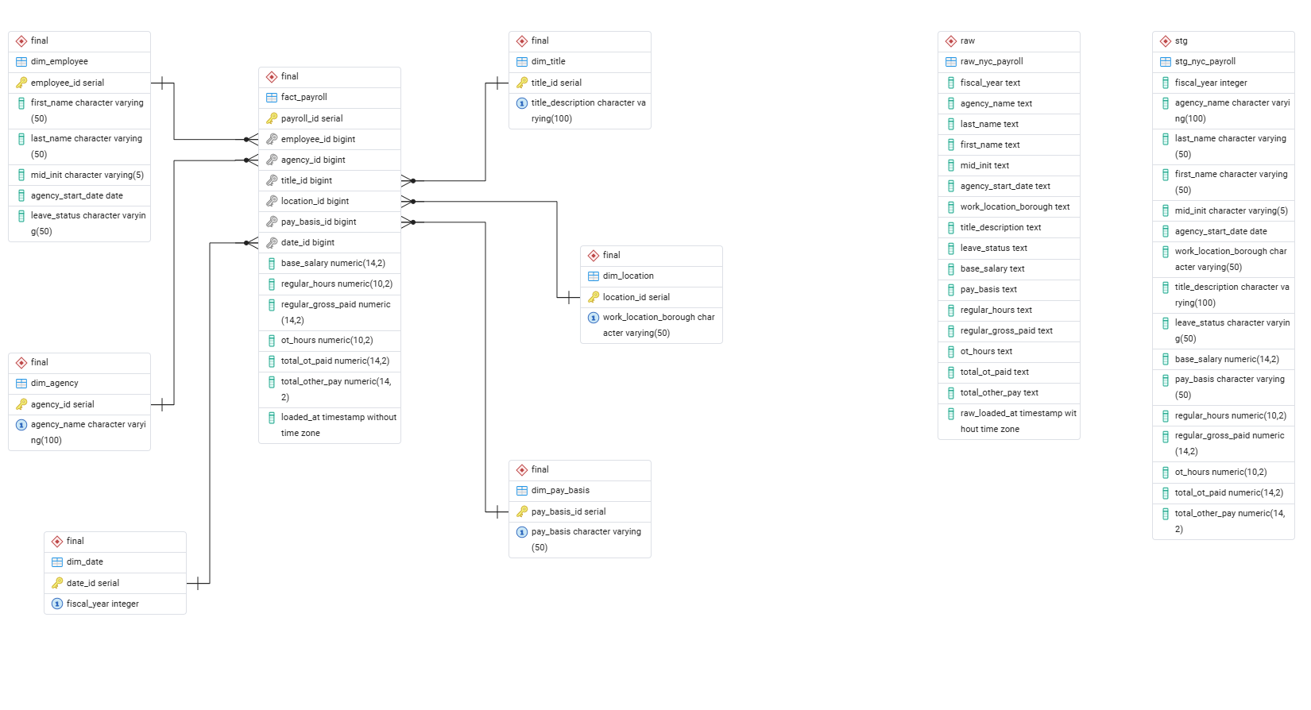
Figure 1: ERD diagram

Slide 6
ETL PIPELINE ARCHITECTURE
EXTRACT
Raw Layer
TRANSFORM
Staging Layer
LOAD
Warehouse Layer
INCREMENTAL
LOAD
New Data
Read CSV row by row
All 16 columns as TEXT
TRUNCATE before load
2,194,488 rows loaded
TRIM all columns
REPLACE $ from salary
COALESCE NULLs
SELECT DISTINCT (remove dups)
Load 6 dim tables first
Load fact table last
Foreign key integrity
Star Schema ready!
Load ONLY new records
On CONFLICT DO NOTHING
Skip existing records
Batch tracker records run
raw.raw_nyc_payroll
stg.stg_nyc_payroll
final.fact_payroll
incremental_2018.csv

Slide 7
IMPLEMENTATION DETAILS
Python Files
Project Folder Structure
nyc_payroll/
├── airflow/ → Orchestration
│ ├── dags/ → DAG files
│ │ └── nyc_payroll_dag.py → Workflow
│ ├── logs/ → Logs
│ ├── plugins/ → Plugins
│ └── docker-compose.yml → Docker
├── data/
│ ├── raw/ → CSV (full)
│ └── new/ → CSV (incremental)
├── database/ → DB connection
│ ├── __init__.py → Init
│ └── postgresql.py → Setup
├── etl/ → Pipeline
│ ├── __init__.py → Init
│ ├── load_raw.py → Extract
│ ├── load_stg.py → Transform
│ ├── load_final.py → Load
│ └── load_incremental.py → Incremental
├── sql/
│ ├── ddl/ → CREATE
│ │ ├── 01_raw.sql → Raw
│ │ ├── 02_stg.sql → Staging
│ │ ├── 03_final.sql → Final
│ │ └── 04_batch.sql → Batch
│ └── dml/ → INSERT
│ ├── 01_raw.sql → Raw
│ ├── 02_stg.sql → Staging
│ └── 03_final.sql → Final
├── profiling/ → Data check
│ └── profiling.sql → Query
├── analysis/ → Insights
│ └── analysis.sql → Query
├── src/ → Utils
│ ├── __init__.py → Init
│ └── sql_utils.py → Read SQL
├── main.py → Entry
└── README.md → Docs
postgresql.py Connect to PostgreSQL database
sql_utils.py Read SQL files from disk
load_raw.py Extract CSV → raw table
load_stg.py Transform raw → staging
load_final.py Load staging → warehouse
main.py Orchestrates entire pipeline
SQL Files
DDL: 01_create_raw | 02_create_stg | 03_create_final
DML: 01_load_raw | 02_load_stg | 03_load_final

Slide 8
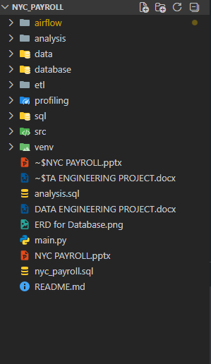
Figure 3: Project Folder Structure

Slide 9
Pipeline Orchestration with Airflow
Content:
→ DAG: nyc_payroll_pipeline
→ Schedule: @daily (runs every day!)
→ 4 Tasks in order: extract_raw_layer
transform_stg_layer
load_warehouse_layer
incremental_load

Slide 10
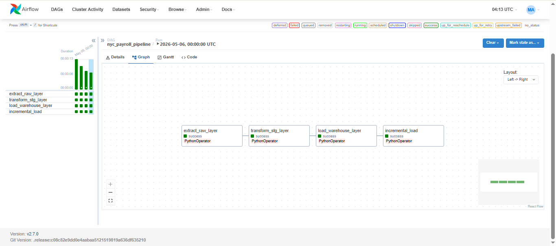
Figure 2: nyc_payroll_pipeline DAG(All Tasks Executed Successfully)
The above screenshot shows the nyc_payroll_pipeline DAG running successfully in Apache Airflow. All 4 tasks completed with green status indicating success.The pipeline runs automatically every day using @daily schedule.

Slide 11
PIPELINE EXECUTION GUIDE
Prerequisites
Install required Python package
pip install psycopg2
Place CSV File
Put CSV inside data/raw/ folder
data/raw/Citywide_Payroll_Data__Fiscal_Year_.csv
1
4
Create Database
Create database in pgAdmin
Database name: nyc_payroll
Activate Environment
Activate virtual environment
venv\Scripts\activate
2
5
Configure Connection
Update your PostgreSQL password
database/postgresql.py → update password
Run Pipeline
Execute the full ETL pipeline
python main.py
3
6
Expected Output: Database Connected → RAW layer loaded → STAGING layer loaded → WAREHOUSE layer loaded

Slide 12
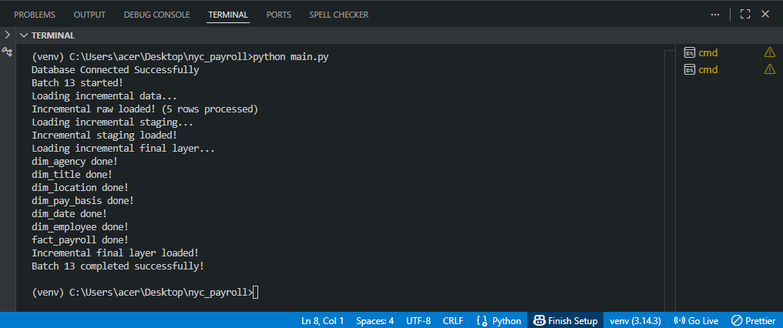
Figure 4: Terminal success output

Slide 13
CHALLENGES FACED
$ Sign in Salary Columns
Salary stored as '$47,678.00' (TEXT). Could not convert to NUMERIC directly. Pipeline broke during staging transformation
✓ Used REPLACE() to remove $ sign before casting to NUMERIC
NULL Values in Key Columns
Work Location Borough had 506,214 NULLs (23%). This caused issues when loading dimension tables.
✓ Used COALESCE() to replace NULLs with 'UNKNOWN'
Leading Spaces in Pay Basis
' per Annum' and 'per Annum' treated as different values due to leading spaces — causing duplicate dim records.
✓ Applied TRIM() on all columns in staging layer
13 Duplicate Records
Profiling found 13 duplicate records in raw data. Loading duplicates would violate primary key constraints.
✓ Used SELECT DISTINCT in staging INSERT query
Foreign Key Errors
Loading fact_payroll before dimension tables caused foreign key constraint violations.
✓ Loaded all 6 dimension tables BEFORE loading fact table
Large Dataset Performance
2.1 million rows took long time to load row by row using Python csv module
✓ Used psycopg2 cursor efficiently and committed after each layer

Slide 14
Solutions & Learnings
Key Solutions Applied What I Learned
Problem | Solution
$ in salary | REPLACE('$', '')::NUMERIC
NULL values | COALESCE(col, 'UNKNOWN')
Spaces | TRIM(column_name)
Duplicates | SELECT DISTINCT
FK errors | Load dims before fact
Type errors | Cast TEXT → INT/DATE/NUMERIC
How to build a complete ETL pipeline from scratch using Python and PostgreSQL
Why data profiling is essential BEFORE building any pipeline
How Star Schema makes queries much faster on large datasets
How to separate code into clean folder structure (ETL layers)
How psycopg2 connects Python with PostgreSQL for data loading
Why raw layer stores TEXT and staging converts to proper types
How to generate meaningful business insights using SQL analysis

Slide 15
Future Enhancements
01 Real Time Streaming
02 Data Validation Layer
03 Data Visualization
Use Apache Kafka to handle real time data instead of CSV files
Add automated checks in staging to catch bad data early — validate salary ranges, check date formats, flag anomalies before loading.
Connect Power BI or Tableau to the PostgreSQL warehouse to create interactive dashboards showing salary trends and agency comparisons
04 Performance Optimizaton
05 Cloud Migration
06 Slowly Changing Dimensions (SCD)
Add database indexes on fact_payroll for faster query performance. Use execute_batch() in psycopg2 for faster bulk inserts.
Migrate the pipeline to the cloud using AWS S3 + Redshift or Google BigQuery for scalable storage and faster queries on large datasets.
Track historical changes in employee data over time Example: employee changes department → keep both old and new record!

Slide 16
Results & Key Findings
798,132
Unique Employees
$117B
Total Payroll Cost
$41,100
Avg Base Salary
145M hrs
Total OT Hours
Key Insights
Key Insights
Pipeline Successfully Loaded
NYC spent over $117 billion on payroll (2014-2017)
Table | Records
raw.raw_nyc_payroll | 2,194,488
stg.stg_nyc_payroll | 2,194,475
final.dim_agency | 165
final.dim_title | 1,963
final.fact_payroll | 2689596
Batch_runs | 12 runs
Incremental_2018.csv | 5 new rows
Highest paid: Scott Evans - $350,000 (Pension Investment Advisor)
DEPT OF ED is largest agency with 423,338 employees
Manhattan has highest average salary among all boroughs
Salary showed steady increase from 2014 to 2017
Employees worked 145 million total overtime hours

Slide 17
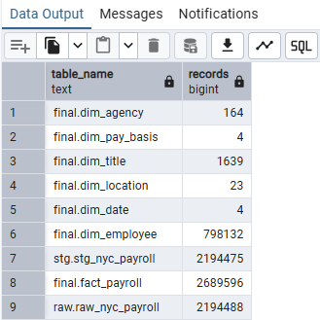
Figure 5: Record Counts

Slide 18
Thank You!
NYC Payroll Data Engineering Project
Presented by: Manoj Adhikari | LeapFrog Connect | May 15, 2026

