Slide 1
Shiny
Reactive programming
Performance optimization
Reducing Duplication with Reactive Expressions

Slide 2
Limitations
regarding active users: no more than 10 -20 people can simultaneously access your application. Shiny framework on purpose, it can be overcome with shinyproxy (we will not discuss it, since it is outside curriculum of this course)
Reactive programming – you cannot put the code of your application in any place, there are specific place for each part

Slide 3

Recommended book

Slide 4
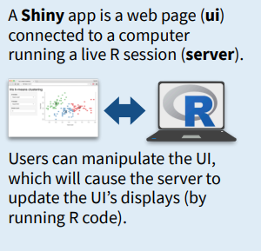
Architecture reminder
shiny::renderPrint()
shiny::renderText()
shiny::renderImage()
shiny::renderTable()
shiny::renderDataTable()
shiny::renderPlot()
shiny::renderCachedPlot()
shiny::renderUI()
All of them starts with render*
shiny::textOutput()
shiny::htmlOutput()
shiny::imageOutput()
shiny::tableOutput()
shiny::dataTableOutput()
shiny::plotOutput()
shiny::uiOutput()
All of them ends with *Output
checkboxInput()
checkboxGroupInput()
radioButtons()
All of them has inputId, label and a a possibility to set a choice
UI
Server
ui<-fluidPage(
sidebarLayout(
sidebarPanel(
selectInput(inputId = "xcol",
label = "xvalue",
choices = names(iris_1))
mainPanel(
plotOutput("plot1")
))))
server <- function(input, output, session) {
output$plot1<-renderPlot({
x <- as.numeric(iris[[as.name(input$xcol)]])
ggplot(data = iris, aes(x=x)) +
geom_histogram()
})
}

Slide 5
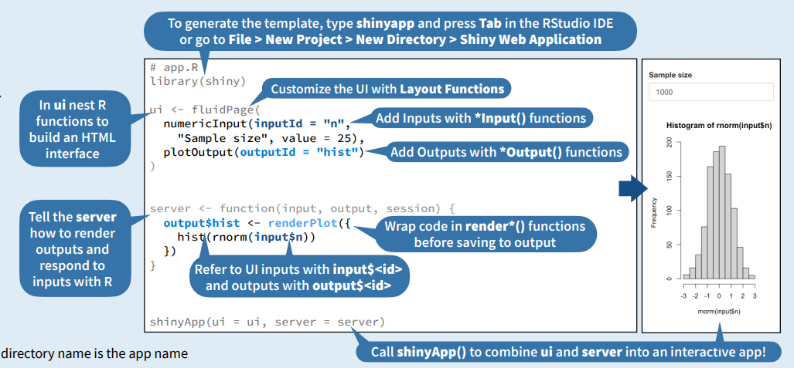

Slide 6
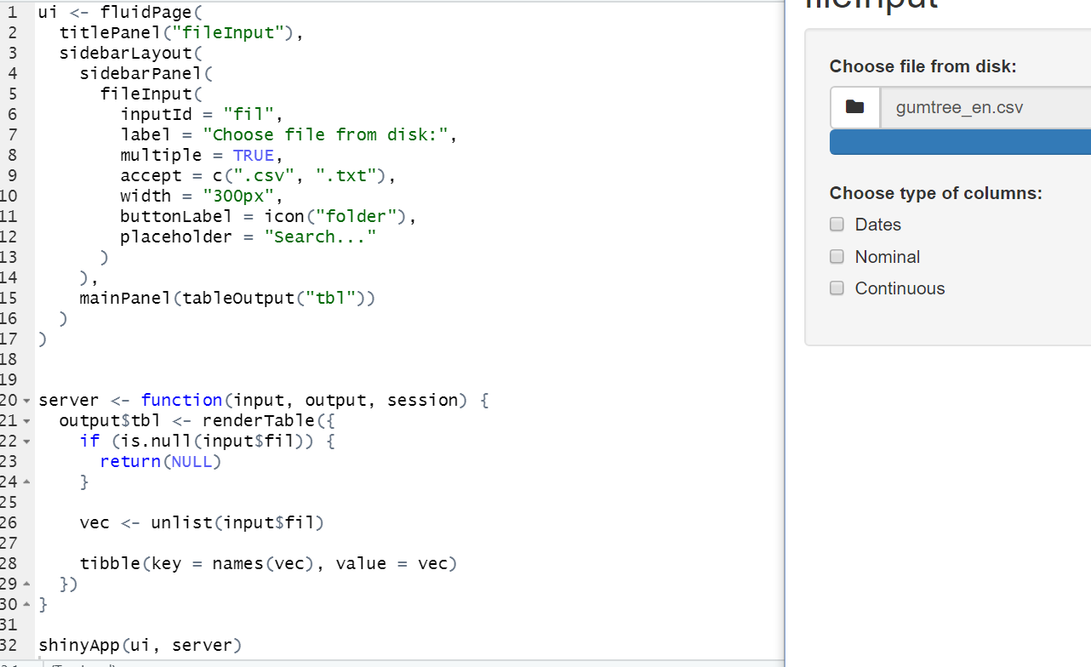
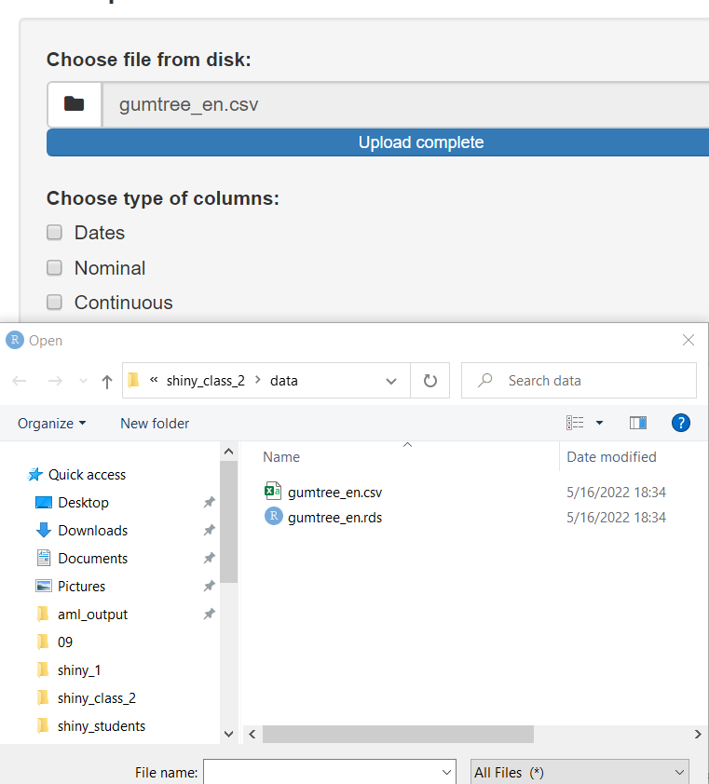
fileInput() Widget – example for your project

Slide 7
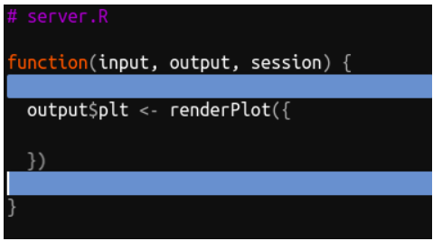
Zone 1, Zone 2, Zone 3
Zone 1 – outside server
Code is executed exactly once when app is initiated on the server
Here, we upload the libraries, uploading datasets that do not change
Here we can also build some helper functions
Zone 2 – outside render* but inside server
New functions reactive* ({})
Reactiveness – these functions reacts on the behavior of the user
Elements specific session or user. For example:
Login (different users have different privileges, they have access to different info)
Many instances but once session?
We in local running no distinction between instances and sessions of the app
Zone 3 – inside render* function
Activities connected with current inputs

Slide 8
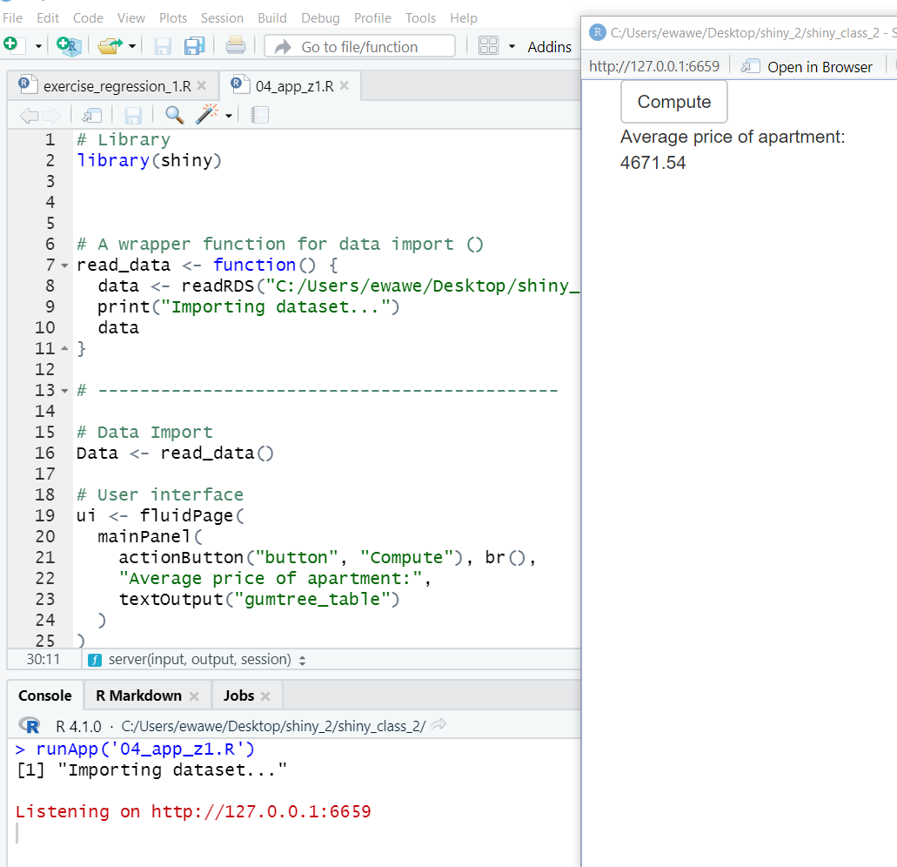
Example 1 04_app_studnets.R
Zone 1: wrapper function to download data
Print – when the function is used, We can see that is a difference in placing this function in different zones
Function is not used twice only at the beginning (only one print)

Slide 9
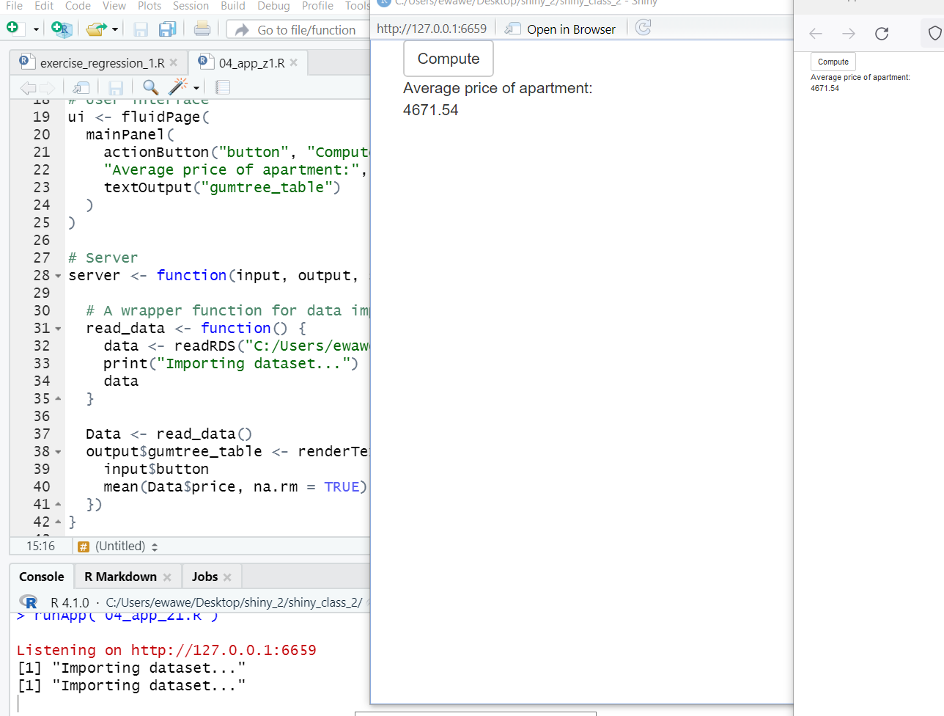
Now let’s place function inside server
Now many prints after opening in browser!!!
Re-accessing application require to download dataset again
When we copy a ling and paste it into the browser again another print
We imitate multiple users
There is another import
It is inefficiency – it should be done before the session

Slide 10
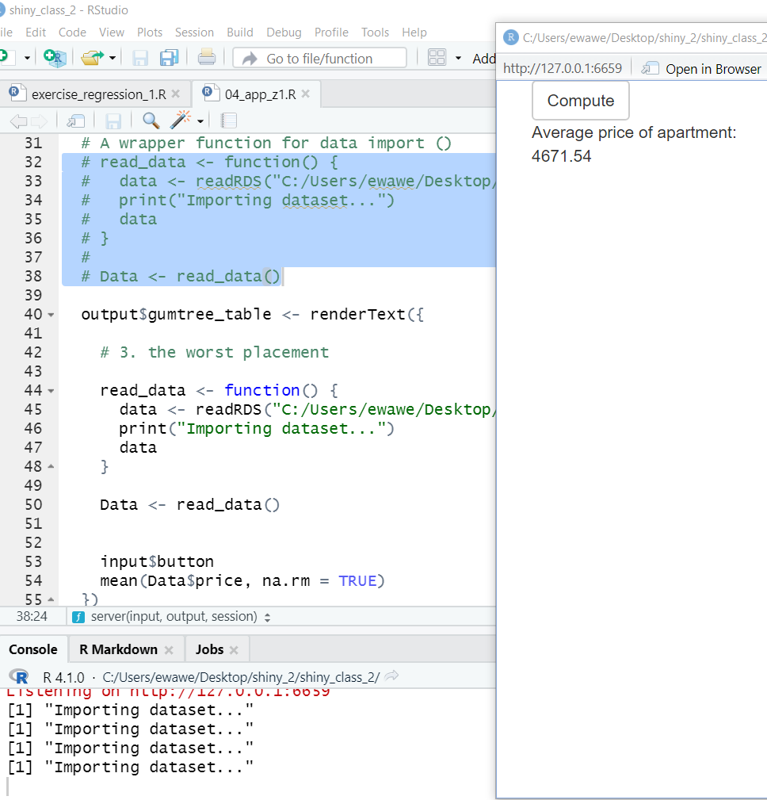
Placing it inside renderText function is the worst
Print every time we press button “Compute”

Slide 11
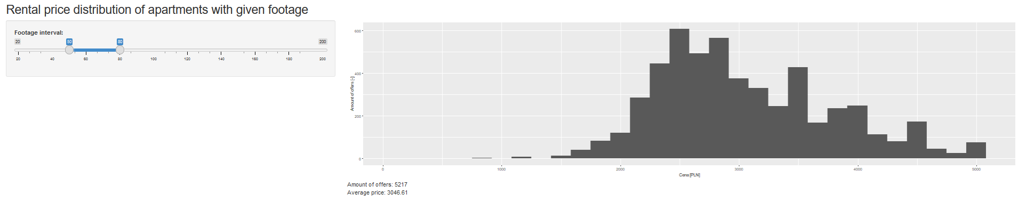

Slide 12
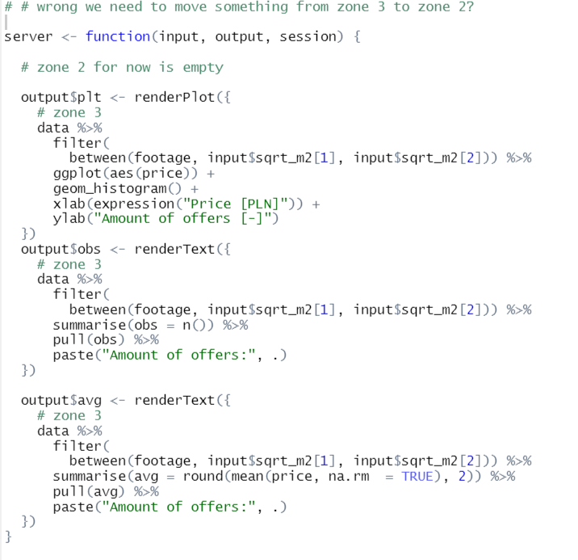
task_1_fin_inefficiency.R
Using gumtree.pl dataset – gathers flat rental advertisements
Price of the rental and footage of the apartment
Can you find any inefficiency and improve it?

Slide 13
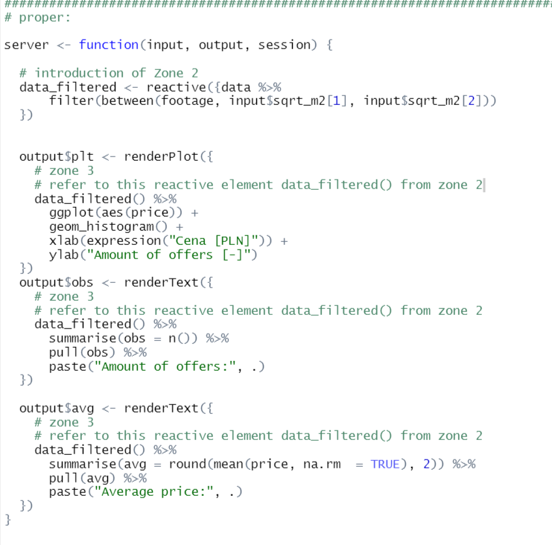
Solution
In reactive({}) function we can still refer to input$inputId
Then in render* we can refer to the build object as reactive_object()
Why?
Because we repeat filtering three times.
Remember, we cannot use only input$inputId outside render*, so we need reactive() functions

Slide 14
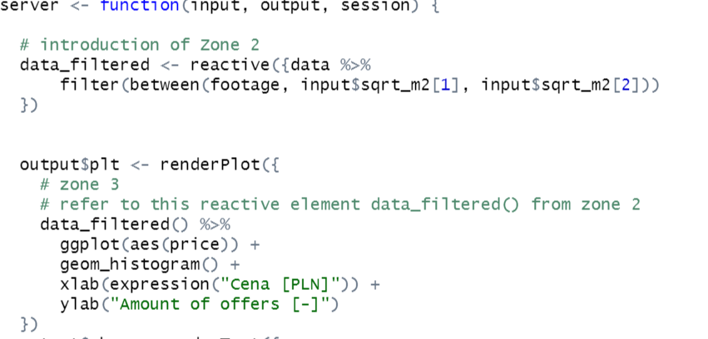
Reactive()
Building reactive object in the server
Wraps a normal expression to create a reactive expression. Conceptually, a reactive expression is a expression whose result will change over time.
Unlike render*() it does not sends an object to output list - instead creates a reactive variable (so it will change when certain input value will change). Interior of function reactive belongs to zone 3.
IMPORTANT: to object created by reactive() function one should refer by its name and brackets: ().
Referring to reactive object in render* function with name_reactive_object()

Slide 15
Why Do We Need Reactive Expressions?
Reactive expressions are important because they give Shiny more information so that it can do less recomputation when inputs change, making apps more efficient, and they make it easier for humans to understand the app by simplifying the reactive graph.
Reactive expressions have a flavor of both inputs and outputs:
Like inputs, you can use the results of a reactive expression in an output.
Like outputs, reactive expressions depend on inputs and automatically know when they need updating.

Slide 16
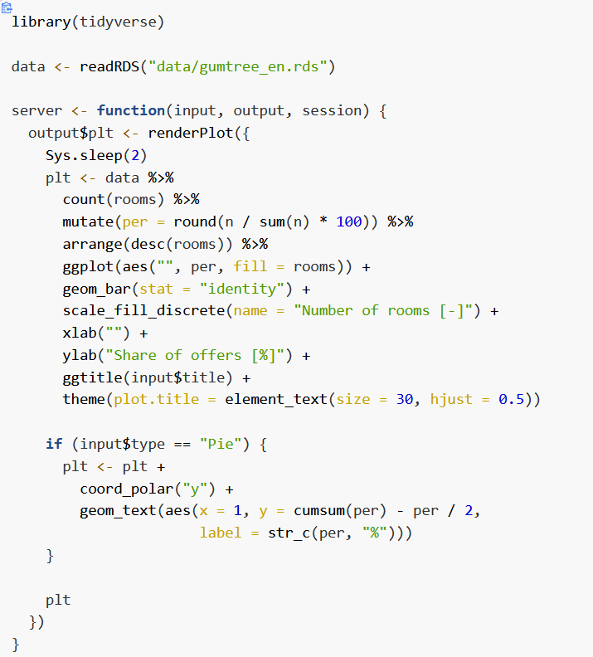
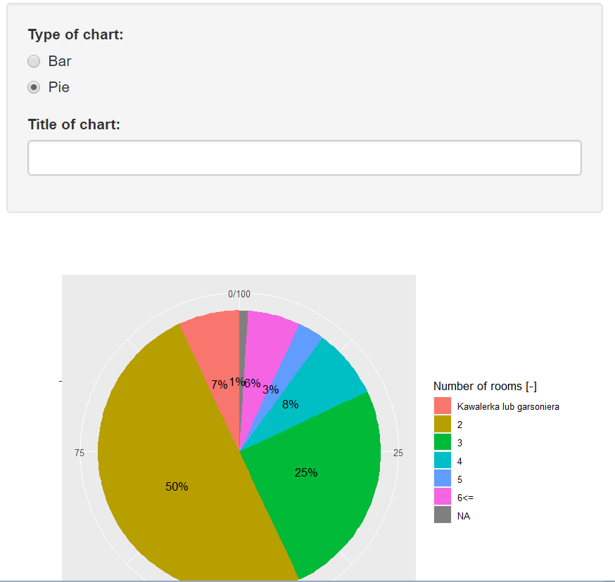
pie_optimization_students.R
Optimize app by:
moving filtering and base graph to zone 1.,
creating reactive value for pie chart (yet without title),
placing definition of the title as the final step within render function.

Slide 17
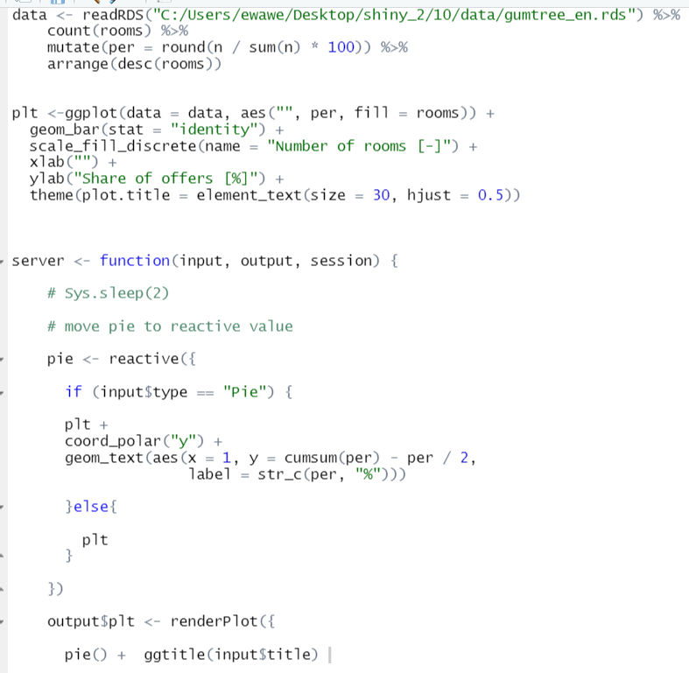
pie_optimization_solution.R
Optimize app by:
moving filtering and base graph to zone 1.,
creating reactive value for pie chart (yet without title),
placing definition of the title as the final step within render function.

Slide 18
Curse of input text
Letters in a title appear step by step?
How to solve it? Sys.sleep(2)??
actionButton() widget (from last week materials, “02_widgets.html”)
Stops automatic update of input until button is presses, using isolate() function

Slide 19
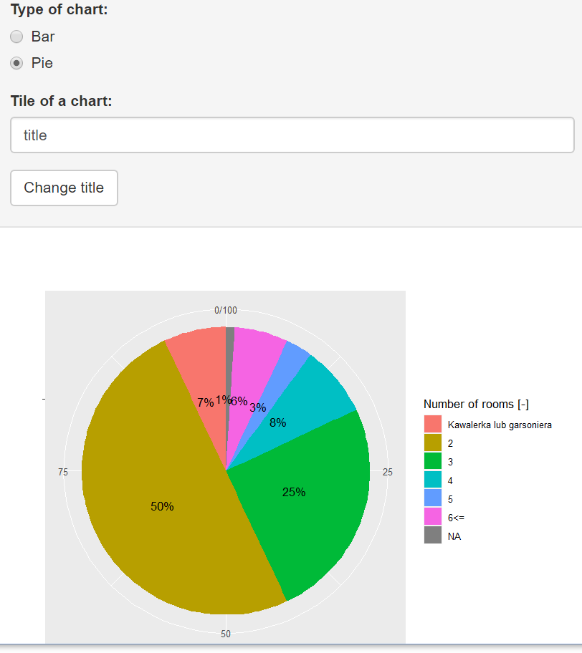
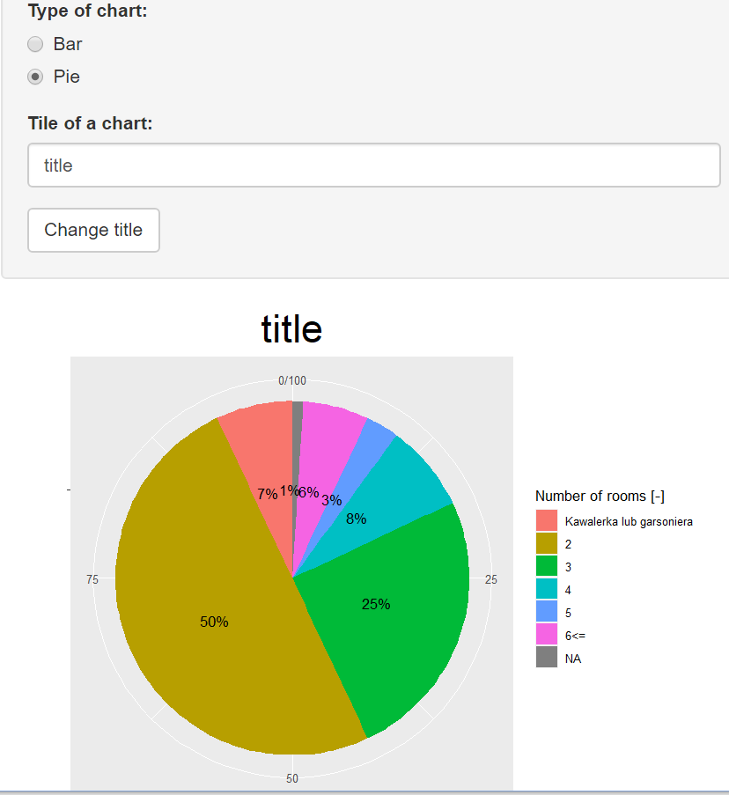

Slide 20
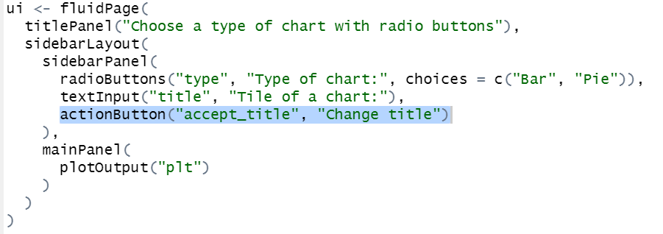
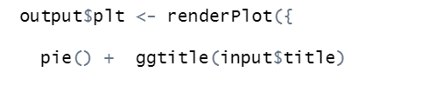
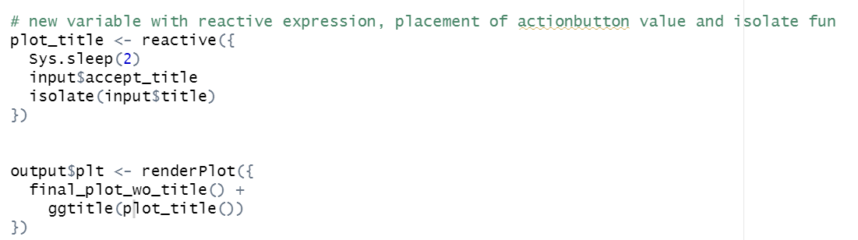
Before and after the change
Before in server
After in server
Insert in server new reactive object
Function isolate – isolate some parts of reactive values to prevent from recomputing the application too often. We isolate title changes from changing other changes in inputs
2. Use reactive object plot_title() in RenderPolt()
curse_text_input.R

Slide 21
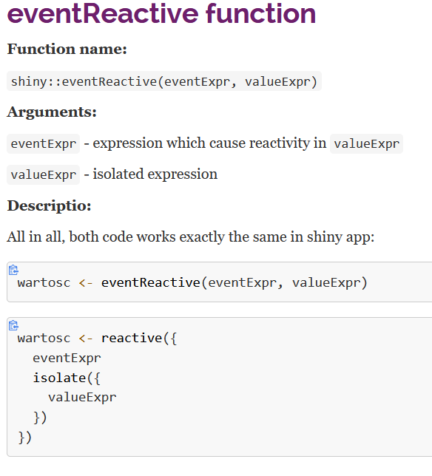
eventReactive() = reactive+isolate together

Slide 22
Reactivity without output – log file write csv file – function observe() and observeEvent()
Export output into csv only with observe()
Sometimes you need to reach outside of the app and cause side effects to happen elsewhere in the world. This might be saving a file to a shared network drive, sending data to a web API, updating a database, or (most commonly) printing a debugging message to the console.
These actions don’t affect how your app looks, so you shouldn’t use an output and a render function.
Instead you need to use an observer.

Slide 23
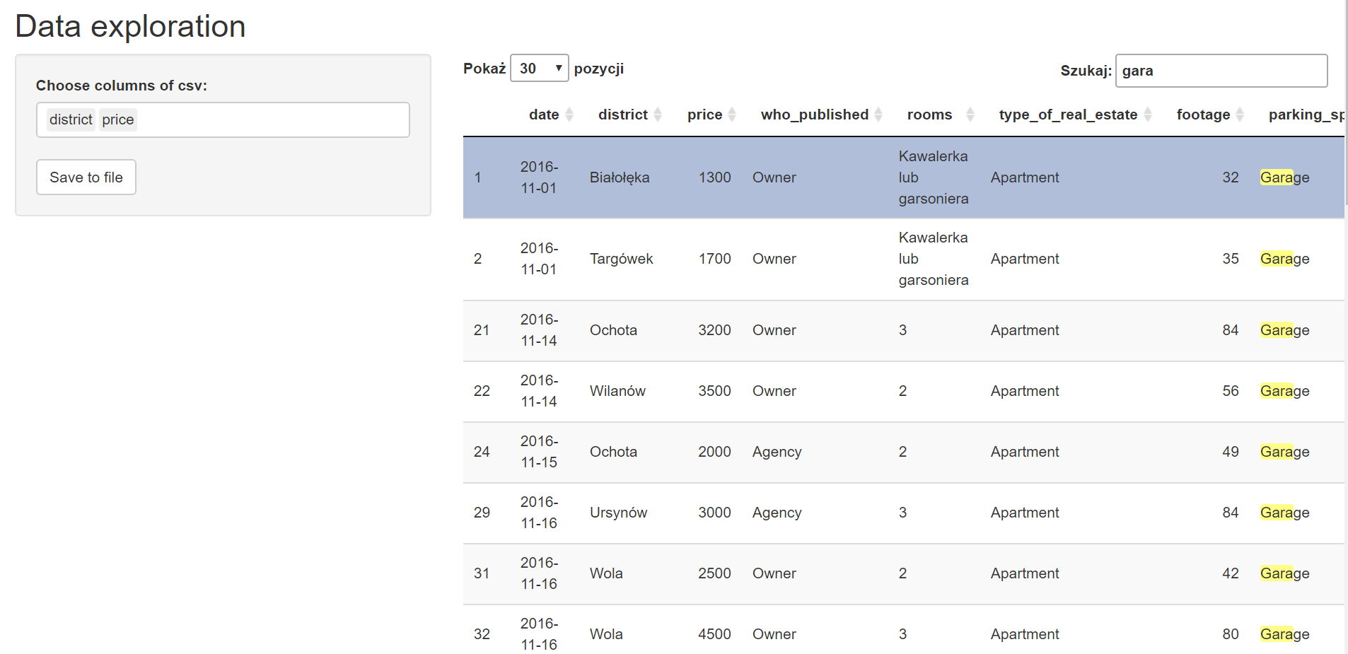

Slide 24
reactiveTimer() –> time_1.R
https://shiny.rstudio.com/reference/shiny/0.14/reactiveTimer.html
Imagine you wanted to reinforce the fact that this is for simulated data by constantly resimulating the data so that you see an animation rather than a static plot.
We can increase the frequency of updates with a new function: reactiveTimer().
reactiveTimer() is a reactive expression that has a dependency on a hidden input: the current time. You can use a reactiveTimer() when you want a reactive expression to invalidate itself more often than it otherwise would. For example, the following code uses an interval of 500 ms so that the plot will update twice a second. This is fast enough to remind you that you’re looking at a simulation, without dizzying you with rapid changes.

Slide 25
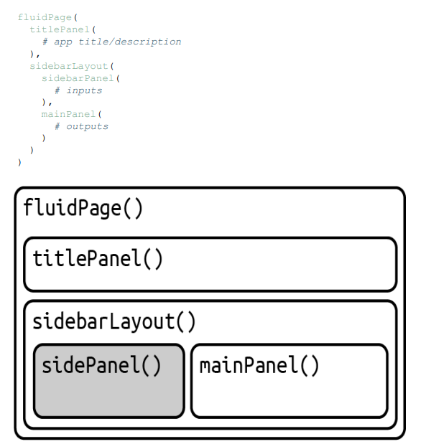
Layout of applications
fluidPage(
titlePanel(
# app title/description
),
sidebarLayout( sidebarPanel(
# inputs
), mainPanel(
# outputs
)
)
)
FlexDashboard
https://rstudio.github.io/shinydashboard/structure.html

Slide 26
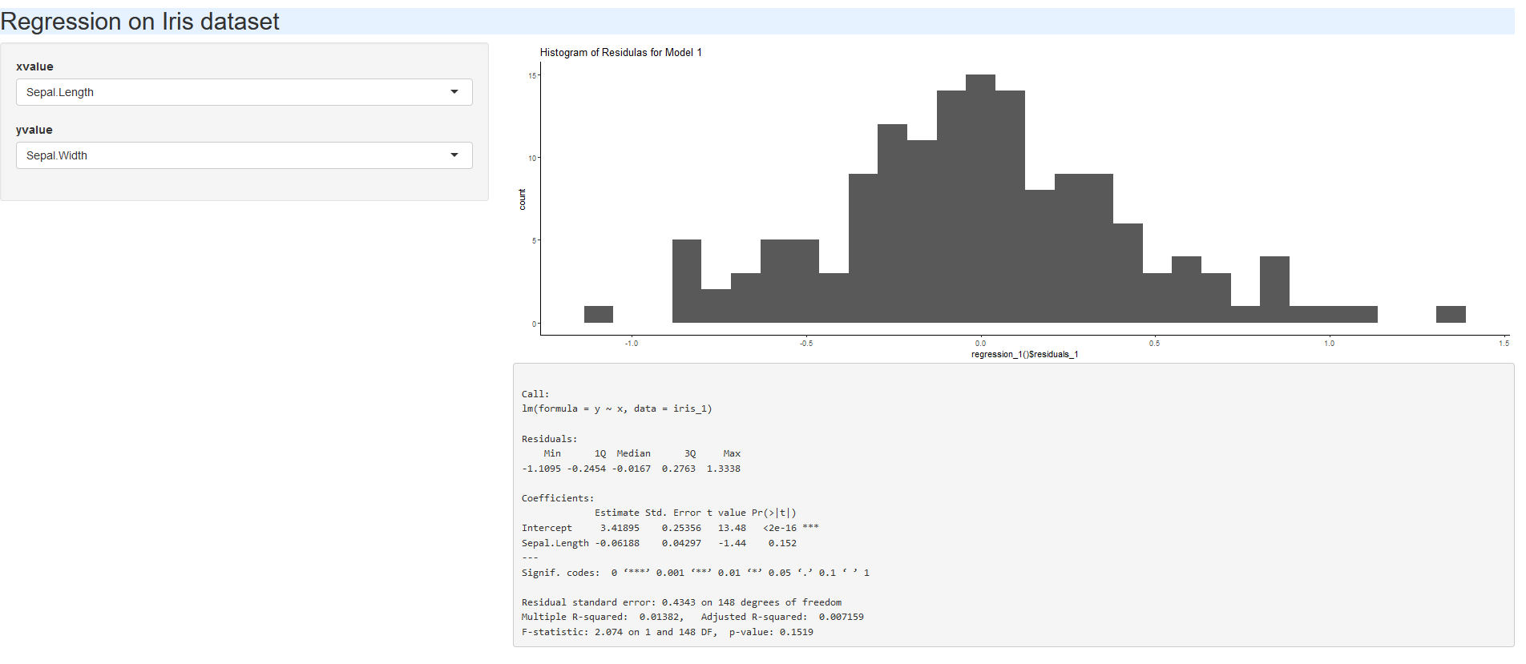
Exercise with regression on iris data
Create two widgets to choose variables from iris
Cerate histogram of residuals for regression of ycol on xcol
Present regression results
Use reactive()
https://bookdown.org/paul/applied-data-visualization/example-a-simple-regression-app.html

Slide 27
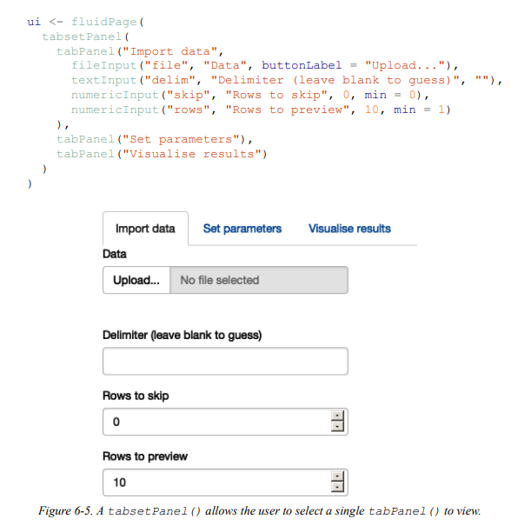
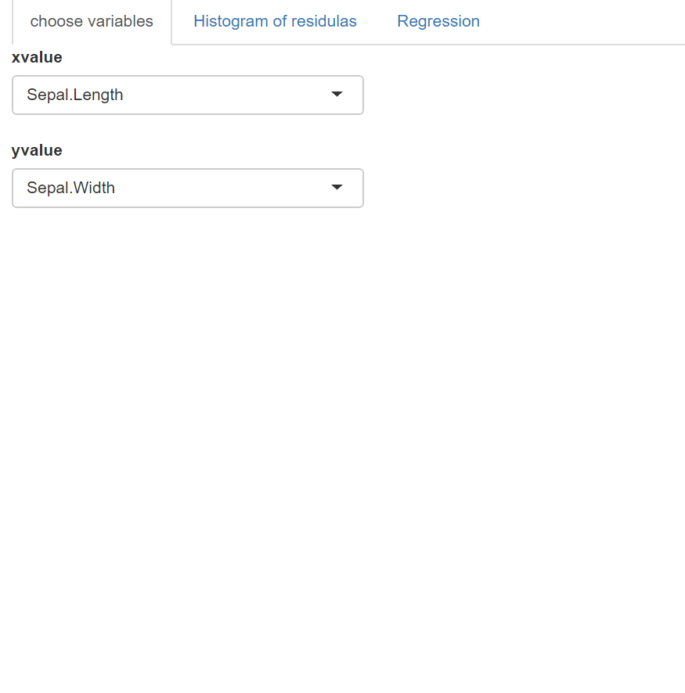
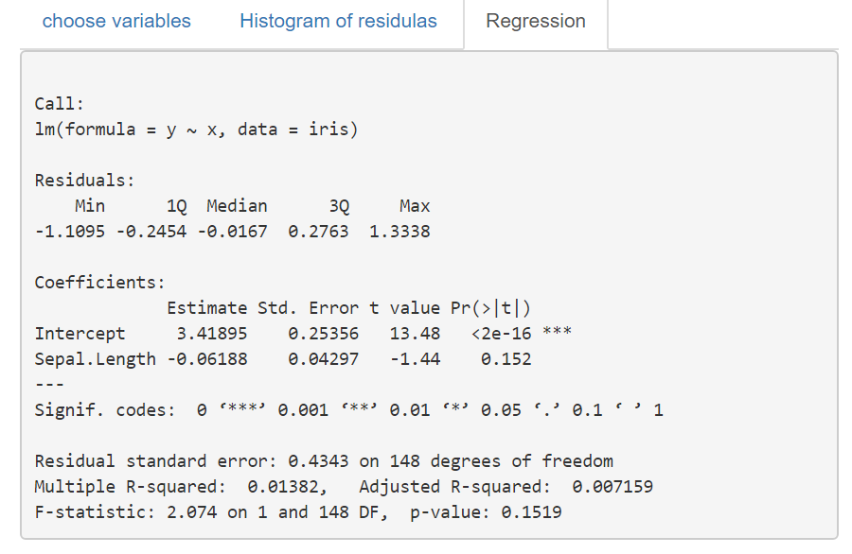
Layout of applications

Slide 28
