Slide 1
If (condition) statement
score <- 75 if (score >= 90) { print ("A") ; } else if (score >= 80) { print (“B") ;
} else if (score >= 70) { print (“C") ;
} else if (score >= 60) { print (“D") ;
} else {
print (“F") ; }
x <- 4 if (x >= 0) { print ("variable x is a positive number") }
If (condition) statement else statement
x <- -4 if (x >= 0) { print ("variable x is a positive number") } else { print ("variable x is a negative number") }

Slide 2
For (variable in sequence) statement
Repeat statement (condition) break
fruit_list <- c('Apple', ‘Kiwi', ‘Orange', 'Banana')
for (i in fruit) { print (i) }
x <- 5
repeat {
print (x)
x = x + 1
if (x == 10) {
break
}
for (i in c(1:10)) { print (sqrt(i)) }
While (condition) statement
a = 0
b = 1
print (a)
while (b < 100) {
print (b)
temp = a + b
a = b
b = temp
}
x <- 1
while (x < 10) {
print (x)
x = x + 1
}

Slide 3
x = c(0,1)
while (length(x) < 10) {
position = length(x)
new = x[position] + x[position – 1]
x = c(x,new)
}
print(x)
set.seed(3)
repeat {
x <- rnorm(1)
print (x)
if (x > 1.0) {
break
}

Slide 4
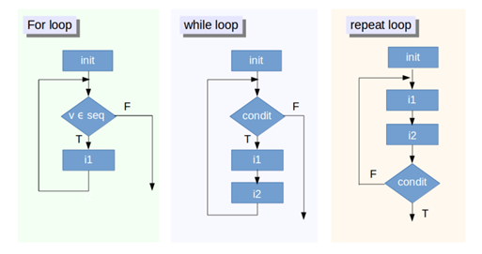
Start
Start
Start
Start
condition
condition
variable in sequence
condition
False
True
True
True
False
True
False
statement
False
statement
statement
statement
statement
End
End
End
End
Start
Start
statement
statement
False
False
condition
condition
True
True
End
End

Slide 5
Start
statement
False
condition
True
Break
End

Slide 6
Population
Sampling
Sample
Inference

Slide 7
Population
Sampling
Sample

Slide 8
Number of Operations
Number of Operations
0(n)
Number of Operations
0(n)
0(1)
Input Data Size
Input Data Size
Input Data Size

Slide 9
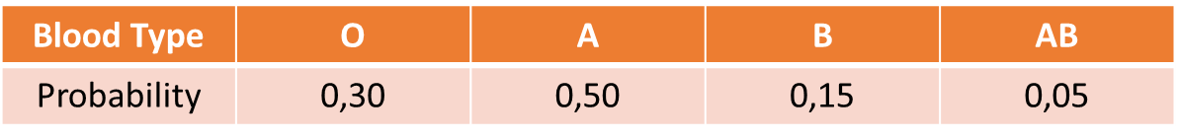
Blood Type | O | A | B | AB
Probability | 0,30 | 0,50 | 0,15 | 0,05
Bedrooms | 1 | 2 | 3 | 4 | 5 | 6 | 7
Probability | 0,10 | 0,20 | 0,25 | 0,20 | 0,15 | 0,05 | 0,05

Slide 10
Bedrooms | 1 | 2 | 3 | 4 | 5 | 6 | 7
# Cases | 10 | 20 | 25 | 20 | 15 | 5 | 5
Bedrooms | 1 | 2 | 3 | 4 | 5 | 6 | 7
Probability | 0,10 | 0,30 | 0,55 | 0,75 | 0,90 | 0,95 | 1
Bedrooms | 1 | 2 | 3 | 4 | 5 | 6 | 7
Probability | 0,10 | 0,20 | 0,25 | 0,20 | 0,15 | 0,05 | 0,05
Multiplication | 0,10 | 0,40 | 0,75 | 0,80 | 0,75 | 0,30 | 0,35
Bedrooms | 1 | 2 | 3 | 4 | 5 | 6 | 7
Probability | 0,10 | 0,20 | 0,25 | 0,20 | 0,15 | 0,05 | 0,05
Step 1 | 6,00 | 2,10 | 0,20 | 0,30 | 2,40 | 6,50 | 12,60
Variance | 0,60 | 0,42 | 0,05 | 0,06 | 0,36 | 0,33 | 0,63
St. Deviation | 0,77 | 0,65 | 0,23 | 0,25 | 0,60 | 0,57 | 0,79

Slide 11
A
B
C
A
B
C
Variable
2
T
u
1
X
p
Variable
1
X
p
2
T
u
Variable
9
B
d
4
G
m
4
G
m
9
B
d
A
B
C
2
T
u
Observation
A
B
C
A
B
C
1
X
p
Observation
2
7
u
1
9
p
9
B
d
Observation
1
9
p
1
2
d
4
G
m
Observation
1
2
d
2
7
u
4
3
m
4
3
m

Slide 12
A
B
C
A
B
A
B
C
A
B
C
2
T
u
2
T
2
T
u
1
X
p
1
X
p
1
X
1
X
p
9
B
d
9
B
d
9
B
9
B
d
4
G
m
4
G
4
G
m

Slide 13
A
B
C
A
B
C
A
B
C
B
A
C
9
B
u
9
B
p
5
D
3
D
7
11
1
X
p
1
X
1
X
3
6
9
B
p
9
D
8
4
G
m
5
X
5

Slide 14
A
B
C
A
B
C
D
A
B
C
A
B
C
5
D
3
5
D
3
15
5
D
3
25
D
3
1
X
1
1
X
1
1
1
X
1
1
X
1
9
D
8
9
D
8
72
9
D
8
9
D
8
5
X
5
5
X
5
25
5
X
5
25
X
25

Slide 15
A
B
C
A
B
C
A
B
C
5
D
3
2
O
9
5
D
3
1
X
1
7
B
7
1
X
1
9
D
8
4
D
8
9
D
8
5
X
5
5
F
2
5
X
5
2
O
9
7
B
7
4
D
8
5
F
2

Slide 16
A
B
C
D
E
F
A
B
C
D
E
F
5
D
3
2
O
9
5
D
3
2
O
9
1
X
1
7
B
7
1
X
1
7
B
7
9
D
8
4
D
8
9
D
8
4
D
8
5
X
5
5
F
2
5
X
5
5
F
2

Slide 17
Processing
Effort
Dis-aggregated
Aggregated
Models & Tools

Slide 18
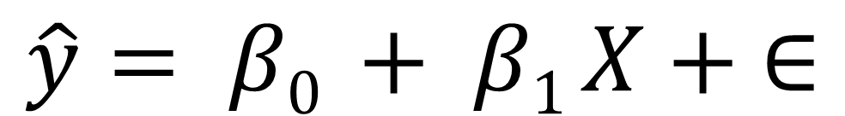
$$\hat{y}= β0 + β1 X + ∈$$
target
coefficients
input
random error
coefficients
$$\hat{y}= β0+β1 X1+…+βn Xn+ ∈$$
target
inputs
random error

Slide 19
y $= β0+β1 X1+β2 X_{1}^{2}$
sales $=2.880 +0.044 TV+0.200 radio+0.002 newspaper$
sales $= β0+β1 TV+β2 radio+β3 newspaper$

Slide 20


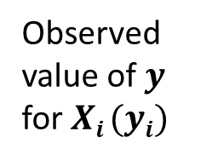

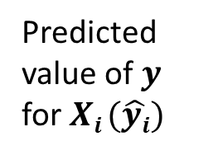



$$y$$
Observed value of $y$ for $Xi$ $(yi)$
Slope = $β1$
$ei \text{for} \text{this} Xi$ $\text{value}$
Predicted value of $y$ for $Xi$ $(\hat{yi})$
$$β0$$
$$Xi$$
$$X$$

Slide 21
w_{new} = w_{old} + l . e . x
x₁
w₁
Σ
f
y
x₂
w₂
b

Slide 22
b
w₀
x₁
w₁
Σ
f
y
x_{n-1}
w_{n-1}
x_{n}
w_{n}

Slide 23
bias
b
w₀
input function
activation function
output
x₁
w₁
---
Σ
f
y
x_{n-1}
w_{n-1}
x_{n}
w_{n}
inputs
weights

Slide 24
inputs
weights
input function
activation function
output
x₁
w₁
---
Σ
f
y
x₂
w₂
b
bias

Slide 25
g(W^{t}X)
1
f(x)
1
0.5
W^{t}X
0.5
-2
-1.5
-1
-0.5
0
0.5
1
1.5
2
x
-2
-1.5
-1
-0.5
0
0.5
1
1.5
2

Slide 26
Error
x₁
w₁
Σ
f
y
x₂
w₂

Slide 28
Automatic Text Summarization
Text Simplification
New Text Generation
Text Style Transfer
Automatic Text Summarization
Text Simplification
New Text Generation
Text Style Transfer
Machine Translation

Slide 29
Text Summarization
Text Simplification
Text Generation
Text Style Transfer
Machine Translation
Speech to Text

Slide 30
Video
Speech to Text
Text
Text
Generate text
Style transfer
Text
Speech to Text
Text Generation
Text Style Transfer
Video
Speech to Text
Summarize
Text
Text
Simplify
Summarize
Translate
Text
Speech to Text
Text Simplification
Text Summarization
Text Summarization
Text Translation

Slide 31
Video
Speech to Text
Text
Text
Generate text
Style transfer
Text
Speech to Text
Text Generation
Text Style Transfer
Video
Speech to Text
Translate
Text
Text
Simplify
Summarize
Translate
Text
Speech to Text
Text Simplification
Text Translation
Text Summarization
Text Translation

