Slide 1
Establishing a Just Culture
Adrian Marquez
07/13/2025
CSD 380

Slide 2
What Is Just Culture?
Definition: A cultural framework balancing system-level learning with individual accountability.
Importance in DevOps: Enables open error reporting, continuous learning, and high psychological safety.

Slide 3
Why It Matters In DevOps
Encourages risk transparency and early failure detection.
Fosters collaboration and trust across teams.
Drives continuous improvement through learning from incidents.

Slide 4
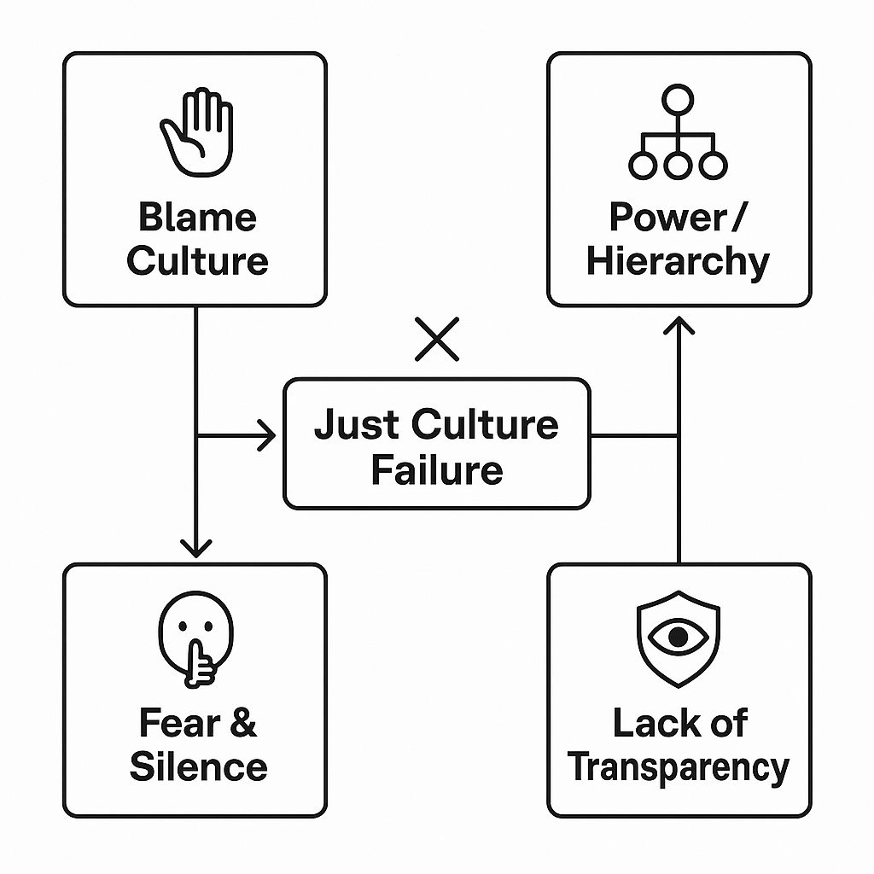

Slide 5
Barrier 1: Blame & Attribution Bias
Natural human tendency to blame individuals rather than systems.
Outcomes heavily influence whether discipline is applied (outcome bias).
DevOps fast pace can amplify scapegoating culture.

Slide 6
Barrier 2: Power & Structural Constraints
Hierarchies and power gradients suppress speaking up.
Management and media pressure to assign blame.
DevOps silos can perpetuate uneven accountability.

Slide 7
Barrier 3: Lack of Transparency & Consistency
Unclear assessment/reporting processes.
Inconsistent responses to incidents, which reduces trust in safety procedures.

Slide 8
Barrier 4: Fear & Employee Silence
Fear of shame, punishment, or job loss leads to underreporting.
The “don’t speak up” culture harms DevOps feedback loops and blunts reslilience.

Slide 9
Overcoming Challenges
Leadership commitment: explicit policies, no punishment, clear accountability.
Education & awareness: training on error classification and context-led investigations.
Transparent processes: standardizing incident reporting and review.
Support psychological safety: reward reporting, encourage open feedback, and reduce fear of repercussion.

Slide 10
Conclusion:
Just Culture is ESSENTIAL for DevOps success.
System changes begin with leaders AND with everyone’s voice.

Slide 11
References:
Understand the Role of Culture and Resilience. (2025). Trailhead. https://trailhead.salesforce.com/content/learn/modules/continuous-innovation-with-copado/understand-the-role-of-culture-and-resilience
Overcoming Barriers to a Just Culture – Health Quality Alberta- Just Culture. (2025). Justculture.hqa.ca. https://justculture.hqa.ca/overcoming-barriers-to-a-just-culture/
Macvittie, D. (2017, October 13). Barriers to DevOps Culture Change - DevOps.com. DevOps.com. https://devops.com/barriers-devops-culture-change/

