Slide 1

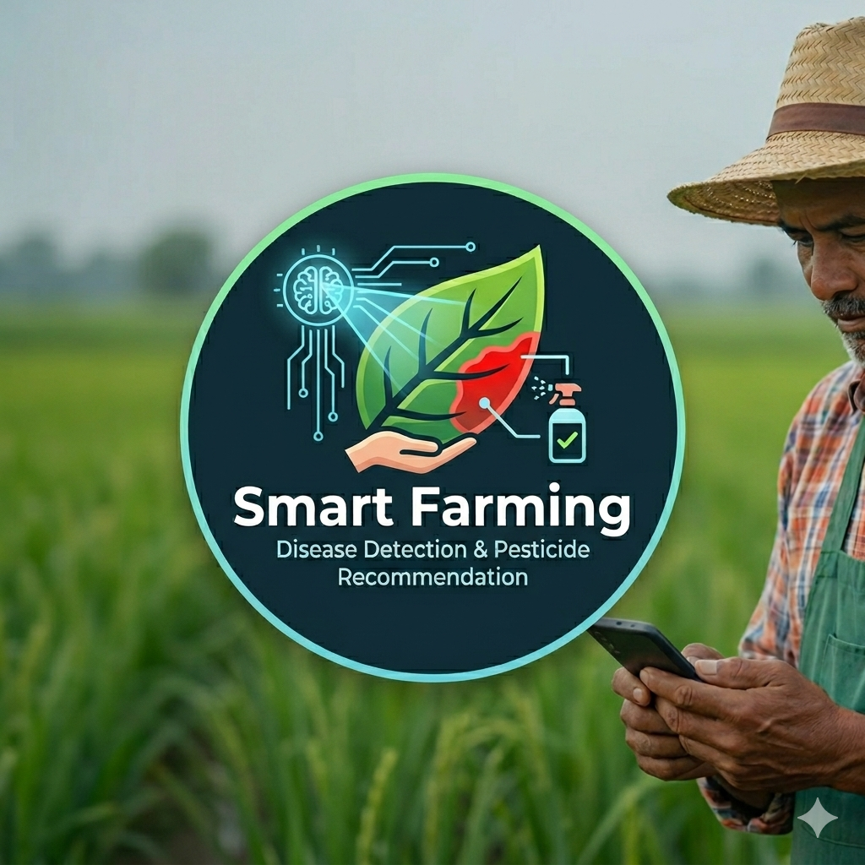

Smart Farming Ethiopia
AI-assisted, offline-first agricultural decision support platform
A practical mobile and backoffice system for farm records, crop disease scanning, soil guidance, weather risk, yield outlook, and expert verification.
Farmer mobile app
Backoffice review
AI inference
Prepared by Admasu Feleke Mulatu
Project exhibition and validation presentation

Slide 2
What the platform demonstrates in 3 minutes
Smart Farming Ethiopia
Simple field value first, technical depth when needed.
1
2
3
Farmers can use the app even when internet is unavailable.
AI supports decisions, but experts verify sensitive guidance.
The project is practical for training, extension, and technology transfer.
Offline-first design keeps farm records, scan history, soil guidance, and sync backlog locally.
Disease reports include image evidence, crop context, confidence, and review status.
It connects mobile farmers, backoffice reviewers, data collection, and future IoT integration.

Slide 3
Problem addressed by the project
Smart Farming Ethiopia
Designed around constraints farmers face in real field conditions.
Delayed disease response
Weak offline access
!
!
Farmers may notice leaf symptoms late and wait for expert access.
Internet and server availability are not guaranteed in rural usage.
Language and literacy barriers
Fragmented farm data
!
!
Text-heavy systems are hard for farmers unless localized and visual.
Farm, plot, planting, soil, weather, and disease records are often separated.
Design principle: show only what farmers need first; keep expert-grade evidence behind the workflow.

Slide 4
Project objectives
Smart Farming Ethiopia
Objectives are grouped by farmer value, institutional value, and technical value.
Farmer value
Record farms, plots, planting, soil health, weather context, disease scans, and local guidance in a simple mobile workflow.
Expert value
Give supporters and experts evidence-backed reports with image preview, crop context, assignment, review decision, and treatment guidance.
Institutional value
Demonstrate applied AI, mobile development, Laravel backoffice, offline sync, localization, and technology transfer readiness.
Technical value
Provide a secure API, role-scoped backoffice, offline cache, synchronized records, and model-serving architecture for future improvement.

Slide 5
Platform value across stakeholders
Smart Farming Ethiopia
The platform creates value for farmers, reviewers, institutions, and partners.
Farmers
Colleges
Enterprises
A simpler way to receive crop, disease, soil, and weather guidance.
A teaching project for software, AI, agriculture, and technology transfer.
Potential productization, support contracts, sensor integration, and farm advisory services.
Science & Technology Bureau
TVET Bureau
Regional innovation, applied AI adoption, and evidence-based extension data.
Skill development, practical demonstration, and institutional promotion model.

Slide 6
System at a glance
Smart Farming Ethiopia
Mobile farmer workflow plus Laravel backoffice plus optional AI inference service.
Farmer Mobile App
Laravel API & MySQL
Backoffice Review
Offline records, scan camera, crop selector, soil/weather/yield guidance, local languages
Authentication, farmer-scoped data, disease/soil reports, media evidence, sync endpoints
Admin assignment, supporter/expert verification, evidence preview, treatment approval
AI Inference Service
Online model serving for server-side disease scoring when the inference server is running
Core rule: AI is decision support. Final chemical or treatment confirmation remains a reviewed decision.

Slide 7
Recommended live demo path
Smart Farming Ethiopia
A 7-minute flow that works for both non-technical and technical visitors.
1
2
3
4
Open app and show localized farmer dashboard
Select farm, plot, crop, and optional field context
Capture leaf image and show offline provisional result
Open disease history with image evidence and finding
5
6
7
Sync report to Laravel backoffice
Reviewer opens assigned case and confirms/rejects
Show soil/weather/yield guidance and offline sync health

Slide 8
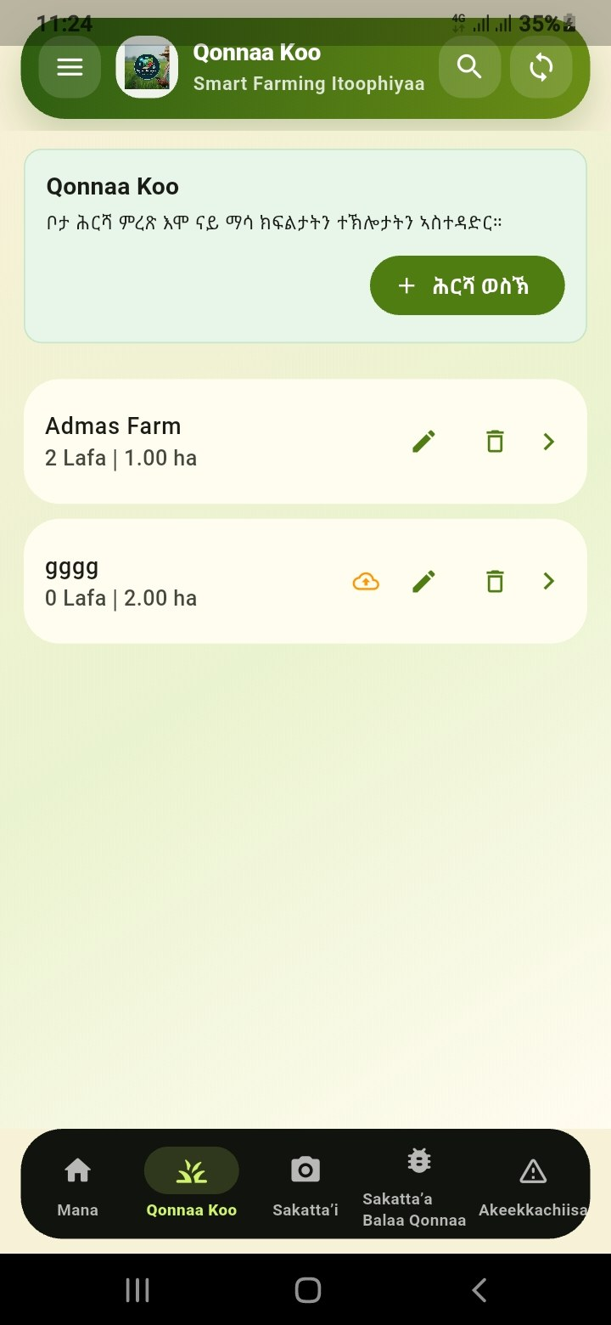
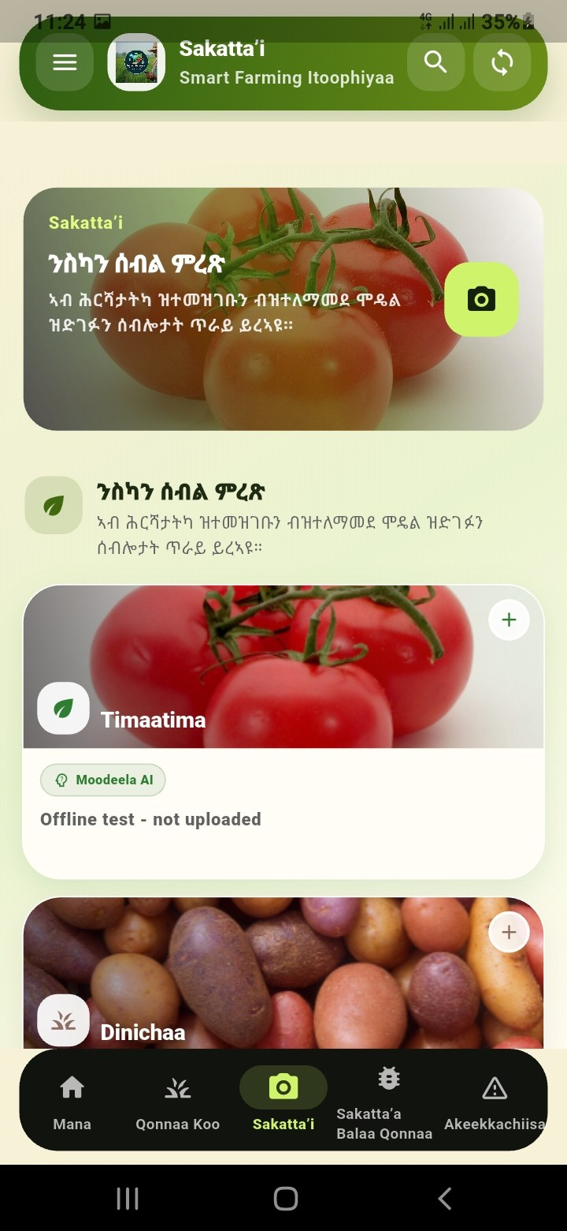
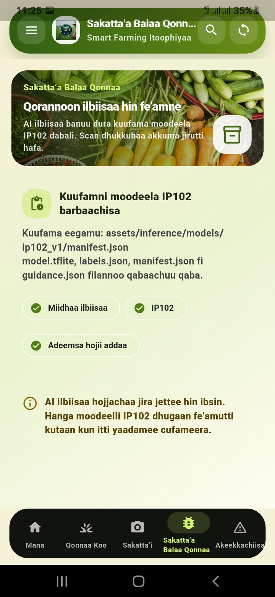
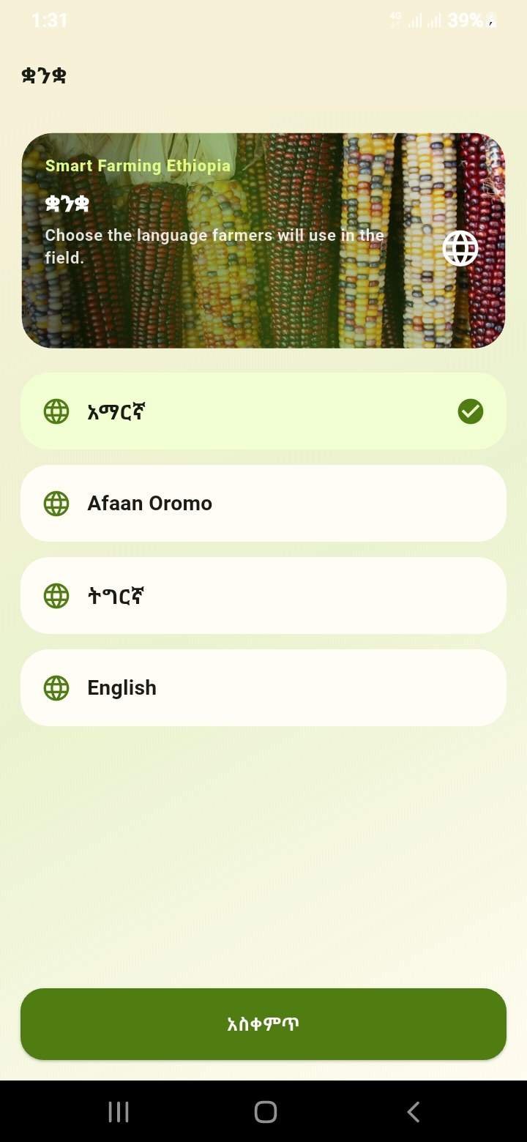
Farmer mobile app: visual workflow
Smart Farming Ethiopia
Large screenshots are included so non-technical visitors can understand without reading code.
Farm setup
Scan crop
Disease prevention
Guidance / records

Slide 9


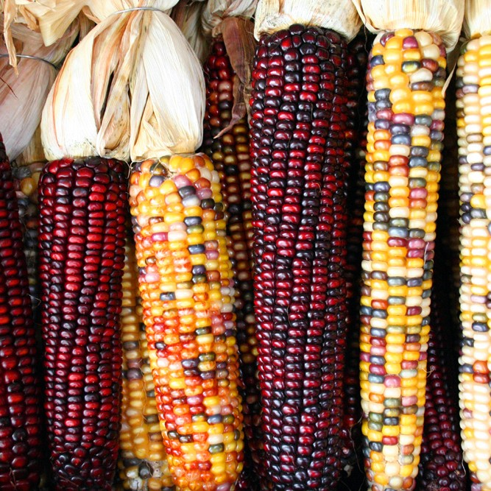
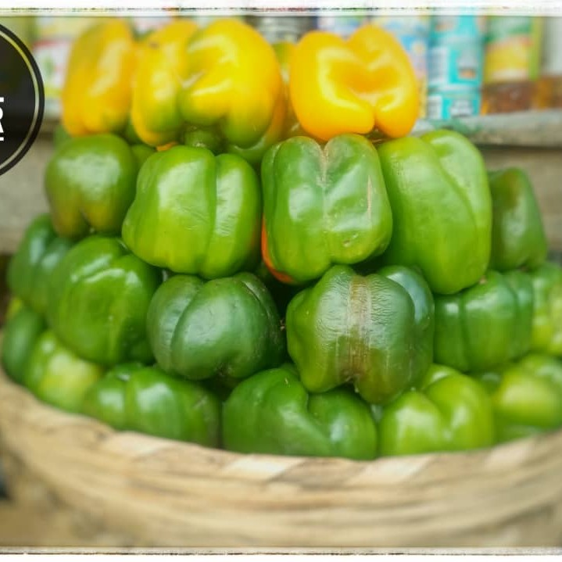

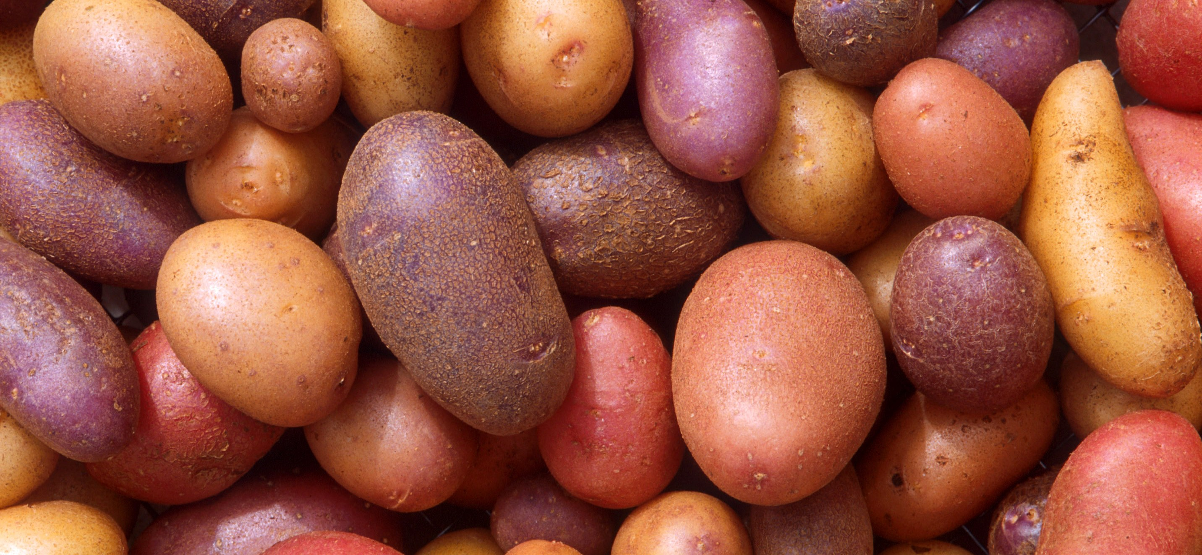
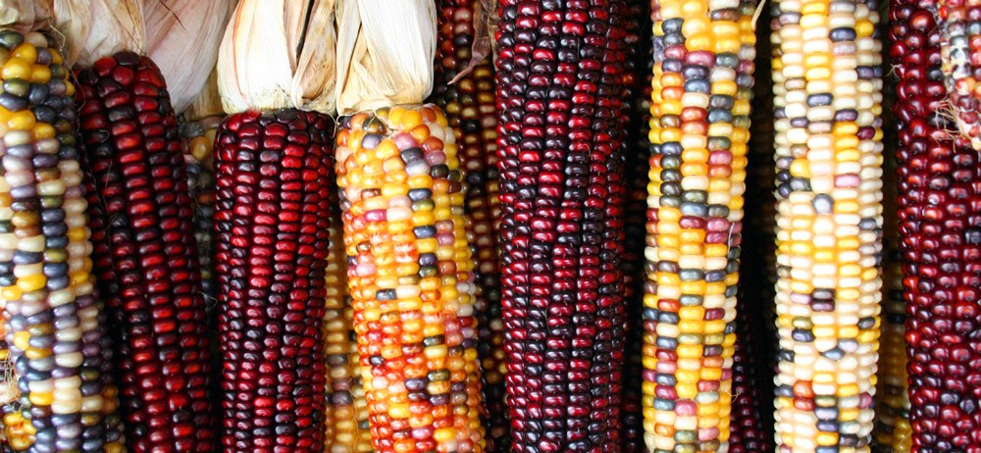
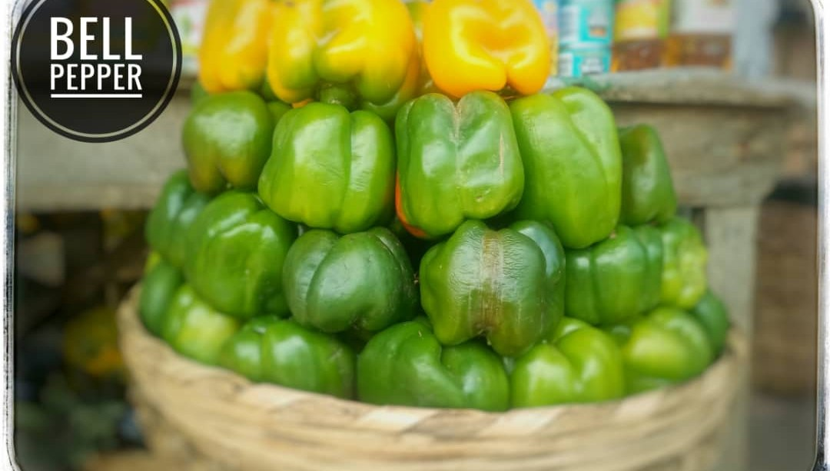
Disease scan workflow
Smart Farming Ethiopia
The system preserves useful offline findings, then improves them through sync and expert review.
1
2
3
4
5
Choose crop context
Capture leaf image
Offline inference
Sync to server
Expert verification
Farm, plot, crop, planting, and optional field condition.
Camera preview, quality check, and local image storage.
Immediate provisional result appears in disease history.
Image evidence and context are uploaded when API is reachable.
Reviewer confirms, rejects, or updates guidance with evidence.
Tomato
Potato
Maize
Pepper
crop-specific model
crop-specific model
crop-specific model
crop-specific model
Decision rule: offline AI result is provisional; online inference and expert review increase confidence without hiding the farmer-s original result.

Slide 10
Supported crop disease detection
Smart Farming Ethiopia
Current focus is crop disease support. Pest detection is prepared but waits for the IP102 model package.
Tomato
early blight, late blight, leaf mold, septoria, spider mite, target spot, mosaic virus, yellow leaf curl, bacterial spot, healthy
Potato
early blight, late blight, healthy
Maize
common rust, gray leaf spot, northern leaf blight, healthy
Pepper
bacterial spot, healthy
Important: healthy leaves must be reported as healthy when confidence supports it, not forced into disease.

Slide 11
Backoffice verification and accountability
Smart Farming Ethiopia
Reports are not just rows. They are evidence-backed cases.
Admin
Supporter
Expert
Super Admin
Configures users, roles, regional scope, crops, and assignment rules.
Reviews assigned local cases, gives first-line advisory support, escalates uncertain cases.
Confirms/rejects disease findings, approves treatment and pesticide guidance.
Oversees all regions, can audit and intervene when regional assignment fails.
Region scoped
Region scoped
Region scoped
Region scoped
Assignment logic: prefer active reviewer in farmer/report region; fall back to admin visibility when no reviewer exists.

Slide 12
Offline-first synchronization
Smart Farming Ethiopia
The app is designed for rural connectivity, not perfect connectivity.
When offline
When online again
- Local account can continue after first successful login
- Farm, plot, planting, disease scan, and soil data are cached
- Sync backlog tracks pending and failed uploads
- Farmer sees honest connection state, not fake online messages
- When API returns, app pulls server records
- Offline provisional disease findings remain visible
- Server result updates without erasing useful local finding
- Image evidence is preserved for review

Slide 13



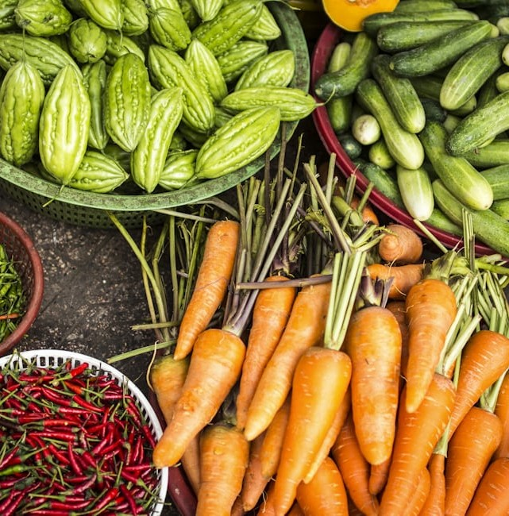



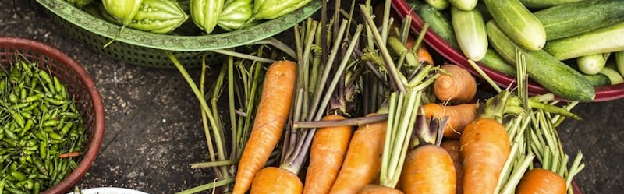
Smart guidance beyond disease scanning
Smart Farming Ethiopia
The platform supports broader field decisions while remaining simple for farmers.
Soil health monitoring
Weather risk monitoring
pH, texture, nutrients, organic matter, moisture, salinity, and crop-specific treatment guidance.
location weather, rainfall, wind, disease-risk signals, and future IoT weather station input.
offline capable
offline capable
Yield outlook
Disease prevention
plot size, planting date, crop stage, soil condition, and field context for expected yield support.
preventive actions based on crop, weather, recent reports, farm context, and reviewer guidance.
offline capable
offline capable
Future direction: schema-backed sensor records can feed soil and weather modules without changing the farmer-facing workflow.

Slide 14
Localization and farmer usability
Smart Farming Ethiopia
The app targets farmers with different literacy levels and local language needs.
English
Amharic
Afaan Oromo
Tigrinya
Developer, demo, and technical reference language
Primary local translation pass
Farmer-facing regional language support
Additional local language support
Usability rule for farmers
Large cards, clear crop images, simple warnings, fewer technical codes, and consistent translation of titles, forms, popups, and recommendations.

Slide 15
Security, privacy, and data scope
Smart Farming Ethiopia
Production readiness means role-aware access, not only working screens.
Farmer scope
Backoffice scope
Evidence access
Mobile users see their own farms, plots, records, reports, and sync state.
Reviewers see assigned or regional reports based on role and region.
Report images are served through protected API paths, not public storage links.
API controls
Audit trail
Offline risk control
Token authentication, throttling, validation, and consistent error handling protect endpoints.
Review status, reviewer decision, image evidence, and timestamps support accountability.
Offline records are marked provisional until sync and review improve confidence.

Slide 16
Production readiness snapshot
Smart Farming Ethiopia
Clear bars replace small unreadable graphs. Ratings are internal implementation readiness, not scientific model certification.
Mobile farmer workflow
88%
Laravel API & auth
86%
Offline sync
80%
Backoffice review
82%
Disease AI reliability
72%
Localization completeness
78%
Deployment readiness
70%
Next improvement priorities: measured model evaluation, production hosting, sensor ingestion, and continuous reviewer feedback loop.

Slide 17
Technical implementation for professional reviewers
Smart Farming Ethiopia
A concise architecture summary for software and ICT professionals.
Flutter mobile
Offline-first farmer app, image capture, local history, localization, API client, sync service.
Laravel backend
REST API, Sanctum auth, MySQL, Filament backoffice, role/region scope, media evidence.
AI inference
Mobile TFLite offline inference and optional FastAPI online inference service.
Data model
Users, roles, farms, plots, plantings, crops, soil records, disease reports, evidence media.
Security
Auth tokens, validation, throttling, protected media, scoped report visibility.
Deployment
Local demo stack now; can split mobile, backend, inference, and database for production.

Slide 18
Known limitations and risk controls
Smart Farming Ethiopia
This slide builds trust by showing what is working and what still needs controlled improvement.
AI model confidence
Needs broader field image validation beyond training dataset examples.
Use expert confirmation and collect feedback images.
Internet dependency for sync
Offline works, but verification needs API availability.
Keep provisional local result visible and sync later.
Chemical treatment safety
Wrong pesticide advice can cause harm.
Expert approval before final chemical guidance.
Localization quality
Direct translation may not capture local disease names.
Schema-backed registry and local expert review.

Slide 19
Project value and impact pathway
Smart Farming Ethiopia
The project is positioned as a practical agricultural technology platform for farmers, reviewers, and institutions.
Innovation evidence
Technology transfer potential
Demonstrates practical software engineering, AI integration, offline-first mobile design, and deployment work.
Suitable for exhibition demonstration, institutional pilot discussion, and technology transfer evaluation.
Training and learning value
Regional impact pathway
Can be used as a practical reference for mobile apps, APIs, database design, AI, and UI/UX.
Can support agricultural extension, local innovation, and data-driven farm advisory services.

Slide 20
Support needed for the next stage
Smart Farming Ethiopia
The next stage needs validation, deployment support, and partnerships.
Training institutions
Technology partners
Innovation partners
Implementation partners
Academic feedback, student collaboration, pilot farms, and training integration.
Hosting, devices, IoT sensors, farm advisory partnership, and commercialization advice.
Innovation recognition, pilot coordination, research support, and regional rollout guidance.
Institutional support, curriculum alignment, exhibition endorsement, and scale-up pathway.
Immediate next step: live pilot with selected farms and assigned reviewers, then collect measured feedback.

Slide 21

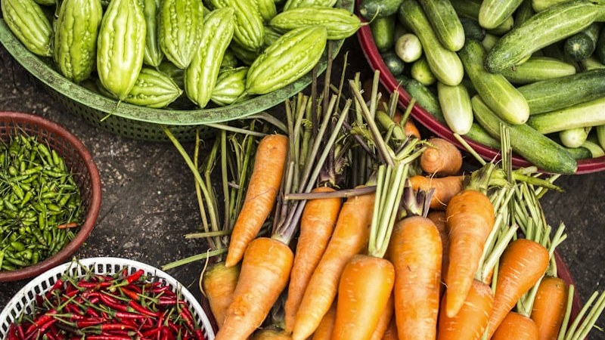
Smart Farming Ethiopia
Thank you
A practical platform for farmer support, AI-assisted crop disease screening, offline records, and expert-verified agricultural guidance.
Admasu Feleke Mulatu
admasu.feleke21@gmail.com | 0900824328
Discussion focus: pilot deployment, expert validation, hosting, sensor integration, and partnerships.

