Slide 1
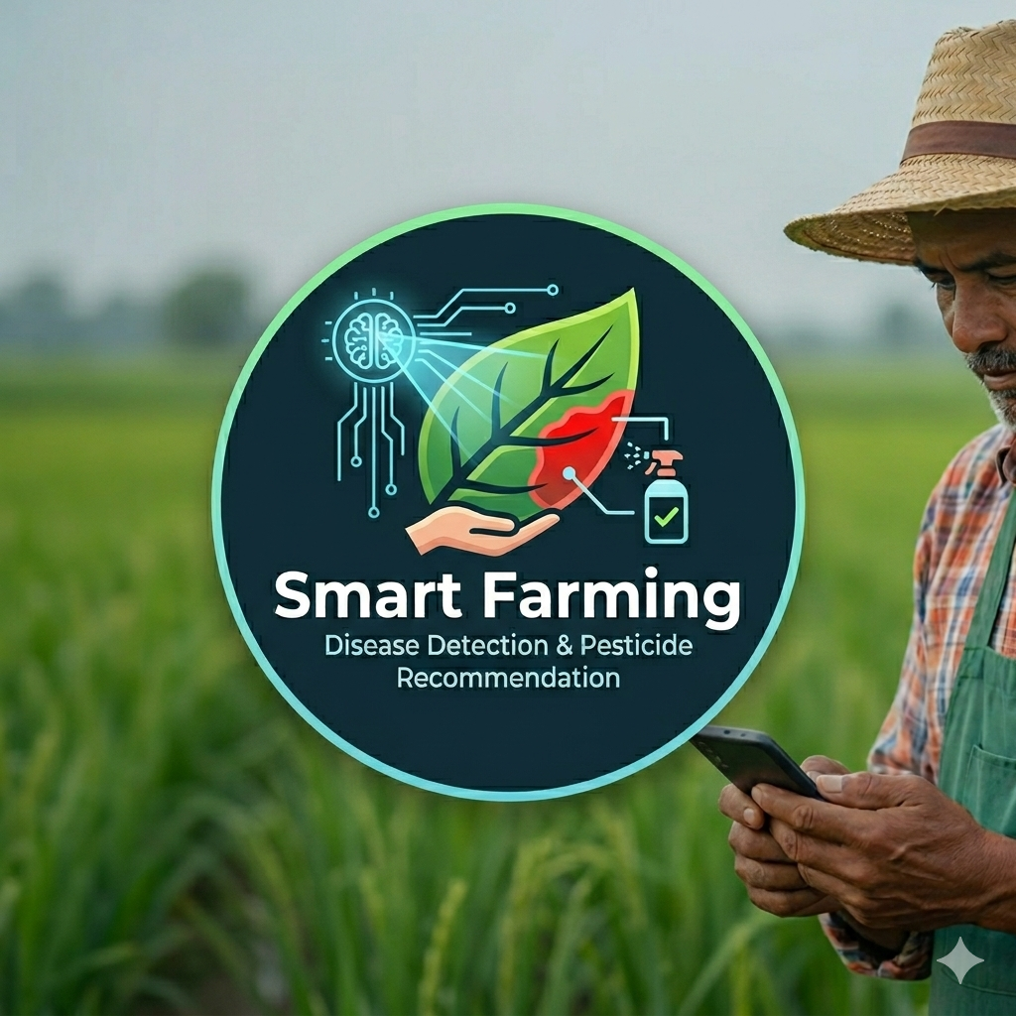

Smart Farming Ethiopia
Dalocha Polytechnic College
Offline-first mobile and Laravel backoffice system for crop disease detection, farm records, soil guidance, weather monitoring, and farmer support
Project Presentation
Prepared by: Admasu Feleke Mulatu Purpose: Career promotion from Assistant Instructor to Instructor Approved by: Technology Transfer Core, Dalocha Polytechnic College
May 2026

Slide 2
Presentation Outline
Background, problem statement, objectives
System scope, users, and core workflows
Architecture, data model, and synchronization
1
2
3
Disease detection, evidence review, and guidance
Soil, weather, prevention, yield, readiness, and future work
4
5
Smart Farming Ethiopia
2

Slide 3
Background
Why a farmer-centered digital agriculture system is needed
- Smallholder farmers often rely on delayed field visits or informal advice for disease and soil decisions.
- Internet access, device quality, and language barriers make cloud-only systems unreliable in rural conditions.
- A practical solution must keep core farmer workflows available offline and synchronize when connectivity returns.
- Evidence-based review helps avoid blind pesticide use and improves confidence in disease recommendations.
Project Direction
Combine offline mobile intelligence with professional Laravel backoffice verification so farmers can act quickly while experts keep final guidance accountable.
Target Setting
Designed for Ethiopian farming context, with local-language support and simplified screens for low-literacy users.
Smart Farming Ethiopia
3

Slide 4
Problem Statement
Disease Response Delay
Leaf problems are reported late or without image evidence, increasing crop loss risk.
Unstable Connectivity
Farmers cannot depend on continuous internet access for diagnosis, records, and login.
Complex Interfaces
Dense forms and technical wording reduce usability for farmers with literacy constraints.
Fragmented Records
Farm, soil, weather, disease history, and guidance are often separated or paper-based.
Smart Farming Ethiopia
4

Slide 5
Project Objectives
- Provide a farmer-only Flutter mobile app with offline login and offline-capable workflows.
- Detect crop diseases from leaf images using crop-specific offline inference and submit evidence for review.
- Maintain synchronized farm, plot, planting, soil, disease, weather, prevention, yield, and alert records.
- Enable backoffice experts/supporters to review disease evidence and confirm or reject reports.
- Support English, Amharic, Afaan Oromo, and Tigrinya for practical local use.
Expected Outcome
A production-oriented prototype that remains useful when offline, then syncs to a controlled server workflow when the API is reachable.
Smart Farming Ethiopia
5

Slide 6
Users and Scope
Farmer Mobile User
Registers or logs in, manages own farm data, scans leaves, views guidance, records soil observations, checks weather/prevention, and receives alerts.
Expert / Supporter
Uses Laravel/Filament backoffice to review disease image evidence, confirm diagnosis, and support guidance quality.
Admin
Manages users, roles, crop/configuration records, and system monitoring through the web backoffice.
- Flutter side is intentionally scoped to farmers only.
- Backoffice users are separated from the mobile farmer workflow.
- Offline-first behavior is a core requirement, not an optional enhancement.
Smart Farming Ethiopia
6

Slide 7
High-Level Architecture
MySQL Application Data
Farmer Flutter App
Laravel API Sanctum Auth Validation
Filament Backoffice
File Storage Disease Evidence
Local Cache Offline Queue Images
Crop-Specific TFLite Models
Offline decisions happen immediately on device; server sync adds verification, persistence, and backoffice accountability.
Smart Farming Ethiopia
7

Slide 8
Flutter Mobile Modules
Authentication
Farmer login, offline unlock, self-registration, logout safety
Farm Operations
Farm, plot, planting CRUD with offline sync
Disease Scan
Camera/gallery, crop chooser, offline inference, evidence upload
Disease History
Offline and synced results, filters, image preview, guidance
Soil Health
Advanced guidance from pH, moisture, organic matter, NPK, soil type
Weather & Prevention
Weather records, disease risk prevention, alerts
Yield Prediction
Advance productivity support from farm/crop context
Localization
English, Amharic, Afaan Oromo, Tigrinya
Smart Farming Ethiopia
8

Slide 9
Scan to Disease History Workflow
1. Select Crop
Tomato, potato, pepper, or maize context is selected before inference.
2. Capture Evidence
Leaf image is captured or selected and stored locally for immediate preview.
3. Offline Inference
Crop-specific EfficientNet/TFLite model generates likely disease or healthy result.
4. Save History
The provisional result is saved on device even if the API is unavailable.
5. Sync for Review
Image evidence and result are submitted to Laravel when online.
6. Expert Decision
Backoffice confirms, rejects, or refines the diagnosis and treatment guidance.
Design rule: server failure must not overwrite a useful offline diagnosis with 'awaiting analysis'.
Smart Farming Ethiopia
9

Slide 10
Offline-First Synchronization
Offline Mode
Previously authenticated or self-registered farmers can continue key work without server access. Local records and images remain visible immediately.
Sync Queue
Creates and updates are queued with status, retried when API becomes reachable, and reconciled into server-backed records.
Conflict Control
Farmer scope, server IDs, local IDs, and status fields prevent other farmers' records from appearing after registration or offline login.
Local-first UX
Queue
Retry
Server
Refresh cache
Smart Farming Ethiopia
10

Slide 11
Laravel Backoffice Verification
- Filament web interface is used by non-farmer roles instead of the Flutter app.
- Disease reports include farmer context, detected crop/disease, confidence, status, date, and image evidence.
- Experts confirm or reject reports and can support safer disease-management guidance.
- Authenticated media access protects farmer images while allowing preview in Flutter and backoffice.
Professional Control
The offline model supports quick decisions, while human review improves trust and reduces unsafe pesticide use.
Evidence Flow
Captured image -> mobile local copy -> Laravel media storage -> backoffice preview -> confirmed history update.
Smart Farming Ethiopia
11

Slide 12
Soil, Weather, Prevention, and Yield
Soil Health
Offline guidance from pH, moisture, organic matter, nitrogen, phosphorus, potassium, and soil type. Includes natural and modern treatments.
Weather Monitoring
Farm-aware weather records and API-backed refresh where server permission and connectivity allow.
Disease Prevention
Risk-oriented recommendations based on crop, farm/plot context, weather signals, and disease history.
Yield Prediction
Advance planning support using crop/farm/soil context and synchronized farm records.
Smart Farming Ethiopia
12

Slide 13
Localization and Farmer Usability
- Supported languages: English, Amharic, Afaan Oromo, and Tigrinya.
- Screens are simplified for farmers: fewer technical labels, clearer actions, and larger readable text.
- Database/API results are mapped to farmer-facing names where possible, avoiding raw status codes.
- Image previews, direct guidance, and offline states reduce confusion when connectivity is poor.
Design Principle
The application should explain what happened, what the farmer can do now, and whether expert/server verification is still pending.
Smart Farming Ethiopia
13

Slide 14
Core Data Model
User/Farmer
Farm
Plot
Planting
Crop
Disease Report
Disease Evidence
Soil Health
Weather Record
Alert
Sync Item
Treatment Guidance
Simplified entity view for presentation; implementation uses Laravel models, migrations, media storage, and Flutter local cache structures.
Smart Farming Ethiopia
14

Slide 15
Technology Stack
Mobile
Flutter, Dart, camera/image handling, local cache, offline queue
Machine Learning
EfficientNet-based TFLite crop-specific disease models
Backend
Laravel API, Sanctum authentication, validation, media routes
Backoffice
Filament admin panel for expert/supporter/admin workflows
Database
MySQL for farms, plots, plantings, users, disease, soil, weather
Deployment
Android APK, local/network API configuration, release build process
Smart Farming Ethiopia
15

Slide 16
Production Readiness Focus
- Offline scan history must save and display immediately without waiting for server response.
- Server sync must not downgrade clear offline findings to vague pending states.
- All farmer data must remain scoped to the authenticated or offline-registered farmer.
- Images must render consistently in offline history, synced history, and Laravel review screens.
- Error messages should be farmer-readable and avoid raw codes unless debugging is explicitly enabled.
Release Practice
Build APK after analyzer checks, offline smoke test, login/logout test, scan-to-history test, image evidence test, and API sync test.
Smart Farming Ethiopia
16

Slide 17
Limitations and Risk Controls
ML Reliability
Offline model output is advisory. Expert verification remains important for high-risk treatment decisions.
Connectivity
The app must treat network reachability as variable and avoid blocking farmers from local records.
Data Quality
Poor images, wrong crop selection, or biased class distribution can affect disease results.
Operational Scale
Full public hosting and push-scale infrastructure require additional budget and deployment resources.
Smart Farming Ethiopia
17

Slide 18
Future Work
- Field validation with real farmer images across crop growth stages and local disease pressure.
- Model retraining with balanced datasets, confidence calibration, and explainable top-score display.
- SMS/USSD or lightweight notification integration for farmers without reliable mobile data.
- More complete agronomic datasets for region/zone/woreda/kebele, crops, fertilizers, and approved treatments.
- Cloud deployment with monitoring, backups, media storage policy, and API performance hardening.
Long-Term Goal
A practical decision-support platform that connects farmers, field supporters, experts, and institutional technology-transfer activities.
Smart Farming Ethiopia
18

Slide 19
Architecture Walkthrough
A simple reading path for non-technical validators
1
2
3
4
5
Farmer uses mobile app
The farmer records farm work and scans crop leaves on the phone.
Phone keeps local copy
Important data and images remain available when internet is not working.
API receives sync
When network returns, the phone sends queued records to Laravel.
Database and storage save evidence
MySQL stores records; file storage keeps disease images.
Expert reviews in backoffice
Supporter or expert checks evidence and confirms the result.
Meaning: the farmer is never blocked by temporary internet failure, but expert review is still possible after synchronization.
Smart Farming Ethiopia
20

Slide 20
Disease Scan Walkthrough
How one leaf photo becomes farmer guidance
1
Choose crop
The model is selected using crop context such as potato, tomato, pepper, or maize.
2
Take photo
The app stores the image so the farmer can see it later in history.
3
Offline diagnosis
The phone gives a quick provisional result, including healthy cases where applicable.
4
History saved
The result is visible immediately, even before sync.
5
Expert verification
Server review improves confidence and protects against unsafe treatment decisions.
Key message for validators: offline result should not disappear or change into a vague pending status just because the server inference service is unavailable.
Smart Farming Ethiopia
21

Slide 21
Offline Sync Walkthrough
What happens when the server is unreachable and later returns
1. Server unavailable
The app must show local disease history, farm records, and soil guidance without long loading delays.
2. Farmer continues work
New scans and records are saved locally with clear status such as saved on this phone or waiting to sync.
3. Server reachable
The sync queue sends local records and images to Laravel using the configured API link.
4. Review completed
Confirmed diagnosis and guidance are pulled back, while the original offline finding and image evidence remain understandable.
5. Farmer sees final result
History should show the exact disease, likely issue, or healthy result with one clear image preview.
Smart Farming Ethiopia
22

Slide 22
Conclusion and Contact
Smart Farming Ethiopia provides a farmer-centered, offline-first path for crop health support, farm records, soil guidance, prevention, and expert-reviewed disease evidence.
Admasu Feleke Mulatu
Email: admasu.feleke21@gmail.com
Phone: 0900824328
Dalocha Polytechnic College
Project Value
The system is designed for real rural constraints: unstable internet, low-literacy usability needs, local languages, and the need for accountable disease guidance.
Approved institutional context: Technology Transfer Core
Smart Farming Ethiopia
19

