Slide 1
INTRODUCTION TO LOGISTIC REGRESSION
Ivan Hernandez, Ph.D

Slide 2
LEARNING OBJECTIVES
INTRODUCTION TO LOGISTIC REGRESSION
Build a Logistic regression classification model using the scikit learn library
Describe a sigmoid function, odds, and the odds ratio as well as how they relate to logistic regression
Evaluate a model using metrics such as classification accuracy/error, confusion matrix, ROC/AUC curves, and loss functions

Slide 3
OPENING
INTRODUCTION TO LOGISTIC REGRESSION

Slide 4

INTRODUCTION TO LOGISTIC REGRESSION
ANSWER THE FOLLOWING QUESTIONS
EXERCISE
Read through the following questions and brainstorm answers for each:
What are the main differences between linear and KNN models? What is different about how they approach solving the problem?
For example, what is interpretable about OLS compared to what's interpretable in KNN?
What would be the advantage of using a linear model like OLS to solve a classification problem, compared to KNN?
What are some challenges for using OLS to solve a classification problem (say, if the values were either 1 or 0)?
DELIVERABLE
Answers to the above questions

Slide 5
INTRODUCTION
LOGISTIC REGRESSION

Slide 6
LOGISTIC REGRESSION
Logistic regression is a linear approach to solving a classification problem.
That is, we can use a linear model, similar to Linear regression, in order to solve if an item belongs or does not belong to a class label.

Slide 7
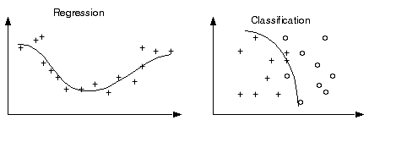
CHALLENGE! LINEAR REGRESSION RESULTS FOR CLASSIFICATION
Regression results can have a value range from -∞ to ∞.
Classification is used when predicted values (i.e. class labels) are not greater than or less than each other.

Slide 8
CHALLENGE! LINEAR REGRESSION RESULTS FOR CLASSIFICATION
In regression, are predictions are unbounded (e.g., increasing the value of a predictor with a positive coefficient will ALWAYS increase the predicted value of our outcome)
Most classification problems are binary (outcome is either 1 or 0)
How might we use a linear model but have our predictions contained within those bounds?
Let’s review some approaches to make classification with regression feasible.

Slide 9
FIX 1: PROBABILITY
One approach is predicting the probability that an observation belongs to a certain class.
We could assume the prior probability (the bias) of a class is the class distribution.

Slide 10
FIX 1: PROBABILITY
For example, suppose we know that roughly 700 of 2200 people from the Titanic survived. Without knowing anything about the passengers or crew, the probability of survival would be ~0.32 (32%).
However, we still need a way to use a linear function to either increase or decrease the probability of an observation given the data about it.

Slide 11
FIX 2: LINK FUNCTIONS AND THE SIGMOID FUNCTION
Link functions allows us to build a relationship between a linear function and the outcome
The link function is what we multiply/transform the outcome variable by
In OLS, we leave the outcome (y) untransformed. Therefore the link is just 1 X the outcome
By using a function on the outcome, we can constrain the bounds of the variable (example: If our model made predictions about the log of a variable, the outcomes would always be positive (logs are always positive)

Slide 12
FIX 2: LINK FUNCTIONS AND THE SIGMOID FUNCTION
For classification, we need to translate our outcome in a way that makes sense for probability
As we increase X, our probability of observing an event increasesGets closer to 1, but never surpasses it.
As X decreases, our probability of observing an event decreases: Geta closer to 0, but never goes below it
The prediction line should look like an “S”
.

Slide 13
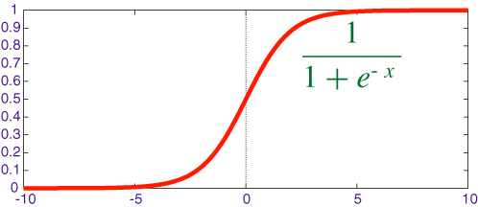

FIX 2: LINK FUNCTIONS AND THE SIGMOID FUNCTION
A sigmoid function is a function that visually looks like an s.
Mathematically, it is defined as

Slide 14
FIX 2: LINK FUNCTIONS AND THE SIGMOID FUNCTION
Recall that e is the inverse of the natural log.
As x increases, the results is closer to 1. As x decreases, the result is closer to 0.
When x = 0, the result is 0.5.

Slide 15
FIX 2: LINK FUNCTIONS AND THE SIGMOID FUNCTION
Since x decides how to much to increase or decrease the value away from 0.5, x can be interpreted as something like a coefficient.
However, we still need to change its form to make it more useful.

Slide 16
INTRODUCTION
LOGISTIC REGRESSION

Slide 17
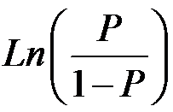
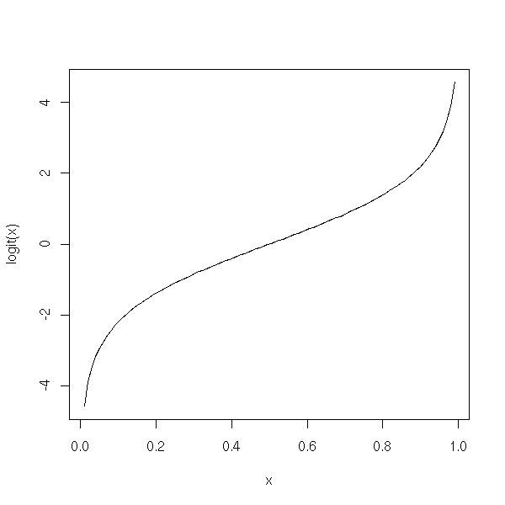
FIX 3: ODDS AND LOG-ODDS
The logit function is the inverse of the sigmoid function.
This will act as our link function for logistic regression.
Mathematically, the logit function is defined as

Slide 18
FIX 3: ODDS AND LOG-ODDS
The value within the natural log, p / (1-p) represents the odds. Taking the natural log of odds generates log odds.

Slide 19
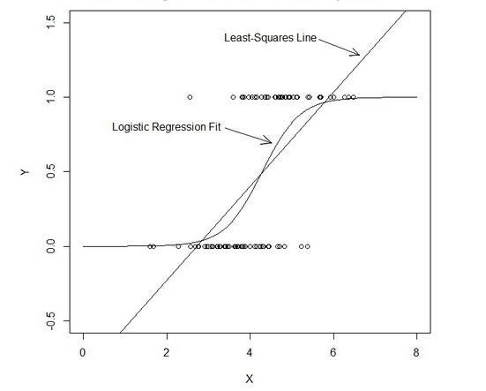
FIX 3: ODDS AND LOG-ODDS
The logit function allows for values between -∞ and ∞, but provides us probabilities between 0 and 1.

Slide 20
FIX 3: ODDS AND LOG-ODDS
For example, the logit value (log odds) of 0.2 (or odds of ~1.2:1):
0.2 = ln(p / (1-p) )
With a mean probability of 0.5, the adjusted probability would be ~0.55.
1 / (1 + e^{-0.2})
To calculate this in python, we could use the following.
1 / (1 + numpy.exp(-0.2) )

Slide 21
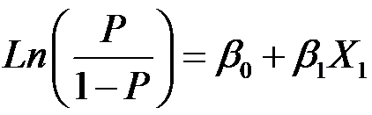

FIX 3: ODDS AND LOG-ODDS
While the logit value represents the coefficients in the logistic function, we can convert them into odds ratios that make them more easily interpretable.
The odds multiply by e^{B1} for every 1-unit increase in x.

Slide 22
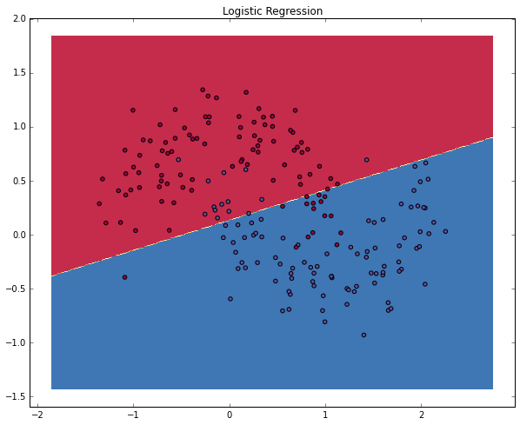
FIX 3: ODDS AND LOG-ODDS
With these coefficients, we get our overall probability: the logistic regression draws a linear decision line which divides the classes.

Slide 23
INTRODUCTION
ADVANCED CLASSIFICATION METRICS

Slide 24
ADVANCED CLASSIFICATION METRICS
Accuracy is only one of several metrics used when solving a classification problem.
Accuracy = total predicted correct / total observations in dataset
Accuracy alone doesn’t always give us a full picture.
If we know a model is 75% accurate, it doesn’t provide any insight into why the 25% was wrong.

Slide 25
ADVANCED CLASSIFICATION METRICS
Was it wrong across all labels?
Did it just guess one class label for all predictions?
It’s important to look at other metrics to fully understand the problem.

Slide 26
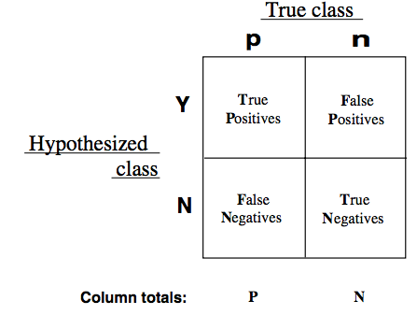
ADVANCED CLASSIFICATION METRICS
We can split up the accuracy of each label by using the true positive rate and the false positive rate.
For each label, we can put it into the category of a true positive, false positive, true negative, or false negative.

Slide 27
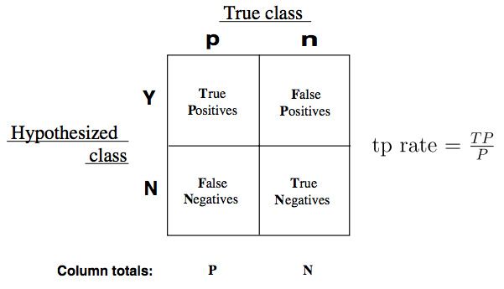
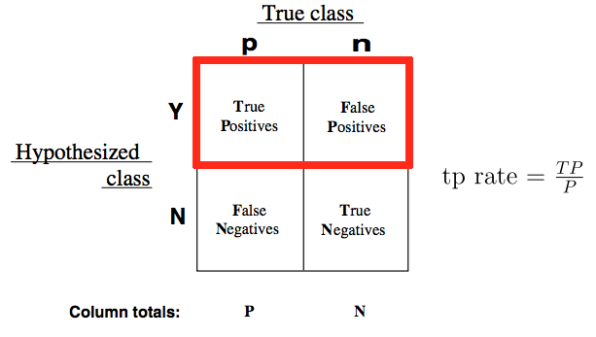
ADVANCED CLASSIFICATION METRICS
True Positive Rate (TPR) asks, “Out of all of the target class labels, how many were accurately predicted to belong to that class?”
For example, given a medical exam that tests for cancer, how often does it correctly identify patients with cancer?

Slide 28
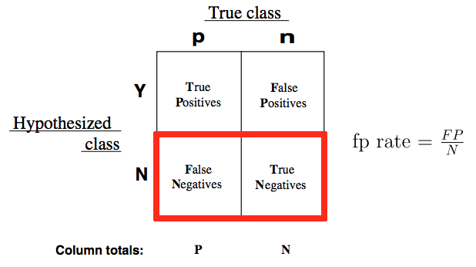
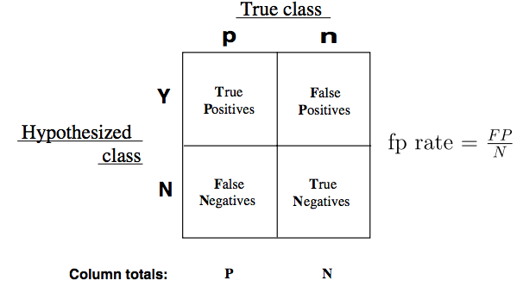
ADVANCED CLASSIFICATION METRICS
False Positive Rate (FPR) asks, “Out of all items not belonging to a class label, how many were predicted as belonging to that target class label?”
For example, given a medical exam that tests for cancer, how often does it trigger a “false alarm” by incorrectly saying a patient has cancer?

Slide 29
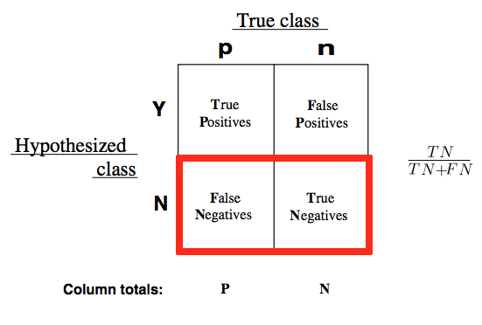
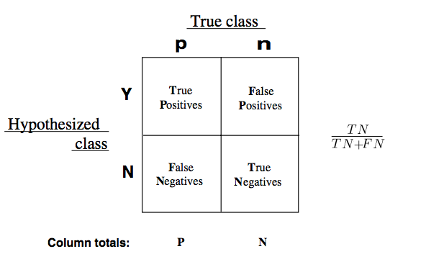
ADVANCED CLASSIFICATION METRICS
These can also be inverted.
How often does a test correctly identify patients without cancer?

Slide 30
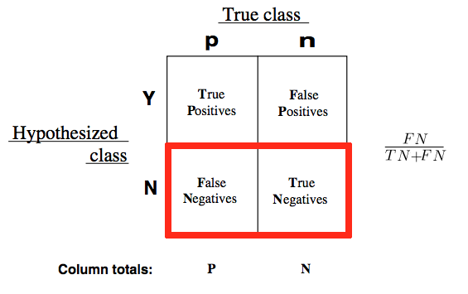
ADVANCED CLASSIFICATION METRICS
How often does a test incorrectly identify patient as cancer-free?

Slide 31
ADVANCED CLASSIFICATION METRICS
The true positive and false positive rates gives us a much clearer pictures of where predictions begin to fall apart.
This allows us to adjust our models accordingly.

Slide 32
ADVANCED CLASSIFICATION METRICS
A good classifier would have a true positive rate approaching 1 and a false positive rate approaching 0.
In predicting the weather, a good model would accurately predict all of the sunny days as sunny and not accidentally predict any of the non-sunny as sunny.

Slide 33
ADVANCED CLASSIFICATION METRICS
We can vary the classification threshold for our model to get different predictions. But how do we know if a model is better overall than other model?
We can compare the FPR and TPR of the models, but it can often be difficult to optimize two numbers at once.
Logically, we like a single number for optimization.
We need to combine our two metrics!

Slide 34
ADVANCED CLASSIFICATION METRICS
This is where the Receiver Operation Characteristic (ROC) curve comes in handy.
The curve is created by plotting the true positive rate against the false positive rate at various model threshold settings.
Area Under the Curve (AUC) summarizes the impact of TPR and FPR in one single value.

Slide 35
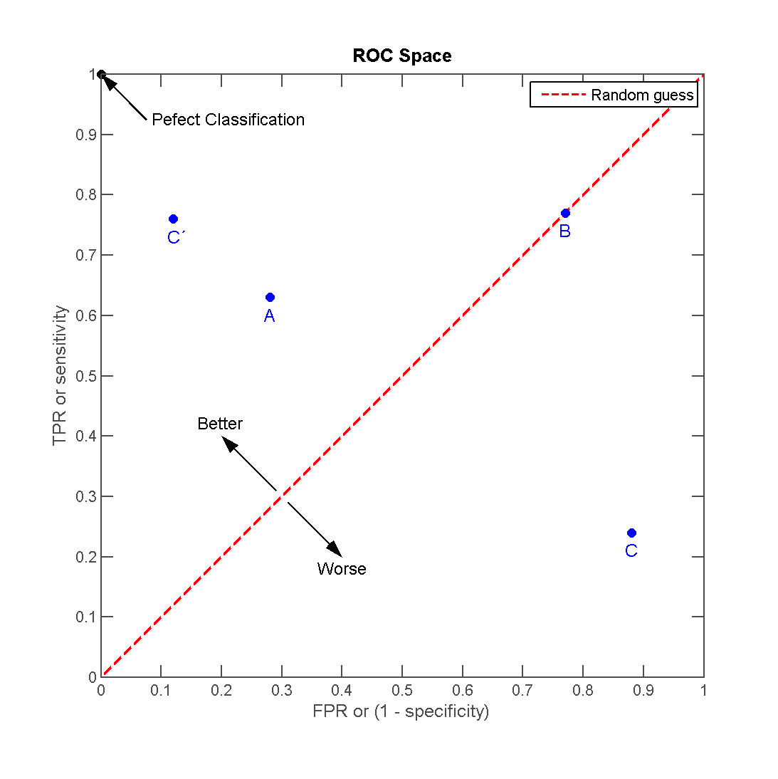
ADVANCED CLASSIFICATION METRICS
There can be a variety of points on an ROC curve.

Slide 36
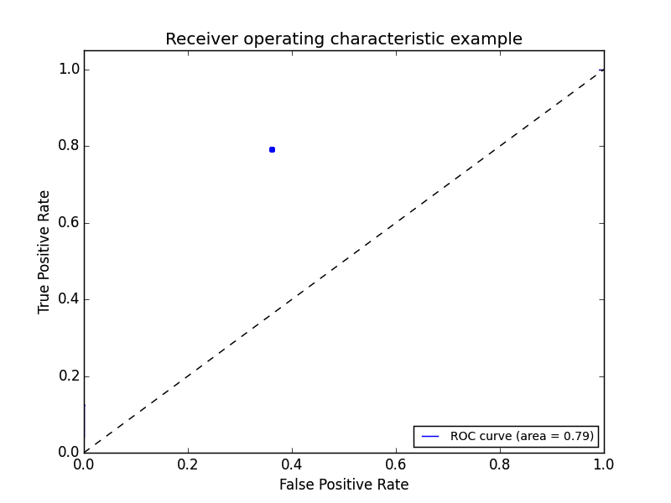
ADVANCED CLASSIFICATION METRICS
We can begin by plotting an individual TPR/FPR pair for one threshold.
(e.g., if probability > .50, classify as “yes”)

Slide 37
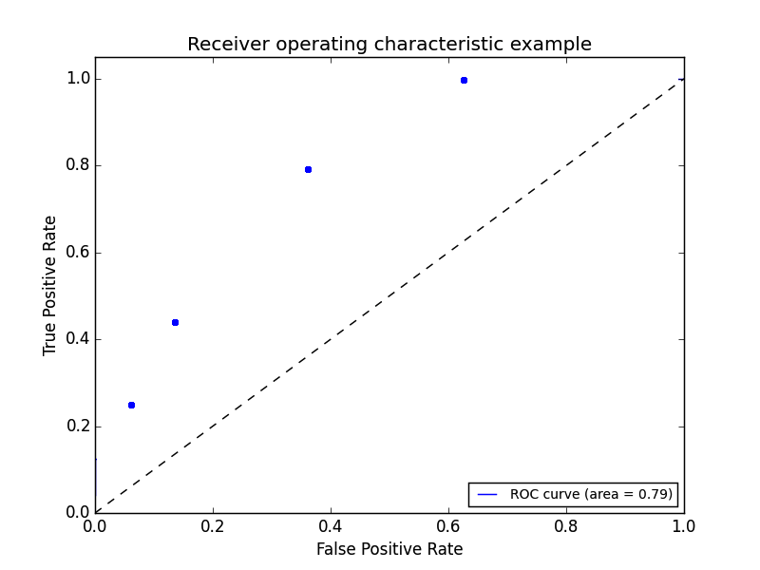
ADVANCED CLASSIFICATION METRICS
We can continue adding pairs for different thresholds (e.g., if probability > .51, classify as “yes”; if probability > .52, classify as “yes”)

Slide 38
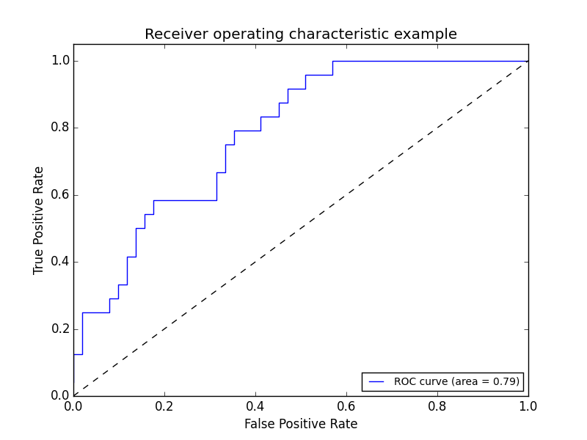
ADVANCED CLASSIFICATION METRICS
Finally, we create a full curve that is described by TPR and FPR.

Slide 39
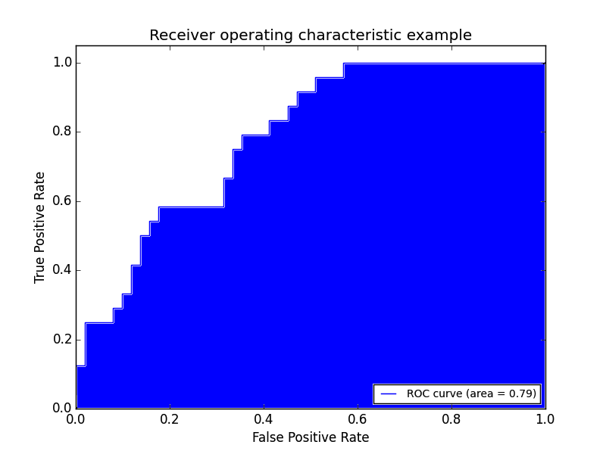
ADVANCED CLASSIFICATION METRICS
With this curve, we can find the Area Under the Curve (AUC).

Slide 40
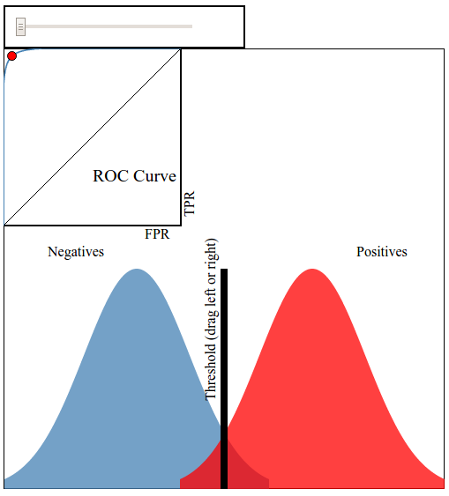
ADVANCED CLASSIFICATION METRICS
This interactive visualization can help practice visualizing ROC curves.

Slide 41
ADVANCED CLASSIFICATION METRICS
If we have a TPR of 1 (all positives are marked positive) and FPR of 0 (all negatives are not marked positive), we’d have an AUC of 1. This means everything was accurately predicted.
If we have a TPR of 0 (all positives are not marked positive) and an FPR of 1 (all negatives are marked positive), we’d have an AUC of 0. This means nothing was predicted accurately.
An AUC of 0.5 would suggest randomness (somewhat) and is an excellent benchmark to use for comparing predictions (i.e. is my AUC above 0.5?).
If you randomly guessed for your predictions, then you get a TRP = FPR

Slide 42
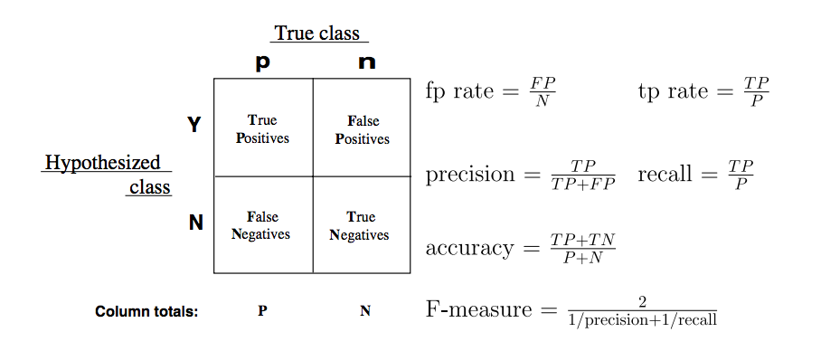
ADVANCED CLASSIFICATION METRICS
There are several other common metrics that are similar to TPR and FPR.
Sklearn has all of the metrics located on one convenient page.

Slide 43
GUIDED PRACTICE
WHICH METRIC SHOULD I USE?

Slide 44
WHICH METRIC SHOULD I USE?
A test is developed for determining if a patient has cancer or not.
Positive = Patient has cancer
Negative = Patient does not have cancer
A newspaper company is targeting a marketing campaign for "at risk" users that may stop paying for the product soon.
Positive = user may stop paying for the product
Negative = user will not stop paying for product
You build a spam classifier for your email system.
Positive = email is spam
Negative = email is not spam

Slide 45
CONCLUSION
TOPIC REVIEW

Slide 46
COURSE
BEFORE NEXT CLASS

Slide 47
DUE DATE
BEFORE NEXT CLASS
Project:

Slide 48
LESSON
EXIT TICKET
DON’T FORGET TO FILL OUT YOUR EXIT TICKET

