Slide 1
WEB-BASED METHODS FOR COLLECTING DATA
Ivan Hernandez, Ph.D

Slide 2
LEARNING OBJECTIVES
Learn how to access an API and collect data from it
Making requests
Parsing XML
Storing the data
Learn how to collect data from websites
Download data from tables
Parse HTML
Storing the data
Learn how to automate web interaction
Have Python navigate websites
Interact with web content
Download data stored on servers

Slide 3
Part 1
COLLECTING DATA FROM AN API

Slide 4
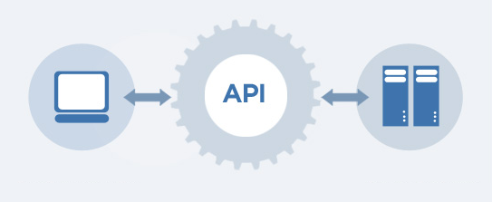
API BASICS
An API is a way for web platforms (Facebook, Twitter, Uber, Amazon) to provide access to some of their data
Allow you to make requests that detail the specific information you need
The platform receives the request, retrieves the information from their database
The platform sends the information back in a structured way (e.g., XML)

Slide 5
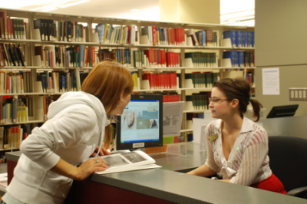
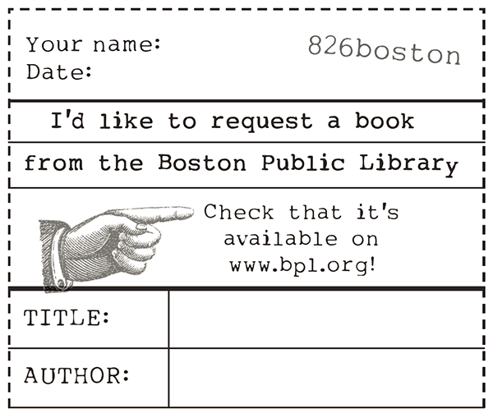
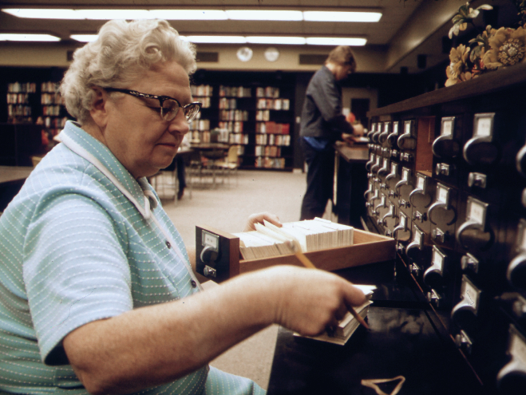
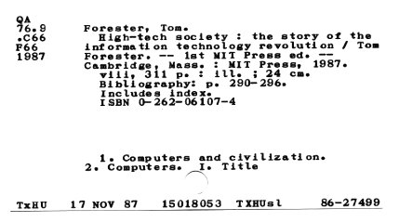
API ANALOGY: LIBRARIANS
An Librarian is a way for Libraries to
provide access to some of their data
(where books are located)
Allow you to make requests that detail the specific information you need
Title
Author
The platform receives the request, retrieves the information from their database
The platform sends the information back in structured way

Slide 6
The API COLLECTION PROCESS
Send a request
Find the appropriate API url
Enter in the variables that are relevant to your request
Get the response back from the API
Usually immediate
Usually in the form of XML or JSON
Parse the XML to extract the information you need from it
Save the data

Slide 7
SENDING AN API REQUEST
http://www.ctabustracker.com/bustime/api/v1/getstops?key=UznMvHN96Q7DpAPu2YtZQgPQS&rt=77&dir=Eastbound
Connect to the API server
Describe the type of request (the bus stops)
Login with your user API key
Ask for the stops for bus # “77” going Eastbound

Slide 8
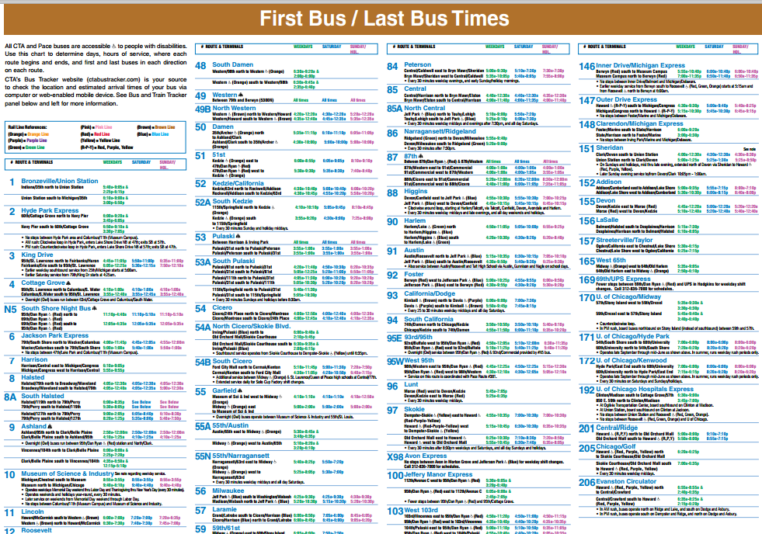
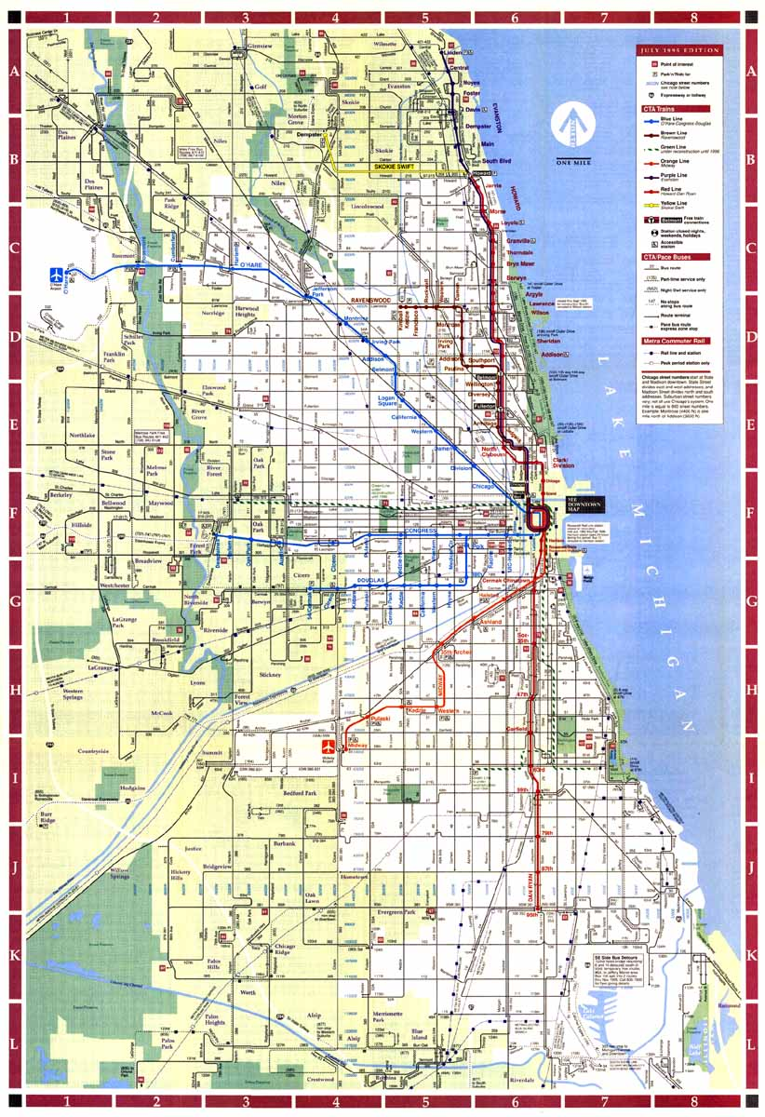
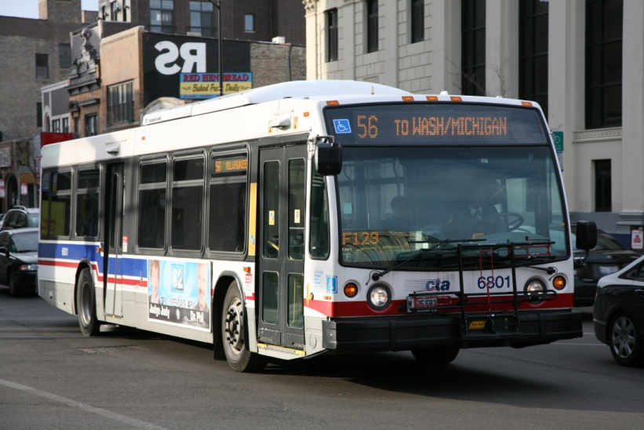

EXAMPLE: CTA

Slide 9
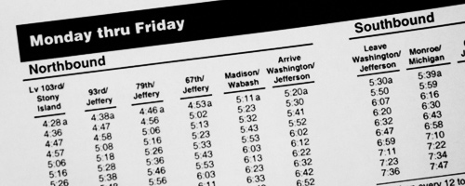

Slide 10
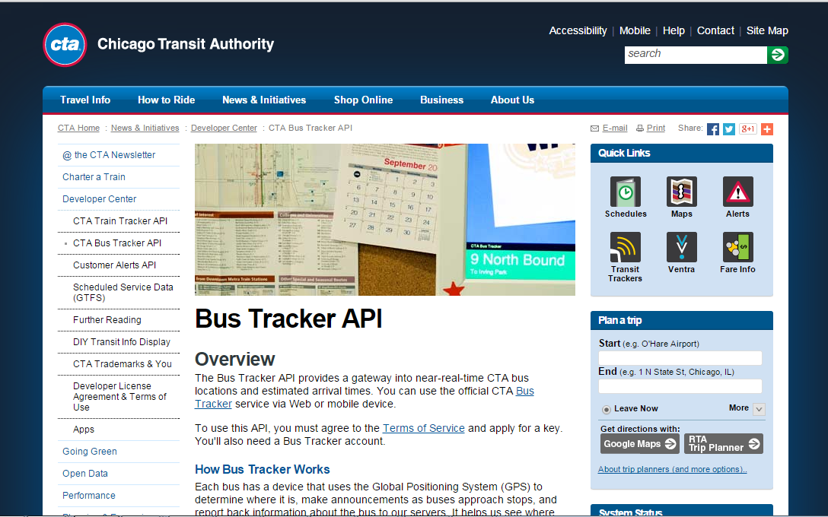
EXAMPLE: CTA – REGISTER FOR AN ACCOUNT
http://www.transitchicago.com/developers/bustracker.aspx

Slide 11
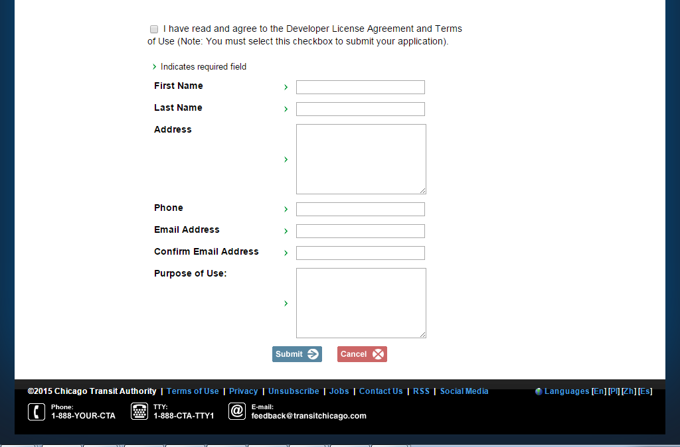
EXAMPLE: CTA – REGISTER FOR AN ACCOUNT

Slide 12
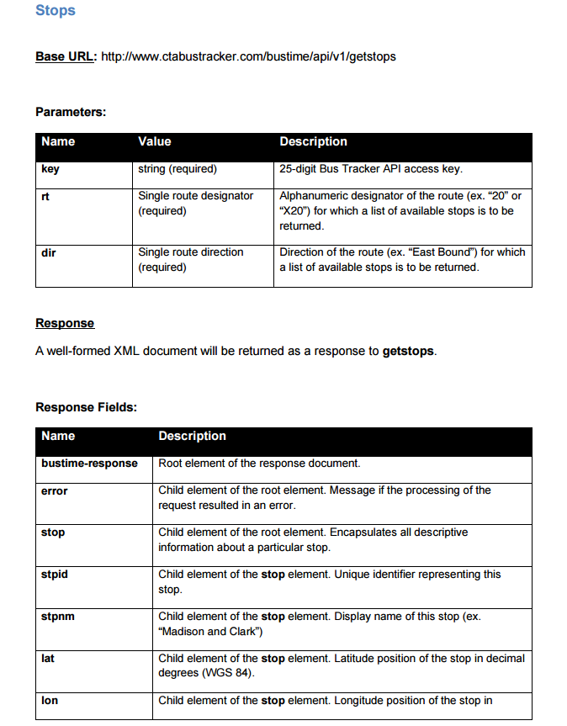
EXAMPLE: CTA – READ THROUGH THE DOCUMENTATION
The URL you use to connect to the API
The information you need to provide to the API after the url. Tells the API what info to return
The information returned by the API. This information needs to be parsed by you depending on what information you need (e.g., just the latitude and longitude of the stop)

Slide 13
EXAMPLE: CTA – ANATOMY OF AN API REQUEST
http://www.ctabustracker.com/bustime/api/v1/getstops?key=UznMvHN96Q7DpAPu2YtZQgPQS&rt=77&dir=Eastbound
Connect to the API server
Describe the type of request (the bus stops)
Login with your user API key
Indicate that you want to include another variable
Ask for the stops for bus # “77” going Eastbound
You always provide the url first, then put a question mark, then the variable name, an equal sign, and what you want the variable to be.
Separate each variable with the and symbols

Slide 14
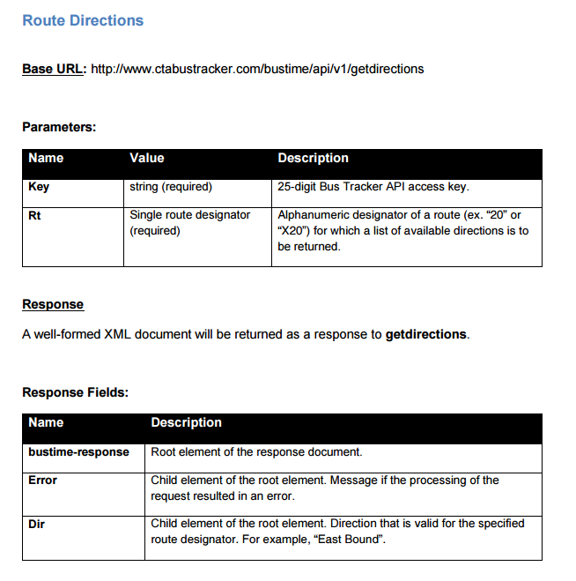

ACTIVITY: KNOWLEDGE CHECK
ANSWER THE FOLLOWING QUESTIONS (2 minutes)
EXERCISE
Imagine, you want to know the direction (North/South or East/West of 156 bus route.
Use the provide API documentation to construct an API request to get you that information.
Assume that your CTA API key is: 112358
DELIVERABLE
The full API address

Slide 15
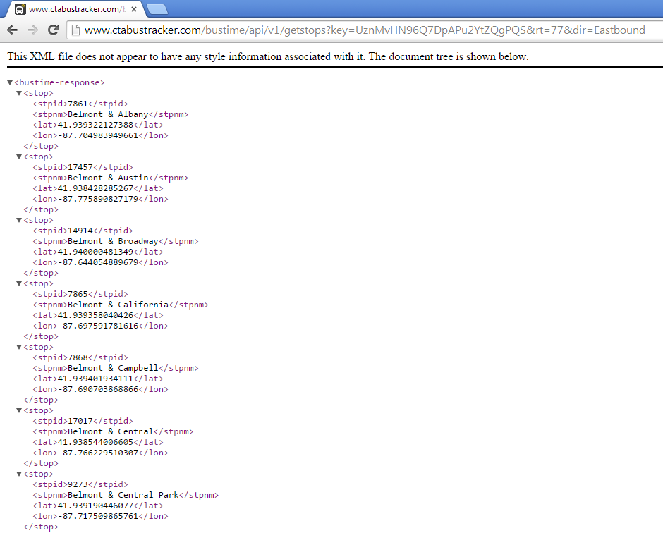
EXAMPLE: CTA – RECEIVING THE XML DATA FROM THE SERVER

Slide 16
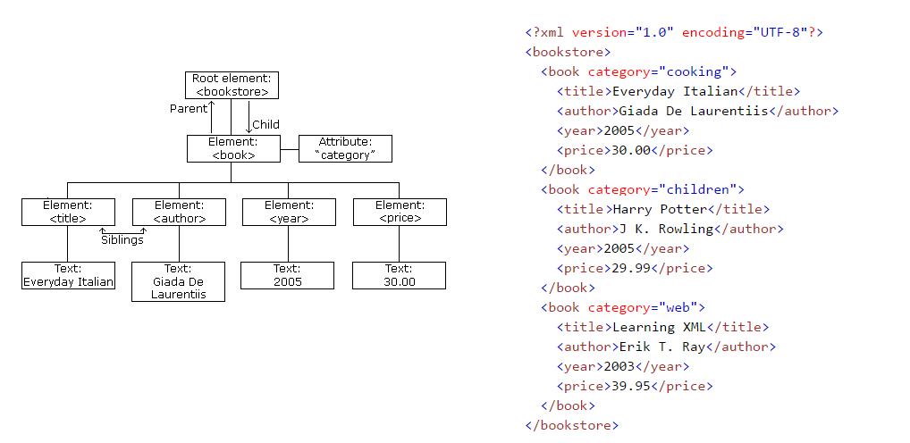
ANATOMY OF AN XML DOCUMENT

Slide 17
EXAMPLE: CTA – RECEIVING THE XML DATA FROM THE SERVER

Slide 18
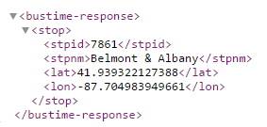
ACTIVITY: KNOWLEDGE CHECK
ANSWER THE FOLLOWING QUESTIONS (5 minutes)
EXERCISE
Draw the XML document tree for the XML object on the right
Make sure to label all parts on trees indicating if it is an element or text
DELIVERABLE
A fully drawn and labeled tree

Slide 19
Part 1
COLLECTING DATA FROM AN API
CODE-ALONG

Slide 20
Part 1
COLLECTING DATA FROM A WEBPAGE

Slide 21
WEB PAGE BASICS
An webpage is like an XML document, in that it is a series of information between tags
Instead of XML, a webpage is written in HTML
Similar to how you parse an XML document to retrieve the information contained in the tags, you can parse the HTML to get the desired information
As before, you make a request to the webpage, retrieve the HTML source, parse it, and store it.

Slide 22
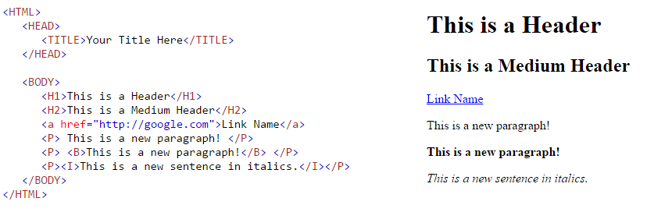
WEB PAGE BASICS - HTML
What the HTML looks like | What the website looks like

Slide 23
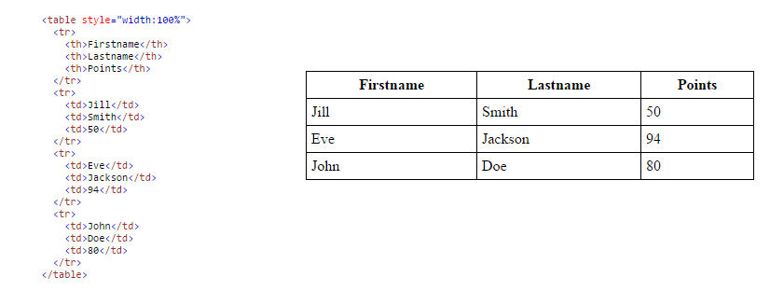
WEB PAGE BASICS – HTML TABLES
What the HTML looks like | What the table looks like

Slide 24
Part 1
COLLECTING DATA FROM A WEBSITE
CODE-ALONG

Slide 25
Part 3
AUTOMATING WEB ACCESS OF STORED DATA

Slide 26
AUTOMATION BASICS
Some data is already stored as a filed on servers
You can download this data directly
Accessing the different pages, downloading, naming, and saving the file can be time consuming
You can tell Python what steps to follow, and have it do the same things you would do, and download all of the data for you
Example: https://www.youtube.com/watch?v=VSKoVsHs_Ko

Slide 27
BROWSER AUTOMATION LIBRARY
Mechanize is a library for Python that simulates a browser
It can access pages, click, fill out forms, go back/forward, etc.
No javascript interaction though
Install mechanize through the command terminal:
pip install mechanize
3) You use mechanize by creating a mechanize browser object in Python, and then sending commands through that variable
import mechanize
br = mechanize.Browser()
br.open("http://www.example.com")

Slide 28
Part 1
COLLECTING STORED DATA FROM A WEBSITE
AUTOMATICALLY

Slide 29
COURSE
BEFORE NEXT CLASS

Slide 30
DUE DATE: Class 5
BEFORE NEXT CLASS
Project: Unit 1: Description
https://github.com/ga-students/CHI-DS-3/tree/master/projects/unit-projects/unit-project-1

Slide 31
LESSON
Q & A

Slide 32
LESSON
EXIT TICKET
DON’T FORGET TO FILL OUT YOUR EXIT TICKET:
Link: http://tiny.cc/chi-ds

