Slide 1
INTRODUCTION TO REGRESSION ANALYSIS
Ivan Hernandez, Ph.D

Slide 2
LEARNING OBJECTIVES
INTRODUCTION TO REGRESSION ANALYSIS
Define data modeling and simple linear regression
Build a linear regression model using a dataset that meets the linearity assumption using the sci-kit learn library

Slide 3
OPENING
INTRODUCTION TO REGRESSION ANALYSIS

Slide 4
WHERE ARE WE IN THE DATA SCIENCE WORKFLOW?
Data has been acquired and parsed.
Today we’ll refine the data and build models.
We’ll also use plots to represent the results.

Slide 5
INTRODUCTION
SIMPLE LINEAR REGRESSION

Slide 6
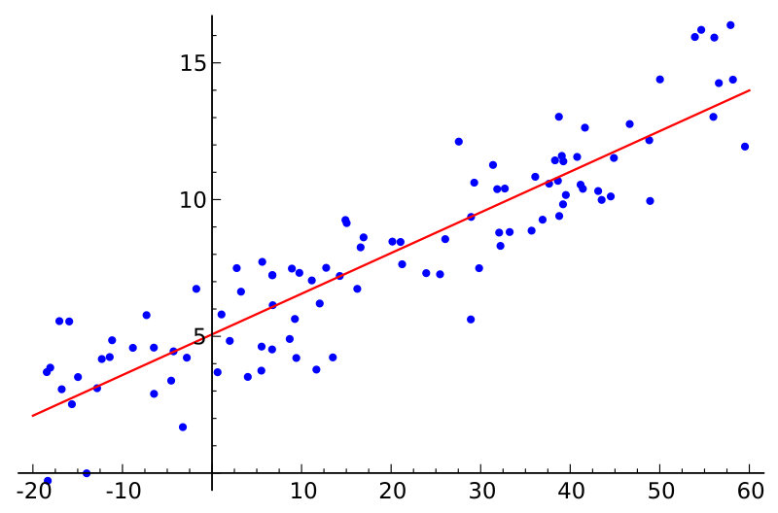
SIMPLE LINEAR REGRESSION
Def: Explanation of a continuous variable given a series of independent variables
The predictor variables can be continuous
or categorical
The simplest version is just a line of best fit: y = mx + b
Explain the relationship between x and y using the starting point b and the power in explanation m.

Slide 7
SIMPLE LINEAR REGRESSION
However, linear regression uses linear algebra to explain the relationship between multiple x’s and y.
The more sophisticated version: y = beta * X + alpha (+ error)
Explain the relationship between the matrix X and a dependent vector y using a y-intercept alpha and the relative coefficients beta.

Slide 8
SIMPLE LINEAR REGRESSION
Linear regression works best when:
The data is normally distributed (but doesn’t have to be)
Predictors explain y (have large standardized coefficients)
Predictors are independent of each other (low multicollinearity)
Resulting values pass linear assumption (depends upon problem)
If data is not normally distributed, we could introduce bias.

Slide 9
INTRODUCTION
SIMPLE REGRESSION ANALYSIS IN SKLEARN

Slide 10
SIMPLE LINEAR REGRESSION ANALYSIS IN SKLEARN
Sklearn defines models as objects (in the OOP sense).
You can use the following principles:
All sklearn modeling classes are based on the base estimator. This means all models take a similar form.
All estimators take a matrix X, either sparse or dense.
Supervised estimators also take a vector y (the response).
Estimators can be customized through setting the appropriate parameters.

Slide 11
CLASSES AND OBJECTS IN OBJECT ORIENTED PROGRAMMING
Classes are an abstraction for a complex set of ideas, e.g. human.
Specific instances of classes can be created as objects.
john_smith = human()
Objects have properties. These are attributes or other information.
john_smith.age
john_smith.gender
Object have methods. These are procedures associated with a class/object.
john_smith.breathe()
john_smith.walk()

Slide 12
SIMPLE LINEAR REGRESSION ANALYSIS IN SKLEARN
General format for sklearn model classes and methods
# generate an instance of an estimator class estimator = base_models.AnySKLearnObject() # fit your data estimator.fit(X, y) # score it with the default scoring method (recommended to use the metrics module in the future) estimator.score(X, y) # predict a new set of data estimator.predict(new_X) # transform a new X if changes were made to the original X while fitting estimator.transform(new_X)
LinearRegression() doesn’t have a transform function
With this information, we can build a simple process for linear regression.

Slide 13
INTRODUCTION
MULTIPLE REGRESSION ANALYSIS

Slide 14
MULTIPLE REGRESSION ANALYSIS
Simple linear regression with one variable can explain some variance, but using multiple variables can be much more powerful.
We want our multiple variables to be mostly independent to avoid multicollinearity.
Multicollinearity, when two or more variables in a regression are highly correlated, can cause problems with the model.

Slide 15
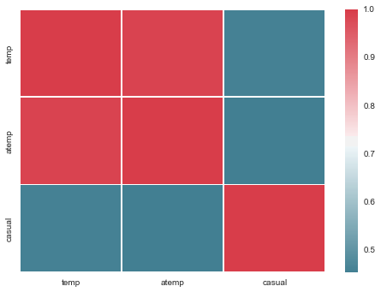
BIKE DATA EXAMPLE
We can look at a correlation matrix of our bike data.
Even if adding correlated variables to the model improves overall variance, it can introduce problems when explaining the output of your model.
What happens if we use a second variable that isn't highly correlated with temperature?

Slide 16
INTRODUCTION
SPECIAL CASES

Slide 17
SPECIAL CASES OF REGRESSION ANALYSIS
It’s possible for our model to be *too* complex.
If we have too many predictors, our model is going to make a special exception (i.e., accommodate) for too many data points.
These special exceptions mean that the predictions won’t hold in later predictions because the reasons the data were slightly off was because of random error (noise)

Slide 18
SPECIAL CASES OF REGRESSION ANALYSIS
Ideally, we want to model that penalizes complexity in the predictors
What is complexity:
L1 norm: The sum of the absolute value of the coefficients
L2 norm: The sum of the squared values of the coefficients

Slide 19
REGULARIZATION
These measures of complexity lead to the following
regularization techniques
L1 regularization: y = Σ βixi + ε such that Σ |βi | < α
L2 regularization: y = Σ βixi + ε such that Σ βi² < α
Regularization refers to the method of preventing overfitting by explicitly controlling model complexity.
λ is a hyperparameter, which tries to minimize the bias (how off the results are from the true values) and variance (how much the results vary)

Slide 20
SPECIAL CASES OF REGRESSION ANALYSIS
L1 Norm Regression = “Lasso Regression”
L2 Norm Regression = “Ridge Regression”
When to use either: situations where you have many correlated variables and not a lot of data.
When to use L1 norm:
When we have a small sample of data, but many features
When to use L2 regularization:
When we have larger samples of data and fewer features

Slide 21
CONCLUSION
TOPIC REVIEW

Slide 22
CONCLUSION
You should now be able to answer the following questions:
What is simple linear regression?
What makes multi-variable regressions more useful?
What challenges do they introduce?

Slide 23
WEEK 3 : LESSON 6
UPCOMING WORK

Slide 24
Lesson 8
UPCOMING WORK
Project: Final Project, Deliverable 1

Slide 25
INTRODUCTION TO REGRESSION ANALYSIS
Q & A

Slide 26
INTRODUCTION TO REGRESSION ANALYSIS
EXIT TICKET
http://tiny.cc/chi-ds

