Slide 1
STATISTICS FUNDAMENTALS
Ivan Hernandez, Ph.D

Slide 2
LEARNING OBJECTIVES
STATISTICS FUNDAMENTALS
Use Pandas libraries to analyze datasets using basic summary statistics: mean, median, mode, max, min, quartile, inter-quartile range, variance, standard deviation, and correlation
Identify a normal distribution within a dataset using summary statistics and visualization
ID variable types and complete dummy coding by hand
Understand Correlations

Slide 3
OPENING
STATISTICS FUNDAMENTALS

Slide 4
TODAY
We’re going to begin transitioning to the more statistical side of the workflow starting with exploratory analysis, then hypothesis testing, and then model building.
Today will be focused on exploratory analysis
The next class will focus on hypothesis testing
The class after will focus on models

Slide 5
INTRODUCTION
LAYING THE GROUND WORK

Slide 6
WE’RE GOING TO COVER SEVERAL TOPICS
Mean
Median
Mode
Max
Min
Quartile
Interquartile Range
Variance
Standard Deviation
Correlation

Slide 7
WE’RE GOING TO COVER SEVERAL TOPICS
Mean
Median
Mode
Max
Min
Quartile
Interquartile Range
Variance
Standard Deviation
Correlation
Where are the data points centered around?
How much does the data vary?
How much do two variables co-vary?

Slide 8
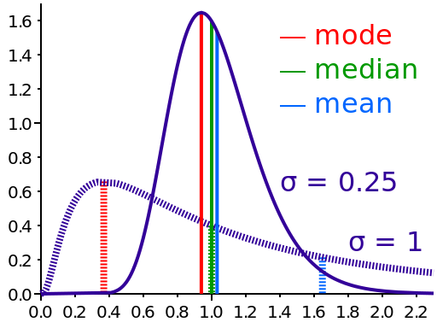
MEAN
The mean of a set of values is the sum of the values divided by the number of values. It is also called the average.
Add up the data points, and divide by how many numbers you added
Example: The mean of 1,2,3,4, 5 and 6 is
1 + 2 + 3 + 4 + 5 + 6
____________________
6

Slide 9
MEAN EXAMPLE
Find the mean of 19, 13, 15, 25, and 18.

Slide 10
MEAN EXAMPLE
Find the mean of 19, 13, 15, 25, and 18.
19 + 13 + 15 + 25 + 18 90
--------------------------- = ----- = 18
5 5

Slide 11
MEDIAN
The median refers to the midpoint in a series of numbers.
To find the median
Arrange the numbers in order smallest to
largest.
If there is an odd number of values, the
middle value is the median.
If there is an even number of values, the
average of the middle two values is the
median.

Slide 12
MEDIAN EXAMPLE
Find the median of 19, 29, 36, 15, and 20.

Slide 13
MEDIAN EXAMPLE
Find the median of 19, 29, 36, 15, and 20.
Ordered Values:
15, 19, 20, 29, 36
20 is the median

Slide 14
MEDIAN EXAMPLE
Find the median of 67, 28, 92, 37, 81, 75.

Slide 15
MEDIAN EXAMPLE
Find the median of 67, 28, 92, 37, 81, 75.
Ordered Values:
28, 37, 67, 75, 81, 92
67 and 75 are the middle values.
67 + 75 142
---------- = ------ = 71
2 2
71 is the median.

Slide 16
MODE
The mode of a set of values is the value that occurs most often.
A set of values may have more than one mode or no mode.
The mode is the number with the highest peak in a distribution

Slide 17
MODE EXAMPLE
Find the mode of 15, 21, 26, 25, 21, 23, 28, and 21.

Slide 18

MODE EXAMPLE
Find the mode of 15, 21, 26, 25, 21, 23, 28, and 21.
15 21 23 25 26 28
21 is the mode because it occurs most frequently

Slide 19
MODE EXAMPLE
Find the mode of 12, 15, 18, 26, 15, 9, 12, and 27.

Slide 20
MODE EXAMPLE
Find the mode of 12, 15, 18, 26, 15, 9, 12, and 27.
9 12 15 18 26 27
12 and 15 are the modes since the both occur twice.

Slide 21
MODE EXAMPLE
Find the mode of 4, 8, 15, 21, and 23.

Slide 22
MODE EXAMPLE
Find the mode of 4, 8, 15, 21, and 23.
4 8 15 21 23
There is no mode since all values occur the same number of times.

Slide 23

ACTIVITY: KNOWLEDGE CHECK
For the following groups of numbers, calculate the mean, median and mode by hand. Also determine the minimum and maximum.
18, 24, 17, 21, 24, 16, 29, 18
75, 87, 49, 68, 75, 84, 98, 92
55, 47, 38, 66, 56, 64, 44, 39
ANSWER THE FOLLOWING QUESTIONS (5 minutes)
EXERCISE
DELIVERABLE
Answers to the above questions

Slide 24
CODEALONG
SUMMARY STATISTICS IN PANDAS

Slide 25
CODING: CENTRAL TENDENCY
We can use Pandas to calculate the mean, median, mode, min, and max.
Methods available include: .min() - Compute minimum value .max() - Compute maximum value .mean() - Compute mean value .median() - Compute median value .mode() - Compute mode value .count() - Count the number of observations

Slide 26
INTRODUCTION
Variability

Slide 27
OVERVIEW
Three major variability measures:
Range
Interquartile range
Standard Deviation

Slide 28
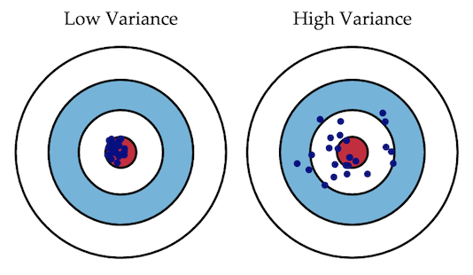
VARIABILITY
Variability: the extent to which these data points differ from each other

Slide 29
RANGE
The range is the how far apart the maximum value and minimum value are from each other for a variable
For example, consider the dataset [12,55,23,30,14]
The maximum value is 55 and the minimum is 12, so the range is 55-12 = 43
Strengths: Simple to calculate
Weakness:
Susceptible to outliers:
[12,55,23,30,14] [12,13,15,14,55] have the same range, but have very different spread

Slide 30
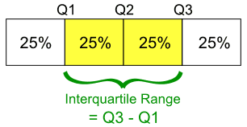
QUARTILES AND INTERQUARTILE RANGE
Quartiles divide a rank-ordered (sorted) data set into four equal parts.
The values that divide each part are called first, second, and third quartiles, denoted Q1, Q2, and Q3, respectively.
The interquartile range (IQR) is Q3 - Q1, a measure of variability.
Strengths: Less influenced by a
single extreme value
Weaknesses: Doesn’t use all of the data

Slide 31
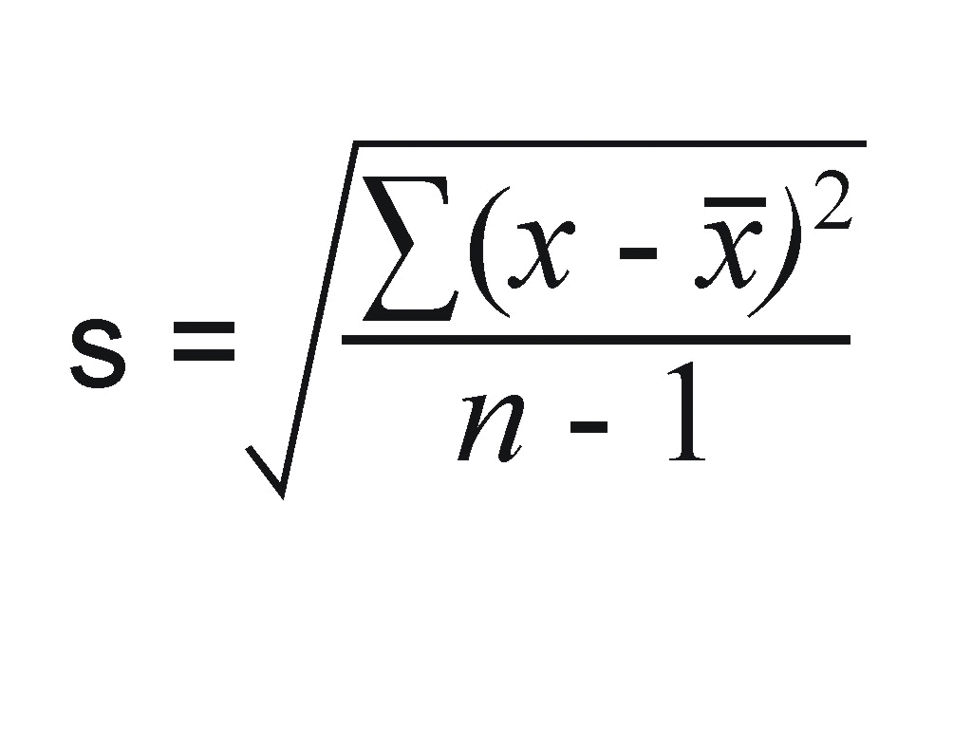
STANDARD DEVIATION
What you want to quantify how bunched together the data are?
Standard deviation (SD) is a measure that is used to quantify the amount of variation or dispersion of a set of data values.
Summarises the amount by which every value within a dataset varies from the mean.
Takes into account every variable in the dataset.
Standard deviation is the square root of variance.

Slide 32
STANDARD DEVIATION
Strengths:
Uses all of the data to calculate
Resistant against extreme values
Weakness:
Harder to explain
More complicated to calculate
Assumes a Normal Distribution

Slide 33
INTRODUCTION
Variability:
Outlier Detection

Slide 34
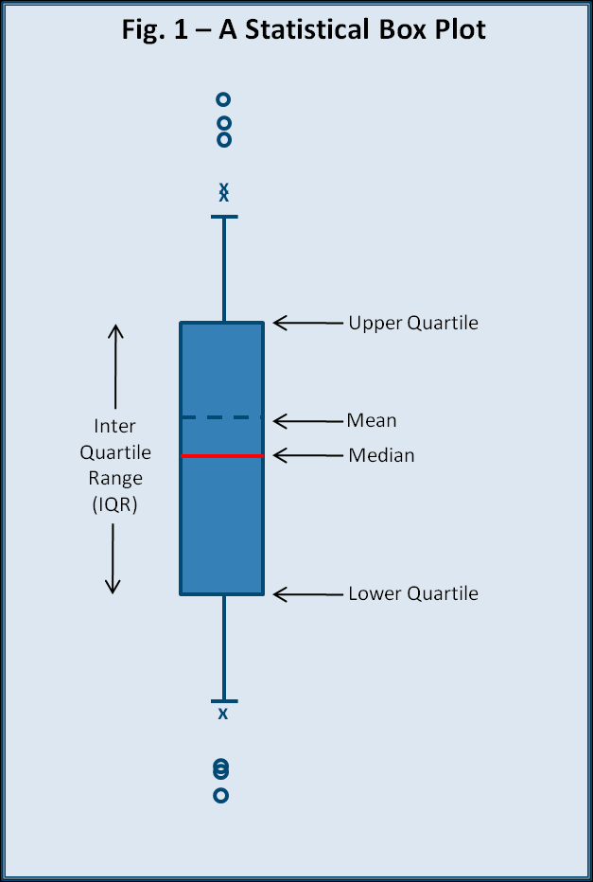
INTERQUARTILE RANGE & OUTLIERS
The interquartile range is often used to find outliers/anomalies in data.
Outliers are observations that fall below Q1 - 1.5(IQR) or above Q3 + 1.5(IQR).
In a boxplot, the highest and lowest occurring value within this limit are drawn as bar of the whiskers, and the outliers as individual points.

Slide 35
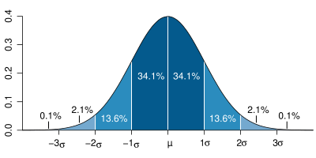
STANDARD DEVIATION & OUTLIERS
You can check for the presence of outliers using the standard deviation.
Observations more/less than 3 standard deviations away from the mean are often seen as anomalous.
Example: Data = [1,2,3,4,5,6,,8,9,10,11,12,99]
Mean = 13.62; SD = 27.04
Outliers < 13.62 - (3*27.04)
Outliers > 13.62 + (3*27.04)

Slide 36
OUTLIER DETECTION: GRUBB’S TEST
Formal test of outliers using the standard deviaiton
This test detects outliers from normal distributions.
Looks at the minimum and maximum values
Identifies samples that below a certain probability of belonging to the core population.
The test is based on the difference of the mean of the sample and the most extreme data considering the standard deviation

Slide 37
CODING STANDARD DEVIATION & VARIANCE
You can calculate variance and standard deviation easily in Pandas.
Methods include: .std() - Compute Standard Deviation .var() - Compute variance .describe() - short cut that prints out count, mean, std, min, quartiles, max

Slide 38
CONTEXT
For most projects, descriptive stats will come first. These help you get to know your dataset better.
Sometimes, descriptive stats may be all you need to answer your question.

Slide 39
INTRODUCTION
Distributions:
Normal

Slide 40
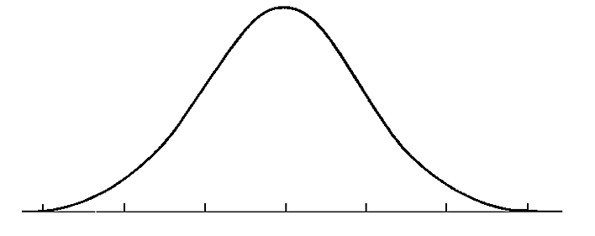
THE NORMAL DISTRIBUTION
A normal distribution is often a key assumption to many models.
The normal distribution depends upon the mean and the standard deviation.
The mean determines the center of the distribution. The standard deviation determines the height and width of the distribution.

Slide 41
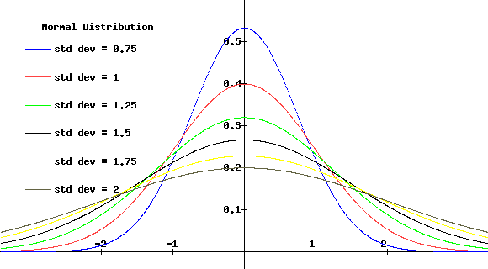
THE NORMAL DISTRIBUTION
Normal distributions are symmetric, bell-shaped curves.
When the standard deviation is large, the curve is short and wide.
When the standard deviation is small, the curve it tall and narrow.

Slide 42
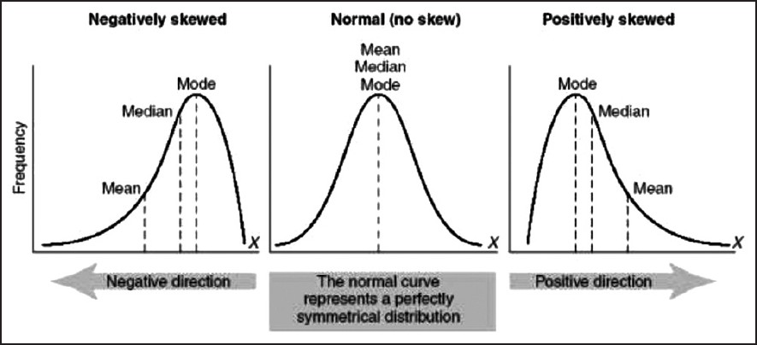
SKEWNESS
Skewness is a measure of the asymmetry of the distribution of a random variable about its mean.
Skewness can be positive or negative, or even undefined.

Slide 43
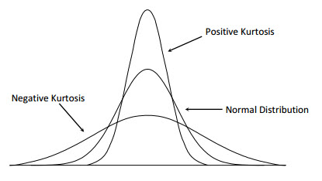
KURTOSIS
Kurtosis is a measure of whether the data are peaked or flat relative to a normal distribution.
Datasets with high kurtosis tend to have a distinct peak near the mean, decline rather rapidly, and have heavy tails.

Slide 44
INTERESTING PROPERTIES ABOUT THE NORMAL DISTRIBUTION
The Empirical Rule (66-95-99 rule):
68% of the values will be within one standard deviation of the mean
95% of the values will be within two standard deviations of the mean
99.7% of the values will be within three standard deviations of the mean

Slide 45
INTERESTING PROPERTIES ABOUT THE NORMAL DISTRIBUTION
Rule of Thumb for Estimating Standard Deviation:
Std. dev ≈ Range / 4
If the smallest value someone gave on your variable is 20, and the largest value someone reported is 60, then the range in 60-20=40
Therefore, the standard deviation should be approximately to 40/4 = 10

Slide 46
INTRODUCTION
VARIABLE TYPES

Slide 47
VARIABLE TYPES
Numeric variables can take on a large range of non-predetermined, quantitative values. These are things such as height, income, etc.
Categorical variables can be represented as non-numeric descriptors and do not have any quantitative value relative to each other. These are things such as race, gender, paint colors, movie titles, etc.
Although, categorical variables do not have any natural numeric value, the algorithms used to fit models often require all variables to be specified as numbers.

Slide 48
CLASS/DUMMY VARIABLES
Let’s say we have the categorical variable area, which takes on one of the following values: rural, suburban, and urban.
We need to represent these numerically for a model. So how do we code them?

Slide 49
CLASS/DUMMY VARIABLES
How about 0=rural, 1=suburban, and 2=urban?

Slide 50
CLASS/DUMMY VARIABLES
But this implies an ordered relationship - is urban twice suburban? That doesn’t make sense.
However, we can represent this information by converting the one area variable into two new variables: area_urban and area_suburban.

Slide 51
CLASS/DUMMY VARIABLES
We’ll draw out how categorical variables can be represented without implying order.
First, let’s choose a reference category. This will be our “base” category.
It’s often good to choose the category with the largest sample size and a criteria that will help model interpretation. If we are testing for a disease, the reference category would be people without the disease.

Slide 52
CLASS/DUMMY VARIABLES
Step 1: Select a reference category. We’ll choose rural as our reference category.
Step 2: Convert the values urban, suburban, and urban into a numeric representation that does not imply order.
Step 3: Create two new variables: area_urban and area_suburban.

Slide 53
CLASS/DUMMY VARIABLES
Why do we need only two dummy variables?
We can derive all of the possible values from these two. If an area isn’t urban or suburban, we know it must be rural
Another example: If you have two categories (male and female), you only need 1 dummy variable to represent the information.
It’s redundant to have one variable representing male and another representing female
In general, if you have a categorical feature with k categories, you need to create k-1 dummy variable to represent all of the information.
rural | urban | suburban

Slide 54
CLASS/DUMMY VARIABLES
Let’s see our dummy variables.
As mentioned before, if we know area_urban=0 and area_suburban=0, then the area must be rural.
 | area_urban | area_suburban
rural | 0 | 0
suburban | 0 | 1
urban | 1 | 0

Slide 55
CLASS/DUMMY VARIABLES
We can do this for a department variable with four categories: sales and accounting and HR and marketing.
How many dummy variables need to be created?

Slide 56
CLASS/DUMMY VARIABLES
# of categories - 1 = 4 -1 = 3

Slide 57
INTRODUCTION
CORRELATION

Slide 58
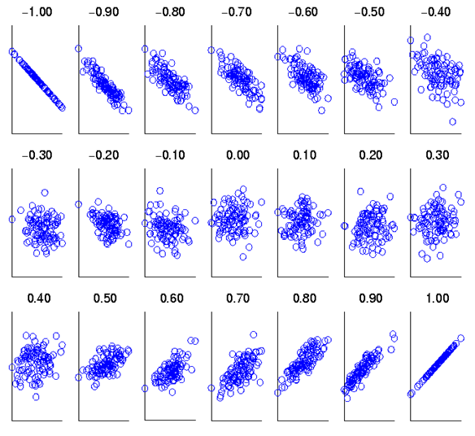
CORRELATION: PROPERTIES
Measures how well a straight line fits the data
A way of quantifying the strength of linear association between two variables

Slide 59
CORRELATION: PROPERTIES
The value of a correlation coefficient ranges between -1 and 1.
The greater the absolute value of a correlation coefficient, the stronger the linear relationship.
The strongest linear relationship is indicated by a correlation coefficient of -1 or 1.
The weakest linear relationship is indicated by a correlation coefficient equal to 0.
A positive correlation means that if one variable gets bigger, the other variable tends to get bigger.
A negative correlation means that if one variable gets bigger, the other variable tends to get smaller.

Slide 60
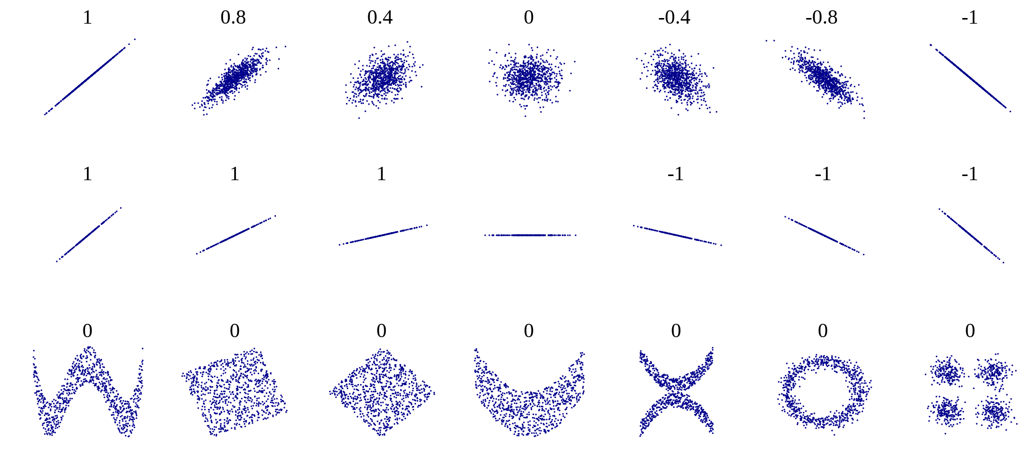
CORRELATION
Keep in mind that the Pearson product-moment correlation coefficient only measures linear relationships. Therefore, a correlation of 0 does not mean zero relationship between two variables; rather, it means zero linear relationship

Slide 61
CONCLUSION
REVIEW

Slide 62
REVIEW
Measures of Central Tendency
Measures of Variability
Applying variability and distributions to detect outliers
Correlations

Slide 63
COURSE
BEFORE NEXT CLASS

Slide 64
DUE DATE: 7/5
BEFORE NEXT CLASS
Project: Unit Project 1

Slide 65
LESSON
Q & A

Slide 66
LESSON
EXIT TICKET
http://tiny.cc/chi-ds

