Slide 1
STATISTICS FUNDAMENTALS, PART 2
Ivan Hernandez, Ph.D

Slide 2
LEARNING OBJECTIVES
STATISTICS FUNDAMENTALS, PART 2
Explain how to examine common statistical questions
Conduct inferential statistical analysis in Python and Pandas

Slide 3
COMMON STATISTICAL QUESTIONS
You collect some data, and you want to answer some questions
What is the true mean of my sample?
Is there a different between the true mean of two different samples of data
Is there a linear relationship between two variables?
Are my data from a specific distribution?

Slide 4
INTRODUCTION
TESTING THE MEAN OF A SAMPLE

Slide 5
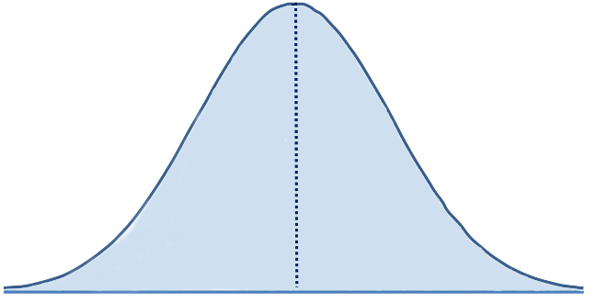
TESTING THE MEAN OF A SAMPLE
Imagine you collected/sampled data from a population
You know what the mean of that sample is.
But you want to know if that mean of the *population* from which the sample was drawn is greater (or less)
than a specific value
For example: Is the average
product evaluation score
greater than 50?
45 50 55 60 65 70 75 80 85 90 95

Slide 6

TESTING THE MEAN OF A SAMPLE
Because your sample is just a small part of the population, we can’t just look at the average of the sample, and say that that value applies to the population.
Populations that have a mean below 50, can also produce samples that have mean above 50.
Imagine that the distribution on the right
was the actual population.
It has a true mean of 40
10 15 20 25 30 35 40 45 50 55 60 65

Slide 7
TESTING THE MEAN OF A SAMPLE
We *could* randomly draw a sample our data from this population and still get a mean of 50.
It would be unlikely, but if you did enough random samples (of let’s say 10 data points), you could get: 39,43,62, 55, 59, 45, 59, 29, 49, 60
The mean of those points is 50,
even though the true mean of the
Distribution where they originate
is 40.
Therefore, we have to quantify the
certainty we have about what the
real population mean of a sample is
10 15 20 25 30 35 40 45 50 55 60 65

Slide 8
CONFIDENCE INTERVALS
A point estimate, like the mean, by itself is of limited usefulness
Does not reveal the uncertainty associated with the estimate;
You do not have a good sense of how far this sample mean may be from the population mean.
For example, can you be confident that the population mean is within 5 points of 50? You simply do not know.
Confidence intervals allow us to specify how certain or uncertain we are of the possible range of the population mean

Slide 9
CONFIDENCE INTERVALS
A Confidence Interval is set of two numbers that define the lower and upper limit for what our population mean is likely to be.
Example: A 95% confidence interval for our data 39,43,62, 55, 59, 45, 59, 29, 49, 60 is
[42.5 , 55.5]
Specifically, if we repeatedly sampled the population and made intervals for each sample, 95% of those intervals would contain the population mean.
Alternative interpretation: 95% of the time, when we calculate a confidence interval in this way, the true mean will be between the two values. 5% of the time, it will not.
Simple Interpretation: “We are 95% confident that the mean score of our population is between 42.5 and 55.5

Slide 10
CONSTRUCTING CONFIDENCE INTERVALS
Traditionally, confidence intervals were constructed by assuming a normal symmetric distribution and using the mean and standard deviation of the sample to infer from a normal distribution what the distribution of sample means is.
A more modern approach is to not assume a specific distribution, but instead use the distribution of the observed data to figure out the distribution of sample means.
Method:
1) Take your data and draw a random sample with replacement equal to the sample size of your sample.
2) Then calculate the test statistic (e.g., mean) from the random sample.
3) Repeat steps 1 and & 2 10,000 times and you will have a distribution of means.
4) Sort all of the test statistics you computed and see what value 95% of the test statistics are greater than and 5% are less than
5) These values represent the range of mean values you could expect to observe from your population 95% of the time.

Slide 11
CODING DEMONSTRATION

Slide 12
INTRODUCTION
COMPARING THE MEAN OF TWO SAMPLES

Slide 13
TESTING THE MEAN OF A SAMPLE
Imagine you collected data from two samples (men and women)
You know what the mean of each sample is:
But you want to know if the mean of the *population* from which the one sample was drawn is greater (or less)
than the mean of the population
from the other sample
For example: Is the average
product evaluation score
Greater for men than for women?
20 25 30 35 40 45 50 55 60 65 70 75 80 85 90 95

Slide 14
COMPARING THE MEAN OF TWO SAMPLES
Just as you could bootstrap a confidence interval for the mean of a sample, you can bootstrap a confidence interval for *each* sample and compare.
If the confidence interval for the two samples overlap, then it implies that there is a certain probability of the two samples sharing the same underlying population with equal means.
95% CI for Men: [35.27, 45.40]
95% CI for Women: [48..33, 53.25]
We are 95% confident that the average rating for men is different than the average rating for females

Slide 15
SPECIAL CASE: PAIRED DATA
Your two groups might not be independent, but drawn from the same people each time.
Example: Before & After Data
Therefore, you are interested not in the difference between the two group’s mean, but on the average difference for each person.
You would construct a confidence interval around the data representing the difference.
Would provide an estimate for the variability of the mean difference
User | Weight at Time 1 | Weight at Time 2 | Difference Time2- TIme1
Mark | 160 | 161 | +1
Roger | .180 | 190 | +10
Mimi | 125 | 120 | -5
Angel | 140 | 120 | -20
Tom | 200 | 202 | +2
Joanne | 157 | 157 | 0
Benny | 225 | 215 | -10
Maureen | 136 | 134 | -2

Slide 16
SPECIAL CASE: PAIRED DATA
Your two groups might not be independent, but drawn from the same people each time.
Example: Before & After Data
Therefore, you are interested not in the difference between the two group’s mean, but on the average difference for each person.
You would construct a confidence interval around the data representing the difference.
Would provide an estimate for the variability of the mean difference
User | Weight at Time 1 | Weight at Time 2 | Difference Time2- TIme1
Mark | 160 | 161 | +1
Roger | .180 | 190 | +10
Mimi | 125 | 120 | -5
Angel | 140 | 120 | -20
Tom | 200 | 202 | +2
Joanne | 157 | 157 | 0
Benny | 225 | 215 | -10
Maureen | 136 | 134 | -2

Slide 17
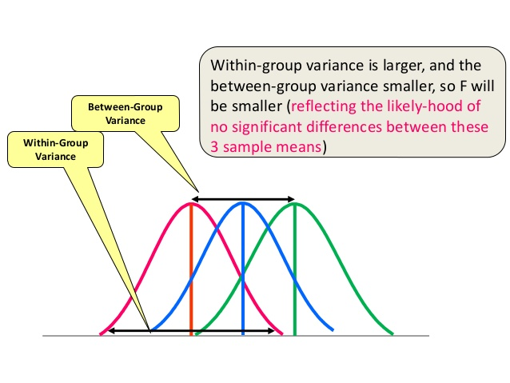

SPECIAL CASE: MULTIPLE INDEPENDENT GROUPS
If you have more than two independent groups you want to compare, and you just want to know if there is an *overall* difference between groups, you would use an F-test
F statistic = variability between group means / variability within groups
F statistic larger than 1 indicates more between group variability than within group variability
F statistic smaller than 1, indicates that groups differ more within themselves than between themselves

Slide 18
INTRODUCTION
EVALUATING CORRELATIONS

Slide 19
CORRELATION OVERVIEW
The Pearson correlation coefficient, r, can take a range of values from +1 to -1.
A value of 0 indicates that there is no linear association between the two variables.
A value greater than 0 indicates a positive linear association; that is, as the value of one variable increases, so does the value of the other variable at a constant rate.
A value less than 0 indicates a negative linear association; that is, as the value of one variable increases, the value of the other variable decreases at a constant amount.

Slide 20
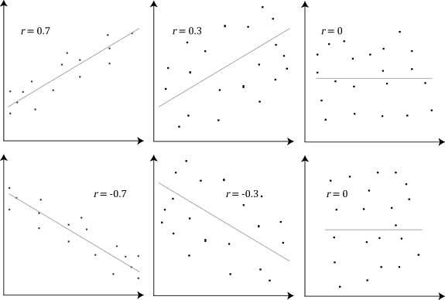
CORRELATION OVERVIEW; EXAMPLES

Slide 21
EVALUATING CORRELATIONS
You might want to have a sense of range of the true correlation values for the underlying population between you variables
You can construct confidence intervals around your correlation coefficient.
Will tell you what kind of variability your correlation coefficient will have

Slide 22
CORRELATION LIMITATIONS
Only tests for constant linear relationship
Increasing the predictor by 1 unit will always lead to the same unit increase in the outcome
Some relationships between variables may be that if you increase the level of one variable, the other variable also increases, but not the same amount of increase each time
Does not assess causality
Causality can only established if you know that X came before Y
- Addressed by longitudinal data
Third Variable Problem: There could be other explanations that cause X and cause Y
- Example: Correlation between Ice Cream consumption and Crime.

Slide 23
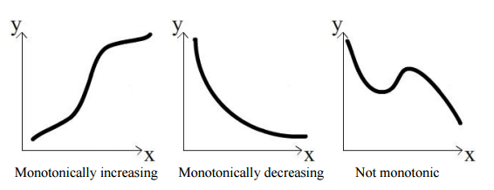
EXAMINING NON-LINEAR RELATIONSHIIPS
You may be interested only in the monotonic relationship
As one variable increases does the variable also tend to increase/decrease
You only care about upwards or downward changes in the outcome variable
It’s okay that you don’t know the exact amount the other variable will increase or decrease as the predictor changes
Spearman’s rho is a correlation that examines that monotonic relationship:
Useful when your data are ranks or only have order information, but not precise values

Slide 24
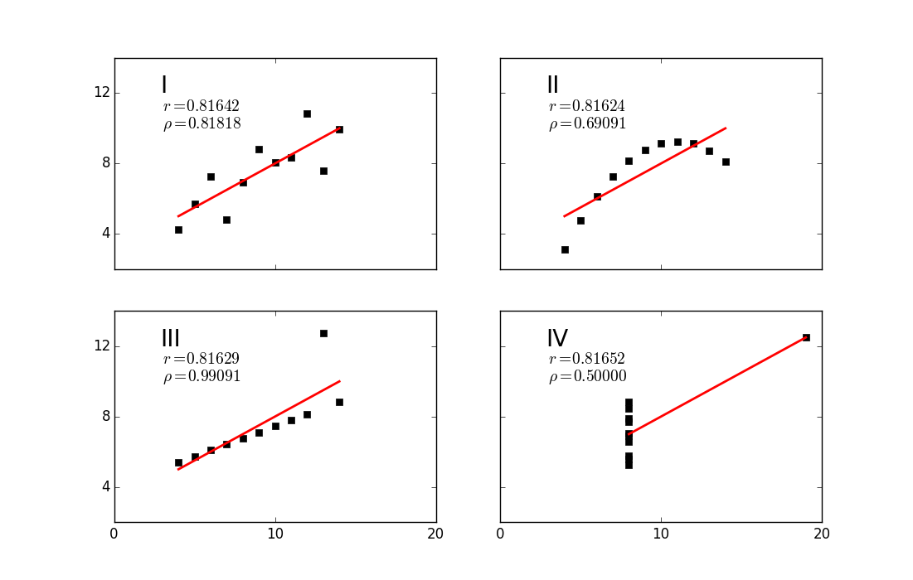
EXAMINING NON-LINEAR RELATIONSHIIPS
Pearson’s r
vs.
Spearman’s rho

Slide 25
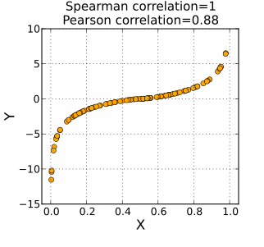
EXAMINING NON-LINEAR RELATIONSHIIPS

Slide 26
THIRD VARIABLE PROBLEM
Example: Correlation between Ice Cream consumption and Crime.
Positive correlation
When Ice Cream consumption increases, Crime increases.
Can’t say that Ice Cream consumption causes Crime.
-There is a third variable that seems plausible for the main cause of Crime, which would also increase Ice Cream Consumption at the same time.
-Heat / Ambient Temperature
How can you show that the relationship between Ice Cream and Heat can be fully explained by the relationship between Heat and Ice Cream and Heat and Crime?
-Vice versa: How can you show that the relationship between Heat and Crime is not explained by a third variable: Ice Cream Consumption?

Slide 27
PARTIAL CORRELATION
Partial correlation is a method used to describe the relationship between two variables whilst taking away the effects of another variable, or several other variables, on this relationship
A variable may correlate (have variance that overlaps) with another variable
Some of that overlap can be attributable to another variable
Notice how the overlap between Ice Cream Consumption and Crime, can be completed accounted for by the overlap between Heat and Crime
Crime Rate
Ice Cream
Consumption
Heat
Crime Rate
Ice Cream
Consumption

Slide 28
PARTIAL CORRELATION
Partial Correlations are used when you want to rule out another variable(s) as explanations for the reason why one variable is correlated with another.
Taking into account the effect that another variable has on an outcome is called controlling for that variable.
Control variables are also called covariates
Partial correlation will provide a correlation coefficient that removes the common effect of another variable(s) on X and Y
Example: Partial correlation between Ice Cream and Crime controlling for Heat, says what is the correlation between Ice Cream and Crime when I remove the overlap that both shared with Heat.

Slide 29
CODING DEMONSTRATION

Slide 30
MEDIATION
What if you wanted to show that the reason one variable (X) influences another variable (Y) is because of third variable (M)?
You would want to do mediation analysis: Show the percentage of the relationship between X and Y that is explained by how X is related to M and M is related to Y, when you control for X

Slide 31
MEDIATION
What if you wanted to show that the reason one variable (X) influences another variable (Y) is because of third variable (M)?
You would want to do mediation analysis: Show the percentage of X -> Y that is explained by the relationships X->M and M->Y
M
X
Y

Slide 32
MEDIATION
What if you wanted to show that the reason one variable (X) influences another variable (Y) is because of third variable (M)?
You would want to do mediation analysis: Show the percentage of X -> Y that is explained by the relationships X->M and M->Y
Average
Income
Housing Prices
Sales

Slide 33
MEDIATION
Two useful things you can do with mediation analysis
Describe the amount of mediation
The amount of mediation is called the indirect effect: a * b
The indirect effect equals the reduction of the effect of the causal variable on the outcome or ab = c - c'.
Want the indirect effect to be big (not zero)
2) Describe the proportion of the effect of X on Y that is explained by the indirect effect: ab/c
a
b
M
c
X
Y
c’
a: correlation from X to M
b: correlation from X to Y controlling for X
c: correlation from X to Y
c’ : correlation between
X and Y controlling for M

Slide 34
INTRODUCTION
WHAT IS MY SAMPLE’S DISTRIBUTION

Slide 35
TESTING IF A SAMPLE MATCHES A SPECIFIC DISTRIBUTION
Imagine you collected a sample of data from a population.
You might have some technique that requires a specific distribution, or you might need to know if it matches the distribution you expect.
Therefore, you need to conduct a test for distributions.
The specific test you use depends on whether the distribution you are interested in testing is “CONTINUOUS” or “DISCRETE”

Slide 36
CONTINUOUS VS DISCRETE DISTRIBUTIONS
Data are continuous (real numbers)
Quantitative Measurements
Data that can be decimals
Ideally, data that can range from –infinity to +infinity
Data that are discrete
Categories
Data that can only be described in a few whole numbers
Counts

Slide 37
TYPES OF DISCRETE DISTRIBUTIONS
Binomial: Describes probabilities of the number of successes over a given number of trials with a specified probability of success in each try.
Example: Coin flips, Getting questions right on a test
Poisson: Describes the likelihood of a number of events occurring in a given time interval
Example: Counts (of calls received by a call center)
Negative Binomial (Right-skewed Counts): Describe the number of tries you will have before you reach the specified number of successes
Example:
Uniform: Describes probability of multiple possible outcomes that are all equally likely to occur.
Example: Lotto Numbers

Slide 38
TYPES OF CONTINUOUS DISTRIBUTIONS
Normal / Gaussian: There is a strong tendency for the data to take on a central value. Positive and negative deviations from this central value are equally likely The frequency of the deviations falls off rapidly as we move further away from the central value.
Example: Heights of adults in a population
Weibull: When data can take on the characteristics of variety of distributions.
Example : modeling reliability (time to first failure) of devices with decreasing failure rate, constant failure rate, or increasing failure rate

Slide 39
TESTING A DISCRETE DISTRIBUTION
Discrete distributions have distinct categories
Example: Lotto Numbers selected can be 1, 2, 3,...,50
In your sample, you observed a proportion of events falling into each category
Example: .025 of the winning lotto numbers are 1. .019 of the winning lotto numbers are 2, etc.
Depending on the underlying distribution, we have an expected proportion of cases falling into each category
Example: Uniform distribution says that all numbers are equally likely, and therefore have 1/50 chance of occurring
You want to test whether the observed proportions are different from the expected proportions
Number | Observed Proportion | Expected Proportion
1 | .025 | .02
2 | .019 | .02
3 | .022 | .02
4 | .018 | .02
5 | .022 | .02
6 | .020 | .02
… | … | …
49 | .022 | .02
50 | .019 | .02

Slide 40

TESTING A DISCRETE DISTRIBUTION
Chi-Square Goodness of Fit-test
Calculate the difference between the
observed and expected proportions for
each category
Compare the Chi-squared value to a Chi-square distribution where the values are independently distributed
Small p-value (less than .05) indicates that distributions are different
Big p-value (greater than .05) indicates that distributions are similar
Number | Observed Proportion | Expected Proportion
1 | .025 | .02
2 | .019 | .02
3 | .022 | .02
4 | .018 | .02
5 | .022 | .02
6 | .020 | .02
… | … | …
49 | .022 | .02
50 | .019 | .02

Slide 41
EXAMPLE: TESTING A DISCRETE DISTRIBUTION
Benford’s law: The distribution of the leading digit of numbers follows a specific pattern of proportions (see table)
We can compare the leading digit of accounting records and compare the proportion of the 1s, 2s, 3s, 4s, etc. to what their expected proportion should be.
Leading Digit | Proportion of all Cases
1 | 0.30103000
2 | 0.17609126
3 | 0.12493874
4 | 0.09691001
5 | 0.07918125
6 | 0.06694679
7 | 0.05799195
8 | 0.05115252
9 | 0.04575749

Slide 42
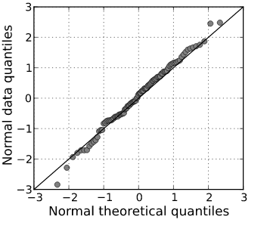
TESTING A CONTINUOUS DISTRIBUTION
Continuous distributions have numeric values across a wide range
Example: Income can range from 0 to billions
In your sample, you observed a proportion of the data falling into quantiles
Example: Incomes between $0 and $30,000 are in the first quantile.
Depending on the underlying distribution, we have an expected proportion of the data falling into the each quantile
Example: Normal distribution says a certain amount of data should be within 1 standard of the mean
You want to test whether the observed quantiles of data are different from the expected quantiles

Slide 43
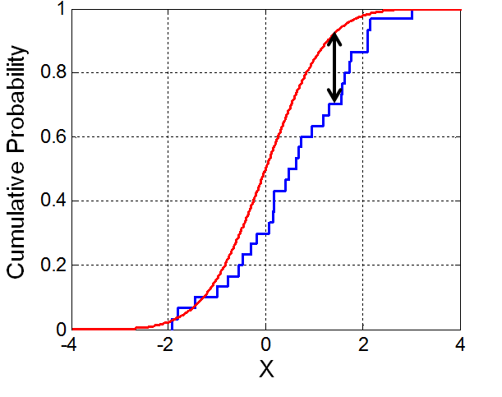
TESTING A CONTINUOUS DISTRIBUTION
Kolmogorov-Smirnoff (k-S) Test
Calculate the difference between the empirical distribution function of the sample and the
cumulative distribution function of the distribution
Of interest
Compare the maximum difference value to the Kolmogorov distribution
Small p-value (less than .05) indicates that distributions are different
Big p-value (greater than .05) indicates that distributions are similar

Slide 44
EXTENSION: KOLMOGOROV-SMIRNOFF TEST
The K-S test can also test whether two samples come from the same distribution
You may want to know whether the distribution between offices is the same or if they are different

Slide 45
LESSON
EXIT TICKET
http://tiny.cc/chi-ds

