Slide 1
EVALUATING MODEL FIT
Ivan Hernandez, Ph.D

Slide 2
LEARNING OBJECTIVES
EVALUATING MODEL FIT
Evaluate model fit using loss functions
Select regression methods based on fit and complexity

Slide 3
PRE-WORK REVIEW
Understand the linear regression method for prediction
Implement a sklearn estimator to predict a target variable

Slide 4
OPENING
RESIDUALS AND R-SQUARES

Slide 5
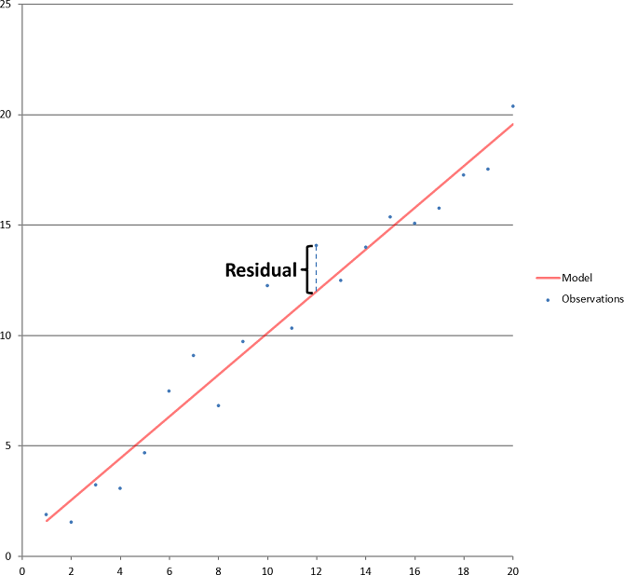
WHAT IS A RESIDUAL?
A residual is the difference between how off you were from your prediction and the actual data point.
The vertical distance between a point and the prediction line

Slide 6
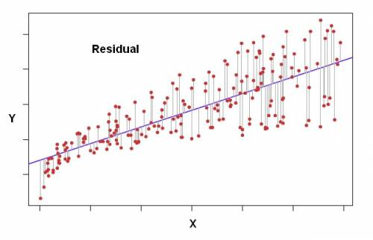
WHAT IS A RESIDUAL?

Slide 7
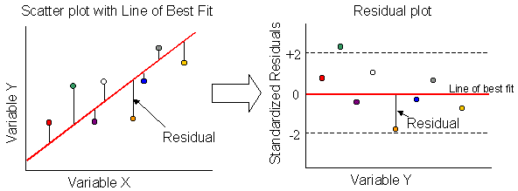
RESIDUAL PLOT

Slide 8
RESIDUALS AND FIT
If our model’s predictions (the straight line) fit the data well, then the residuals should be small (close to 0)
If the predictions are way off from the actual data, then all of the residuals should be large.
The residuals represent how well we’ve explained our outcome (error).
Because the size of the residuals depend on the scale of our outcome and predictors, data scientists sometimes express fit as a percentage:
The percentage of an outcome’s variation that your model has explained

Slide 9
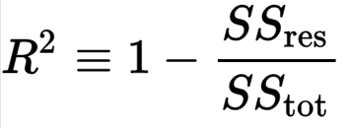
WHAT IS R-SQUARED?
R²: the proportion of the variance (fluctuation) of one variable that is predictable from the other variable.
R-squared, the central metric introduced for linear regression

Slide 10
WHAT IS R-SQUARED? WHAT IS A RESIDUAL?
The outcome data has variation (points are not all of the same)
You have a line that tries to explain why the outcome is sometimes high and sometimes low,
How good your line can explain that variation is measured by the residuals. If your predictions are never off from the real data, then sum of the residuals is 0

Slide 11
WHAT IS R-SQUARED?
Therefore, we can express the amount of variance in your outcome explained by your model as fraction
Variance explained in Y / total variance Y
Or
1 – (Residual Error in Prediction / Total Variance in Y)

Slide 12
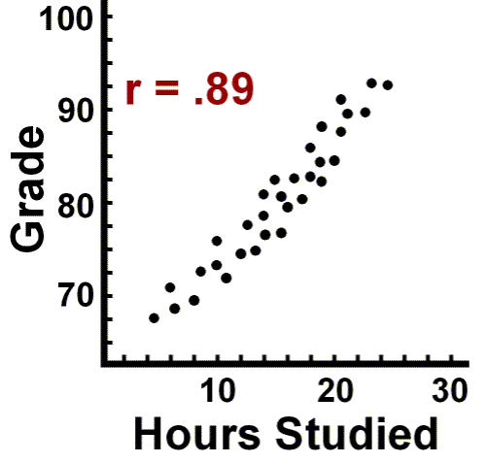
WHAT IS R-SQUARED?
R² is the correlation (r) squared when only using one predictor
Example
r = .89
R² = .89^2 = .7921
79.21% of the variance in grades is explained by its relationship to hours studied

Slide 13

ACTIVITY: KNOWLEDGE CHECK
ANSWER THE FOLLOWING QUESTIONS (1 minutes)
EXERCISE
Given what you know about R2, what would be the range of possible values it can take? R² can range between ___ and ____
Will the R² potentially increase or decrease when another predictor variable is added?
Will adding another predictor to the model that is perfectly correlated with another predictor already in the model, increase the R²?
DELIVERABLE
Answers to the above questions

Slide 14
INTRODUCTION
LINEAR MODELS AND ERROR

Slide 15
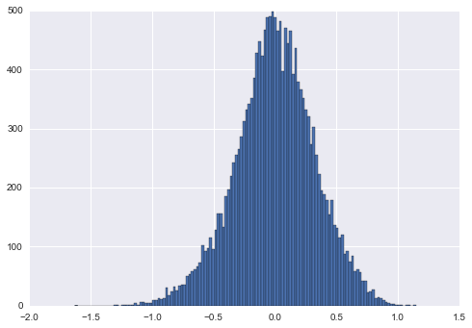
RECALL: WHAT’S RESIDUAL ERROR?
In linear models, residual error must be normal with a median close to zero.
Individual residuals are useful to see the error of specific points, but it doesn’t provide an overall picture for optimization.
We need a metric to summarize the error in our model into one value: What do the residuals tend to be in general?
Mean square error: the mean residual error squared in our model

Slide 16
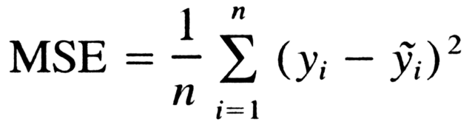
MEAN SQUARED ERROR (MSE)
To calculate MSE:
Calculate the difference between each target y and the model’s predicted value y-hat (i.e. the residual)
Square each residual.
Take the mean of the squared residual errors.

Slide 17
MEAN SQUARED ERROR (MSE)
sklearn’s metrics module includes a mean_squared_error function.
from sklearn import metrics metrics.mean_squared_error(y, model.predict(X))

Slide 18
MEAN SQUARED ERROR (MSE)
For example, two arrays of the same values would have an MSE of 0.
from sklearn import metrics metrics.mean_squared_error([1, 2, 3, 4, 5], [1, 2, 3, 4, 5])
0.0

Slide 19
MEAN SQUARED ERROR (MSE)
Two arrays with different values would have a positive MSE.
from sklearn import metrics metrics.mean_squared_error([1, 2, 3, 4, 5], [5, 4, 3, 2, 1]) # (4^2 + 2^2 + 0^2 + 2^2 + 4^2) / 5
8.0

Slide 20
MEAN SQUARED ERROR (MSE)
sklearn’s metrics module includes a mean_squared_error function.
from sklearn import metrics metrics.mean_squared_error(y, model.predict(X))

Slide 21

ROOT MEAN SQUARED ERROR (RMSE)
RMSE: square root of the variance of the residuals.
It indicates the absolute fit of the model to the data–how close the observed data points are to the model’s predicted values.
Benefit: RMSE can be interpreted as the standard deviation of the unexplained variance

Slide 22
ROOT MEAN SQUARED ERROR (RMSE)
sklearn’s metrics module DOES NOT include a root_mean_squared_error function.
from sklearn import metrics np.sqrt(metrics.mean_squared_error(y, model.predict(X)))
or
metrics.mean_squared_error(y, model.predict(X))**0.5

Slide 23
ACTIVITY: KNOWLEDGE CHECK
ANSWER THE FOLLOWING QUESTIONS (2 minutes)
EXERCISE
Which of the following scenarios would be better for a weatherman?
Knowing that I can very accurately “predict" (only off by 2 degrees) the temperature outside from previous days perfectly, but be 20-30 degrees off for future days
Knowing that I can somewhat accurately “predict” the general trend of the temperate outside from previous days, and be at most only 10 degrees off on future days
DELIVERABLE
Answers to the above question

Slide 24
DEMO
CROSS VALIDATION

Slide 25
HOW DO WE MINIMIZE ERROR?
The regression method we’ve used is called “Ordinary Least Squares”.
This means that given a matrix X, solve for the least amount of reisdual error for y.
However, this assumes that X is unbiased, that it is representative of the population.
What if our dataset isn’t perfectly representative of the population?
The relationships between the Xs and Y aren’t exactly as they are in the real world
How does that affect our coefficients?

Slide 26
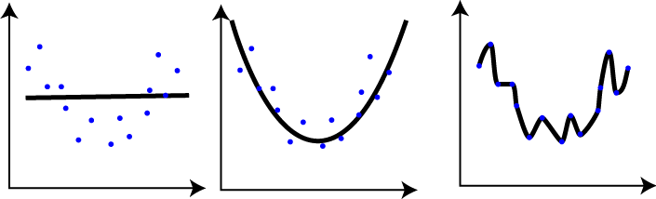
WHAT IS OVERFITTING?
The first model poorly explains the data.
The second model explains the general curve of the data.
The third model drastically overfits the model, bending to every point.
How do you know if you’ve gone too far with fitting the model?

Slide 27
CROSS VALIDATION
Cross validation can help prevent overfitting.
The general idea is to
Generate several models on different cross sections of the data
Measure the performance of each
Take the mean performance
This technique swaps bias error for generalized error, describing previous trends accurately enough to extend to future trends.

Slide 28
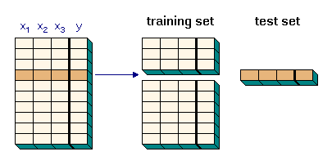
CROSS VALIDATION

Slide 29
K-FOLD CROSS VALIDATION
k-fold cross validation
Split the data into k group
Train the model on all segments except one
Test model performance on the remaining set
If k = 5, split the data into five segments and generate five models.

Slide 30
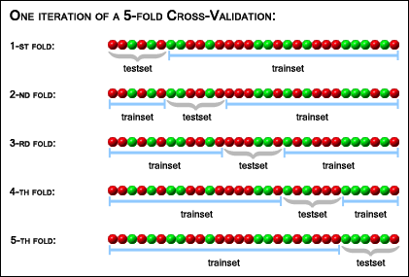
K-FOLD CROSS VALIDATION

Slide 31
GUIDED PRACTICE
CROSS VALIDATION WITH LINEAR REGRESSION

Slide 32
ACTIVITY: CROSS VALIDATION WITH LINEAR REGRESSION
DIRECTIONS (20 minutes)
EXERCISE
If we were to continue increasing the number of folds in cross validation, would error increase or decrease?

Slide 33
INTRODUCTION
REGULARIZATION AND CROSS VALIDATION

Slide 34
WHAT IS REGULARIZATION? AND WHY DO WE USE IT?
Regularization is an additive approach to protect models against overfitting (being potentially biased and overconfident, not generalizing well).
Regularization becomes an additional weight to coefficients, shrinking them closer to zero.
L1 (Lasso Regression) adds the extra weight to coefficients.
L2 (Ridge Regression) adds the square of the extra weight to coefficients.
Use Lasso when we have more features than observations (k > n) and Ridge otherwise.

Slide 35
INTRODUCTION
MINIMIZING LOSS THROUGH GRADIENT DESCENT

Slide 36
GRADIENT DESCENT
Gradient Descent can also help us minimize error.
How Gradient Descent works:
A random linear solution is provided as a starting point
The solver attempts to find a next “step”: take a step in any direction and measure the performance.
If the solver finds a better solution (i.e. lower MSE), this is the new starting point.
Repeat these steps until the performance is optimized and no “next steps” perform better. The size of steps will shrink over time.

Slide 37
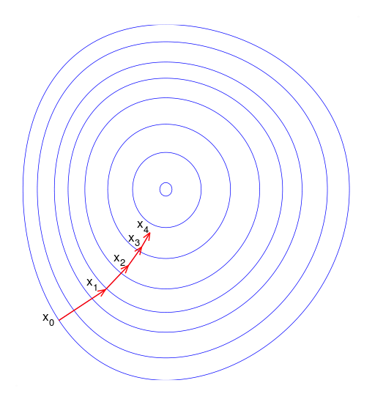
GRADIENT DESCENT

Slide 38
APPLICATION OF GRADIENT DESCENT
Gradient Descent works best when:
We are working with a large dataset. Smaller datasets are more prone to error.
Data is cleaned up and normalized.
Gradient Descent is significantly faster than OLS. This becomes important as data gets bigger.

Slide 39
APPLICATION OF GRADIENT DESCENT
We can easily run a Gradient Descent regression.
Note: The verbose argument can be set to 1 to see the optimization steps.
lm = linear_model.SGDRegressor() lm.fit(modeldata, y) print lm.score(modeldata, y) print metrics.mean_squared_error(y, lm.predict(modeldata))
Untuned, how well did gradient descent perform compared to OLS?

Slide 40
INDEPENDENT PRACTICE
ON YOUR OWN

Slide 41
CONCLUSION
TOPIC REVIEW

Slide 42
COURSE
BEFORE NEXT CLASS

Slide 43
DUE DATE
BEFORE NEXT CLASS
Homework:
Project: Final Project, Deliverable 1

Slide 44
LESSON
EXIT TICKET
http://tiny.cc/chi-ds

