Slide 1
INTRO TO CLASSIFICATION
Ivan Hernandez, Ph.D

Slide 2
LEARNING OBJECTIVES
INTRO TO CLASSIFICATION
Define class label and classification
Create a classification model with K-Nearest Neighbors
Evaluate and tune model by using metrics such as classification accuracy/error

Slide 3
OPENING
INTRO TO CLASSIFICATION

Slide 4
INTRO TO CLASSIFICATION
So far, we’ve worked primarily with regression problems.
Regression = predicting a continuous outcome
That means we’ve been able to use distance from our predicted values and the actual values to measure how accurate our prediction is.
However, for other problems, we need to predict binary responses. E.g.: A loan will default or it won’t. An email is spam or isn’t spam.

Slide 5
WHY CHANGE THINGS?
Regression is limited in its predictions
In classification problems, you aren’t trying to predict along a range of numbers, you are trying to predict a few outcomes:
1 or 0 (Yes vs. No)
If you used 1s and 0s as predictors in your regression, what kinds of predicted values would you get?

Slide 6
INTRODUCTION
WHAT IS CLASSIFICATION?

Slide 7
WHAT IS CLASSIFICATION?
Classification is a machine learning problem of identifying to which of a set of categories a new observation belongs, on the basis of a training set of data
Many classification problems are trying to predict binary outcomes (two possible categories that an observation could belong to).
For example, we may be using patient data (medical history) to predict whether the patient is a smoker or not.

Slide 8
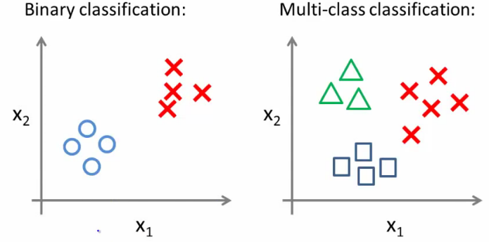
WHAT IS CLASSIFICATION?
Binary classification is the simplest form of classification.
However, classification problems can have multiple class labels.
Instead of predicting whether the pixel is red or blue, you could predict whether the pixel is red, blue, or green.

Slide 9
WHAT IS A CLASS LABEL?
A class label is a representation of what we are trying to predict: our target.
Examples of class labels from before are:
Data Problem | Class Labels
Patient data problem | is smoker, is not smoker
pixel color | red, blue, green

Slide 10
DETERMINING REGRESSION OR CLASSIFICATION
One of the easiest ways to determine if a problem is regression or classification is to determine if our target variable is naturally ordered on a number line.
For example, if predicting company revenue, $100MM is greater than $90MM. This is a regression problem because the target can be ordered.
However, if predicting pixel color, red is not inherently greater than blue. Therefore, this is a classification problem.
Another way to deterine if a problem is classification is whether you can describe all of the possible outcomes with an “or”
Predicting cancer (Classification): Determine if mole is malignant OR benign
Predicting income (Regression): Determine a person’s yearly revenue (0-infinity)

Slide 11
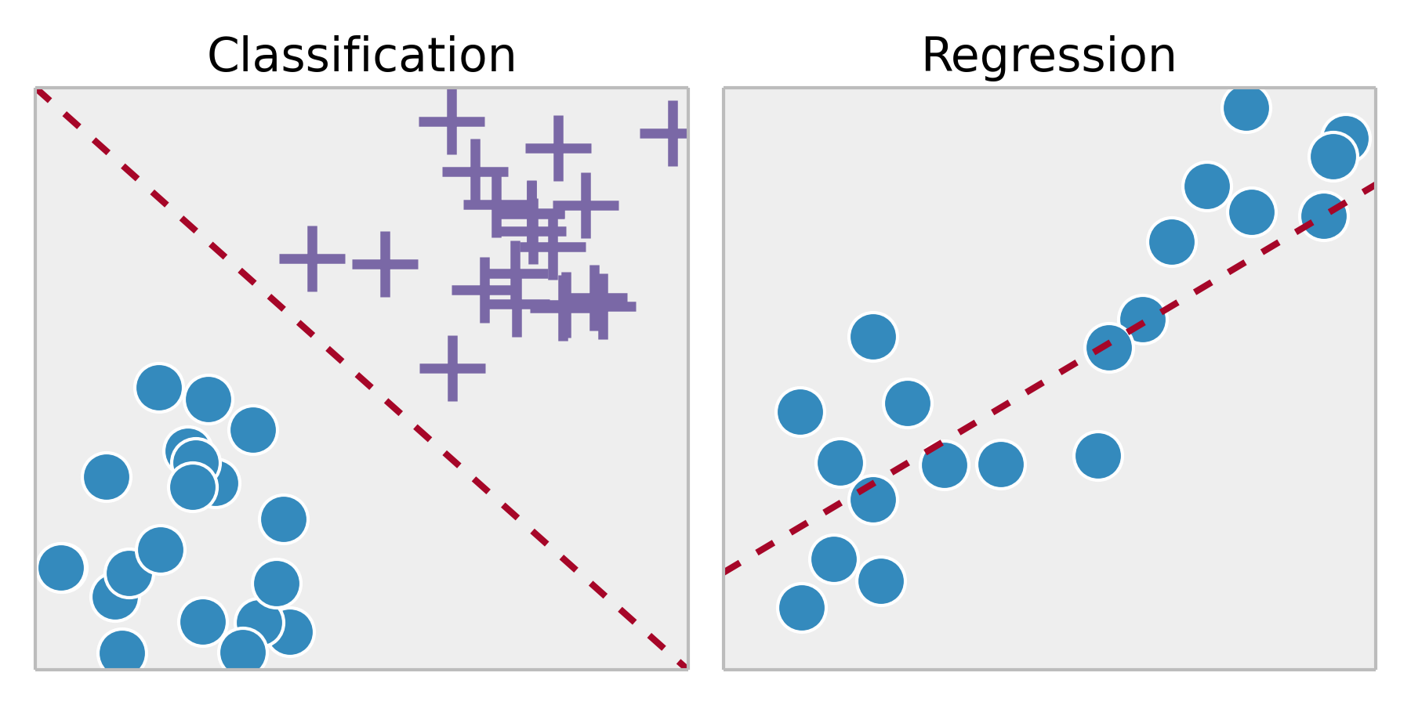
DETERMINING REGRESSION OR CLASSIFICATION
Classification and regression differ in what you are trying to predict.

Slide 12
GUIDED PRACTICE
REGRESSION OR CLASSIFICATION?

Slide 13

ACTIVITY: REGRESSION OR CLASSIFICATION?
DIRECTIONS (5 minutes)
EXERCISE
Review the following situations and decide if each one is a regression problem, classification problem, or neither:
Using the total number of explosions in a movie, predict if the movie is by JJ Abrams or Michael Bay.
Determine how many tickets will be sold to a concert given who is performing, where, and the date and time.
Given the temperature over the last year by day, predict tomorrow's temperature outside.
Using data from four cell phone microphones, reduce the noisy sounds so the voice is crystal clear to the receiving phone.
With customer data, determine if a user will return or not in the next 7 days to an e-commerce website.
DELIVERABLE
Answers to the above questions

Slide 14
INDEPENDENT PRACTICE
BUILD A CLASSIFIER!

Slide 15
INTRODUCTION
K NEAREST NEIGHBORS

Slide 16
WHAT IS K NEAREST NEIGHBORS?
Intuition:
Imagine you want to know if a person will like a movie or not
How do you know which one of those categories a new customer will fall into (Like vs. Not Like)
Look at similar people.
If they had an identical twin, you would want to use them as a close reference.
A friend’s preferences might be helpful as a basis for guessing
If they also had a brother or a parent that would be a good reference too.

Slide 17
WHAT IS K NEAREST NEIGHBORS?
Intuition:
Similarity is a helpful predictor
If we are alike on every dimension, then probably we are going to be alike on this other dimension too!
We can use people “near” (similar on other traits) to another person as the basis for our prediction
We can include other similar people too in our guesses (not just hinge on the single closest person)
We could also give them less importance because they are not as similar

Slide 18
WHAT IS K NEAREST NEIGHBORS?
K Nearest Neighbors (KNN) is a classification algorithm that makes a prediction based upon the closest data points.
The KNN algorithm:
For a given point, calculate the distance to all other points.
Given those distances, pick the k closest points.
Calculate the probability of each class label given those points.
The original point is classified as the class label with the largest probability (“votes”).

Slide 19
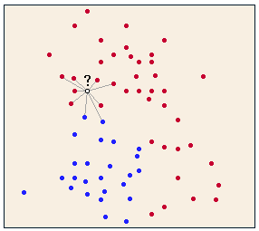
WHAT IS K NEAREST NEIGHBORS?
KNN uses distance to predict a class label. This application of distance is used as a measure of similarity between classifications.
We’re using shared traits to identify the most likely class label.

Slide 20
CALCULATION
Imagine the following are our labeled training data for a variety of beers.
We are interested in knowing whether a certain shipment will fail quality inspection
Acidity | Clarity | Status
7 | 7 | Fail
7 | 4 | Fail
3 | 4 | Pass
1 | 4 | Pass

Slide 21
CALCULATION
If we wanted classify whether a specific shipment would pass or fail, we would calculate the distance between its characteristics and the characteristics of every other beer in our training data.
Example: The shipment we want to classify has an Acidity of 3 and a Clarity of 7
Acidity | Clarity | Distance
7 | 7 | (3-7)² + (7-7)² = 16
7 | 4 | (3-7)² + (7-4)² = 25
3 | 4 | (3-3)² + (7-4)² = 9
1 | 4 | (3-1)² + (7-4)² = 13

Slide 22
CALCULATION
When examining distances, we want the “Nearest” point (smallest distance away from our observation)
Acidity | Clarity | Distance
7 | 7 | (3-7)² + (7-7)² = 16
7 | 4 | (3-7)² + (7-4)² = 25
3 | 4 | (3-3)² + (7-4)² = 9
1 | 4 | (3-1)² + (7-4)² = 13

Slide 23
CALCULATION
The Nearest Neighbor’s classification is “Pass”, so we will say that the shipment will pass too
Acidity | Clarity | Status
7 | 7 | Fail
7 | 4 | Fail
3 | 4 | Pass
1 | 4 | Pass

Slide 24
ACTIVITY: KNOWLEDGE CHECK
ANSWER THE FOLLOWING QUESTIONS
EXERCISE
Imagine we had the following table in our training data
Suppose we wanted to predict what gender a customer who is 60 inches and 123 lbs using their 1-Nearest Neighbor,
Who is their Nearest Neighbor?
What gender would we predict for the following person?
Height | Weight | Gender
68 in | 170 lbs | M
72 in | 220 | M
65 in | 140 lbs | F
62 in | 130 lbs | F
DELIVERABLE
Answers to the above questions

Slide 25
DEMO
KNN CONSIDERATIONS

Slide 26
WHAT HAPPENS IN TIES?
What happens if two classes get the same number of votes?
This could happen in binary classification if we use an even number for k. This could also happen if there are multiple class labels.
In sklearn, it will choose the class that it first saw in the training set.

Slide 27
WHAT HAPPENS IN TIES?
We could implement a weight, taking into account the distance between the point and its neighbors.
This can be done in sklearn by changing the weights parameter to ”distance”.
Try changing the weights parameter. How does this affect accuracy?

Slide 28
WHAT HAPPENS IN HIGH DIMENSIONALITY?
Since KNN works with distance, higher dimensionality of data (i.e. more features) requires significantly more samples in order to have the same predictive power.
Consider this: with more dimensions, all points slowly start averaging out to be equally distant. This causes significant issues for KNN.
Keep the feature space limited and KNN will do well. Exclude extraneous features when using KNN.

Slide 29
WHAT HAPPENS IN HIGH DIMENSIONALITY?
Consider two different examples: classifying users of a newspaper and users of a particular toothpaste.
The features of the newspapers are very broad and there are many: sections, topics, types of stories, writers, online vs print, etc.
However, the features of a toothpaste are more narrow: has fluoride, controls tartar, etc.
For which problem would KNN work better?

Slide 30
WHAT HAPPENS IN HIGH DIMENSIONALITY?
KNN would work better on classifying users of a particular toothpaste since the feature set is more narrow and distinct.

Slide 31
DEMO
KNN IN ACTION

Slide 32
KNN IN ACTION
The following code demonstrates using KNN via sklearn.
from sklearn import datasets, neighbors, metrics import pandas as pd iris = datasets.load_iris() # n_neighbors is our option in KNN. We'll tune this value to attempt to improve our prediction. knn = neighbors.KNeighborsClassifier(n_neighbors=5, weights='uniform') knn.fit(iris.data[:,2:], iris.target) print knn.predict(iris.data[:,2:]) print iris.target print knn.score(iris.data[:,2:], iris.target)

Slide 33
INTRODUCTION
CLASSIFICATION METRICS

Slide 34
INTRODUCTION TO CLASSIFICATION METRICS
Metrics for regression do not apply to classification.
In regression, because our outcome was continuous, it was okay if our predictions were a little over or under (residual error)
In classification, there is not being off on your prediction by a little or a lot. You are either wrong or right.
We could measure the distance between the probability of a given class and an item being in that class. Guessing 0.6 for a 1 is a 0.5 error.
But this overcomplicates our goal: understanding binary classification, whether something is black or white, right or wrong.
To do this, we’ll measure “correctness” or “incorrectness”.

Slide 35
INTRODUCTION TO CLASSIFICATION METRICS
We’ll use two primary metrics: accuracy and misclassification rate.
Accuracy is the number of correct predictions out of all predictions in the sample. This is a value we want to maximize.
Misclassification rate is the number of incorrect predictions out of all predictions in the sample. This is a value we want to minimize.
These two metrics are directly opposite of each other.
1 - misclassification rate = accuracy

Slide 36
INTRODUCTION TO CLASSIFICATION METRICS
We’ll use two primary metrics: accuracy and misclassification rate.
Accuracy is the number of correct predictions out of all predictions in the sample. This is a value we want to maximize.
Accuracy = How many predictions were right / How many predictions did you make?
Ranges from ? to ?
Misclassification rate is the number of incorrect predictions out of all predictions in the sample. This is a value we want to minimize.
Misclassification rate = 1 - Accuracy

Slide 37
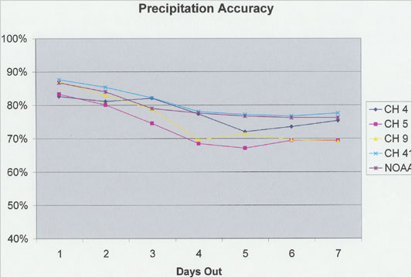
ISSUE WITH ACCURACY
Imagine you learned that a weather forecaster was 85% accurate when predicting whether it would rain or not:

Slide 38
ISSUE WITH ACCURACY
Problem: The base-rate of sunshine is high. If you predicted it would be sunny every day you would be 86% accurate
 | Actually Sunny | Actually Raining
Predict Sunny | 86 | 14
Predict Rain | 0 | 0
 | Actually Sunny | Actually Raining
Predict Sunny
Predict Rain
Accuracy =
 | Actually Sunny | Actually Raining
Predict Sunny
Predict Rain
http://freakonomics.com/2008/04/21/how-valid-are-tv-weather-forecasts/

Slide 39
PROBLEM WITH ACCURACY
Treats all incorrect predictions equally.
In the previous example, the
weather forecaster was really good at detecting sunny days. Out of all sunny days, he was 100% right
He was really bad at detecting rainy days. Out of all rainy days, he was right 0% of the time
 | Actually “YES” | Actually “NO”
Predict “YES” | True Positive | False Positive
Predict “NO” | False Negative | True Negative
Ability to detect positive cases: Sensitivity
Ability to detect negative cases: Specificity

Slide 40
PROBLEM WITH ACCURACY
Sensitivity = TP / (TP + FN)
Specificity = TN / (FP + TN)
Care more about Specificity when you want to make sure you DON’T miss a positive case: (e.g., predicting cancer, predicting loan default)
Care more about Sensitivity when you want to make sure you don’t label something accidentally positive (e.g., assigning a guilty verdict with the death penalty, a foul during the championship game)
 | Actually “YES” | Actually “NO”
Predict “YES” | True Positive | False Positive
Predict “NO” | False Negative | True Negative

Slide 41
PROBLEM WITH ACCURACY
Sensitivity = TP / (TP + FN)
Specificity = TN / (FP + TN)
Care more about Specificity when you want to make sure you DON’T miss a positive case: (e.g., predicting cancer, predicting loan default)
Care more about Sensitivity when you want to make sure you don’t label something accidentally positive (e.g., assigning a guilty verdict with the death penalty, a foul during the championship game)
 | Actually “YES” | Actually “NO”
Predict “YES” | True Positive | False Positive
Predict “NO” | False Negative | True Negative

Slide 42
PRECISION AND RECALL
Precision: What proportion of your positive predictions were correct
TP / (TP + FP)
Recall/Sensitivity:
What proportion of the positive outcomes were identified/predicted
TP / (TP + FN)
Often these are combined into a single metric called the F1 score (Harmonic mean of the two)
F1 Score = precision * recall / (precision + recall)
 | Actually “YES” | Actually “NO”
Predict “YES” | True Positive | False Positive
Predict “NO” | False Negative | True Negative

Slide 43
CONCLUSION
TOPIC REVIEW

Slide 44
REVIEW
What are class labels? What does it mean to classify?
How is a classification problem different from a regression problem? How are they similar?
How does the KNN algorithm work?
What primary parameters are available for tuning a KNN estimator?
How do you define: accuracy, misclassification?

Slide 45
LESSON
EXIT TICKET
DON’T FORGET TO FILL OUT YOUR EXIT TICKET:
http://tiny.cc/chi-ds

