Slide 1
DECISION TREES AND RANDOM FORESTS
Ivan Hernandez, PhD

Slide 2
LEARNING OBJECTIVES:
DECISION TREES
Understand and build decision tree models for classification
Understand the differences between linear and non-linear models
Understand and build random forest models for classification and regression
Know how to extract the most important predictors in a random forest model
Notes:
By the end of the lesson today, I hope to leave you with a basic understanding of what decision trees are
and how to build them to classify data into different outcomes / categories
As we’ve seen in our previous classes, classification is important topic in data science. Classification techniques allow us to make predictions about many outcomes that can be described in distinct categories,
Some examples of categorical outcomes are:
Will a team win or lose?
Should we buy or sell a stock?
Is this news article about politics, opinion, or sports?
Does this person have a disease or is not?
and decision trees are one method of helping predict those outcomes.

Slide 3
INTRODUCTION
TREES
Notes:
Let's start with an overview of what decision trees are

Slide 4
TREES
Trees are a data structure made up of nodes and branches.
Each node typically has two or more branches that connect it to its children.
Node
Branches
Child
Node
Child
Node

Slide 5
TREES
Each child is another node in the tree and contains its own subtree.
Nodes without any children are known as leaf nodes.
Node
Branches
Child
Node
Leaf Node
Branches
Leaf Node
Leaf Node

Slide 6
DECISION TREES
A decision tree contains a question at every node.
Depending upon the answer to the question, we proceed down the left or right branch of the tree and ask another question.
Once we don’t have any more questions (at the leaf nodes), we make a prediction.
Note: The next question is always dependent on the last.
Question
Question
Leaf Node
Leaf Node
Question
Leaf Node
Leaf Node

Slide 7
INTRODUCTION
DECISION TREES
Notes:
Let's start with an overview of what decision trees are

Slide 8
DECISION TREES
Decision trees use a series of “questions” and “if-then” rules based on the answers to those questions to predict an outcome for a selected case.
Depending upon the answer to the question, we proceed down the left (yes) or right (no) branch of the tree and ask another question. (Note: The next question always depends on the last)
Once we don’t have any more questions, we make a prediction
Domain is .info?
Yes
No
Risky
Domain is .gov?
Safe
Top 25 Google?
Safe
Risky?
Decision Tree for whether a URL is “Safe” or “Risky” to click
Notes:
Let’s start with an example:
Imagine that you are using Google to search for a topic and you come across a URL and you’re unsure about whether it’s safe or might have viruses
That is, you’re interested in classifying whether the URL is “safe” or “risky”
Now, you know some characteristics or features about the URL, such as its domain and rank on Google
And you know that those variables can sometimes predict whether the url is safe or risky.
For example, you know that domains ending in .info tend to have viruses.
So you ask yourself, “Is the URL’s domain .info?”
And if it is, then it’s risky.
If it’s not, and it’s a .gov domain, then you know those tend to be trustworthy, and you think it’s safe
This example illustrates the basic premise of a decision tree.

Slide 9
DECISION TREES
Decision trees use a series of “questions” and “if-then” rules based on the answers to those questions to predict an outcome for a selected case.
Depending upon the answer to the question, we proceed down the left (yes) or right (no) branch of the tree and ask another question. (Note: The next question always depends on the last)
Once we don’t have any more questions, we make a prediction
Question
Yes
No
Prediction
Question
Prediction
Question
Prediction
Prediction
Notes:
Decision trees are a method of classifying/predicting what category something you observe belongs to based on its specific attributes
They make these predictions by using a series of questions about those attributes, and applying “if-then” rules based on the answers to those question
We can represent these questions and if-then rules visually as a descending series of questions and answers, as seen on the right. This is the tree.
You start by asking a primary question (at the top), and depending on the answer to that question ("yes" or "no") you move down and to the left or right of the tree until you end up on a prediction.

Slide 10
DECISION TREES VS LOGISTIC REGRESSION
Decision trees are non-linear, an advantage over logistic regression.
A linear model is one in which a change in an input variable has a constant change on the output variable.
Example:
Logistic regression tries to find a constant relationship between a predictor and the probability of category membership
“The odds of surviving multiply by 2.1 for every 1 unit increase in income”
Decision trees allow for exceptions (NOT constant): Making income above 30,000 makes you more likely to survive, unless your income is below $5,000 - super poor
Notes:
Decision trees are a method of classifying/predicting what category something you observe belongs to based on its specific attributes
They make these predictions by using a series of questions about those attributes, and applying “if-then” rules based on the answers to those question
We can represent these questions and if-then rules visually as a descending series of questions and answers, as seen on the right. This is the tree.
You start by asking a primary question (at the top), and depending on the answer to that question ("yes" or "no") you move down and to the left or right of the tree until you end up on a prediction.

Slide 11
DECISION TREES VS LOGISTIC REGRESSION
Interactions:
Whether a variable has an effect depends on the level of another variable
Whether air conditioning makes me happy (coefficient of AC on Happiness), depends on the temperature outside
We could do this in regression by multiplying two predictors, but we had to explicitly think of those cases
Decision trees automatically contain interaction of features, since each question is dependent on the last.
If this -> then that
If the temperature outside is hot, then if the AC is on, I’ll be happy. If the temperature outside is cold, then if the AC is off, I’ll be happy
Notes:
Decision trees are a method of classifying/predicting what category something you observe belongs to based on its specific attributes
They make these predictions by using a series of questions about those attributes, and applying “if-then” rules based on the answers to those question
We can represent these questions and if-then rules visually as a descending series of questions and answers, as seen on the right. This is the tree.
You start by asking a primary question (at the top), and depending on the answer to that question ("yes" or "no") you move down and to the left or right of the tree until you end up on a prediction.

Slide 12
INTRODUCTION
BUILDING
DECISION TREES
Notes:
Let's start with an overview of what decision trees are

Slide 13
BUILDING A DECISION TREE
Pick a categorical outcome you are interested in knowing.
Consider the features that could predict an outcome.
Consider what questions to ask about those features.
A good question will be one that best segregates the different groups and then narrows in on the correct answer.
Decide when to stop asking questions
Notes:
We can summarize the process of building a decision tree using the following steps:
First, pick a categorical outcome that you’re interesting in knowing.
Think about the features or characteristics of what you are trying to classify that might be able to predict its outcome
Think about what questions you could ask about those features to narrow down which category the case belongs to
Ask enough questions that the model is not too complex and can categorize different kinds of cases with high enough accuracy
Let’s take a look at the process more in depth revisiting our example of whether or not a URL is “safe” or “risky”

Slide 14
BUILDING A DECISION TREE MODEL
Example: Picking the right question:
What if-then rule best separates the data into the two possible categories (i.e., “if the site is X, then I’m pretty sure it is safe”)
R = Risky Website
S = Safe Website
R
S
S
R
S
R
S
S
1 2 3 4 5 6 7
R
Website Age (Years)
R
S
S
S
R
R
Tip: Think of the decision rule like drawing a long line at a specific value on the axis that splits the data into distinct groups
1 5 10 15 20 25 30 35 40 45 50
Rank on Google
Notes:
Imagine we had a collection of data about different URLs.
For these URLs, we know their outcome (whether they were safe or risky), and we know some other information about each URL (i.e., their features):
Their rank on Google and the how long the website has existed.
Imagine we wanted to create an if-then rule based on the value of those features that told us whether or not a url was safe or risky.
What rule could we say that if the answer is “yes,” the data are probably safe and if the answer is “no” the data is risky?
One way to visualize a rule is with a horizontal or vertical line that can separate the data into two predicted groups. If we drew a line at the 25 mark for the Google Rank, we would be able to cleanly split the data into the two groups of interest, and predict that anything to the left of the line (Google rank < 25) is a “safe” URL, and anything to the right of the line (Google rank > 25) is “risky”

Slide 15
BUILDING A DECISION TREE MODEL
Example: Picking the right question:
Google Rank
< 25?
Yes
No
R = Risky Website
S = Safe Website
R
S
S
R
Safe
Risky
S
R
S
S
Predict Safe
Predict Risky
1 2 3 4 5 6 7
R
Website Age (Years)
R
S
S
S
R
R
Choosing “25” as the value to ask in the question is done because it separates the data into two distinct groups with little/no overlap (Safe on one side and Risky on the other)
1 5 10 15 20 25 30 35 40 45 50
Rank on Google
Notes:
Therefore, our rule could be:
If the rank on Google is less than 25 (i.e., in the top 25 results), then the website is probably safe
Otherwise, it is risky.
Then our decision tree would need to ask “Is the rank on Google < 25?”, and have the paths leads to the corresponding outcome

Slide 16
BUILDING A DECISION TREE MODEL
We can quantify the purity of the separation of groups using Classification Error, Entropy, or Gini Coefficient.
How well are the groups separated by a question
We want to choose the question that gives us the best change in our purity measure. At each step, we can ask, “Given our current set of data points, which question will make the largest change in purity?”
This is done recursively for each new set of two groups until we reach a stopping point.
Notes:
The idea behind the question and rule creation is that you want to separate the groups as best you can.
There’s many different ways to attach a number to how well you are separating groups, but they all capture the same fundamental idea: that group separation occurs when we can get all of the cases for one category on one side and all of the cases belonging to the other category on the other side of the split.
In the previous example were able to classify the groups into their correct category perfectly, with just one rule that separated the groups evenly
But sometimes, data isn’t that easily separable with a single question and rule.
Let’s take a look at another example, which is more complex than the last

Slide 17
BUILDING A DECISION TREE MODEL
Example: Picking the right question:
S
S
S
S
1 2 3 4 5 6 7
S
S
Website Age (Years)
S
R
R
R
S
S
R
S
R
R
R
1 5 10 15 20 25 30 35 40 45 50
Rank on Google
Notes:
Imagine the data looked like this.

Slide 18
BUILDING A DECISION TREE MODEL
Example: Picking the right question:
Google Rank
< 25?
Yes
No
S
S
S
S
Safe
Risky
S
Predict Safe
1 2 3 4 5 6 7
Predict Risky
S
Website Age (Years)
S
R
R
R
S
S
R
Correctly Classified:
5 / 5
Correctly Classified:
7 / 12
S
R
R
R
1 5 10 15 20 25 30 35 40 45 50
Rank on Google
Notes:
We could draw a line like before that separates the groups, and make a decision tree that looks like the one on the right, but the separation isn’t perfect.
While every case that has a Google rank under 25 is correctly classified as being “safe” by our rule, there are some “safe” cases (on the top right of the graph) that have a Google rank over 25, which our rule would classify them as “risky.”
If we followed our decision tree’s rules, we would accidentally misclassify 5 / 17 cases.
To minimize our classification error, we can add another rule.

Slide 19
BUILDING A DECISION TREE MODEL
Example: Picking the right question:
Google Rank
< 25?
Yes
No
S
S
S
S
Safe
Age > 4?
Predict Safe
S
Predict Risky
1 2 3 4 5 6 7
Predict Safe
S
Website Age (Years)
S
R
R
R
S
S
R
S
R
R
Safe
Risky
R
1 5 10 15 20 25 30 35 40 45 50
Rank on Google
Correctly Classified:
4 / 5
Correctly Classified:
7 / 7
Notes:
This new rules says that if the website’s rank is higher than 25 on Google AND older than 4 years, then it is probably “safe.”
Notice how our final decision tree changes. We now have an extra question, that is asked only when the Google rank of a website is not < 25.
With this new rule, we only misclassify 1 / 17 cases.
We could add more rules if we wanted, but this could lead to overfitting, where we are try to accommodate specific instances in the data, that we do not have enough of a sample size to support, and less likely to replicate if we collected similar data in the future.

Slide 20

ACTIVITY: KNOWLEDGE CHECK
SPLIT INTO PAIRS AND ANSWER THE FOLLOWING
M = Melanoma
N = Non-Melanoma
EXERCISE
M
M
M
M
M
N
M
M
N
N
N
N
M
M
M
M
M
M
M
N
M
M
N
M
NN
N
N
N
N
N
Build a decision tree for the following medical data shown on the right.
Create questions about the features (symmetry and diameter) that accurately classify whether a mole is melanoma or not
Make sure to label all of the questions and predictions at each step.
Diameter of mole (mm)
1 2 3 4 5 6 7 8 9
DELIVERABLE
Symmetric Asymmetric
Your labeled decision tree
Symmetry of mole (Categorical)
Notes:
Now that you have a basic understanding of decision trees and how to build them, let’s take a look at another example.
Imagine we had data from patients with moles that were classified by a doctor as either melanoma or non-melanoma.
We also know two features about each person’s moles:
The diameter and whether the Mole was Symmetric vs. Asymmetric.
Break into pairs and build a decision tree that asks questions about the cases, and has if-then rules that either make predictions or lead to other questions.

Slide 21
MAKING PREDICTIONS FROM A DECISION TREE
Predictions are made by answering each of the questions.
Once we reach a leaf node, our prediction is made by taking the majority label of the training samples that fulfill the questions.
In our sample tree, if we want to classify a new article, ask:
Does the article contain the word recipe?
If it doesn’t, does the article have a lot of images?
If it does, then 630 / 943 article are evergreen.
So we can assign a 0.67 probability for evergreen sites.

Slide 22
DEMO
OVERFITTING IN DECISION TREES

Slide 23
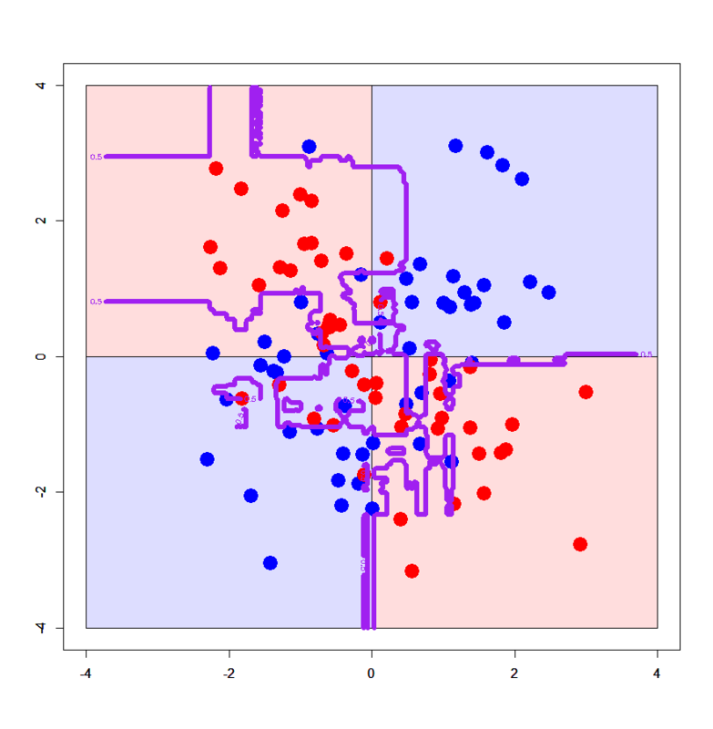
OVERFITTING IN DECISION TREES
Decision trees tend to be weak models because they can easily memorize or overfit to a dataset.
A model is overfit when it memorizes or bends to a few specific data points rather than picking up general trends in the data.

Slide 24
OVERFITTING IN DECISION TREES
An unconstrained decision tree can learn an extreme tree (e.g. one feature for each word in a news article).
We can limit our decision trees using a few methods.
Limiting the number of questions (nodes) a tree can have).
Limiting the number of samples in the leaf nodes.

Slide 25
ACTIVITY: KNOWLEDGE CHECK
ANSWER THE FOLLOWING QUESTIONS
EXERCISE
Why are decision trees generally thought of as weak models?
How can we limit our decision trees?
DELIVERABLE
Answers to the above questions

Slide 26
INTRODUCTION
EXTENSIONS

Slide 27
EXTENSIONS TO DECISION TREES
How can we improve performance?
Combine decision trees
Classifier of Classifiers = Ensemble
How can we apply it to continuous outcomes?
Regressor

Slide 28
INTRODUCTION
RANDOM FORESTS

Slide 29
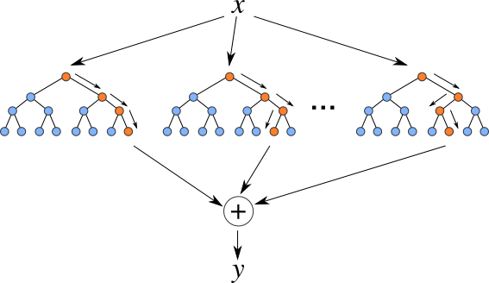
RUNNING THROUGH THE RANDOM FORESTS
Random forest models are one of the most widespread classifiers used.
They are relatively simple to use and help avoid overfitting.
Random Forests are an ensemble or collection of individual decision trees.

Slide 30
TRAINING A RANDOM FOREST
Training a random forest model involves training many decision tree models.
Since decision trees overfit easily, we use many decision trees together and randomize the way they are created.

Slide 31
TRAINING A RANDOM FOREST
Random Forest Algorithm
Take a bootstrap sample of the dataset.
Train a decision tree on the bootstrap sample. For each split/feature selection, only evaluate a limited number of features to find the best one.
Repeat this for N trees.

Slide 32
PREDICTIONS USING A RANDOM FOREST
Predictions for a random forest model come from each decision tree.
Make an individual prediction with each decision tree.
Combine the individual predictions and take the majority vote.

Slide 33
PROS AND CONS OF RANDOM FORESTS
Advantages
Easy to tune
Built-in protection against overfitting
Non-linear
Built-in interaction effects
Disadvantages
Slow
Black-box
No “coefficients”
Harder to explain

Slide 34
GUIDED PRACTICE
REGRESSION WITH DECISION TREES AND RANDOM FORESTS

Slide 35
CONCLUSION
TOPIC REVIEW

Slide 36
REVIEW Q&A
What are decision trees?
What does training involve?
What are some common problems with decision trees?
What are random forests?
What are some common problems with random forests?

Slide 37
SUMMARY
DECISION TREES

Slide 38
SUMMARY OF DECISION TREES
Decision trees use a series sequential “questions” about the features of a specific case to classify it into a specific category.
These series of “questions,” “rules,” and predictions can be visually represented as a tree.
Constructing a decision tree requires finding a minimal set of variables, and the specific values and combinations of them that predict the correct category for a set of data.
It is important to find a balance between complexity and simplicity with the number of predictors and rules.

