Slide 1
NATURAL LANGUAGE PROCESSING AND TEXT CLASSIFICATION
Ivan Hernandez, PhD

Slide 2
LEARNING OBJECTIVES
NATURAL LANGUAGE PROCESSING AND TEXT CLASSIFICATION
Demonstrate how to classify text or documents using scikit-learn
Describe how to extract meaning from texts
Define natural language processing and

Slide 3
INTRODUCTION
TEXT CLASSIFICATION

Slide 4
TEXT CLASSIFICATION
Text classification is the task of predicting which category or topic a text sample is from.
For example, we may want to identify whether an article is a sports or business story. Or whether an article has positive or negative sentiment.
Typically, this is done by using the text as features and the label as the target output. This is referred to as bag-of-words classification.
To include text as features, we usually create a feature for each word, i.e. how often does this piece of text contain that word?

Slide 5
FEATURES FROM TEXT
In all of our machine learning approaches and methods, we try to predict some outcome with a matrix of features/predictor variables.
Each row in the matrix is an observation, and each column is a predictor variable, and the cells represent the value of that predictor variable for that observation
 | Predictor 1 | Predictor 2 | Predictor 3 | Predictor 4
Person 1 | 25 | 1 | 5 | 3
Person 2 | 30 | 2 | 20 | 4
Person 3 | 10 | 3 | 1 | 20

Slide 6
FEATURES FROM TEXT
In text classification, our predictors will be the words themselves,
Each row in the matrix is a document containing words that we want to classify, and each column is a word, and the cells represent the count of words for that document:
Document X Term Matrix
 | Word 1 | Word 2 | Word 3 | Word 4
Document1 | 25 | 1 | 5 | 3
Document 2 | 30 | 2 | 20 | 4
Document 3 | 10 | 3 | 1 | 20

Slide 7
TEXT CLASSIFICATION
To create a Document X Term Matrix text features, we first create a vocabulary to account for all possible words in our collection of documents.
Often requires going through the documents first and seeing what the words are, and making a matrix with each word as its own unique column and then going through them again, and count how often that word occurred.
As we do this, we need to consider several things.
Does order of words matter?
Does punctuation matter?
Does upper or lower case matter?

Slide 8
TEXT CLASSIFICATION
This Document X Term Matrix illustrates features created from the following two documents.
Document 1: “”
Document 2: “”
 | Word 1 | Word 2 | Word 3 | Word 4 | Word 5 | Word 6 | Word 7 | Word 8 | Word 9
Document1
Document 2

Slide 9

ACTIVITY: KNOWLEDGE CHECK
ANSWER THE FOLLOWING QUESTIONS
EXERCISE
Discuss your answers to the following questions and explain your reasoning.
Does word order matter?
Does word case (e.g. upper or lower) matter?
Does punctuation matter?
DELIVERABLE
Answers to the above questions

Slide 10
DEMO
TEXT PROCESSING IN SCIKIT-LEARN

Slide 11
TEXT PROCESSING IN SCIKIT-LEARN
Scikit-learn has many pre-processing utilities that simplify tasks required to convert text into features for a model.
These can be found in the sklearn.preprocessing.text package.
The assumption behind these preprocessing utilities is that you already have a collection of text documents that you want to classify and you have them in a list/Pandas column, where each row is a new document

Slide 12
COUNTVECTORIZER
CountVectorizer is a function converts a collection of text into a matrix of features. Each row will be a sample (an article or piece of text) and each column will be a text feature (usually a count or binary feature per word).
CountVectorizer takes your column of text and creates a running count of what are all of the possible words, in the document as well as their total frequency.
You actually have to “fit” the CountVectorizer to your dataset to have it learn the vocabulary

Slide 13
COUNTVECTORIZER
Instantiate a new CountVectorizer.
from sklearn.feature_extraction.text import CountVectorizer vectorizer = CountVectorizer()
# Use `fit` to learn the vocabulary of the titles
vectorizer.fit(documents) # Use `tranform` to generate the sample X word matrix - one column per feature (word or n-grams) X = vectorizer.transform(documents )

Slide 14
COUNTVECTORIZER
Vectorizers are like other models in scikit-learn.
We create a vectorizer object with the parameters of our feature space.
We fit a vectorizer to learn the vocabulary.
We transform a set of text into that feature space.

Slide 15
INDEPENDENT PRACTICE
CONSIDERATIONS WHEN PROCESSING TEXT

Slide 16
PROBLEM WITH USING COUNTS AS PREDICTOR VALUES
Documents that are longer will have higher counts for every word,
We want the words to represent what the document is about.
If a wikipedia is about Barack Obama, we want the word “president” to have a high score
An article about U.S. history will have a higher count for president, even though that’s not what it’s mainly about.
We also want words that are NOT unique to the article to be less emphasized:
An article about Barack Obama will have a lot more counts for the word “the” than the word “president”
Only because “the” is a common word.
We need to take into account that “president” is a unique term

Slide 17
TERM FREQUENCY - INVERSE DOCUMENT FREQUENCY
Using the pure counts of words can over represent words that are not important.
An alternative approach to using counts is a Term Frequency - Inverse Document Frequency (TF-IDF) representation.
Rather than assign each word a count for each document, the word is assigned a value called the TF-IDF.
The TF-IDF for a word in a document is the product of:
That word’s frequency in the document
The inverse of the word’s overall frequency in all of the documents

Slide 18
TERM FREQUENCY - INVERSE DOCUMENT FREQUENCY
Term Frequency is equivalent to CountVectorizer features, just the number of times a word appears in the document (i.e. count).
Our way of seeing what is the document is about. If the document is about “presidents”, then “president” should occur a lot in the document
We just need to correct/weight the counts to downplay words that have a high-base rate of occurrence (e.g, “the”
Inverse Document Frequency is just 1/Document Frequency.
Document Frequency is the percentage of documents that a particular word appears in.
For example, “the” would be 100% while “president” is much lower.
This value corrects the term frequency value for common vs. rare words

Slide 19
TERM FREQUENCY - INVERSE DOCUMENT FREQUENCY
Combining, TF-IDF = Term Frequency * Inverse Document Frequency or TF-IDF = Term Frequency / Document Frequency
The intuition is that the words that have high weight are those that either appear frequently in this document or appear rarely in other documents (and are therefore unique to this document).
from sklearn.feature_extraction.text import TfidfVectorizer vectorizer = TfidfVectorizer()

Slide 20
TF-IDF: EXAMPLES
Word “president” appears 10 times in a document, and appears in 1 / 100 documents, the tf-idf value for the “president” column for that document is:
Term Frequency = 10
Inverse Document frequency = (100 / 1) = 100
TF-IDF = 10 * (100 ) = 1000
Word “the” appears 20 time in a document, and appears in 100/100 documents, the tf-idf value for the “president” column for that document is:
Term Frequency = 20
Inverse Document frequency = (100 / 100) = 1
TF-IDF = 20 * (1 ) = 20
Note: The log of the IDF is usually taken so a document that occurs in 100/100 documents gets an IDF value of log(100/100) = 0

Slide 21
ACTIVITY: KNOWLEDGE CHECK
ANSWER THE FOLLOWING QUESTIONS
What does TF-IDF stand for?
What does this function do and why is it useful?
EXERCISE
DELIVERABLE
Answers to the above questions and feature representation

Slide 22
PROBLEM WITH USING WORDS AS FEATURES
We want to represent documents in terms of the concepts they represent.
Barack Obama’s article should be about presidents. IBM’s article should be about computers.
They should get high tf-idf scores for those words.
Problem is that words can take make forms despite representing similar concepts:
“president,” “presidents,” “president’s” “presidential”
“computer” “computers” “computing”
If we coded each version as a separate feature, it would the article seem like it’s not about any of those, because the full term frequency count is divided by 3
Need to combine similar word stems into a single word

Slide 23
LEMMATIZATION AND STEMMING
How would you describe the relationship between the terms ‘bad’ and ‘badly’ or ‘different’ and ‘differences’?
Stemming and lemmatization help identify common roots of words.
Stemming is a crude process of removing common endings from sentences, such as ‘s’, ‘es’, ‘ly’, ‘ing’, and ‘ed’.
Common stemming algorithms:
Porter: Older / Less Aggressive (Tends to keep words intact)
Snowball / Porter 2: Moderately Aggressive
Lancaster: Very Aggressive / Faster

Slide 24
LEMMATIZATION AND STEMMING
Lemmatization is a more refined process that uses specific language and grammar rules to derive the root of a word.
This is useful for words that do not share an obvious root such as ‘better’ and ‘best’.
The WORDNET library in the NLTK package handles lemmatization

Slide 25
LEMMATIZATION AND STEMMING EXAMPLES
Lemmatization
shouted → shout
best → good
better → good
good → good
wiping → wipe
hidden → hide
Stemming
badly → bad
computing → comput
computed → comput
wipes → wip
wiped → wip
wiping → wip

Slide 26
OVERFITTING
Because there are so many possible words, one issue that can arise is overfitting:
A feature seem like it’s really predictive, but only because that feature occurs just once in the text
You might want to limit the features to only the N^{th} most common words (e.g., 1,000)
You might also want to remove features that you know have no semantic meaning, called stopwords (is, of, the, an, to) to prevent them from influencing the model
You can also make sure everything is lowercase so that “President” and “president” count for the same term

Slide 27
TAKING INTO ACCOUNT CONTEXT
The method of counting word frequencies to represent a document we use is called a “bag-of-words” approach.
Word order never matters
Does not take into account context: a Document that says “Barack Obama is a president from the Democratic party” would treat “party” the same as “Barack Obama celebrated his Birthday party”
Context depends on the surrounding words
Can code documents as both words (1-grams) and collections of word pairs (2-grams) or triplets (3-grams) etc.
Example: Columns in a 2-gram approach:
“barack obama”, “obama celebrated”, “celebrated his”, “his birthday”, “birthday party”

Slide 28
TAKING INTO ACCOUNT CONTEXT
The method of counting word frequencies to represent a document we use is called a “bag-of-words” approach.
Word order never matters
Does not take into account context: a Document that says “Barack Obama is a president from the Democratic party” would treat “party” the same as “Barack Obama celebrated his Birthday party”
Context depends on the surrounding words
Can code documents as both words (1-grams) and collections of word pairs (2-grams) or triplets (3-grams) etc.
Example: Columns in a 2-gram approach:
“barack obama”, “obama celebrated”, “celebrated his”, “his birthday”, “birthday party”

Slide 29
IMPLEMENTING CONSIDERATIONS
Instantiate a new CountVectorizer.
from sklearn.feature_extraction.text import CountVectorizer vectorizer = CountVectorizer(max_features = 1000, ngram_range=(1, 2), stop_words='english')

Slide 30
COUNTVECTORIZER PARAMETERS
There are several parameters to utilize.
max_features=1000
Maximum number of words to consider (uses the first N most frequent)
ngram_range - a range of word phrases to use
(1,1) means use all single words
(1,2) means use all contiguous pairs of word
(1,3) means use all triples

Slide 31
COUNTVECTORIZER PARAMETERS
stop_words=’english’
Stop words are non-content words (e.g. ‘to’, ‘the’, ‘it’, etc). They aren’t helpful for prediction, so they get removed.

Slide 32
INDEPENDENT PRACTICE
EXTENSION:
BUILDING A SEARCH ENGINE

Slide 33
DOCUMENT REPRESENTATION
You have learned how to take a document/text and convert it to a numeric matrix
Each document has it’s own “profile”
A sequence of numbers representing its meaning
Two documents that have similar meanings will have similar values in each columns
“George Bush” and “Barack Obama” will have high values for “president,” “United States,” “Harvard,” “politician”
Can find related documents by computing a similarity score between a target document and all other documents - then take the highest scoring N documents

Slide 34
CREATING A SEARCH ENGINE
Have a collection of text documents
Train a tf-idf vectorizer
Use the ‘transform’ function to create a Document X Term Matrix that has the tf-idf counts. This is your database
Get a query (“He was a president from Chicago”)
Transform the query to vector space
For every document in the Matrix, compute the similarity between your query and the document. Keep track of the indexnumber for the similarities
Sort the similarities in descending order
Return the first N indexes

Slide 35
OTHER FEATURES FROM TEXT

Slide 36
FEATURES FROM TEXT
Currently, we have been treating the words as the features/predictors in our model.
We can code other features from the text as well
Two types:
Content
Top-Down: Themes we know about ahead of time
Bottom-up: Themes from the text we discover
Style

Slide 37
INDEPENDENT PRACTICE
CODING THE CONTENT OF TEXT

Slide 38
CONTENT FROM THE TEXT
Content: What constructs and concepts is the text discussing
Topics: Politics, People, Sports, War, Religion, etc…
Valence: Positive things, Negative things
Tone: Serious, Sarcastic, Emotional
Source: First person, Second Person, Third person
The content of the text can be determined in two ways
Top-down: You already know what concepts you want and find out how much the text contains that content
Bottom-up: The content of the text is unknown and you discover the underlying themes

Slide 39
TOP-DOWN CONTENT ANALYSIS
Imagine you know ahead of time what concepts you want to examine (i.e., how positive the text is). You could code you text on that dimension in two possible ways:
Word count method: Count proportion of words in a document that relate to a target
Natural Language Classifier: Use a pre-trained classifier that follows rules and natural language structure to determine the content of text

Slide 40
WORD COUNT METHOD
Process:
Have a collection of words (dictionary) that relate to the concept (e.g., “good” “love” “excellent” “great”
Count the number of words in the document that match any of the words in your dictionary.
Divide by total number of words
Example:
“I am happy” = 1 positivity word / 3 total words = .333 positivity
“I am happy and excited today” = 2 positivity words / 6 total words = .333 positivity

Slide 41
IMPLEMENTING WORD COUNT METHOD
Create a list of words/word stems related to a target:
lst = [“good”, “great”, “happy”
Make a regular expression that separates each word with a word boundary “\b” and a | symbol
regular_expression = ”\b”+“\b|\b”.join(lst)+”\b”
Compile the list of words into a regular expresion object
dictionary = re.compile(regular expression)
Make a function that finds the number of words matching your dictionary and divide by the total number of words
score = dictionary.find_all(text) / len(text.split())

Slide 42
EXAMPLES OF WORD COUNT METHOD
Linguistic Inquiry Word Count (LIWC):
Emotion: Positive, Negaive, Anxiety, Anger, Sadness
Social: Family, Friends, Humans
Cognitive Mechnisms
Causation
Negatation
Huge list of others: http://riot.ryanb.cc/general-content-coding/

Slide 43
PRE-TRAINED CONTENT ANLYSIS METHOD
Process:
Gather a collection of documents that have been coded in terms of an outcome of interest (e.g., positive vs. negative)
Train a classifier to predict which outcome it represents
Use the classifier
Example:
Gather 1,000 amazon reviews that have 5 or 4 stars (positive). Gather 1,000 Amazon reviews that have 1 or 2 stars (negative).
Train a classifier to predict whether it is a positive or negative review.
Code new text in terms of it’s positivity vs. negativity using the classifier

Slide 44
EXAMPLES OF PRETRAINED CLASSIFIER METHOD
Positive / Negative Sentiment
VADER: https://pypi.python.org/pypi/vaderSentiment
SentimentAnalyzer (nltk.sentiment)
Alchemy: http://www.alchemyapi.com/products/alchemylanguage
Watson: https://www.ibm.com/watson/developercloud/personality-insights.html

Slide 45
BOTTOM-UP CONTENT ANALYSIS
Imagine you knew that there were certain common themes or overarching concepts in your text.
You don’t know what they are, but your know they are there, and you might even have a guess as to how many there are.
You could use a technique called “topic anlaysis” to determine:
What are are the underlying themes/topics within a document
How does each document score on each topic?
E.g., Document 1 is high on topic 1, but low on topic 2

Slide 46
MIXTURE MODELS AND LANGUAGE PROCESSING
LDA or Latent Dirichlet Allocation create clusters of common words and generate probability distributions to explicitly state how related words are.
Assumes that documents are formed by “topics”
Topics are probability distributions of words. A “sports” topics for example would have a high probability of the word “ball” and “win occuring, but a low probability of the word “printer” occuring
LDA is given a set number of topics and it tries to assign probabilities to each word for each topic to determine the topic structure

Slide 47
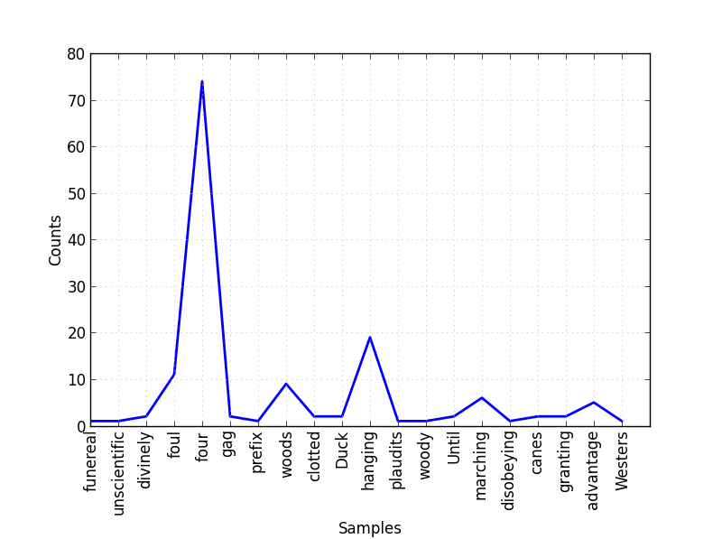
MIXTURE MODELS AND LANGUAGE PROCESSING
The word distribution is a multinomial distribution of each topic representing what words are most likely from that topic.

Slide 48
MIXTURE MODELS AND LANGUAGE PROCESSING
To understand this better, let’s imagine a new way to generate text:
Start writing a document
Choose a topic (sports, news, science).
Choose a random word from that topic.
Repeat.
Repeat for the next document.

Slide 49
MIXTURE MODELS AND LANGUAGE PROCESSING
This ‘model’ of text is assuming that each document is some mixture of topics.
It may be mostly science but may contain some business information.
The latent structure we want to uncover are the topics (or concepts) that generate that text.

Slide 50
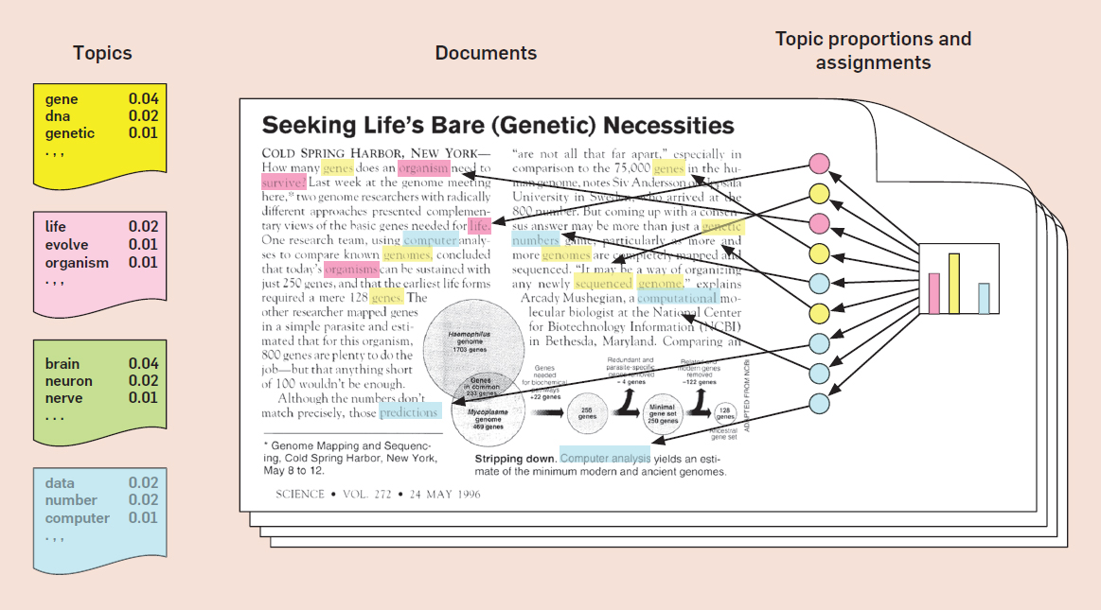
MIXTURE MODELS AND LANGUAGE PROCESSING

Slide 51
MIXTURE MODELS AND LANGUAGE PROCESSING
For example, let’s say we have three topics: sports, business, and science.
For each topic, we uncover the most likely words to come from them:
sports: [football: 0.3, basketball: 0.2, baseball: 0.2, touchdown: 0.02 ... genetics: 0.0001] science: [genetics: 0.2, drug: 0.2, ... baseball: 0.0001] business: [stocks: 0.1, ipo: 0.08, ... baseball: 0.0001]
For each word and topic pair, we learn some probability: P(word|topic).

Slide 52
MIXTURE MODELS AND LANGUAGE PROCESSING
The topic distribution is a multinomial distribution for each document representing what topics are most likely to appear in that document.
For all our of sample documents, we have a distribution over {sports, science, business}.
ESPN article: [sports: 0.8, business: 0.2, science: 0.0] Bloomberg article: [business: 0.7, science: 0.2, sports: 0.1]
For each topic and document pair, we learn some probability, P(topic|document).

Slide 53
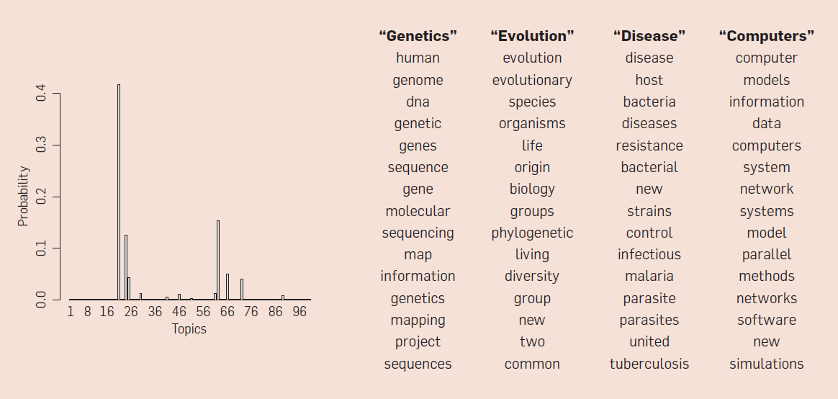
MIXTURE MODELS AND LANGUAGE PROCESSING

Slide 54
STYLE
The structure of the sentences can also be used as features to predict an outcome (e.g. quality of review)
Style = Not *what* you say, but *how* you say it.
Average sentence length
Average word length
Diversity of words (MTLD): http://textinspector.com/workflow
Proportion of pronouns to total words
Proportion of adjectives to total words
Grammar structure: Subject -> Verb -> Object
Punctuation usage

Slide 55
INTRODUCTION
NATURAL LANGUAGE PROCESSING

Slide 56
WHAT IS NATURAL LANGUAGE PROCESSING (NLP)?
Natural language processing is the task of extracting meaning and information from text documents.
There are many types of information we might want to extract.
These tasks may range from simple classification tasks, such as deciding what category a piece of text falls into, to more complex tasks like translating or summarizing text.
For most tasks, a fair amount of pre-processing is required to make the text digestible for our algorithms. We typically need to add structure to our unstructured data.

Slide 57

WHAT IS NATURAL LANGUAGE PROCESSING (NLP)?
Many AI assistant systems are typically powered by fairly advanced NLP engines.
A system like Siri uses voice-to-transcription to record a command and then various NLP algorithms to identify the question asked and possible answers.

Slide 58
TOKENIZATION
Tokenization is the task of separating a sentence into its constituent parts, or tokens.
Determining the “words” of a sentence seems easy but can quickly become complicated with unusual punctuation (common in social media) or different language conventions.

Slide 59
TOKENIZATION
What sort of difficulties can you find in the following sentence?
The L.A. Lakers won the NBA championship in 2010, defeating the Boston Celtics.

Slide 60
TOKENIZATION EXAMPLES
My house is located in Uptown. → [My, house, is, located, in, Uptown]
The Lakers are my favorite team. → [The, Lakers, are, my, favorite, team]
Data Science is the future! → [Data, Science, is, the, future]
GA has many locations. → [GA, has, many, locations.]

Slide 61
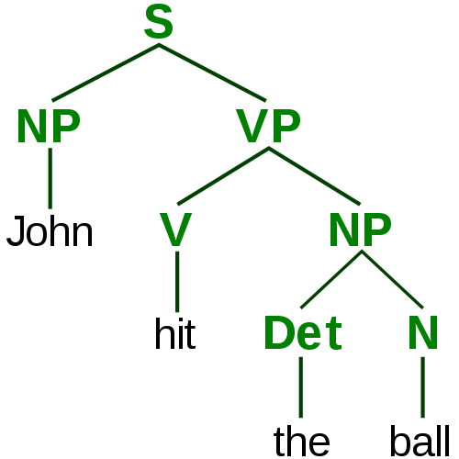
PARSING AND TAGGING
In order to understand the various elements of a sentence, we need to tag important topics and parse their dependencies.
Our goal is to identify the actors and actions in the text in order to make informed decisions.

Slide 62
PARSING AND TAGGING
If we are processing financial news, we might need to identify which companies are involved and which actions they are taking.
If we are writing an assistant application, we might need to identify specific command phrases in order to determine what is being asked:
e.g. “Siri, when is my next appointment?”

Slide 63
PARSING AND TAGGING
Tagging and parsing is made up of a few overlapping subproblems:
“Parts of speech” tagging: What are the parts of speech in a sentence (e.g. noun, verb, adjective, etc)?
Chunking: Can we identify the pieces of the sentence that go together in meaningful chunks (e.g. noun or verb phrases)?
Named entity recognition: Can we identify specific proper nouns? Can we pick out people and locations?

Slide 64
ACTIVITY: KNOWLEDGE CHECK
ANSWER THE FOLLOWING QUESTIONS
EXERCISE
How might NLP be applied within your current jobs or final projects?
What are some other potential NLP use-cases?
DELIVERABLE
Answers to the above questions

Slide 65
DEMO
NATURAL LANGUAGE PROCESSING WITH ‘SPACY’

Slide 66
NATURAL LANGUAGE PROCESSING WITH ‘SPACY’
Most NLP techniques require pre-processing large collections of annotated text in order to learn specific language rules.
There are many tools available for English and other popular languages.
Each tool typically requires a large amount of data and large databases of special use-cases, including language inconsistencies and slang.
In Python, two popular NLP packages are nltk and spacy.
nltk is more popular but not as advanced and well maintained. spacy is more modern but not available for commercial use.

Slide 67
NATURAL LANGUAGE PROCESSING WITH ‘SPACY’
We’ll be using spacy to process some news article titles. First load the NLP toolkit by specifying the language.
from spacy.en import English nlp_toolkit = English()
This toolkit has 3 pre-processing engines:
A tokenizer: to identify the word tokens
A tagger: to identify the concepts described by the words
A parser: to identify the phrases and links between different words
Each of these engines can be overridden with a different, specialized tool. You can even write your own and use them in place of the defaults.

Slide 68
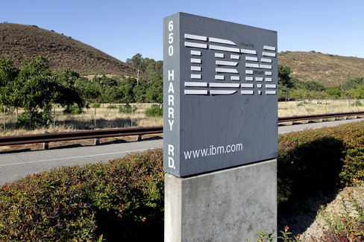
NATURAL LANGUAGE PROCESSING WITH ‘SPACY’
The first title is “IBM Sees Holographic Calls, Air Breathing Batteries”.
From this, we may want to extract several pieces of information: this title references a company and that company is referencing a new possible product: air-breathing batteries.

Slide 69
NATURAL LANGUAGE PROCESSING WITH ‘SPACY’
We can use spacy to get information about this title.
title = "IBM sees holographic calls, air breathing batteries" parsed = nlp_toolkit(title)
for (i, word) in enumerate(parsed): print("Word: {}".format(word)) print("\t Phrase type: {}".format(word.dep_)) print("\t Is the word a known entity type? {}".format(word.ent_type_ if word.ent_type_ else "No")) print("\t Lemma: {}".format(word.lemma_)) print("\t Parent of this word: {}".format(word.head.lemma_))
nlp_toolkit runs each of the individual pre-processing tools.

Slide 70
NATURAL LANGUAGE PROCESSING WITH ‘SPACY’
The output will look similar to this:
Word: IBM Phrase type: nsubj Is the word a known entity type? ORG Lemma: ibm Parent of this word: see Word: sees Phrase type: ROOT Is the word a known entity type? No Lemma: see Parent of this word: see Word: holographic Phrase type: amod Is the word a known entity type? No Lemma: holographic Parent of this word: call

Slide 71
NATURAL LANGUAGE PROCESSING WITH ‘SPACY’
In this output:
“IBM” is identified as an organization (ORG).
We identify a phrase: “holographic calls”.
We identify a compound noun phrase: “air breathing batteries”.
We identify that “see” is at the root as an action “IBM” is taking.
We can see that “batteries” was lemmatized to “battery”.

Slide 72
NATURAL LANGUAGE PROCESSING WITH ‘SPACY’
We can use this output to find all titles that discuss an organization.
def references_organization(title): parsed = nlp(title) return any([word.ent_type_ == 'ORG' for word in parsed]) data['references_organization'] = data['title'].fillna('').map(references_organization) data[data['references_organization']][['title']].head()

Slide 73
COMMON PROBLEMS IN NLP
These subtasks are very difficult, because language is complex and changes frequently.
Most often, we are looking for heuristics to search through large amounts of text data. The results may not be perfect... and that’s okay!
Older techniques rely on rule-based systems. More recent techniques use flexible systems, focusing on the words used rather than the structure of the sentence.
We’ll see an example of these modern approaches in the next class.

Slide 74
CONCLUSION
TOPIC REVIEW

Slide 75
COURSE
BEFORE NEXT CLASS

Slide 76
DUE DATE
BEFORE NEXT CLASS
Project: Final Project, Part 2

Slide 77
LESSON
EXIT TICKET
DON’T FORGET TO FILL OUT YOUR EXIT TICKET

