Slide 1
Platform Overview and Role Map
Training Pack
Role-dependent. The seeded demo uses `/campaigns/manage-data/`, `/campaigns/publisher- landing-page/`, `/share/fieldrep-gmail- login/`, and `/shortlinks/go/<code>/` as the main route families.
Explain how campaign master data, portal operations, field-rep sharing, doctor verification, and reporting connect end to end.
Platform Overview
Primary user: New team members, trainers, implementation partners, and AI agents orienting to the product.
Generated: 2026-04-23

Slide 2
Workflow Overview
Platform Overview and Role Map
Primary User
Entry Point
Purpose
New team members, trainers, implementation partners, and AI agents orienting to the product.
Role-dependent. The seeded demo uses `/campaigns/manage-data/`, `/campaigns/publisher-landing-page/`, `/share/fieldrep-gmail-login/`, and `/shortlinks/go/<code>/` as the main route families.
Explain how campaign master data, portal operations, field-rep sharing, doctor verification, and reporting connect end to end.
What to cover
Campaign definitions originate in the master database and are surfaced in the portal through the Manage Data Panel and publisher landing pages.
Editable campaign metadata, collateral assets, share logs, and transaction rollups live in the portal database.
Field reps are prepared in the campaign manager or staff-admin flow, then use the public Field Rep login page with Email ID and Field Rep ID before sharing.
Doctors unlock collateral with the same WhatsApp number used during sharing, then consume PDF/video content in a viewer that also surfaces archive and webinar follow-ons.
Reporting screens summarize the latest engagement state per doctor, per collateral, per campaign.
Source manual: docs/product-user-flows/01-platform-overview-and-role-map.md

Slide 3
Role Map
Platform Overview
Publisher / partner system
Open a campaign in the portal and maintain the editable PE-side campaign fields.
/campaigns/publisher-landing-page/?campaign-id=<uuid>&jwt=<token>
Campaign operations users and field-rep setup.
Internal campaign operator
Search campaign inventory, open campaign records, and branch into collateral or field-rep operations.
/campaigns/manage-data/
Collateral operations and field-rep administration.
Staff admin
Maintain master field reps and the doctor lists attached to each rep.
/admin_dashboard/fieldreps/
Field reps who will actually share the content.
Field rep
Authenticate, pick the right campaign collateral, and share it with doctors through WhatsApp.
/share/fieldrep-gmail-login/
Doctors who receive the short link.
Doctor
Verify access with the same WhatsApp number and consume the PDF/video collateral.
/shortlinks/go/<code>/
Reporting and follow-up users.
Reporting stakeholder
Review transaction rollups and doctor-level engagement for a campaign.
/reports/collateral-transactions/<brand_campaign_id>/
Campaign optimization and rep follow-up.
Cross-role handoff map for the seeded training campaign.

Slide 4
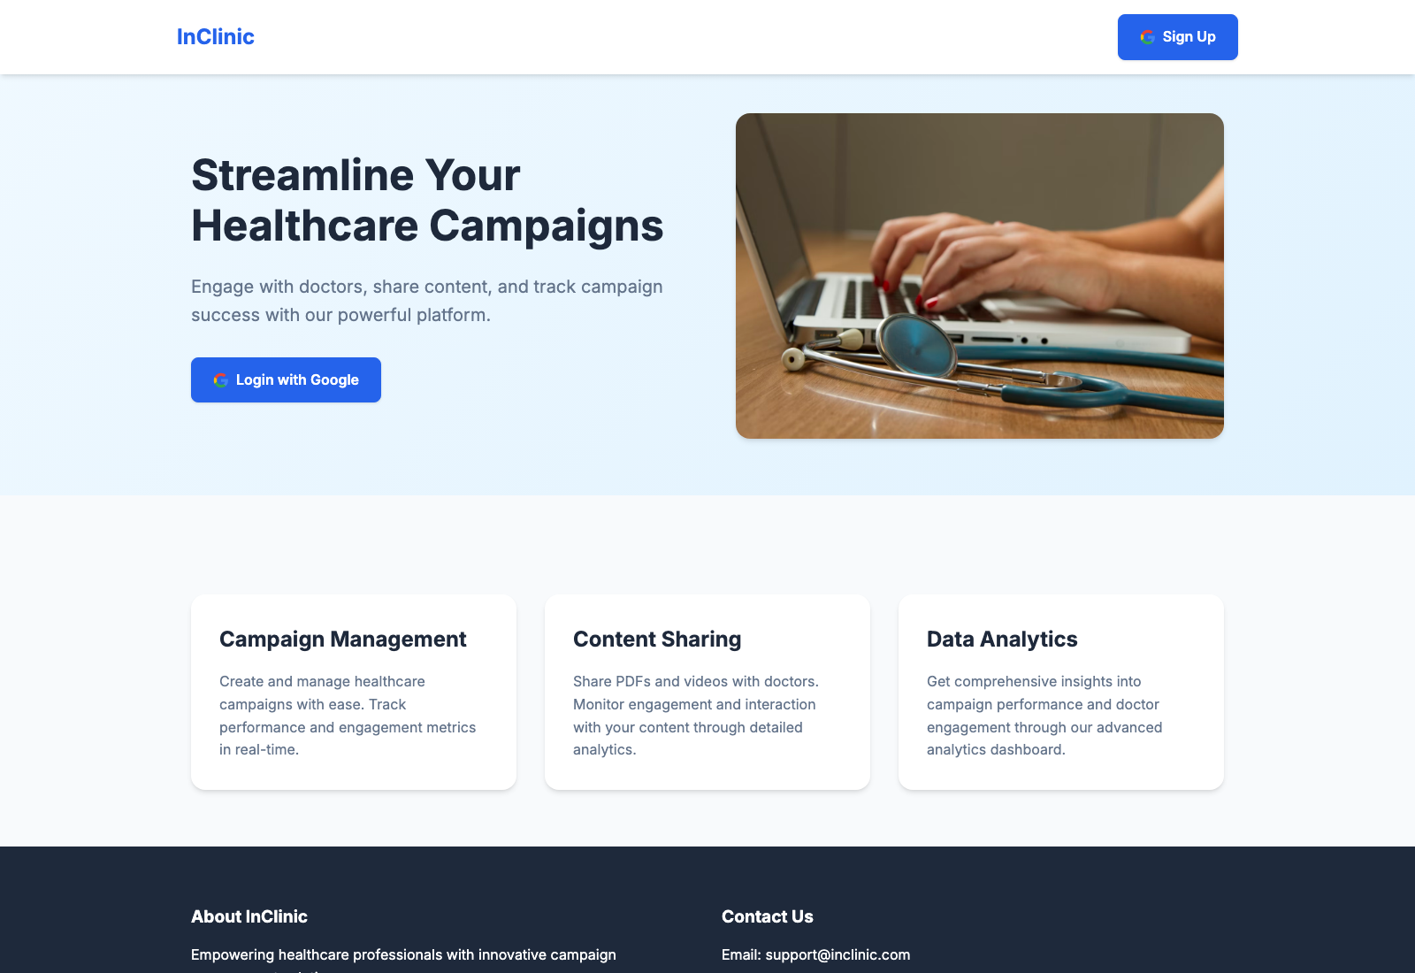
Step 1: Identify the role-specific entry point
Platform Overview and Role Map
User action
Start from the route that matches the role: publisher link, authenticated Manage Data Panel, field-rep login page, or public short link.
What appears on screen
A role-appropriate screen with the campaign context already embedded or selected.
Why it matters
The system is intentionally route-driven. The entry point determines which database data is consulted and which actions are available next.
Expected result
The user lands on the correct role surface without manually stitching together URLs.
Trainer note
Call out that the codebase has separate routes for publisher, staff, field-rep, and doctor experiences rather than a single unified shell.
Public home page used before an authenticated or signed route is chosen.
The simple unauthenticated landing page that redirects authenticated users into campaign operations.
Screenshot asset: docs/product-user-flows/assets/platform-overview-and-role-map/platform-home.png

Slide 5
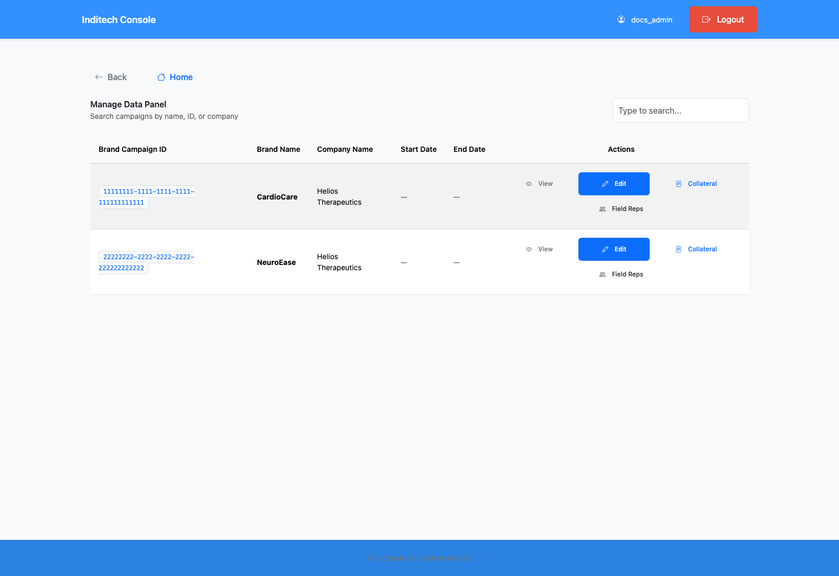
Step 2: Move campaign context from master data into portal operations
Platform Overview and Role Map
User action
Open the Manage Data Panel or the publisher flow for a specific brand campaign.
What appears on screen
A campaign inventory or campaign form populated with master-owned context such as brand name, company name, and doctor count.
Why it matters
This is the handoff from source-of-truth campaign definitions into the operational portal where the team can manage assets and distribution.
Expected result
The campaign is recognizable and ready for collateral, rep, and doctor operations.
Trainer note
Master values are shown read-only in the campaign update flow; only PE-side fields are meant to be edited locally.
Manage Data Panel with campaign shortcuts into field-rep and collateral operations.
The main operational hub that ties campaigns to downstream workflows.
Screenshot asset: docs/product-user-flows/assets/platform-overview-and-role-map/platform-manage-data.png

Slide 6
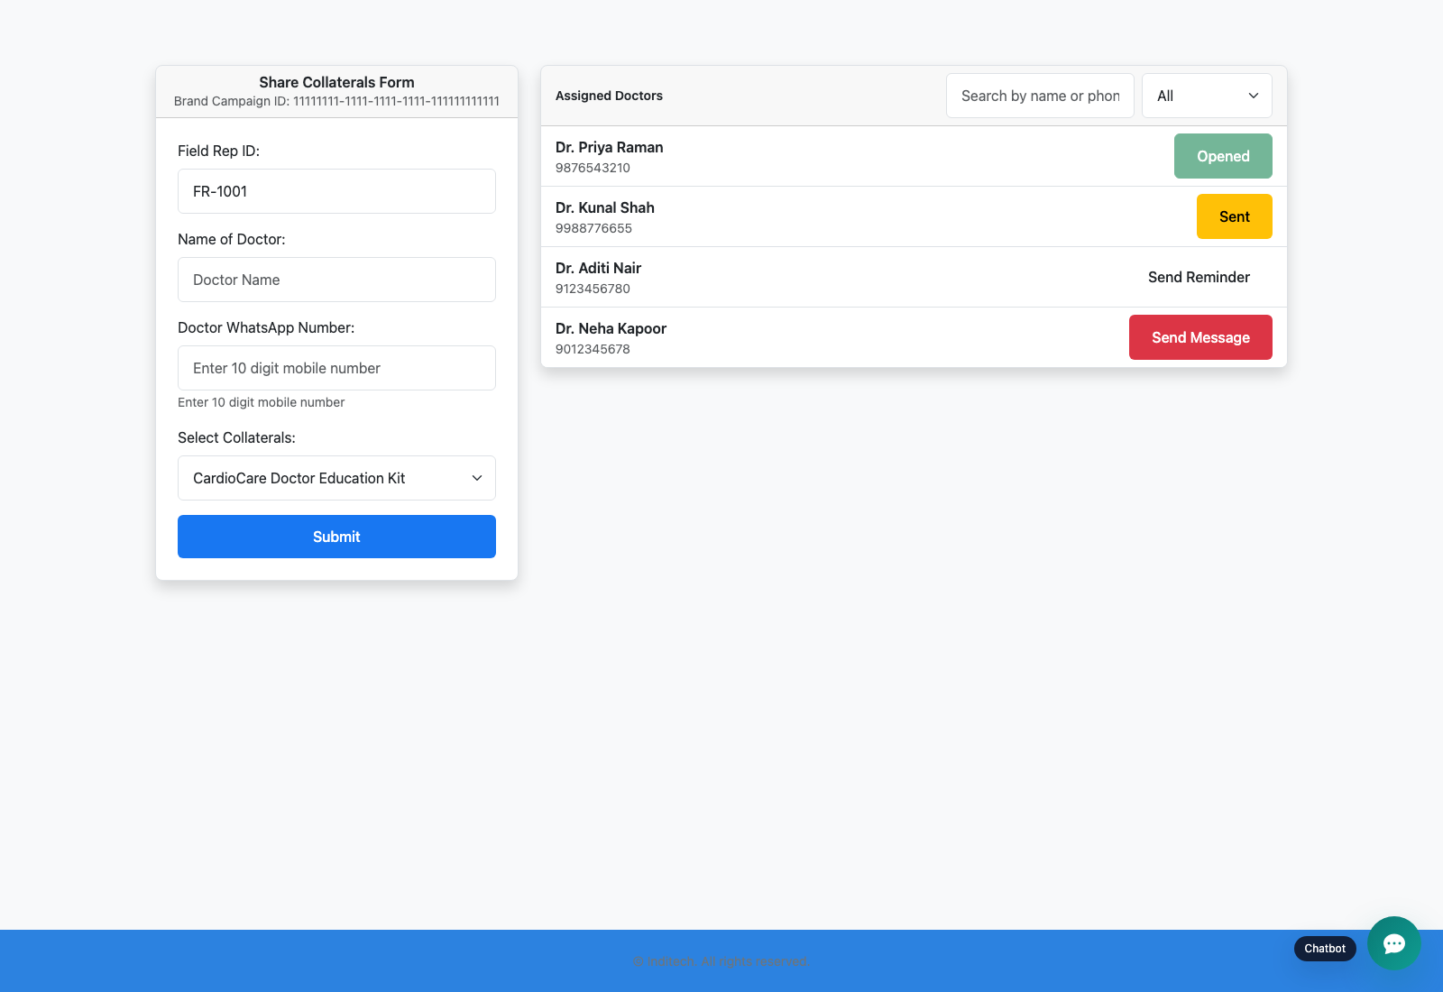
Step 3: Distribute collateral through campaign-assigned field reps
Platform Overview and Role Map
User action
Assign or confirm field reps, then let a field rep authenticate into the Gmail/manual share flow or signed SSO entry point and send a doctor-facing WhatsApp message.
What appears on screen
Campaign-specific collateral options, doctor lists, send/reminder statuses, and the floating support chatbot on the field-rep pages.
Why it matters
This is the commercial and educational delivery loop the platform is built to support.
Expected result
A doctor receives a short link tied back to the right collateral, campaign, and rep.
Trainer note
The operator-facing campaign screens and the field-rep share screens live in different route families but reference the same campaign ID. Field-rep registration happens earlier in the campaign manager or staff-admin flow; this public route family is for live login and outreach only.
Field-rep share page showing the current campaign form, doctor list, and support chatbot entry point.
The moment where campaign operations become doctor outreach in the current Gmail-first flow.
Screenshot asset: docs/product-user-flows/assets/platform-overview-and-role-map/platform-share-handoff.png

Slide 7
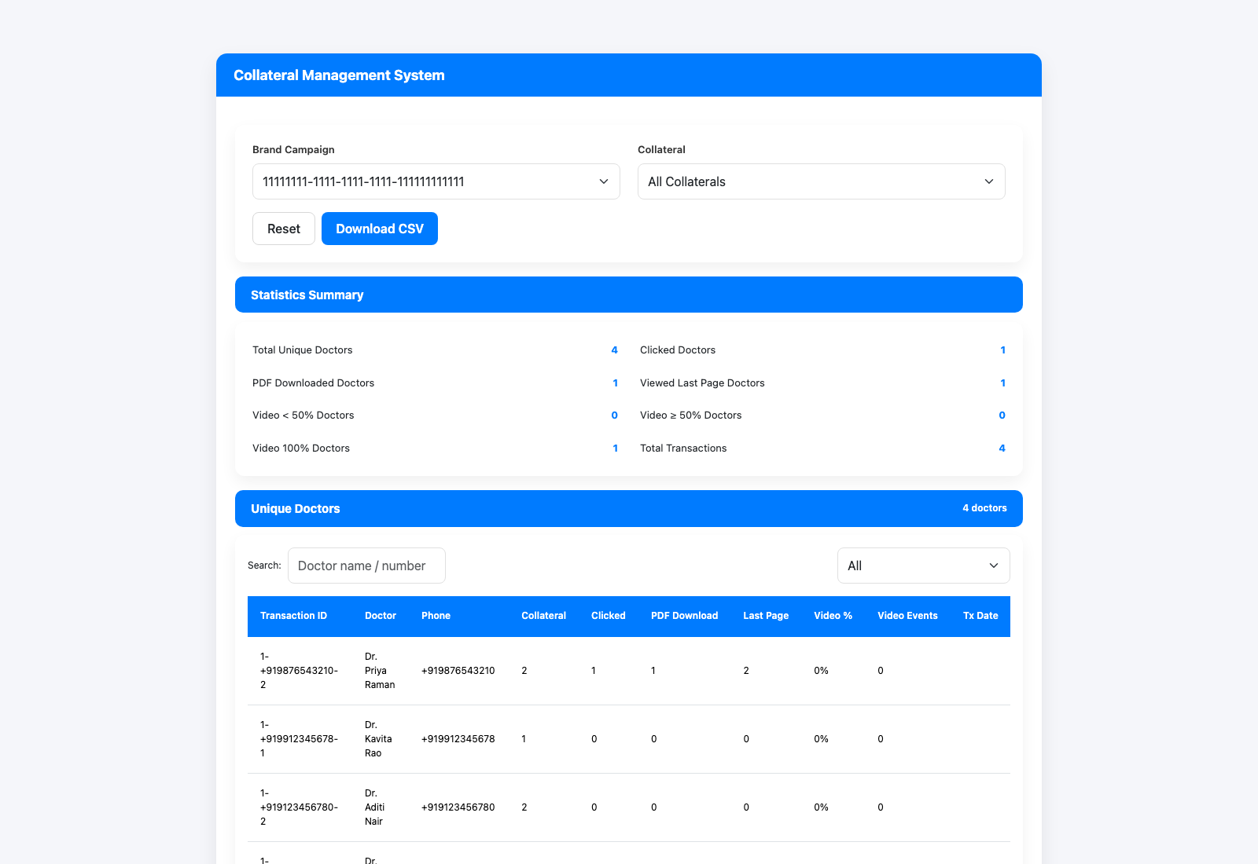
Step 4: Close the loop with doctor verification and reporting
Platform Overview and Role Map
User action
Follow the doctor from short-link click to verification, then open the transaction dashboard for the same campaign.
What appears on screen
The doctor unlock screen, the collateral viewer with PDF/archive/webinar content and support chatbot, and a reporting dashboard summarizing doctor-level outcomes.
Why it matters
The product is not just a file host; it exists to connect campaign setup to verifiable doctor engagement.
Expected result
Doctor actions are visible again in reporting and can drive follow-up conversations.
Trainer note
Point out that the transaction dashboard shows the latest state per doctor and collateral rather than every raw event row.
Reporting dashboard that reflects the downstream result of shares and doctor engagement.
The closed feedback loop from campaign setup to doctor behavior.
Screenshot asset: docs/product-user-flows/assets/platform-overview-and-role-map/platform-reporting-loop.png

Slide 8
Trainer Tips
Platform Overview and Role Map
Facilitation notes
Treat the campaign UUID as the product's cross-role handoff key.
Use the platform overview deck first during training so later role decks make sense faster.
Related documents: README.md, docs/product-user-flows/02-publisher-campaign-onboarding-and-update.md, docs/product-user-flows/07-field-rep-sharing-and-doctor-bulk-upload.md, docs/product-user-flows/09-engagement-reporting-and-transaction-review.md
Validated against the seeded docs demo and the current Django route map on 2026-04-23.

Slide 9
What success looks like
A new user can explain which role owns which screen family.
The relationship between master data, portal edits, sharing, verification, and reporting is clear.
The team knows where to start each downstream workflow without guessing routes.
Use next
Review README.md
Review docs/product-user-flows/02-publisher-campaign-onboarding-and-update.md
Review docs/product-user-flows/07-field-rep-sharing-and-doctor-bulk-upload.md
Validated against the seeded docs demo and the current Django route map on 2026-04-23.

