Slide 1
Publisher Campaign Onboarding and Update
Training Pack
Signed publisher route: `/campaigns/publisher- landing-page/?campaign- id=<uuid>&jwt=<token>`.
Show how a publisher or partner system opens the portal with a signed campaign link and maintains the editable portal-side campaign fields.
Publisher and Campaign Operations
Primary user: Publisher users, partner-system operators, and trainers supporting SSO onboarding.
Generated: 2026-04-23

Slide 2
Workflow Overview
Publisher Campaign Onboarding and Update
Primary User
Entry Point
Purpose
Publisher users, partner-system operators, and trainers supporting SSO onboarding.
Signed publisher route: `/campaigns/publisher-landing-page/?campaign-id=<uuid>&jwt=<token>`.
Show how a publisher or partner system opens the portal with a signed campaign link and maintains the editable portal-side campaign fields.
What to cover
A signed JWT establishes the publisher session without a standard Django login.
The landing page stores the campaign ID in session and offers the add/edit campaign paths.
The campaign update page merges read-only master data with locally editable PE fields and exposes Add/Edit Field Rep outbound buttons.
Successful saves keep the user on the campaign update route so the campaign can be refined iteratively.
Source manual: docs/product-user-flows/02-publisher-campaign-onboarding-and-update.md

Slide 3
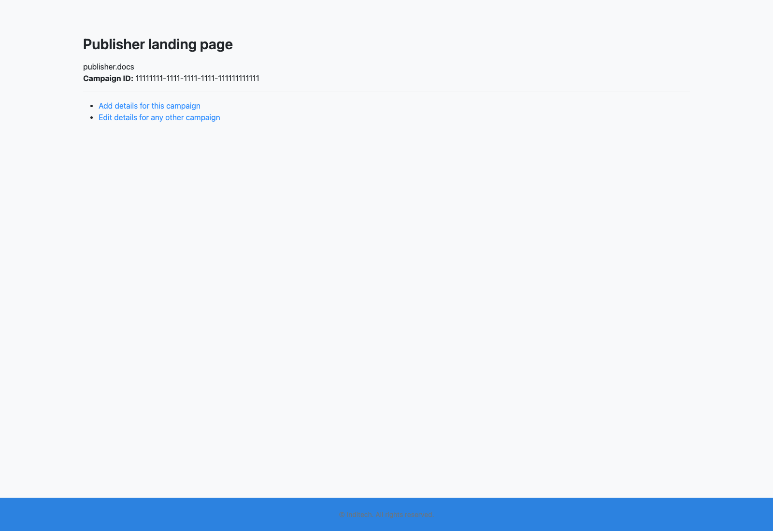
Step 1: Open the signed publisher landing page
Publisher Campaign Onboarding and Update
User action
Launch the partner-provided URL that contains the `campaign-id` and publisher JWT.
What appears on screen
A minimal publisher landing page confirming the campaign ID and offering the `Add details for this campaign` and `Edit details for any other campaign` actions.
Why it matters
The signed link is what authorizes a publisher without giving them a normal portal user account.
Expected result
The publisher session is established and the campaign ID is stored in the session.
Trainer note
If the JWT is missing or invalid, the route returns `unauthorised access` instead of falling back to a portal login screen.
Publisher landing page after a valid signed link is opened.
Campaign ID confirmation and the branch into the add-details workflow.
Screenshot asset: docs/product-user-flows/assets/publisher-campaign-onboarding-and-update/publisher-landing.png

Slide 4
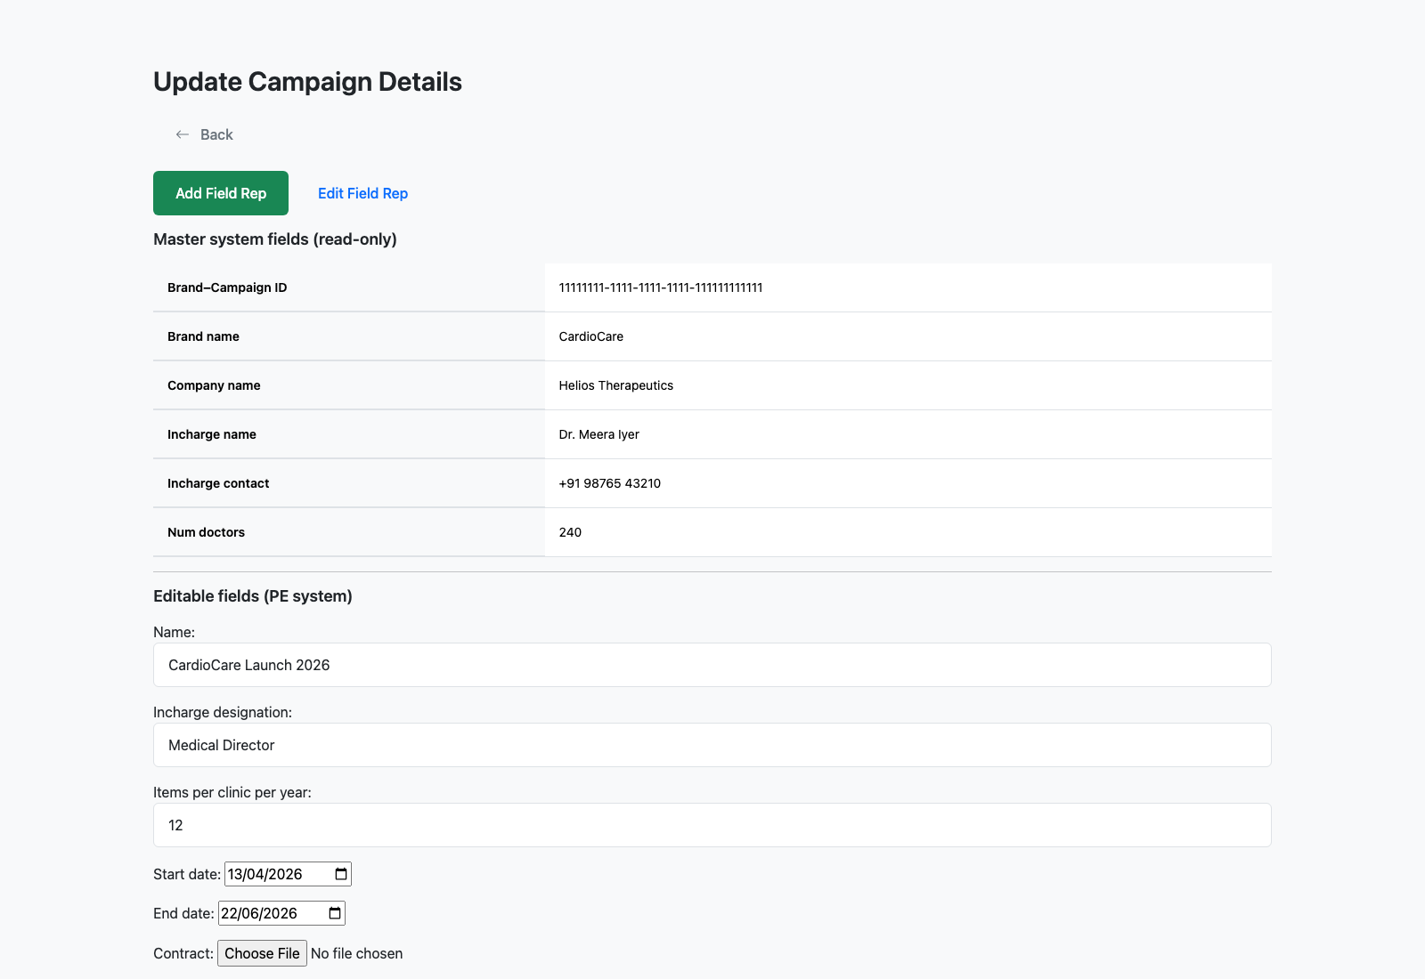
Step 2: Open the campaign update form
Publisher Campaign Onboarding and Update
User action
Choose the add-details or edit path for the current campaign.
What appears on screen
A campaign form that keeps master-system fields read-only and exposes portal-specific fields such as campaign name, dates, logos, background image, printing requirement, and status, plus `Add Field Rep` and `Edit Field Rep` outbound buttons.
Why it matters
This is the sanctioned place where the PE system adds campaign-specific presentation and timing details without mutating the master record.
Expected result
The publisher understands which information is reference-only and which is editable locally.
Trainer note
The form includes direct outbound buttons for field-rep management in the external field-rep site, which is a separate integration touchpoint from the local Django routes.
Publisher-facing campaign update screen showing read-only master fields and editable portal fields.
The split between immutable master metadata and editable PE-side fields.
Screenshot asset: docs/product-user-flows/assets/publisher-campaign-onboarding-and-update/publisher-campaign-update.png

Slide 5
Step 3: Populate the editable campaign fields
Publisher Campaign Onboarding and Update
User action
Review the campaign dates, description, logos, field-rep login background image, printing settings, and status, then save the changes.
What appears on screen
The standard Django multipart form experience with the campaign values preserved on return.
Why it matters
These fields drive the field-rep visual experience, campaign timing, and what downstream users see in the portal.
Expected result
The portal campaign record is ready for collateral setup and field-rep access.
Trainer note
Because the route saves back to the same campaign update URL, it is normal to treat this page as a working draft screen rather than a one-time wizard.
Campaign update form used to maintain the PE-side metadata for the selected campaign.
The editable form controls and save action.
Screenshot asset: docs/product-user-flows/assets/publisher-campaign-onboarding-and-update/publisher-campaign-update.png

Slide 6
Step 4: Hand off to downstream campaign operations
Publisher Campaign Onboarding and Update
User action
After saving, hand the campaign over to the operator or internal team responsible for collaterals and field reps.
What appears on screen
The refreshed campaign update page, which now represents the latest local state for that campaign.
Why it matters
Publisher onboarding is the start of the lifecycle, not the end. The downstream team still needs campaign context to assign reps and publish assets.
Expected result
The campaign is ready for staff-level operations and field-rep activation.
Trainer note
If the publisher enters a campaign that does not yet exist locally, the portal automatically routes them into the create/update path rather than failing.
Saved campaign update screen that becomes the handoff state for the operations team.
The persistent campaign record after publisher edits are stored.
Screenshot asset: docs/product-user-flows/assets/publisher-campaign-onboarding-and-update/publisher-campaign-update.png

Slide 7
Trainer Tips
Publisher Campaign Onboarding and Update
Facilitation notes
Keep a sample signed URL handy during training so participants can see the JWT-based bootstrap in action.
Explain that the landing page is intentionally simple because its main job is session establishment and campaign selection.
Related documents: docs/product-user-flows/03-internal-campaign-operations-from-the-manage-data-panel.md, backend/campaign_management/views.py, backend/campaign_management/publisher_auth.py
Validated against the signed publisher demo route on 2026-04-23.

Slide 8
What success looks like
The publisher can enter with a signed link and reach the campaign update screen.
The distinction between master-owned and portal-owned data is clear.
The saved campaign is ready to be used by the operational team.
Use next
Review docs/product-user-flows/03-internal-campaign-operations-from-the-manage-data-panel.md
Review backend/campaign_management/views.py
Review backend/campaign_management/publisher_auth.py
Validated against the signed publisher demo route on 2026-04-23.

