Slide 1
Internal Campaign Operations from the Manage Data Panel
Training Pack
Authenticated portal login followed by `/campaigns/manage-data/`.
Teach internal operators how to search campaign inventory, open individual campaigns, and branch into the linked operational tools.
Publisher and Campaign Operations
Primary user: Internal campaign operators and trainers onboarding operational staff.
Generated: 2026-04-23

Slide 2
Workflow Overview
Internal Campaign Operations from the Manage Data Panel
Primary User
Entry Point
Purpose
Internal campaign operators and trainers onboarding operational staff.
Authenticated portal login followed by `/campaigns/manage-data/`.
Teach internal operators how to search campaign inventory, open individual campaigns, and branch into the linked operational tools.
What to cover
The Manage Data Panel pulls campaign reference data from the master database and merges it with any local portal campaign rows.
Operators can search by brand campaign ID, brand name, or company name.
Every campaign row provides direct shortcuts into view, edit, collateral, and field-rep operations.
This screen is the fastest route for orienting to a campaign before switching into a role-specific workflow.
Source manual: docs/product-user-flows/03-internal-campaign-operations-from-the-manage-data-panel.md

Slide 3
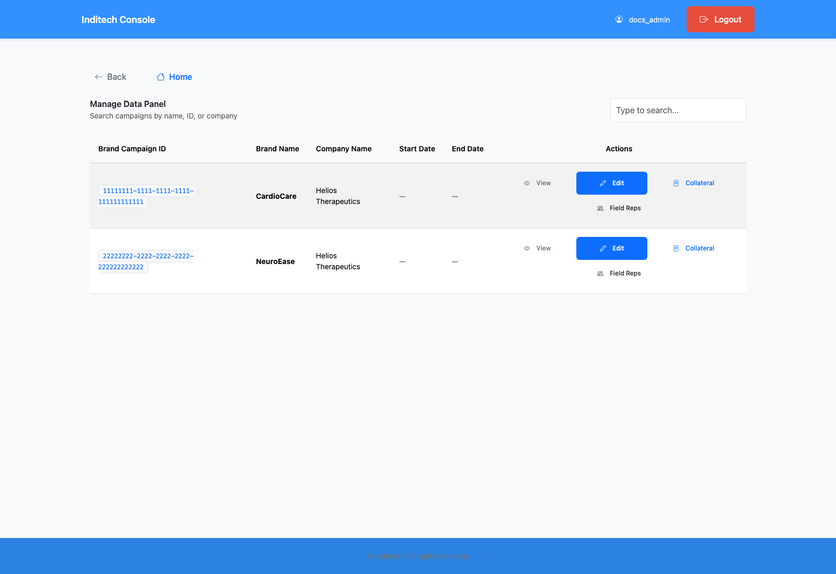
Step 1: Log in and open the Manage Data Panel
Internal Campaign Operations from the Manage Data Panel
User action
Sign in to the portal and navigate to the Manage Data Panel.
What appears on screen
A searchable campaign table with brand campaign IDs, brand names, company names, dates, and row buttons labeled `View`, `Edit`, `Collateral`, and `Field Reps`.
Why it matters
This is the operational inventory of campaigns that can be maintained in the portal right now.
Expected result
The operator can quickly locate the campaign that needs work.
Trainer note
The live-search field debounces and refreshes the URL query string automatically. Blank start or end dates usually mean the portal-side campaign row is not fully configured yet.
Manage Data Panel with campaign inventory and action buttons.
The search field and per-row action shortcuts.
Screenshot asset: docs/product-user-flows/assets/internal-campaign-operations-from-the-manage-data-panel/manage-data-panel.png

Slide 4
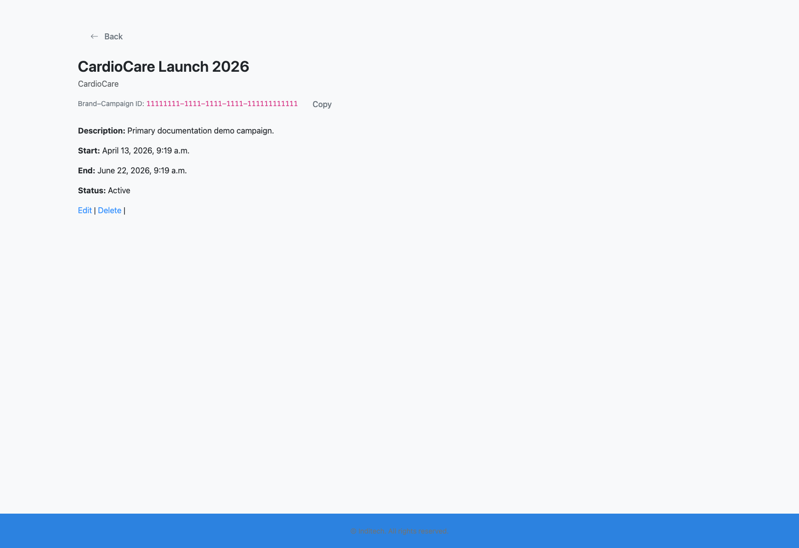
Step 2: Filter and inspect a specific campaign
Internal Campaign Operations from the Manage Data Panel
User action
Use the live search field and open the selected campaign's view or edit route.
What appears on screen
A campaign detail or campaign update page where the operator can confirm the local description, dates, status, and other portal-side metadata for the selected brand campaign.
Why it matters
Operators rarely work on every campaign at once; the panel is meant to narrow attention to a single campaign quickly.
Expected result
The campaign row that matters is isolated and ready for action.
Trainer note
Use `View` when you only need a quick read of the campaign, and `Edit` when you need to change the PE-side metadata or inspect the master read-only fields in more depth.
Campaign detail page reached from the Manage Data Panel.
The campaign-specific detail context after selecting a row.
Screenshot asset: docs/product-user-flows/assets/internal-campaign-operations-from-the-manage-data-panel/campaign-detail.png

Slide 5
Step 3: Branch into the next operational tool
Internal Campaign Operations from the Manage Data Panel
User action
Choose the shortcut for collateral management or field-rep management from the same row.
What appears on screen
A new tab that opens either the collateral dashboard or the field-rep administration list with the same brand campaign ID already carried into the next screen.
Why it matters
The Manage Data Panel is meant to hand campaign context forward instead of forcing users to re-enter campaign IDs elsewhere.
Expected result
The next workflow opens already focused on the same brand campaign.
Trainer note
This is where trainers should explain the brand campaign ID as the shared handoff key across the product. The `Collateral` button opens the rep-facing collateral dashboard, and `Field Reps` opens the staff rep list.
Campaign row with shortcut buttons for downstream operations.
The direct handoff from campaign inventory into field-rep and collateral routes.
Screenshot asset: docs/product-user-flows/assets/internal-campaign-operations-from-the-manage-data-panel/manage-data-panel.png

Slide 6
Step 4: Confirm downstream readiness
Internal Campaign Operations from the Manage Data Panel
User action
Check that the campaign has the expected dates, status, and accessible collateral or rep routes.
What appears on screen
A consistent campaign context across the linked screens.
Why it matters
A small mismatch at this stage can ripple into the sharing and doctor experience later.
Expected result
The operator knows the campaign is ready for rep and collateral workflows.
Trainer note
The codebase currently links some operator buttons into routes that are role-gated differently, so it is worth validating the user account used for training ahead of time.
Campaign inventory used as the launching point for all downstream work.
Campaign readiness before switching to the next role deck.
Screenshot asset: docs/product-user-flows/assets/internal-campaign-operations-from-the-manage-data-panel/manage-data-panel.png

Slide 7
Trainer Tips
Internal Campaign Operations from the Manage Data Panel
Facilitation notes
Use this deck immediately after the publisher deck so the same campaign ID is still familiar.
Call out the current role-gating nuance when you demonstrate the collateral shortcut.
Related documents: docs/product-user-flows/04-admin-field-rep-and-doctor-management.md, docs/product-user-flows/05-collateral-authoring-and-message-setup.md, backend/campaign_management/views.py
Validated against the seeded Manage Data Panel on 2026-04-23.

Slide 8
What success looks like
Operators can locate a campaign quickly from the campaign inventory.
The purpose of each row-level shortcut is understood.
The campaign is verified before the trainer moves into collateral or field-rep decks.
Use next
Review docs/product-user-flows/04-admin-field-rep-and-doctor-management.md
Review docs/product-user-flows/05-collateral-authoring-and-message-setup.md
Review backend/campaign_management/views.py
Validated against the seeded Manage Data Panel on 2026-04-23.

