Slide 1
Collateral Authoring and Message Setup
Training Pack
Campaign-scoped collateral panel: `/share/dashboard/?ca mpaign=<brand_campaign_id>` plus `/collaterals/add/<bran d_campaign_id>/` and `/collaterals/collateral- messages/`.
Show how campaign assets, dashboard shortcuts, collateral schedules, and WhatsApp messages are configured before field reps start sharing.
Publisher and Campaign Operations
Primary user: Campaign operators and training leads preparing the collateral side of a launch.
Generated: 2026-04-23

Slide 2
Workflow Overview
Collateral Authoring and Message Setup
Primary User
Entry Point
Purpose
Campaign operators and training leads preparing the collateral side of a launch.
Campaign-scoped collateral panel: `/share/dashboard/?campaign=<brand_campaign_id>` plus `/collaterals/add/<brand_campaign_id>/` and `/collaterals/collateral-messages/`.
Show how campaign assets, dashboard shortcuts, collateral schedules, and WhatsApp messages are configured before field reps start sharing.
What to cover
The collateral dashboard is the campaign-scoped control panel for asset inventory, calendar edits, and rep-facing entry points.
Add Collateral combines campaign selection, asset upload, banner configuration, webinar metadata, and a default WhatsApp message path.
Collateral Messages Management stores custom message text per campaign-collateral pair.
Calendar windows determine when a collateral is considered available in the share screens.
Source manual: docs/product-user-flows/05-collateral-authoring-and-message-setup.md

Slide 3
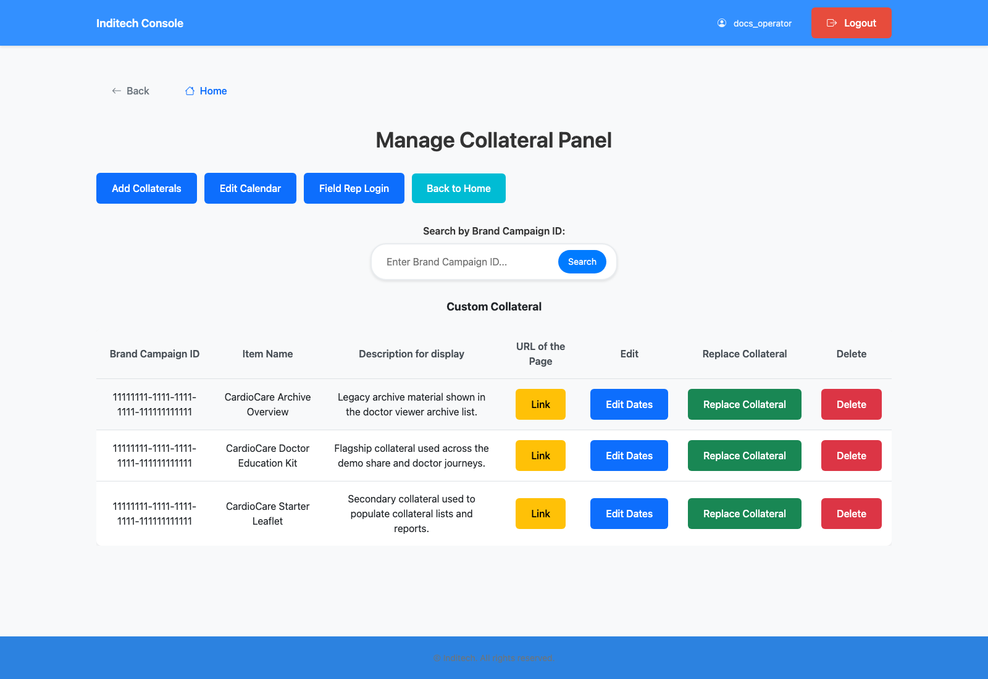
Step 1: Open the campaign collateral dashboard
Collateral Authoring and Message Setup
User action
Navigate to the campaign's collateral panel from the campaign inventory or directly through the filtered route.
What appears on screen
A campaign-scoped dashboard with top buttons for `Add Collaterals`, `Edit Calendar`, `Field Rep Login`, and `Back to Home`, plus a collateral table with `Link`, `Edit Dates`, `Replace Collateral`, and `Delete` actions.
Why it matters
This dashboard is the operator's launch pad for collateral and rep-facing setup.
Expected result
The operator sees the current collateral inventory and the next setup actions in one place.
Trainer note
This route is campaign-aware and surfaces the same brand campaign ID used elsewhere in the product. The dashboard search box also lets trainers jump directly between campaigns by brand campaign ID.
Campaign collateral dashboard with collateral inventory and setup shortcuts.
The operator-facing control panel for campaign assets.
Screenshot asset: docs/product-user-flows/assets/collateral-authoring-and-message-setup/collateral-dashboard.png

Slide 4
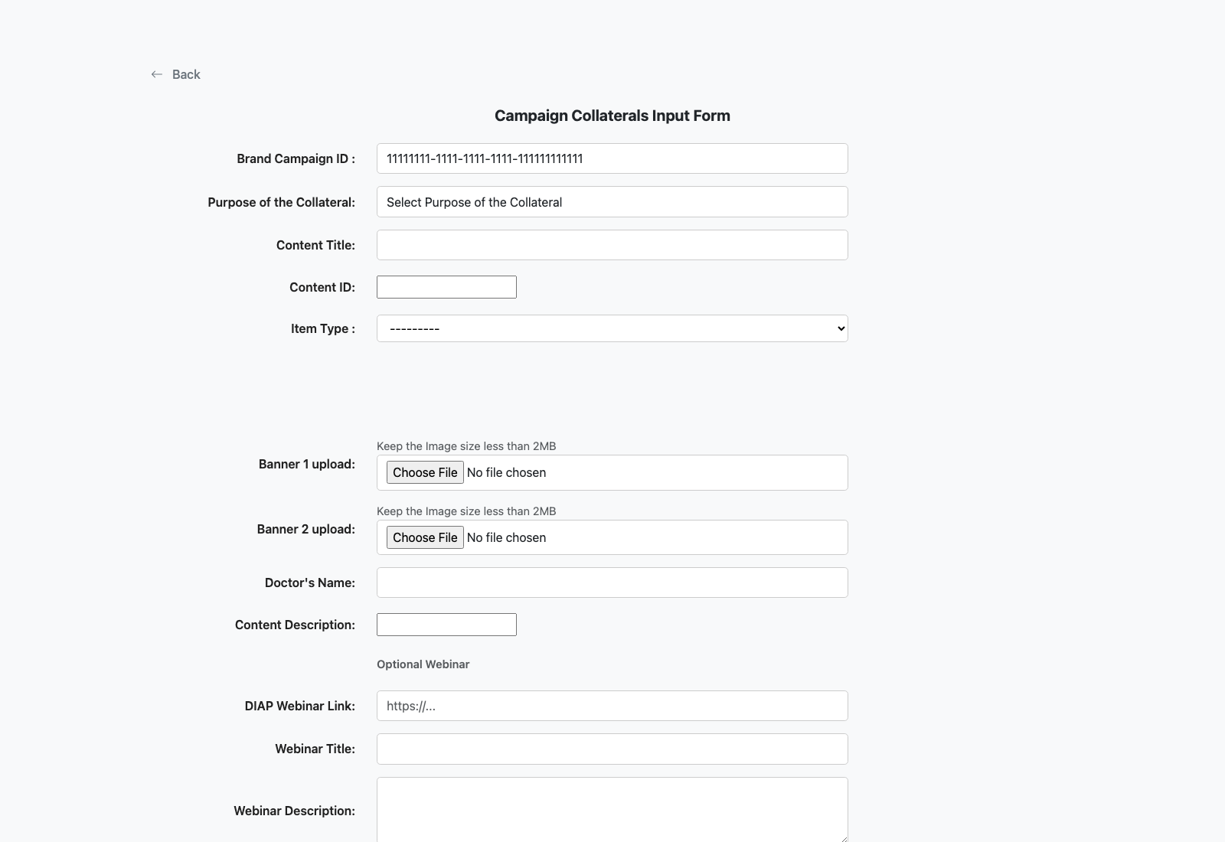
Step 2: Create or update a collateral asset
Collateral Authoring and Message Setup
User action
Open the Add Collateral form, choose the campaign and purpose, upload the PDF and banners, choose the type, and add descriptive or webinar metadata before submitting.
What appears on screen
A large multipart form for campaign, purpose, content title, content ID, collateral type, PDF or Vimeo input, banners, doctor display name, description, webinar details, and an inline WhatsApp message text area.
Why it matters
This screen defines what the doctor ultimately sees after verification.
Expected result
The campaign has a polished collateral record that can be linked and shared.
Trainer note
The type selector changes which asset inputs are visible: PDF, Vimeo, or both. The submit button saves both the collateral record and the optional WhatsApp message text for that campaign-collateral pair.
Collateral input form used to create campaign-ready doctor content.
The PDF upload, metadata, and banner sections of the form.
Screenshot asset: docs/product-user-flows/assets/collateral-authoring-and-message-setup/add-collateral-form.png

Slide 5
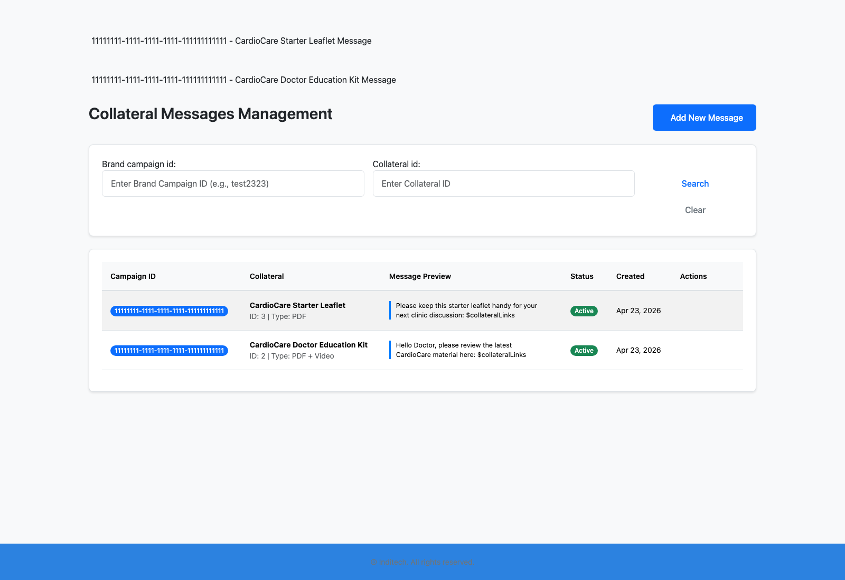
Step 3: Review or customize the WhatsApp message
Collateral Authoring and Message Setup
User action
Open the Collateral Messages Management page and inspect the message linked to the collateral and campaign pair.
What appears on screen
A searchable message list with campaign and collateral filters, message preview, status, created date, and edit/delete actions.
Why it matters
The share experience depends on good rep-facing message text that includes the `$collateralLinks` placeholder.
Expected result
The active message is appropriate for the campaign and collateral being launched.
Trainer note
Use this step to remind trainees that the message text is not global; it is scoped to a specific campaign and collateral.
Message-management page showing the campaign-to-collateral WhatsApp text setup.
The message preview list and campaign/collateral filtering controls.
Screenshot asset: docs/product-user-flows/assets/collateral-authoring-and-message-setup/collateral-messages.png

Slide 6
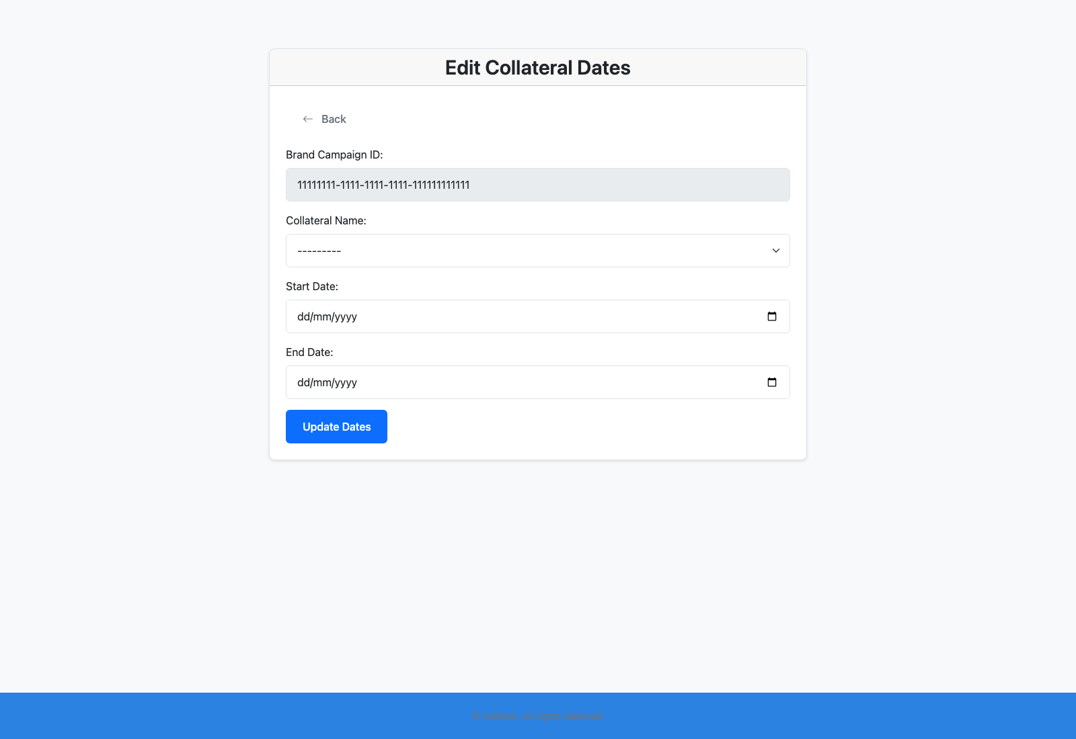
Step 4: Adjust the collateral calendar window
Collateral Authoring and Message Setup
User action
Open the Edit Calendar screen from the top dashboard button or the row-level `Edit Dates` action and confirm the start and end dates for the campaign-collateral mapping.
What appears on screen
A calendar-edit screen that shows the campaign ID, collateral title, and editable start and end date controls.
Why it matters
Availability windows are one of the key reasons a collateral might not appear for a field rep even when the asset exists.
Expected result
Only the intended collateral is active during the campaign window.
Trainer note
This is one of the first places to inspect if a field rep says a collateral is missing from the share page.
Calendar management screen used to control collateral availability windows.
The date controls that determine whether a collateral appears in the share flow.
Screenshot asset: docs/product-user-flows/assets/collateral-authoring-and-message-setup/edit-calendar.png

Slide 7
Trainer Tips
Collateral Authoring and Message Setup
Facilitation notes
Demonstrate the message placeholder explicitly so trainees understand how the short link gets injected.
If a share screen looks empty, revisit the calendar window before assuming the asset is missing.
Related documents: docs/product-user-flows/07-field-rep-sharing-and-doctor-bulk-upload.md, backend/collateral_management/views.py, backend/collateral_management/views_collateral_message.py
Validated against the seeded collateral dashboard and forms on 2026-04-23.

Slide 8
What success looks like
Operators can create or review a collateral tied to the campaign.
Message text and collateral availability windows are understood as part of the launch workflow.
The field-rep-facing collateral inventory is ready before rep training starts.
Use next
Review docs/product-user-flows/07-field-rep-sharing-and-doctor-bulk-upload.md
Review backend/collateral_management/views.py
Review backend/collateral_management/views_collateral_message.py
Validated against the seeded collateral dashboard and forms on 2026-04-23.

