Slide 1
Field Rep Login
Training Pack
Campaign-scoped Field Rep login route: `/share/fieldrep-gmail-login /?campaign=<brand_campaign_i d>`.
Explain the live public Field Rep login screen and how campaign-scoped reps sign in with Email ID and Field Rep ID.
Field Rep Journeys
Primary user: Field reps and trainers preparing reps for their first campaign login.
Generated: 2026-04-23

Slide 2
Workflow Overview
Field Rep Login
Primary User
Entry Point
Purpose
Field reps and trainers preparing reps for their first campaign login.
Campaign-scoped Field Rep login route: `/share/fieldrep-gmail-login/?campaign=<brand_campaign_id>`.
Explain the live public Field Rep login screen and how campaign-scoped reps sign in with Email ID and Field Rep ID.
What to cover
Field reps are registered through the campaign manager or staff-admin workflow before they ever reach the public login page.
Public training now focuses on one live login pattern: Email ID plus Brand Specific Field ID.
Campaign context can travel in the query string or session so a rep is taken directly into the correct campaign after login.
Successful login takes the rep straight into the campaign share page used in workflow 07.
The field-rep background can be campaign-specific when the campaign has a configured background image.
Source manual: docs/product-user-flows/06-field-rep-registration-and-login.md

Slide 3
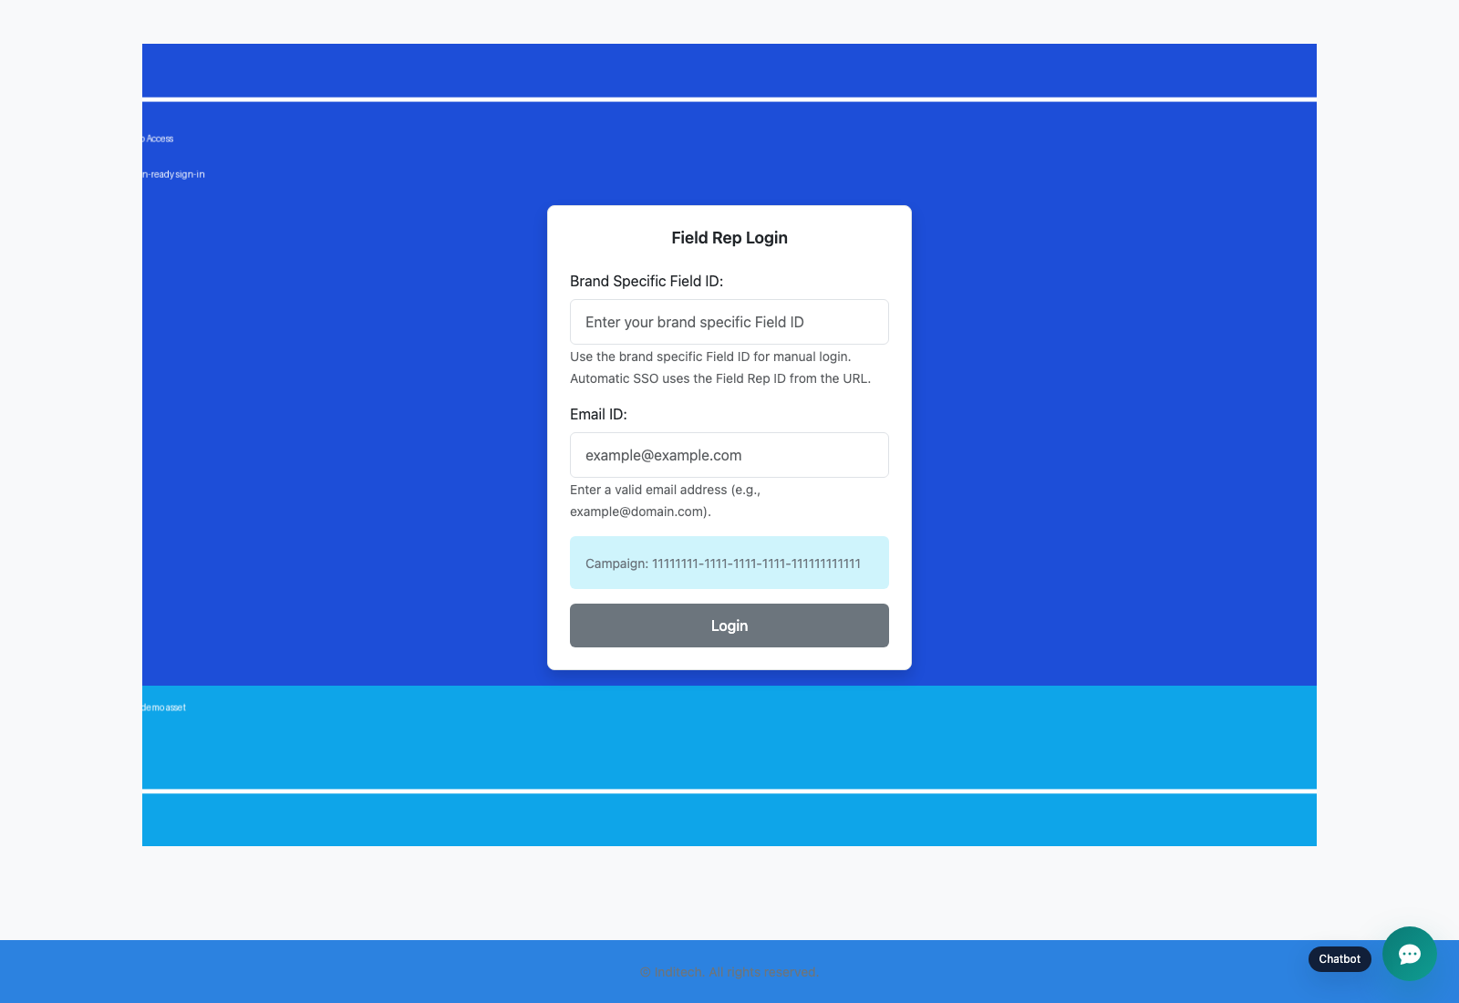
Step 1: Open the campaign-scoped Field Rep login page
Field Rep Login
User action
Launch the public Field Rep login URL for the selected campaign.
What appears on screen
A campaign-scoped login form labeled Brand Specific Field ID and Email ID, along with the campaign context and the floating support chatbot.
Why it matters
This is the live entry point field reps use after they have already been registered in the campaign manager workflow.
Expected result
The rep reaches the correct login surface for the campaign they need to work on.
Trainer note
Set the expectation clearly: this page is for login only. Registration and rep setup happen earlier in the admin workflow covered in workflow 04.
Current Field Rep login page used for campaign-scoped rep access.
The Email ID and Brand Specific Field ID fields that lead into the share experience.
Screenshot asset: docs/product-user-flows/assets/field-rep-registration-and-login/fieldrep-gmail-login.png

Slide 4
Step 2: Sign in with Email ID and Field Rep ID
Field Rep Login
User action
Enter the Email ID and Brand Specific Field ID exactly as assigned for the campaign, then submit the form.
What appears on screen
The same login card until submission succeeds, after which the rep is redirected into the campaign share screen with the selected campaign already in context.
Why it matters
These two identifiers are the only public-login fields the rep needs for the live workflow.
Expected result
The rep lands on the share page and is ready to start sending collateral.
Trainer note
If login fails, confirm that the rep record exists in the campaign manager dashboard and that the Email ID plus Field Rep ID pair belongs to the same campaign assignment.
Field Rep login page showing the two identifiers required for campaign access.
The credential fields and submit action used before the rep is redirected into sharing.
Screenshot asset: docs/product-user-flows/assets/field-rep-registration-and-login/fieldrep-gmail-login.png

Slide 5
Trainer Tips
Field Rep Login
Facilitation notes
Anchor the training on the actual two-field login pattern instead of describing historical public registration routes.
If the audience asks where reps are created, point them back to workflow 04 rather than expanding this deck into admin setup.
Keep this deck short so the training spends most of its time in the share workflow.
Related documents: docs/product-user-flows/04-admin-field-rep-and-doctor-management.md, docs/product-user-flows/07-field-rep-sharing-and-doctor-bulk-upload.md, backend/sharing_management/views.py, backend/sharing_management/templates/sharing_management/fieldrep_gmail_login.html
Validated against the current public Field Rep login screen on 2026-04-23; registration is documented in the admin workflow instead of the public rep deck.

Slide 6
What success looks like
Trainees understand that registration happens in the campaign manager or staff-admin workflow, not on the public rep page.
The live public login uses only Email ID and Brand Specific Field ID.
Campaign context in the URL is explained clearly.
The group is ready to continue into the share workflow with the correct login path.
Use next
Review docs/product-user-flows/04-admin-field-rep-and-doctor-management.md
Review docs/product-user-flows/07-field-rep-sharing-and-doctor-bulk-upload.md
Review backend/sharing_management/views.py
Validated against the current public Field Rep login screen on 2026-04-23; registration is documented in the admin workflow instead of the public rep deck.

