Slide 1
Field Rep Sharing and Doctor Addition
Training Pack
Campaign-scoped Gmail share route: `/share/fieldrep- gmail-share-collateral/?bran d_campaign_id=<brand_campaig n_id>`.
Document the day-to-day field-rep workflow for choosing doctors, adding missing doctors one at a time, sending collateral through WhatsApp, and following up with reminders.
Field Rep Journeys
Primary user: Field reps and trainers running campaign distribution sessions.
Generated: 2026-04-23

Slide 2
Workflow Overview
Field Rep Sharing and Doctor Addition
Primary User
Entry Point
Purpose
Field reps and trainers running campaign distribution sessions.
Campaign-scoped Gmail share route: `/share/fieldrep-gmail-share-collateral/?brand_campaign_id=<brand_campaign_id>`.
Document the day-to-day field-rep workflow for choosing doctors, adding missing doctors one at a time, sending collateral through WhatsApp, and following up with reminders.
What to cover
The Gmail share page is the campaign-aware workbench for choosing a doctor, choosing collateral, and launching the WhatsApp handoff.
Missing doctors are handled one at a time from the left-side manual form, where the rep enters the doctor's name and WhatsApp number, chooses a collateral, and sends with the `Submit` button.
Doctors can be typed manually on the left-side form or reused from the rep's assigned doctor list on the right, where each row doubles as a quick-send shortcut.
The right-side doctor statuses are collateral-specific and progress from `Send Message` to `Sent`, then to `Send Reminder` after six days without engagement, and finally to `Opened` once the doctor views the collateral.
Each quick-send action creates or reuses a short link, upserts the doctor record if needed, writes a ShareLog entry, and opens the WhatsApp deep link for that doctor and collateral.
The public rep screens now include the support chatbot so reps and trainers can jump into help without leaving the workflow.
If the roster is incomplete, the current training flow adds doctors one at a time either from this share page or earlier in the staff-admin doctor maintenance workflow.
Source manual: docs/product-user-flows/07-field-rep-sharing-and-doctor-bulk-upload.md

Slide 3
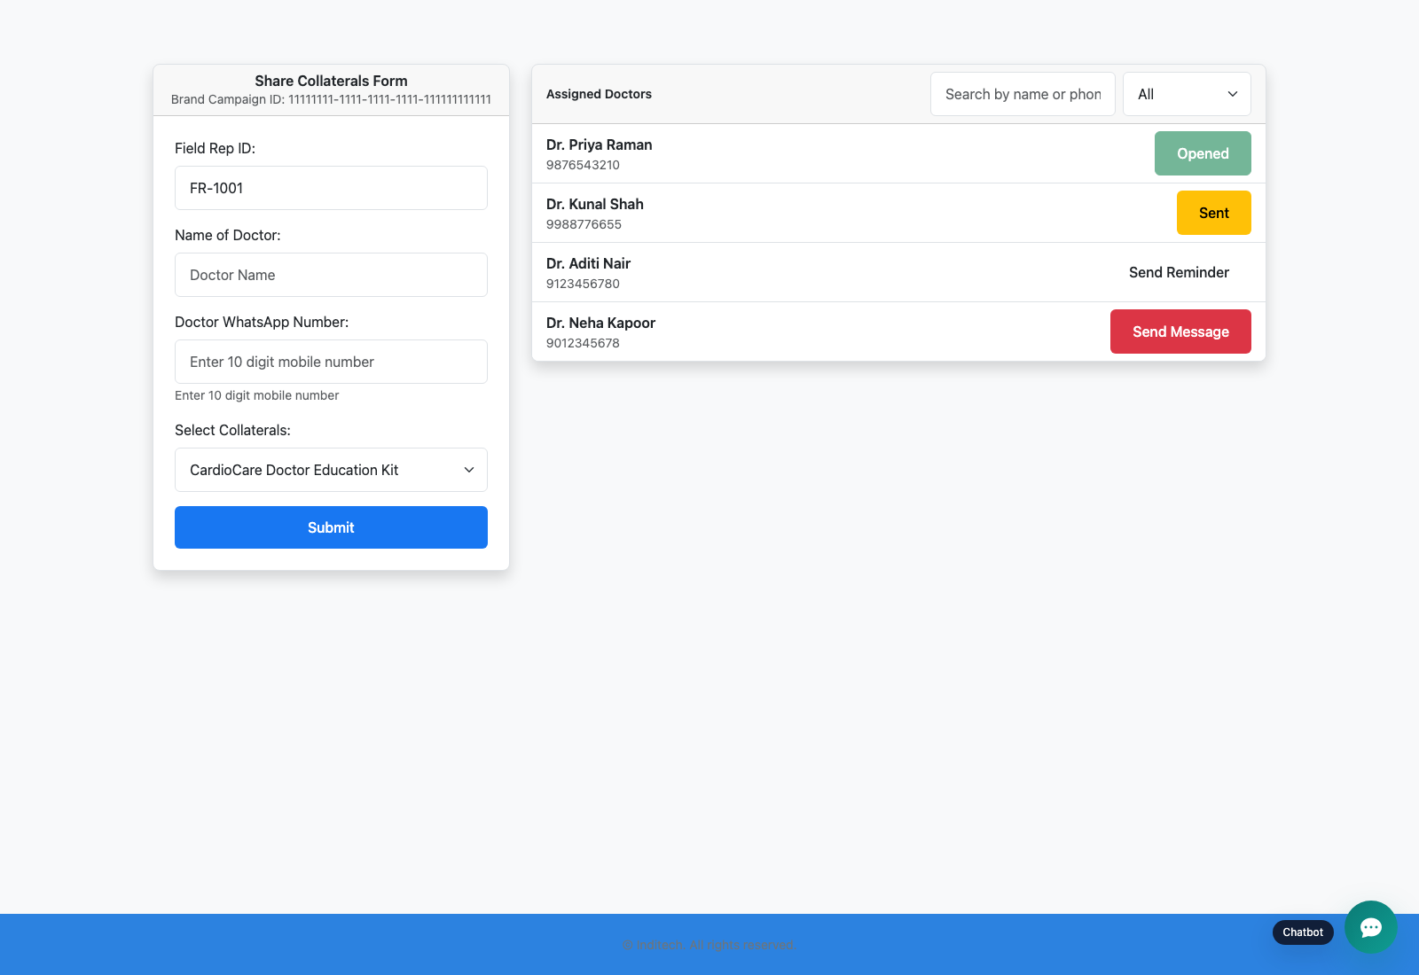
Step 1: Authenticate into the campaign share screen
Field Rep Sharing and Doctor Addition
User action
Use the Gmail login route for the selected campaign and land on the rep share screen.
What appears on screen
A campaign-scoped page with the rep identity, available collateral, doctor-sharing controls, and the floating support chatbot.
Why it matters
This is the operational screen reps use most frequently during campaign outreach.
Expected result
The rep can see only the active collateral that belongs to the current campaign window.
Trainer note
If the list is empty, check the campaign assignment and collateral calendar windows before debugging anything else. If login fails outright, confirm the rep is assigned to the campaign.
Campaign share page after a successful Gmail/manual rep login.
The left-side share form, collateral picker, and help entry point at the top of the current screen.
Screenshot asset: docs/product-user-flows/assets/field-rep-sharing-and-doctor-bulk-upload/fieldrep-gmail-share.png

Slide 4
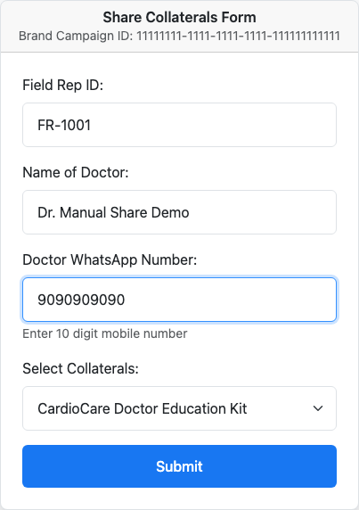
Step 2: Add a doctor one at a time from the left-side form
Field Rep Sharing and Doctor Addition
User action
Enter the doctor name, type the doctor's WhatsApp number, choose the collateral from the dropdown, and review the rep ID before clicking `Submit`.
What appears on screen
The full left-side share form with the campaign ID, read-only Field Rep ID, doctor inputs, collateral selector, and the primary `Submit` button.
Why it matters
This is the current doctor-addition path when the doctor is not yet in the right-side roster or when the trainer wants to demonstrate the form fields one by one.
Expected result
The rep is ready to send the selected collateral using the left-hand form without relying on a preloaded doctor row.
Trainer note
Emphasize that the collateral dropdown drives the entire page state. The same selected collateral also determines the right-side doctor statuses and the hidden values in the quick-send forms. There is no bulk doctor-upload step in the current training flow.
Left-side manual share form used to add one doctor at a time with the selected collateral.
The one-by-one doctor entry path that pairs a typed doctor with a selected collateral.
Screenshot asset: docs/product-user-flows/assets/field-rep-sharing-and-doctor-bulk-upload/fieldrep-send-form.png

Slide 5
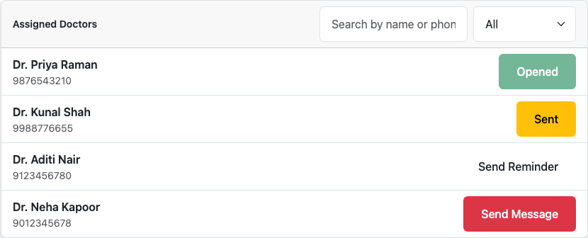
Step 3: Review the doctor queue and filter the worklist
Field Rep Sharing and Doctor Addition
User action
Use the right-side search box, status filter, and the shared collateral selector to find the doctor who needs action for the currently selected collateral.
What appears on screen
A searchable doctor roster with row-level quick-send buttons labeled `Send Message`, `Sent`, `Send Reminder`, or `Opened` depending on the latest share and engagement state.
Why it matters
The right panel is the rep's live work queue. It shows who still needs a first send, who was contacted recently, who is ready for a reminder, and who already opened the collateral.
Expected result
The rep can isolate the correct doctor and understand whether the next action is an initial send, a reminder, or no action at all.
Trainer note
Changing the collateral dropdown refreshes the page so the doctor-row statuses are recalculated for that asset. The right-side filter is a queue-management aid, not a separate data source.
Assigned doctor list with search, status filtering, and the live send-state buttons.
A mixed queue that shows `Send Message`, `Sent`, `Send Reminder`, and `Opened` for the currently selected collateral.
Screenshot asset: docs/product-user-flows/assets/field-rep-sharing-and-doctor-bulk-upload/fieldrep-doctor-status.png

Slide 6
Step 4: Send the first collateral message with the Submit flow
Field Rep Sharing and Doctor Addition
User action
Complete the left-side doctor form and click `Submit` to send the currently selected collateral to a manually entered doctor.
What appears on screen
A submit action that resolves the doctor phone number, creates or updates the doctor record, creates or reuses the short link and ShareLog entry, and redirects into a WhatsApp deep link for the chosen doctor.
Why it matters
This is the primary field-rep outcome: the doctor receives a trackable message that carries the right campaign, collateral, and rep context.
Expected result
The rep launches WhatsApp with the configured collateral message and the right short link for the selected doctor.
Trainer note
This is the clearest slide for explaining the dropdown-based collateral choice and the `Submit` button. The manual form is also how the system adds or updates a single doctor in the rep's list.
Manual share form immediately before the rep submits the first collateral message.
The doctor details and collateral selection used by the Submit-based share flow.
Screenshot asset: docs/product-user-flows/assets/field-rep-sharing-and-doctor-bulk-upload/fieldrep-send-form.png

Slide 7

Step 5: Use the right-side quick-send buttons and follow-up states
Field Rep Sharing and Doctor Addition
User action
Click a doctor-row `Send Message` button for a first send, then revisit the same queue later to use the `Sent` and `Send Reminder` buttons as follow-up shortcuts.
What appears on screen
A right-side work queue where first-send and follow-up actions reuse the currently selected collateral and launch the same WhatsApp handoff logic as the left form.
Why it matters
This is the fastest day-to-day sharing path once the rep's doctor roster is already loaded.
Expected result
The rep can send, resend, or remind from the doctor list without retyping the doctor details.
Trainer note
The quick-send buttons on the right use the same POST flow as the left form. In the current UI only `Opened` is disabled; `Sent` is still actionable as a resend shortcut, while `Send Reminder` appears once the six-day threshold is reached.
Doctor queue filtered to the first-send state with an active Send Message button.
The row-level action that launches the quick-send version of the share flow.
Screenshot asset: docs/product-user-flows/assets/field-rep-sharing-and-doctor-bulk-upload/fieldrep-send-message.png

Slide 8

Step 6: Interpret reminder and opened states
Field Rep Sharing and Doctor Addition
User action
Return to the same doctor list after a share and use the row labels to decide whether a doctor needs a resend, a reminder, or no action.
What appears on screen
A reminder-due queue where older unopened shares show `Send Reminder`, recently shared doctors can still show `Sent`, and engaged doctors show a disabled `Opened` button.
Why it matters
This is how reps decide whether to resend, remind, or move on without opening a separate report.
Expected result
The rep can identify reminder-ready doctors quickly and avoid recontacting doctors who already opened the collateral.
Trainer note
Explain the age rule explicitly: the template changes from `Sent` to `Send Reminder` once the latest share is older than six days and there is still no doctor engagement for that collateral.
Reminder-due doctor view showing the follow-up state after the first share ages without engagement.
The `Send Reminder` action and the surrounding `Sent` and `Opened` status cues.
Screenshot asset: docs/product-user-flows/assets/field-rep-sharing-and-doctor-bulk-upload/fieldrep-send-reminder.png

Slide 9
Trainer Tips
Field Rep Sharing and Doctor Addition
Facilitation notes
Use a real-looking doctor list before your demo so the share screen feels grounded.
If a doctor is missing, add them one at a time from the left-side form or from the staff-admin doctor maintenance screen before retrying the share.
Remind trainees that changing the collateral dropdown recalculates the right-side statuses for that collateral and keeps the quick-send forms in sync.
Demonstrate the left-hand Submit flow before the right-side quick-send buttons so the audience understands both paths.
Only `Opened` is disabled in the current template; `Sent` and `Send Reminder` are both actionable quick-send buttons.
Warn the audience that the product opens a WhatsApp deep link, which may leave the browser context during a live session.
Related documents: docs/product-user-flows/04-admin-field-rep-and-doctor-management.md, docs/product-user-flows/08-doctor-verification-and-collateral-consumption.md, backend/sharing_management/views.py, backend/sharing_management/templates/sharing_management/fieldrep_gmail_share_collateral.html
Validated against the Gmail/manual share flow on 2026-04-23; one-by-one doctor entry is now the documented preparation path.

Slide 10
What success looks like
The rep can explain how the left-side collateral selector and Submit flow work together on the share page.
The rep can explain how the doctor search and status filter change the right-side work queue.
The audience understands the row-button lifecycle from `Send Message` to `Sent`, `Send Reminder`, and `Opened`.
The audience understands why the doctor's exact WhatsApp number matters.
The audience understands that missing doctors are added one at a time from the share form or the admin doctor-maintenance screen.
Use next
Review docs/product-user-flows/04-admin-field-rep-and-doctor-management.md
Review docs/product-user-flows/08-doctor-verification-and-collateral-consumption.md
Review backend/sharing_management/views.py
Validated against the Gmail/manual share flow on 2026-04-23; one-by-one doctor entry is now the documented preparation path.

