Slide 1
Doctor Verification and Collateral Consumption
Training Pack
Public short-link path `/shortlinks/go/<code>/` which redirects into `/view/collateral/verify/`.
Show the doctor journey from WhatsApp short-link click through verification, viewer access, and archive/webinar exploration.
Doctor and Reporting
Primary user: Doctors, trainers demonstrating the doctor experience, and support teams validating the public flow.
Generated: 2026-04-23

Slide 2
Workflow Overview
Doctor Verification and Collateral Consumption
Primary User
Entry Point
Purpose
Doctors, trainers demonstrating the doctor experience, and support teams validating the public flow.
Public short-link path `/shortlinks/go/<code>/` which redirects into `/view/collateral/verify/`.
Show the doctor journey from WhatsApp short-link click through verification, viewer access, and archive/webinar exploration.
What to cover
Short links resolve to a doctor verification screen rather than directly exposing the collateral.
Verification is based on the last 10 digits of the WhatsApp number originally used in the share log.
A successful verify step grants access, creates or reuses the doctor engagement context, and renders the PDF/video viewer.
The viewer can show banners, embedded video, downloadable PDF content, archive links, webinar links, and the support chatbot.
The PDF viewer now auto-loads with device-aware behavior: most devices use an in-page scroll box, while iOS devices switch to inline lazy rendering.
Source manual: docs/product-user-flows/08-doctor-verification-and-collateral-consumption.md

Slide 3
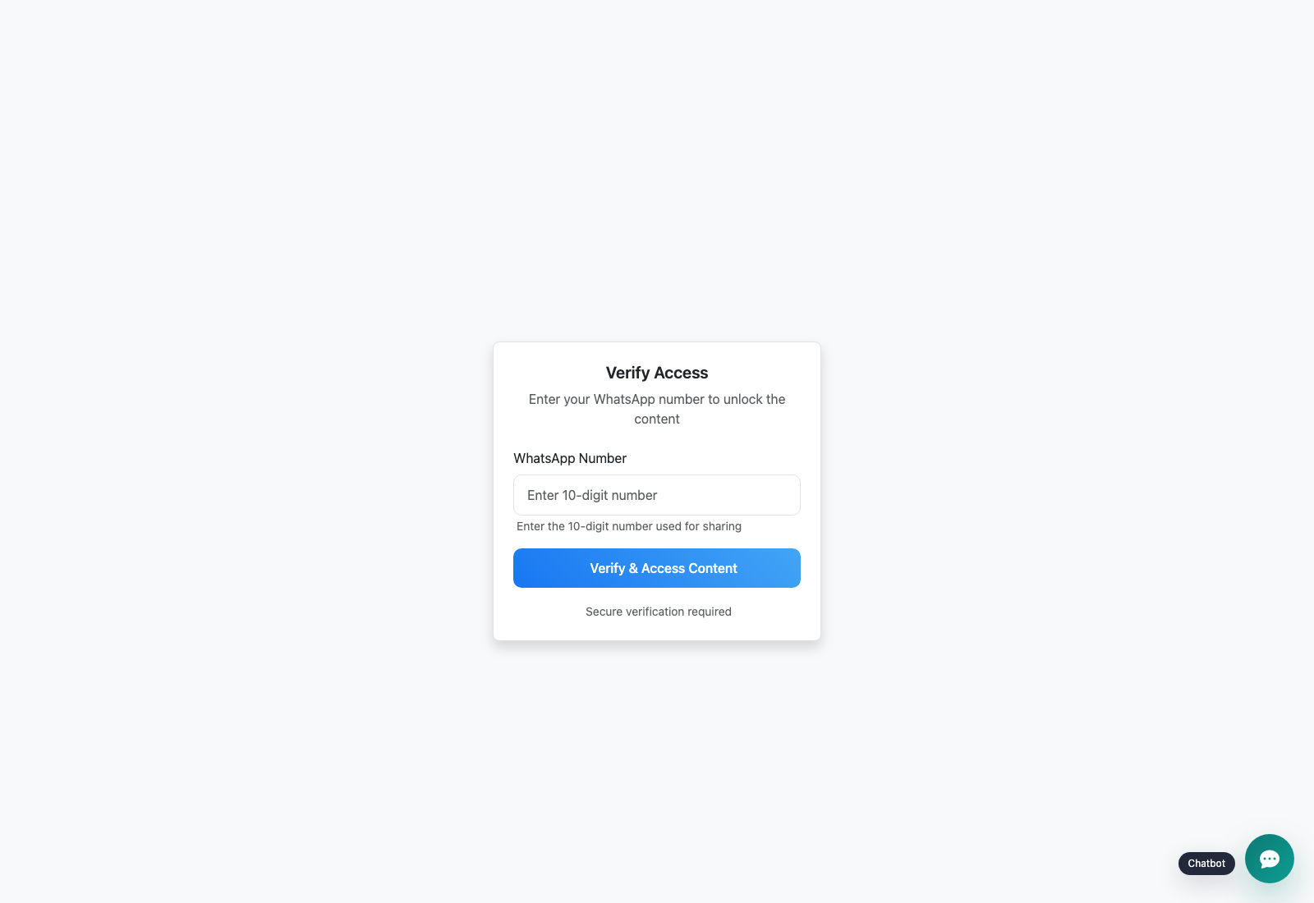
Step 1: Open the short link and reach the verification page
Doctor Verification and Collateral Consumption
User action
Tap the short link from the WhatsApp message.
What appears on screen
A public Verify Access screen that asks for the WhatsApp number used during sharing and includes the floating support chatbot.
Why it matters
This prevents the collateral from behaving like an unguarded public file link.
Expected result
The doctor is ready to prove they are the intended recipient.
Trainer note
Support teams should always ask for the exact shared number when helping a doctor who cannot unlock content.
Public doctor verify page reached from the short link.
The number-entry step required before content is unlocked.
Screenshot asset: docs/product-user-flows/assets/doctor-verification-and-collateral-consumption/doctor-verify.png

Slide 4

Step 2: Verify with the same WhatsApp number used during sharing
Doctor Verification and Collateral Consumption
User action
Enter the matching 10-digit number and submit the form.
What appears on screen
A successful handoff into the doctor viewer instead of an access-denied message, with the unlocked collateral title and content area visible immediately.
Why it matters
The matching logic is what binds the public doctor experience back to a specific share log and grants download access for that short link.
Expected result
The doctor gains access to the content and engagement tracking starts.
Trainer note
If verification fails, double-check number formatting and whether the rep used a different phone number during sharing.
Verified doctor viewer shown immediately after a successful unlock.
The content area that appears once verification succeeds.
Screenshot asset: docs/product-user-flows/assets/doctor-verification-and-collateral-consumption/doctor-viewer.png

Slide 5
Step 3: Consume the PDF, banners, and video content
Doctor Verification and Collateral Consumption
User action
Scroll the PDF, watch the embedded video, or download the PDF copy.
What appears on screen
A branded viewer with banners, embedded Vimeo player, download button, and an auto-loading PDF area that adapts to the device type.
Why it matters
This is the content experience the field rep promised to the doctor and the source of the later engagement metrics.
Expected result
Doctor engagement events can be captured and reflected in downstream reporting.
Trainer note
The PDF area is intentionally large and scrollable because the product treats scroll depth as a meaningful engagement signal. On iPhone and iPad, the viewer switches to inline lazy rendering rather than a nested scroll box.
Doctor viewer showing banners, PDF download, and the embedded collateral content.
The content-consumption experience after verification.
Screenshot asset: docs/product-user-flows/assets/doctor-verification-and-collateral-consumption/doctor-viewer.png

Slide 6
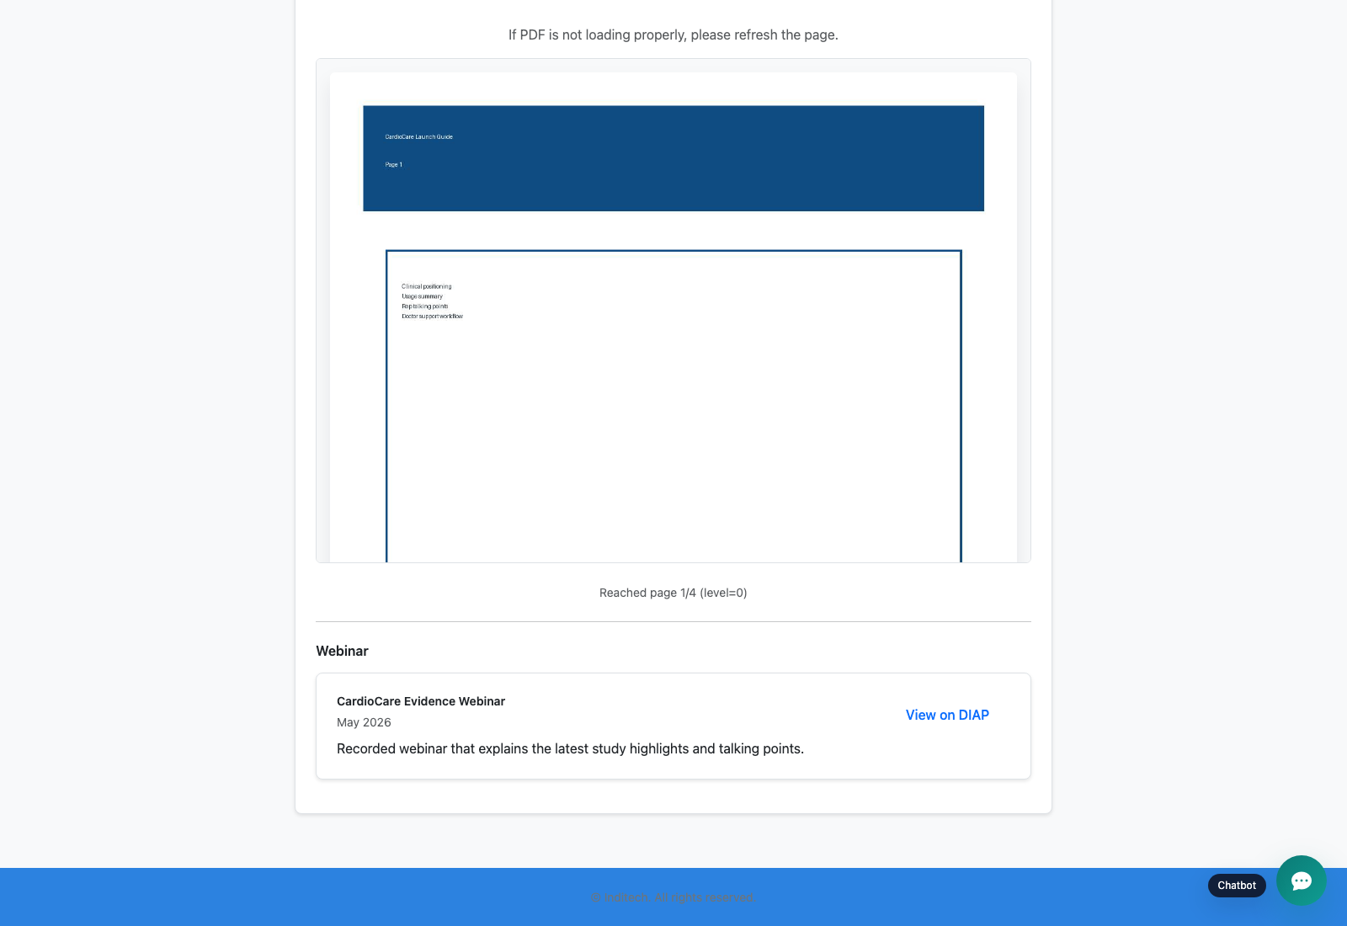
Step 4: Use the archive and webinar options when present
Doctor Verification and Collateral Consumption
User action
Open older collateral from the archive cards or launch the webinar link.
What appears on screen
Additional campaign content options such as archive cards or a webinar panel below the primary collateral.
Why it matters
The product can extend beyond a single PDF or video and act as a campaign micro-journey for the doctor.
Expected result
The doctor can discover related material without needing a separate share from the rep.
Trainer note
Archive and webinar blocks are collateral-dependent, so explain that they appear only when the asset was configured with those extras.
Doctor viewer lower section showing optional follow-on content below the main collateral.
The webinar panel and any archive follow-ons available to the doctor after unlock.
Screenshot asset: docs/product-user-flows/assets/doctor-verification-and-collateral-consumption/doctor-viewer-archive.png

Slide 7
Trainer Tips
Doctor Verification and Collateral Consumption
Facilitation notes
Use the exact phone number from the seeded ShareLog when demonstrating the unlock step.
If you demonstrate on iPhone or iPad, explain that the PDF scrolls inline with lazy page rendering rather than inside a separate box.
A successful doctor demo is the best setup for the reporting deck because it gives the audience a concrete event chain to remember.
Related documents: docs/product-user-flows/07-field-rep-sharing-and-doctor-bulk-upload.md, docs/product-user-flows/09-engagement-reporting-and-transaction-review.md, backend/doctor_viewer/views.py
Validated against the seeded public doctor flow on 2026-04-23, including the current support widget and device-aware PDF viewer behavior.

Slide 8
What success looks like
The audience can explain why the doctor must use the same WhatsApp number.
The doctor viewer's main content areas are easy to identify.
Archive and webinar options are understood as optional extensions of the core flow.
Use next
Review docs/product-user-flows/07-field-rep-sharing-and-doctor-bulk-upload.md
Review docs/product-user-flows/09-engagement-reporting-and-transaction-review.md
Review backend/doctor_viewer/views.py
Validated against the seeded public doctor flow on 2026-04-23, including the current support widget and device-aware PDF viewer behavior.

