Slide 1
Engagement Reporting and Transaction Review
Training Pack
`/reports/collateral-transac tions/<brand_campaign_id>/`.
Show how campaign stakeholders review the doctor engagement outcomes created by sharing and doctor consumption.
Doctor and Reporting
Primary user: Campaign analysts, operations leads, and trainers closing the loop after a doctor demo.
Generated: 2026-04-23

Slide 2
Workflow Overview
Engagement Reporting and Transaction Review
Primary User
Entry Point
Purpose
Campaign analysts, operations leads, and trainers closing the loop after a doctor demo.
`/reports/collateral-transactions/<brand_campaign_id>/`.
Show how campaign stakeholders review the doctor engagement outcomes created by sharing and doctor consumption.
What to cover
The transaction dashboard aggregates the latest state per doctor, collateral, and field rep for the selected campaign.
The report header exposes both a collateral filter and visible `Reset` and `Download CSV` controls.
The collateral filter narrows the view when stakeholders want to discuss one asset at a time.
Summary counters surface clicked doctors, downloaded PDFs, viewed-last-page counts, and video watch buckets.
The doctor table is the operational follow-up surface for identifying which doctors engaged and how far they got, and it includes client-side search plus a status filter.
Source manual: docs/product-user-flows/09-engagement-reporting-and-transaction-review.md

Slide 3
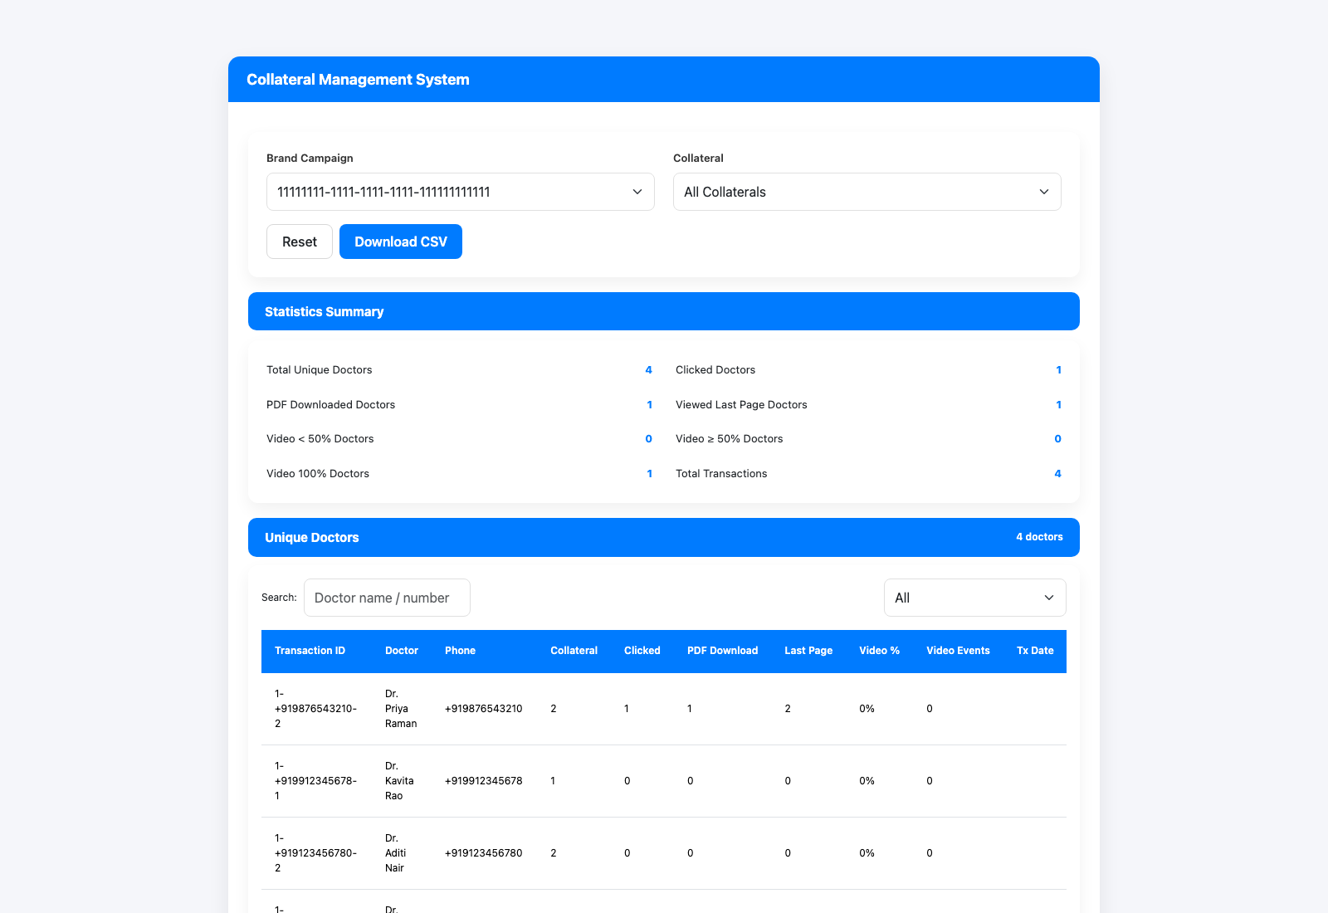
Step 1: Open the campaign transaction dashboard
Engagement Reporting and Transaction Review
User action
Navigate directly to the report URL for the campaign.
What appears on screen
A branded reporting page with a campaign selector, collateral filter, summary section, doctor table, and visible `Reset` and `Download CSV` controls.
Why it matters
This is the clearest operational view of whether the campaign is generating meaningful doctor interaction.
Expected result
Stakeholders can immediately orient to the campaign and available collateral.
Trainer note
The dashboard is latest-state oriented, which is useful for follow-up but different from a raw event log.
Campaign transaction dashboard with summary metrics and doctor rows.
The top summary section and the campaign/collateral filters.
Screenshot asset: docs/product-user-flows/assets/engagement-reporting-and-transaction-review/report-dashboard.png

Slide 4
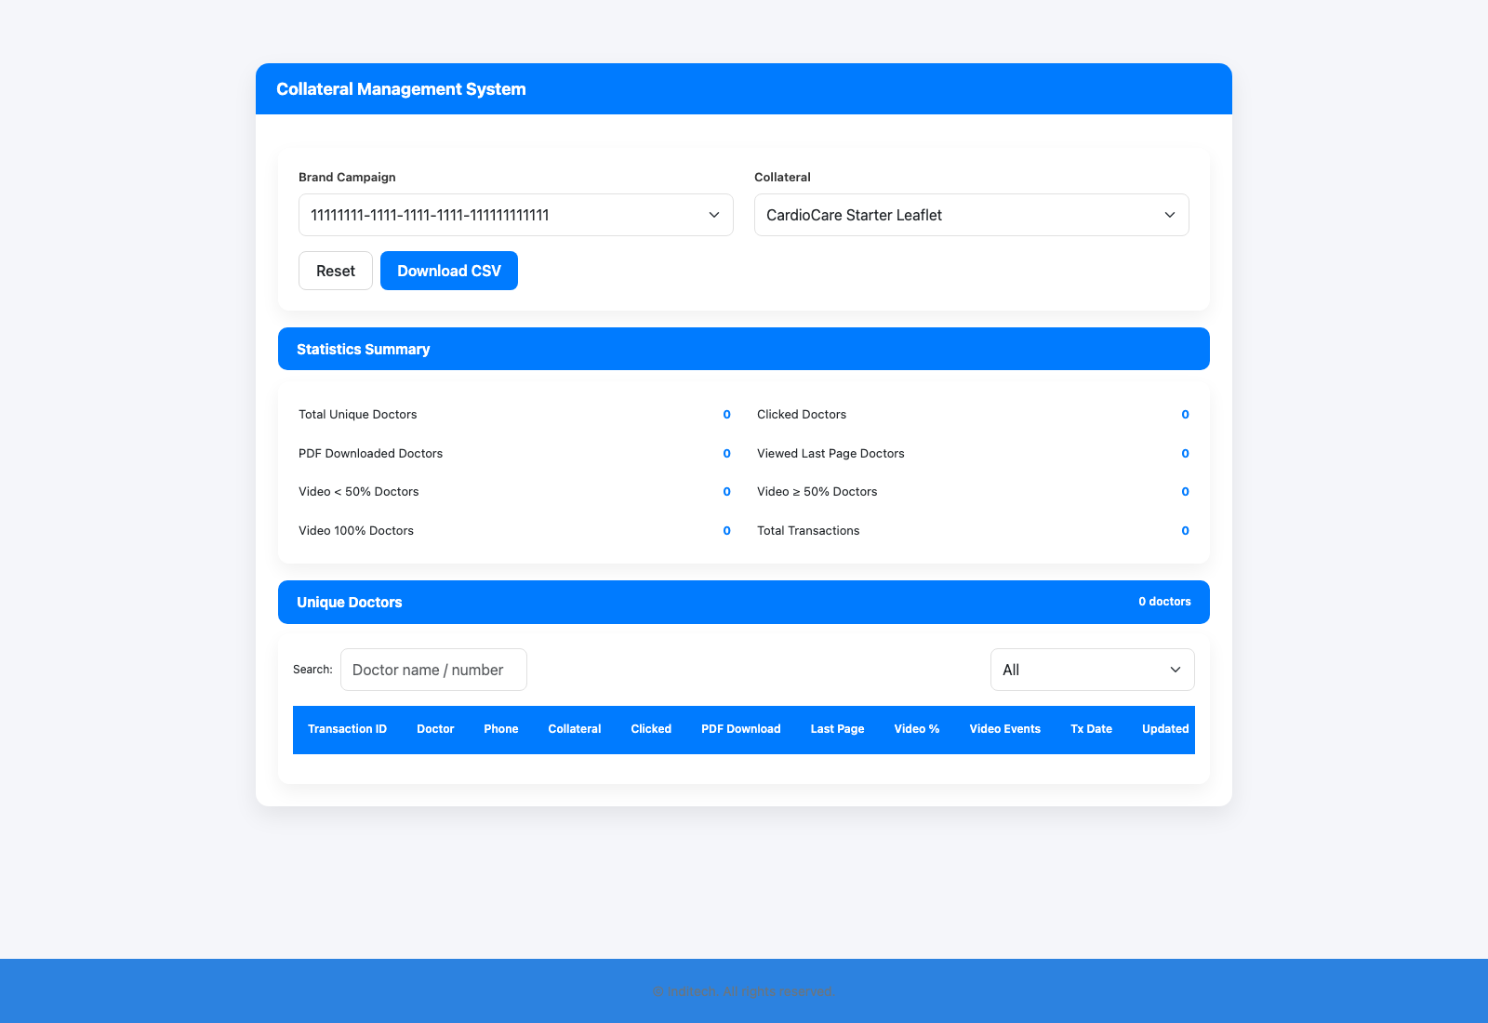
Step 2: Filter to a specific collateral when needed
Engagement Reporting and Transaction Review
User action
Choose a collateral from the drop-down and refresh the page context.
What appears on screen
The same dashboard narrowed to a single collateral's doctor outcomes, with the summary counters and doctor rows recalculated for that asset.
Why it matters
Filtering keeps the conversation concrete when the campaign has more than one asset.
Expected result
The summary metrics and doctor rows now reflect the selected collateral only.
Trainer note
This is a strong way to compare flagship collateral against supporting leaflets during a training review.
Transaction dashboard filtered to a specific collateral.
The same report with the collateral scope narrowed for discussion.
Screenshot asset: docs/product-user-flows/assets/engagement-reporting-and-transaction-review/report-filtered.png

Slide 5
Step 3: Read doctor-level engagement status
Engagement Reporting and Transaction Review
User action
Use the search box and status filter above the table, then inspect who clicked, viewed, downloaded, or reached the later video buckets.
What appears on screen
A doctor table that combines transaction ID, doctor number, collateral ID, clicked state, PDF progress, video progress, transaction date, and updated timestamp.
Why it matters
This is the bridge from aggregate counts to real operational follow-up.
Expected result
The team can identify which doctors need another touchpoint or a different content approach.
Trainer note
Use the report right after the doctor-viewer demo so the audience recognizes how those actions appear operationally. The status filter is client-side, so it is safe to use live during training without losing the page state.
Doctor-level table used for campaign follow-up discussions.
The detailed rows that support rep and campaign follow-up.
Screenshot asset: docs/product-user-flows/assets/engagement-reporting-and-transaction-review/report-dashboard.png

Slide 6
Step 4: Export and reuse the report output
Engagement Reporting and Transaction Review
User action
Use the CSV download option and hand the resulting data to downstream reporting or follow-up teams.
What appears on screen
The same report page with a dedicated `Download CSV` button positioned alongside the `Reset` control at the top of the dashboard.
Why it matters
Campaign reporting often continues outside the portal in spreadsheets or BI workflows.
Expected result
The transaction view can feed a follow-up or analytics process without manual rewriting.
Trainer note
The export action preserves the current collateral filter in the query string so stakeholders can take either the whole campaign dataset or a filtered asset-specific extract.
Report page showing the export-oriented controls.
The controls that let stakeholders take the data beyond the portal screen.
Screenshot asset: docs/product-user-flows/assets/engagement-reporting-and-transaction-review/report-dashboard.png

Slide 7
Trainer Tips
Engagement Reporting and Transaction Review
Facilitation notes
Close the training pack with this deck so the audience sees the business value of the earlier workflows.
If time is short, focus on one collateral and one doctor row instead of trying to read every metric live.
Related documents: docs/product-user-flows/08-doctor-verification-and-collateral-consumption.md, backend/sharing_management/views_transactions_page.py, backend/sharing_management/services/transactions.py
Validated against the seeded transaction dashboard on 2026-04-23.

Slide 8
What success looks like
Stakeholders can connect doctor actions back to what they saw in the field-rep and doctor decks.
The audience understands the difference between top-line counts and doctor-level rows.
The export path is documented clearly enough for follow-up teams.
Use next
Review docs/product-user-flows/08-doctor-verification-and-collateral-consumption.md
Review backend/sharing_management/views_transactions_page.py
Review backend/sharing_management/services/transactions.py
Validated against the seeded transaction dashboard on 2026-04-23.

