Slide 1
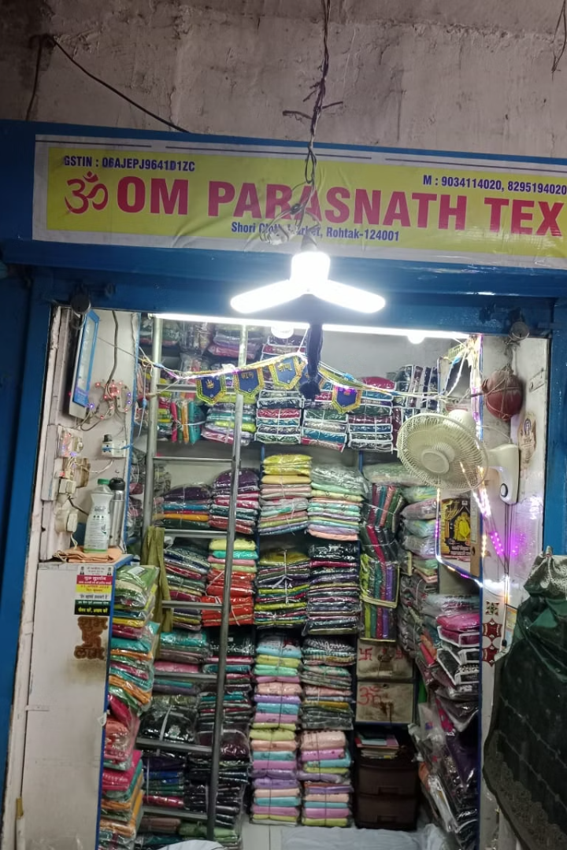


Data-Driven Inventory Optimization and Financial Performance Analysis
A Case Study of Om ParasNath Textile Wholesale Business
Presenter: Sanyam Jain | DS23F2002611 |
IITM Online BS Degree Program, IIT Madras | May 24, 2025

Slide 2
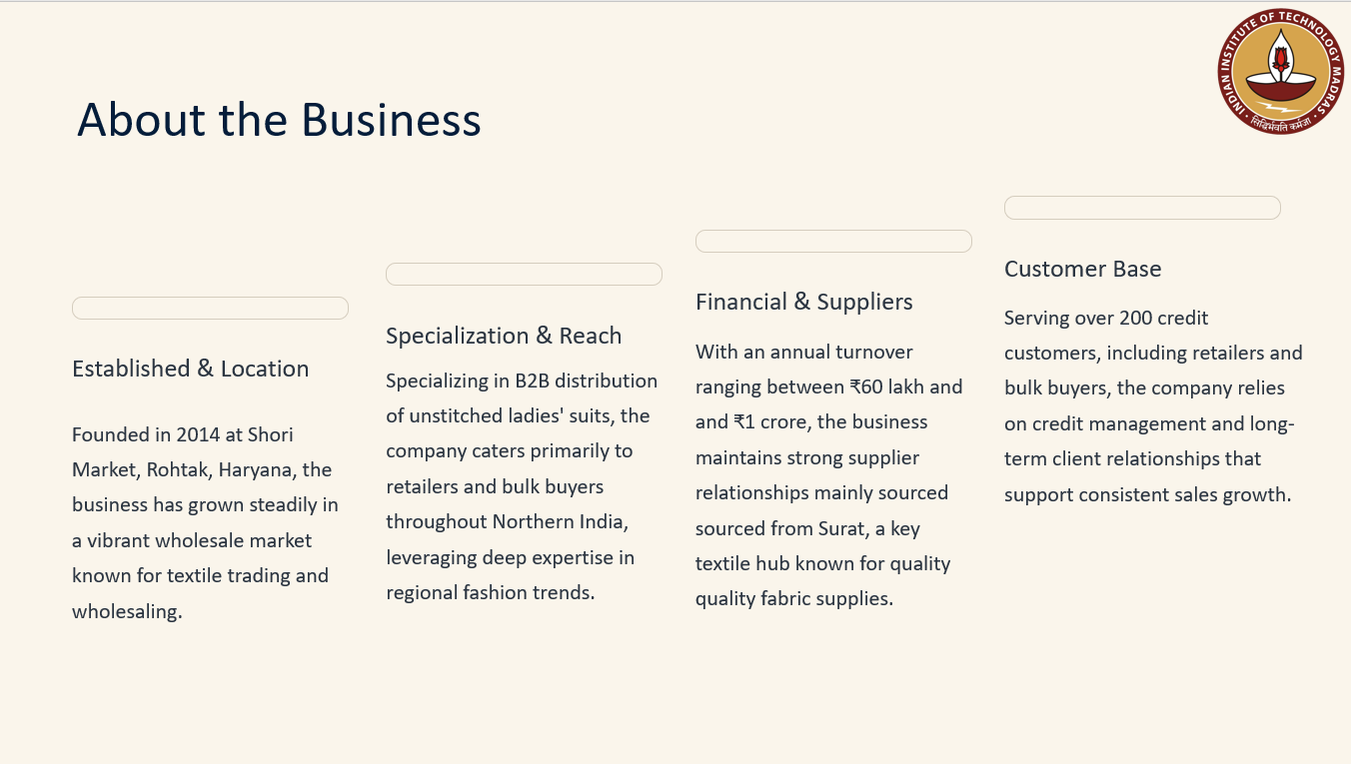

Slide 3
Problem Statement & Objectives
Inventory Management
Seasonal Supply Disruptions
Manual stock tracking leading to inefficiencies
2-month Surat supplier shutdowns
Overstocking and stockout situations
Predictable revenue drops (September: ₹225,300 vs October: ₹745,795)
Credit Management
Competitive Pricing Pressure
200+ customers with handwritten ledger system
Margin compression in competitive market
Payment delays affecting cash flow
Negotiation challenges with bulk buyers
Objectives
Optimize inventory levels and reduce costs
Improve cash flow management
Develop data-driven pricing strategies
Create predictive seasonal planning

Slide 4
Data Collection & Methodology
Data Period & Sources
April to December 2024; sales, inventory, credit, costs, and surveys
Primary Data Sources:
Data Types Collected:
Sales Records: Manual registers maintained by shop owner
Monthly sales revenue (₹4,778,507 total)
Inventory Data: Purchase records and stock levels
Fabric-wise purchase costs and quantities
Credit Transactions: Personal ledger with payment details
Credit payment patterns and aging
Cost Data: Procurement records for margin analysis
Seasonal demand variations
Market Data: Competitor pricing surveys in Shori Market
Competitive pricing benchmarks
Analytics Techniques
ABC-Pareto analysis
Economic Order Quantity (EOQ)
Seasonal forecasting
Margin and DSO analysis

Slide 5
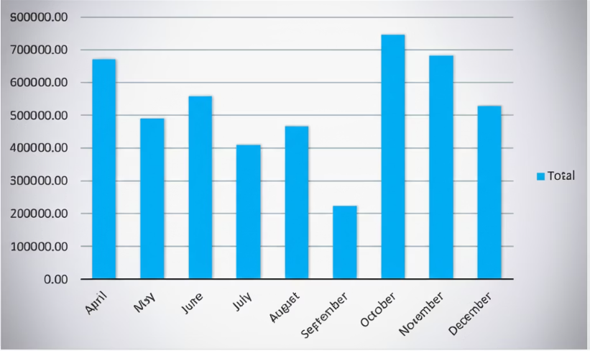
Data Overview & Descriptive Statistics
Data Quality & Cleaning:
Sales Distribution & Fabric Mix
Removed duplicate entries
Daily sales highest on Friday (24%)
Cross-referenced purchase and sales data
Cotton (38.8%), Velvet (20%), Silk (17.9%) fabric focus
Validated financial calculations
Data cleaned to standardize categories
Sales & Revenue
Total revenue ₹47.78 lakh; average monthly sales ₹5.31 lakh over 9 months
Peak sales in October ₹7.46 lakh, lowest in September ₹2.25 lakh

Slide 6
Analysis Results – Inventory Optimization
ABC Classification
EOQ & ROP Values
Cotton, Silk, Velvet represent 76.7% of inventory investment
Cotton: EOQ=703, ROP=355
Silk: EOQ=592, ROP=283
Velvet: EOQ=296, ROP=79
Fabric | Purchase Cost | % of Total | Cumulative % | Category
Cotton | ₹19,30,000 | 38.8% | 38.8% | A
Silk | ₹8,90,000 | 17.9% | 56.7% | A
Velvet | ₹9,95,000 | 20.0% | 76.7% | A
Georgette | ₹8,60,000 | 17.3% | 94.0% | B
Wool | ₹2,95,947 | 5.9% | 100.0% | C
Fabric
Annual Demand
EOQ (units)
ROP (units)
Current Impact
Cotton
8,633
703
355
40% reduction in ordering frequency
Silk
6,827
592
283
25% cut in holding costs
Velvet
1,767
296
79
Optimized safety stock

Slide 7
Seasonal Trends & Competitive Analysis
Seasonal Analysis
Competitive Pricing Analysis
Month
Sales (₹)
Seasonal Index
Pattern
Fabric
Unit Cost (₹)
Selling Price (₹)
Margin %
Market Position
September
2,25,300
0.42
Supplier shutdown low
Velvet
215.37
1,247.17
82.7%
Premium positioning
October
7,45,795
1.41
Festival peak
Silk
207.48
326.27
36.4%
Competitive
November
6,82,965
1.29
Wedding season high
Cotton
186.49
287.03
35.0%
Market standard
April
6,69,727
1.26
Strong start
Georgette
231.18
313.93
26.4%
Underpriced
Velvet 82.7%
Silk 36.4%
Cotton 35%
Georgette 26.4% (underpriced)
Opportunity to reprice Georgette products

Slide 8
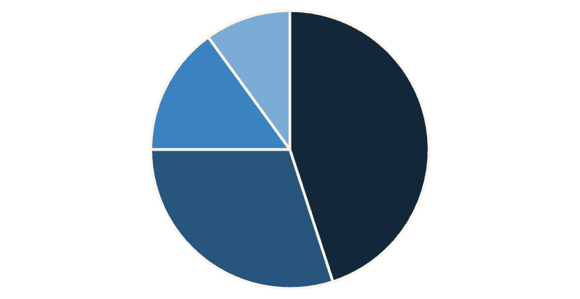
Credit Management & Cash Flow Analysis
Receivables Aging
0-30 days: 45%
31-60 days: 30%
61-90 days: 15%
>90 days: 10%
DSO & Recommendations
DSO at 48 days, exceeding 45-day benchmark by ₹47,000
0-30
31-60
61-90
>90
Apply tiered credit limits
Send payment reminders
Offer early payment discounts

Slide 9

Key Insights & Strategic Recommendations
Inventory Risk
Seasonality
Pricing Strategy
Credit Policy
Currently, 77% of the inventory investment is tied up in three main fabric types, which necessitates a more dynamic and responsive EOQ management approach to optimize stock levels and reduce holding costs effectively.
Sales demonstrate significant fluctuations throughout the year, with an overall variation of 232%, necessitating robust inventory planning to meet demand peaks without excess stock during off-peak periods.
To improve profit margins, it is advisable to increase prices of underpriced Georgette fabric products by 10%, aligning them closer to market standards without negatively impacting demand.
Enhance cash flow by automating payment reminders to customers, reducing overdue receivables and improving collection efficiency.
To address this, implement a weekly ABC classification monitoring dashboard that tracks inventory categories in real-time, enabling quicker adjustments to procurement and stocking decisions.
A practical step includes maintaining a 20% seasonal buffer stock specifically for September, accounting for supplier shutdowns and ensuring seamless fulfillment during low supply months.
Additionally, consider bundling premium Velvet and Silk fabrics during major festivals to attract customers and boost sales volume while maximizing profitability through strategic discounting.
Introduce a structured payment reminder system combined with a 1% discount incentive for early payments to encourage timely settlements and strengthen customer relationships.

Slide 10
Transforming Traditional Wholesale Through Data Analytics
Project Achievements
Quantified Benefits & Next Steps
Analyzed 9 months of detailed operational and financial data across multiple product categories to identify inefficiencies and opportunities
Achieved 40% fewer orders through enhanced demand forecasting, leading to significant improvements in inventory efficiency
Realized a 25% reduction in holding costs by optimizing stock levels and implementing just-in-time inventory practices
Discovered ₹2+ lakh in annual cost-saving opportunities through robust inventory and supply chain optimization techniques
Identified a 5% potential increase in revenue margins by refining pricing strategies and product bundling
Formulated actionable strategies focused on reducing excess inventory while maintaining service levels, resulting in improved cash flow
Reduced Days Sales Outstanding (DSO) by 8 days, freeing up ₹62,000 in working capital for reinvestment
Built sustainable competitive advantages by integrating data-driven decision-making into traditional wholesale processes for long-term benefits
Implementation Phases: Rollout includes phases for real-time tracking systems, automation of ordering processes, and full digital transformation of analytics capabilities
Success Metrics: Monitor improvements in inventory turnover rates, DSO reduction, margin growth, and enhanced accuracy in sales and production planning

