Slide 1
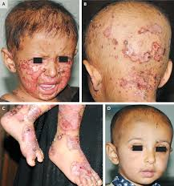
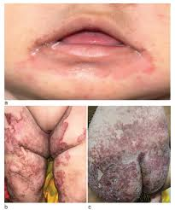

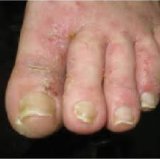
Dermatological conditions related to Nutritional deficiency in children

Slide 2

Introduction
Dermatological signs in pediatric patients often reflect underlying nutritional deficiencies.
In India, around 38.4% of children under 5 are stunted, indicating chronic malnutrition.
Anemia affects 59.7% of children aged 6-59 months, highlighting prevalent iron deficiency.
Deficiencies in vitamins A, B complex, zinc, and essential fatty acids contribute to dermatological issues in Indian children.
Notes:
"In today's presentation, we'll explore the dermatological signs in pediatric patients and their association with nutritional deficiencies. In pediatric patients, dermatological signs can serve as crucial indicators of underlying nutritional deficiencies. In India, where a significant portion of children suffer from malnutrition and anemia, these signs become even more relevant. With deficiencies in key nutrients like iron, vitamins, and essential fatty acids being prevalent, understanding and addressing dermatological issues becomes essential for pediatric healthcare professionals.”

Slide 3
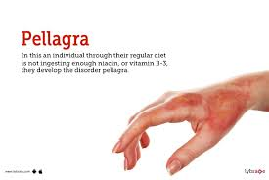
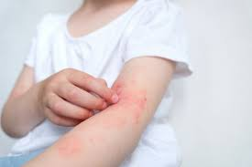
Prevalent Conditions
Dermatitis
Alopecia
Spooning of Nails (Koilonychia)
Xerophthalmia
Hyperpigmentation.
Hypopigmentation
Angular stomatitis.
Notes:
"Dermatitis, alopecia, koilonychia, and xerophthalmia are dermatological conditions that often indicate underlying nutritional deficiencies in pediatric patients. Understanding these conditions and their implications is crucial for effective management.

Slide 4
Dermatitis
Description: Skin inflammation causing redness, itching, and rash.
Nutrition Association: Inadequate essential fatty acids and vitamins A, C, and E.
Red Flags: Dry, scaly, or blistered skin with itching.
Diagnosis: Clinical evaluation by a dermatologist.
Treatment: Topical corticosteroids, moisturizers, and trigger avoidance.
Notes:
"Dermatitis, a common skin condition characterized by inflammation, often arises due to nutritional deficiencies. Inadequate intake of essential fatty acids and vitamins A, C, and E can exacerbate this condition. Clinically, it presents with dry, scaly, or blistered skin, accompanied by itching. Diagnosis involves a thorough clinical evaluation by a dermatologist, with treatment typically involving topical corticosteroids, moisturizers, and identifying triggers."

Slide 5
Vitamin deficiencies
Vitamin A deficiency: Can cause phrynoderma, or "toad skin", and night blindness. It can also cause acne.
Vitamin B deficiency: Can cause periorificial dermatitis, angular stomatitis, and glossitis.
Vitamin C deficiency: Can cause scurvy, which includes skin hemorrhages, gum disease, and anemia. It can also cause corkscrew hairs and perifollicular erythema or hemorrhage.
Vitamin B3 (niacin) deficiency: Can cause pellagra, which includes dermatitis, diarrhea, dementia, and death .

Slide 6
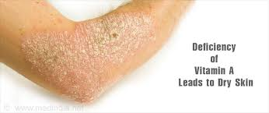
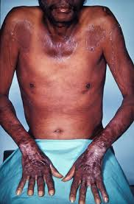
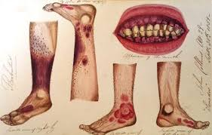

Slide 7
Dermatological signs
Vitamin B6 (pyridoxine) deficiency: Can cause a rash similar to seborrheic dermatitis around the mouth.
Vitamin B9 (folate) deficiency: Can cause hyperpigmentation in areas exposed to the sun.
Vitamin B12 deficiency: Can cause hyperpigmentation in the palms, soles, nails, and oral cavity.
Zinc deficiency: Can cause scaly skin changes around the mouth, genitals, and extremities.
Copper deficiency: Can cause generalized skin depigmentation or hypo-pigmentation.

Slide 8
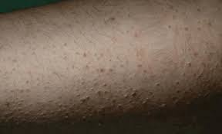
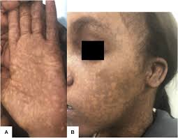
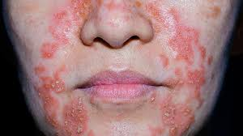
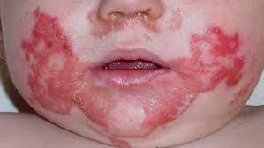
Folate deficiency
B12 deficiency
Pyridoxin deficiency

Slide 9
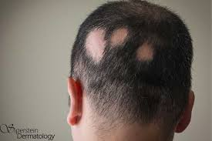
Alopecia
Description: Hair loss in patches or across the scalp.
Nutrition Association: Deficiencies in vitamins D, E, and biotin.
Red Flags: Thinning hair, bald patches, or complete hair loss.
Diagnosis: Medical history, physical exam, and blood tests.
Treatment: Topical medications, supplements, and lifestyle changes.
Notes:
"Alopecia, or hair loss, can also be linked to nutritional deficiencies, particularly vitamins D, E, and biotin. Red flags include thinning hair, bald patches, or complete hair loss. Diagnosis relies on medical history, physical examination, and blood tests. Treatment options include topical medications, supplements, and lifestyle adjustments to support hair growth."

Slide 10
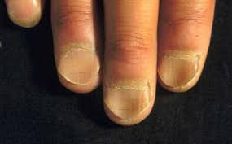
Spooning of Nails (Koilonychia)
Description: Spoon-shaped nails due to iron deficiency.
Nutrition Association: Inadequate iron intake or absorption issues.
Red Flags: Thin, brittle nails with a concave shape.
Diagnosis: Blood tests to measure iron levels.
Treatment: Dietary changes and iron supplementation.
Notes:
"Spooning of nails, medically known as koilonychia, is characterized by spoon-shaped nails and is often associated with iron deficiency. Thin, brittle nails with a concave shape are common indicators. Diagnosis is confirmed through blood tests to measure iron levels, and treatment primarily involves dietary changes and iron supplementation."

Slide 11
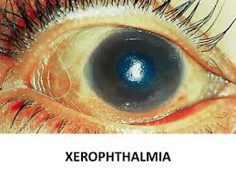
Xerophthalmia
Description: Dry eyes from vitamin A deficiency.
Nutrition Association: Lack of vitamin A-rich foods.
Red Flags: Dry, gritty eyes with poor night vision.
Diagnosis: Eye examination and tear production assessment.
Treatment: Vitamin A supplements and eye lubricants.
Notes:
"Xerophthalmia, a condition of dry eyes, is frequently attributed to vitamin A deficiency, which can result from a lack of vitamin A-rich foods in the diet. Symptoms include dry, gritty eyes and poor night vision. Diagnosis entails an eye examination and assessment of tear production. Treatment typically includes vitamin A supplements and eye lubricants to alleviate discomfort."

Slide 12
Diagnosis
Dermatitis primarily affects the skin, leading to inflammation, redness, itching, dry, scaly, or blistered skin.
Alopecia affects the hair follicles, resulting hair thinning, bald patches, or complete hair loss.
Associated growth conditions and deficiency signs to be seen.
Spooning of nails (koilonychia) affects the nails, resulting in thin, brittle nails with a concave, spoon-shaped appearance.Classical sign of Iron deficiency
Xerophthalmia affects the eyes, resulting in dryness, grittiness, and poor night vision. It is primarily linked to vitamin A deficiency.H/o night blindness to be asked.
Notes:
"Dermatitis primarily affects the skin, causing inflammation, redness, itching, and various skin manifestations. Alopecia targets the hair follicles, resulting in hair thinning, bald patches, or complete hair loss. Spooning of Nails (Koilonychia) affects the nails, causing them to become thin, brittle, and take on a concave, spoon-shaped appearance. Xerophthalmia impacts the eyes, leading to symptoms like dryness, grittiness, and poor night vision, often due to vitamin A deficiency."

Slide 13
General Treatment Recommendations
Dermatitis: Topical corticosteroids, emollients, and avoiding triggers like harsh soaps.
Alopecia: Minoxidil, corticosteroid injections, or hair transplantation in severe cases.
Above two if proved nutritional supplementation to be given with dietary changes..
Spooning of Nails (Koilonychia): Iron supplementation, dietary changes to include iron-rich foods.
Xerophthalmia: Vitamin A supplementation, consumption of foods rich in vitamin A like carrots and spinach.Local eye treatment.
Notes:
“In India, treatments for pediatric dermatitis include topical corticosteroids and emollients, while alopecia may require minoxidil or corticosteroid injections. Iron supplementation and dietary changes are recommended for koilonychia, and vitamin A supplementation is crucial for managing xerophthalmia.”

Slide 14
Follow-up Recommendations
Regular dermatological follow-up appointments for monitoring skin condition progression and treatment effectiveness.
Periodic assessment of hair growth and scalp health to track changes in alopecia status.
Nail health check-ups to monitor improvements in koilonychia and ensure proper nail care.
Ophthalmological evaluations to assess eye health and detect any signs of xerophthalmia recurrence or complications.
Notes:
“Regular follow-up is crucial for monitoring and assessing the effectiveness of treatment for dermatological conditions. Tracking changes in hair growth and nail health is important, along with ophthalmological evaluations to detect any recurrence or complications of xerophthalmia.”

Slide 15
Conclusion
Skin, hair, and nail changes in pediatric patients can serve as valuable indicators of underlying nutritional deficiencies.
Early recognition and intervention are crucial in addressing these issues and promoting overall health and well-being in children.
By understanding the significance of these dermatological signs and implementing appropriate treatments, healthcare professionals can make a meaningful impact on pediatric patients' health outcomes.
Notes:
"Dermatological signs in pediatric patients serve as valuable indicators of underlying nutritional deficiencies. By recognizing these red flags and implementing appropriate interventions, healthcare professionals can improve health outcomes and quality of life for children."

Slide 16


