Slide 1

Importance of PCV Booster Dose
DR. SHEKHAR BISWAS
MD
Senior Consultant
Department of Pediatrics
Jaipur Golden Hospital , New Delhi

Slide 2

Introduction
The PCV targets several strains of the bacterium Streptococcus pneumoniae, which can cause severe infections such as pneumonia, meningitis, and sepsis, particularly dangerous in children and the elderly.
The introduction of PCV in India's Universal Immunization Programme (UIP) in 2017 marked a crucial step in combating this public health issue. The PCV is administered in a three-dose schedule at 6 weeks, 14 weeks with a booster at 9-12 months.
The booster dose of PCV, given at 9-12 months, is crucial for reinforcing the initial immunity provided by the primary doses. This additional dose ensures prolonged protection against pneumococcal diseases as the child grows, which is critical in preventing the resurgence of vulnerability to infections.
The content is by Dr. Bhaskar and adheres to medical academy guidelines and does not favor any individual, group, or product. This video is produced by Inditech Technology Services Pvt. Ltd. Distribution prohibited without permission.
Notes:
Welcome to an overview of the Pneumococcal Conjugate Vaccine, or PCV. This vaccine targets multiple strains of Streptococcus pneumoniae, a major cause of severe infections such as pneumonia and meningitis. Since its inclusion in India's Universal Immunization Programme in 2017, the PCV has significantly impacted public health, providing essential protection to the most vulnerable populations—children and the elderly.

Slide 3
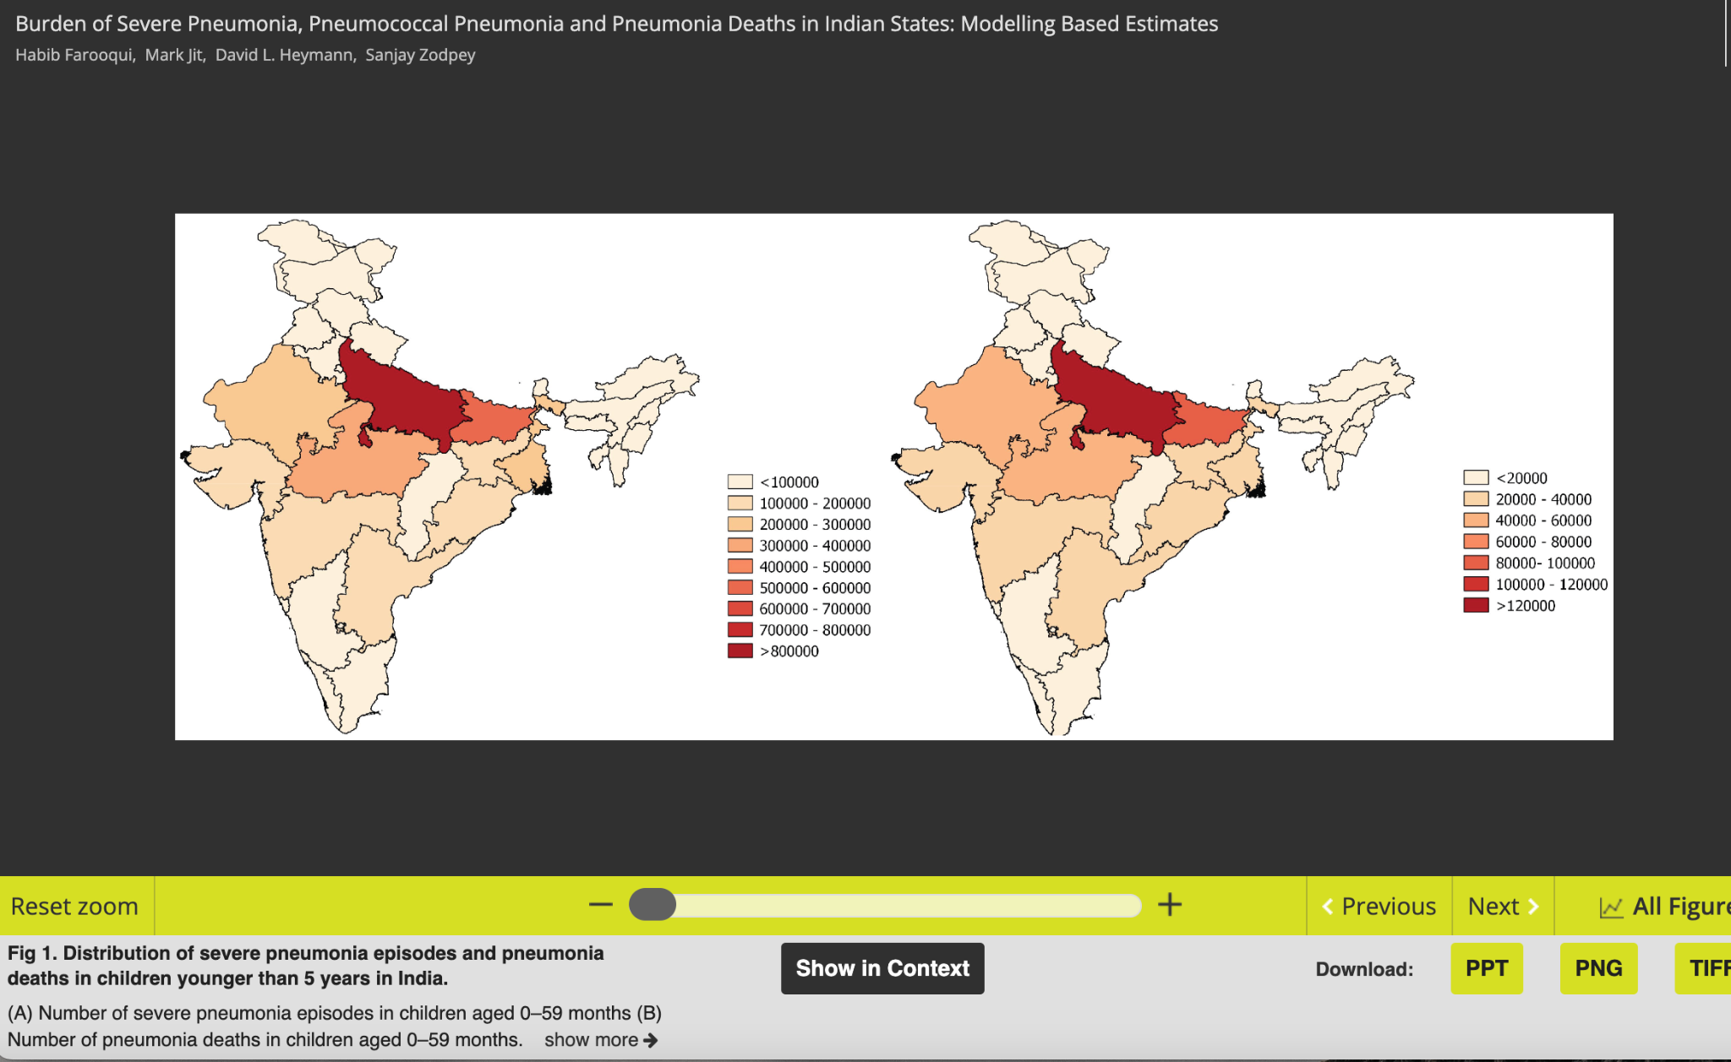

Slide 4
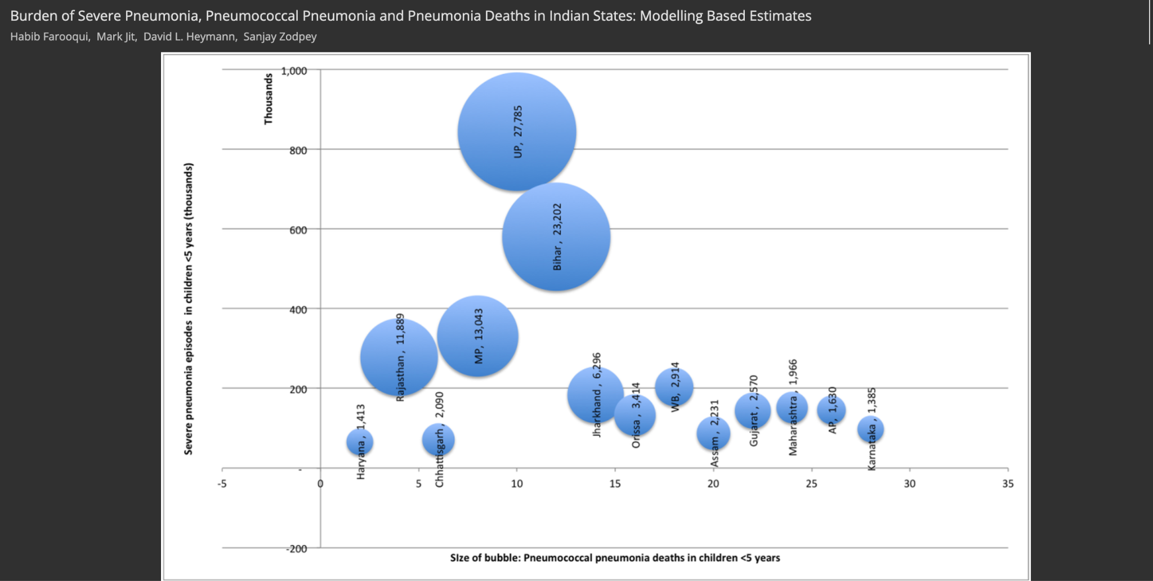

Slide 5
Pneumococcal Vaccines Overview
Types of PCVs Available in India:
PCV10 and PCV13: These vaccines cover 10 and 13 serotypes of pneumococcal bacteria, respectively. PCV13 includes serotypes 1, 3, 4, 5, 6A, 6B, 7F, 9V, 14, 18C, 19A, 19F, and 23F, which are among the most prevalent and invasive serotypes globally and in India.
PCV10 covers 10 serotypes but does not include serotypes 3, 6A, and 19A which are covered by PCV13.
Efficacy and Serotype Coverage:
Studies show that both PCV10 and PCV13 are highly effective in reducing the incidence of invasive pneumococcal diseases caused by the serotypes they cover.
The choice between PCV10 and PCV13 may depend on regional serotype prevalence and specific public health goals.
The content is by Dr. Bhaskar and adheres to medical academy guidelines and does not favor any individual, group, or product. This video is produced by Inditech Technology Services Pvt. Ltd. Distribution prohibited without permission.
Notes:
In India, two main types of PCV are available—PCV10 and PCV13, targeting 10 and 13 serotypes of pneumococcal bacteria, respectively. The choice between these vaccines depends on regional serotype prevalence and public health objectives. Both vaccines have shown high efficacy in reducing invasive pneumococcal diseases, crucial for child health and community well-being.

Slide 6
Pneumococcal Vaccines Overview
Vaccination Schedule and Administration:
The Indian Academy of Pediatrics (IAP) recommends administering the PCV at 6 weeks, 14 weeks, and a booster dose at 9 months to ensure optimal immune response and prolonged protection.
This schedule is designed to integrate with the existing Universal Immunization Programme (UIP) which seeks to maximize early childhood vaccination coverage.
Public Health Impact:
The widespread use of PCVs as part of the UIP has significantly reduced the burden of pneumococcal disease among Indian children.
The introduction of these vaccines has been linked to decreases in hospital admissions for pneumococcal disease and reductions in overall child mortality rates from respiratory infections.
The content is by Dr. Bhaskar and adheres to medical academy guidelines and does not favor any individual, group, or product. This video is produced by Inditech Technology Services Pvt. Ltd. Distribution prohibited without permission.
Notes:
The Indian Academy of Pediatrics recommends the PCV be administered at 6 weeks, 14 weeks, and a booster at 9 months, aligning with the Universal Immunization Programme to maximize early childhood vaccination coverage. The widespread use of PCVs has notably decreased hospital admissions and mortality from respiratory infections among Indian children.

Slide 7
Necessity of Booster Doses
Background: Booster doses are pivotal in maintaining the long-term effectiveness of vaccination programs. They are particularly important in the context of pneumococcal conjugate vaccines (PCVs) to ensure continued protection against pneumococcal diseases, which can be severe and life-threatening in young children.
Strengthening Immunity: Studies have shown that while the initial series of PCV shots establish the foundation of immunity, booster doses are critical for extending and enhancing this protection. Booster doses help in maintaining higher antibody concentrations over time, which are essential to combating infection effectively
The content is by Dr. Bhaskar and adheres to medical academy guidelines and does not favor any individual, group, or product. This video is produced by Inditech Technology Services Pvt. Ltd. Distribution prohibited without permission.
Notes:
Booster doses are key to maintaining long-term vaccine effectiveness, especially for pneumococcal conjugate vaccines. They ensure prolonged protection by maintaining high antibody concentrations, which are crucial for fighting infections effectively as initial immunity from the primary doses wanes.

Slide 8
Necessity of Booster Doses
Addressing Serotype Replacement: The pneumococcal landscape is dynamic, with changes in serotype prevalence occurring as a result of vaccination. Booster doses play a crucial role in adjusting the body's immune response to these changes, particularly with the introduction of vaccines like PCV-13 and PCV-15, which cover additional serotypes not included in earlier vaccines.
Clinical Evidence: Research indicates improved serotype-specific antibody responses and better overall protection against invasive diseases after receiving booster doses. This enhanced response is crucial in maintaining the vaccine's effectiveness against working both old and new pneumococcal serotypes​.
The content is by Dr. Bhaskar and adheres to medical academy guidelines and does not favor any individual, group, or product. This video is produced by Inditech Technology Services Pvt. Ltd. Distribution prohibited without permission.
Notes:
With changes in serotype prevalence due to vaccination, booster doses adjust the immune response to include protection against new and residual serotypes. Clinical evidence supports that booster doses provide enhanced antibody responses and superior protection against invasive pneumococcal diseases.

Slide 9
Booster Dose Impact on Public Health
Enhancing Herd Immunity: By ensuring a higher and more uniform level of immunity within the population, booster doses reduce the overall transmission of Streptococcus pneumoniae within communities. This is especially significant in densely populated areas or communities with lower overall vaccination rates, where herd immunity can prevent outbreaks among unvaccinated individuals.
Reduction in Disease Burden: Widespread administration of booster doses has been associated with a significant reduction in the burden of pneumococcal diseases. This includes decreases in the number of cases of invasive pneumococcal disease, pneumonia, and otitis media. Studies have demonstrated that enhanced immunization schedules incorporating booster doses can lead to a noticeable decline in hospital admissions and medical interventions.
The content is by Dr. Bhaskar and adheres to medical academy guidelines and does not favor any individual, group, or product. This video is produced by Inditech Technology Services Pvt. Ltd. Distribution prohibited without permission.
Notes:
Booster doses play a pivotal role in enhancing herd immunity and reducing the public health burden of pneumococcal diseases. Their widespread use has led to fewer cases of severe infections and a reduction in hospitalizations, contributing significantly to community health and cost savings in healthcare.

Slide 10
Booster Dose Impact on Public Health
Cost-Effectiveness: Inclusion of booster doses in vaccination programs has proven to be cost-effective. By reducing the incidence of severe pneumococcal infections, booster doses decrease long-term healthcare costs associated with the treatment of acute and chronic complications of these infections. Economies scale further by minimizing potential outbreaks, which can be particularly costly to manage and control​.
Supporting Long-term Health Outcomes: The long-term health benefits of booster doses extend beyond immediate disease prevention. By maintaining high immunity levels in the population, booster doses contribute to the overall health resilience of societies, ensuring that children can reach their developmental milestones without the setbacks of severe infections, thereby supporting better educational and social outcomes.
The content is by Dr. Bhaskar and adheres to medical academy guidelines and does not favor any individual, group, or product. This video is produced by Inditech Technology Services Pvt. Ltd. Distribution prohibited without permission.
Notes:
Implementing booster doses in vaccination schedules not only proves cost-effective by reducing severe infections but also supports long-term health outcomes. This approach helps children reach developmental milestones without the setbacks of severe infections, fostering better educational and social outcomes.

Slide 11
International Guidelines and Recommendations
World Health Organization (WHO): WHO recommends the inclusion of the pneumococcal conjugate vaccine (PCV) in national immunization programs globally, especially in countries with high child mortality rates. According to WHO, a complete PCV series should include at least one booster dose, emphasizing its critical role in sustaining immunity against pneumococcal disease in children under the age of five .
Centers for Disease Control and Prevention (CDC): The CDC advises the use of a booster dose of PCV for children aged 6 through 18 years who are at increased risk for pneumococcal disease due to certain medical conditions, despite previously completing the recommended PCV series during infancy. This recommendation underlines the importance of maintaining protective immunity against pneumococcal infections throughout childhood and adolescence .
The content is by Dr. Bhaskar and adheres to medical academy guidelines and does not favor any individual, group, or product. This video is produced by Inditech Technology Services Pvt. Ltd. Distribution prohibited without permission.
Notes:
Global health authorities like WHO and CDC emphasize the importance of including at least one booster dose in the PCV schedule, especially for children and at-risk populations. These recommendations aim to sustain immunity and protect against pneumococcal disease throughout childhood and adolescence.

Slide 12
International Guidelines and Recommendations
European Centre for Disease Prevention and Control (ECDC): ECDC supports the administration of a booster dose of PCV, particularly in regions with high incidence of pneumococcal disease. Their guidelines suggest tailoring the vaccination schedule based on local epidemiological data, thereby optimizing the impact of the booster dose in reducing disease burden.
Indian Academy of Pediatrics (IAP): Reflecting on local disease burden, the IAP recommends a booster dose of PCV at 15-18 months after the primary series. This guidance aims to enhance the duration of immunity provided by the initial vaccination series in Indian children, who are particularly susceptible to pneumococcal infections due to higher exposure risks .
The content is by Dr. Bhaskar and adheres to medical academy guidelines and does not favor any individual, group, or product. This video is produced by Inditech Technology Services Pvt. Ltd. Distribution prohibited without permission.
Notes:
Research continues to evolve PCV formulations to cover more serotypes and improve efficacy. Efforts are also directed towards making these vaccines more accessible and affordable globally, particularly in low-resource settings. Ongoing studies aim to optimize vaccination strategies and assess long-term safety and efficacy

Slide 13
Barriers to Booster Dose Implementation in India
Awareness and Education: There is a significant lack of awareness among the general population about the importance of booster doses. This is particularly true in rural and underserved areas where educational efforts are not as robust.
Vaccine Availability: Inconsistencies in vaccine supply chains can lead to shortages at critical times. This issue is exacerbated in remote areas where logistics and infrastructure are limited.
Cost and Accessibility: The cost of vaccines can be a barrier for low-income families, despite government subsidies. Private healthcare settings may offer the vaccine but at a higher cost, making it inaccessible to a broader population.
Healthcare Infrastructure: Limited healthcare infrastructure and insufficient numbers of healthcare providers can hinder the effective distribution and administration of vaccines, especially in densely populated or rural areas.
The content is by Dr. Bhaskar and adheres to medical academy guidelines and does not favor any individual, group, or product. This video is produced by Inditech Technology Services Pvt. Ltd. Distribution prohibited without permission.
Notes:
In India, the implementation of booster doses faces challenges such as lack of awareness, inconsistent vaccine supply, and accessibility issues. These barriers need addressing to ensure widespread vaccine coverage and protection against pneumococcal diseases across all demographics.

Slide 14
Case Studies - Booster Dose Success
COVID-19 Vaccine Booster Success:
Research demonstrates significant benefits of booster doses, especially with mRNA vaccines like Pfizer-BioNTech's. In clinical trials, the Pfizer-BioNTech booster dose was shown to markedly enhance immune responses and improve protection against severe outcomes of COVID-19, even in high-risk populations​.
General Public Health Impact:
The introduction of booster doses has been linked to reduced hospitalization rates and severe COVID-19 cases across various demographics, including the elderly and frontline workers. This underscores the role of booster vaccinations in controlling the pandemic and preventing health systems from being overwhelmed​.
The content is by Dr. Bhaskar and adheres to medical academy guidelines and does not favor any individual, group, or product. This video is produced by Inditech Technology Services Pvt. Ltd. Distribution prohibited without permission.
Notes:
This segment highlights successful case studies of booster doses, such as the marked improvements in immune responses and protection against severe COVID-19 outcomes observed with the Pfizer-BioNTech booster. These examples underscore the significant role booster vaccinations play in public health, reducing hospitalizations and severe cases across various groups, including the elderly and frontline workers.

Slide 15
Future Directions in PCV Research
Enhanced Vaccine Formulations: Ongoing development aims to broaden serotype coverage and effectiveness across diverse pneumococcal strains.
Accessibility and Affordability: Efforts to reduce costs and enhance global access to PCV, especially in low-resource settings, are crucial.
Antibiotic Resistance: Research is evaluating the impact of widespread PCV use on antibiotic resistance patterns among pneumococcal bacteria.
Tailored Vaccination Strategies: Studies focus on optimizing vaccine schedules based on demographic and geographic risk factors to improve outcomes.
Long-term Efficacy and Safety: Continuous monitoring is essential to assess the longevity of protection and the potential need for additional booster doses.
Integration with Other Vaccines: Exploring possibilities to combine PCV with other vaccines to simplify immunization schedules and increase coverage.
The content is by Dr. Bhaskar and adheres to medical academy guidelines and does not favor any individual, group, or product. This video is produced by Inditech Technology Services Pvt. Ltd. Distribution prohibited without permission.
Notes:
Research is continuously pushing the boundaries of pneumococcal vaccine development. The focus is on enhancing vaccine formulations to cover more serotypes and improve effectiveness. Simultaneously, efforts are underway to ensure vaccines are accessible and affordable worldwide, particularly in regions that are resource-limited. Studies are also assessing the impact of PCVs on antibiotic resistance, aiming to tailor vaccination strategies based on demographic and geographic risks.

Slide 16
Conclusion
Challenges and Advances: Recognizes existing barriers such as logistics and public awareness but also notes progress due to ongoing research and international cooperation improving vaccine accessibility and efficacy.
Health Professionals' Role: Urges pediatricians and healthcare providers to advocate for complete PCV schedules, including booster doses, and educate families on the importance of full vaccination.
Policy Engagement: Encourages interaction with policymakers to support the inclusion of booster doses in national immunization programs, highlighting the health benefits and cost-effectiveness of pneumococcal disease prevention.
Community Outreach: Calls for community-level engagement to raise awareness and drive up vaccination rates through educational campaigns and public health initiatives.
Support for Research: Advocates for continued support for research into PCV, including new vaccine developments and long-term efficacy studies, to further global health security against pneumococcal diseases.
The content is by Dr. Bhaskar and adheres to medical academy guidelines and does not favor any individual, group, or product. This video is produced by Inditech Technology Services Pvt. Ltd. Distribution prohibited without permission.
Notes:
As we conclude, let's recognize the ongoing challenges and advancements in pneumococcal vaccination. It's crucial for health professionals to advocate for comprehensive vaccination schedules, including booster doses, and educate families on their importance. We also encourage policy engagement to support booster inclusion in national programs, emphasize community outreach to raise vaccination rates, and advocate for ongoing research to further global health security against pneumococcal diseases.

