Slide 1


Managing Cradle Cap:
A Step-by-Step Approach
Comprehensive Insights for Indian Healthcare Providers
Dr. Vidya Kharkar
M.D, D.V.D
Professor & Head
Department of Dermatology
Seth G.S. Medical College & KEM Hospital, Mumbai
Dr. Kharkar, has confirmed that the presentation content is as per mainstream medical guidelines and medical academy guidelines and is not biased or in favor of any individual, group, product, or company
Notes:
I, Dr Bhaskar, consent to the recording and distribution of this video. The content is objective and adheres to the guidelines of the Indian Academy of Pediatrics (IAP). It is not biased or in favour of any party.

Slide 2

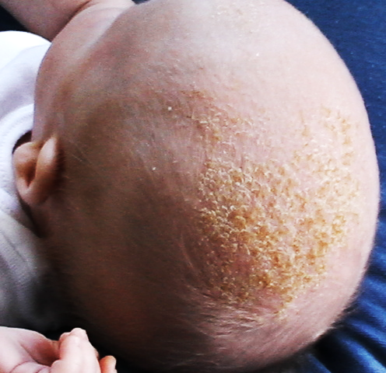
2
Introduction
Overview:
Cradle cap, also known as infantile seborrheic dermatitis, is a common skin condition in infants
It presents as greasy, scaly patches on the scalp
Significance:
Frequently observed in Indian infants due to climatic and environmental factors
Importance of proper management to prevent complications and discomfort
Incidence:
Affects a significant percentage of infants within the first few months of life
Impact:
Causes aesthetic concerns and potential discomfort if left untreated
Notes:
Cradle cap is a common, non-serious condition that affects infants, characterized by yellowish, greasy, scaly patches on the scalp. It typically appears within the first few months of life and usually clears up on its own within weeks to months.

Slide 3
Causes and Risk Factors
3
Overproduction of Sebum:
Overactive sebaceous glands produce excess sebum, leading to greasy scales
Malassezia Yeast:
Presence of Malassezia yeast on the skin contributes to the condition
Hormonal Factors:
Maternal hormones in the baby’s body may trigger sebaceous gland activity
Environmental Factors:
Humidity and heat can exacerbate the condition
Notes:
Cradle cap is caused by overproduction of sebum due to overactive sebaceous glands, leading to greasy scales on the infant's scalp. The presence of Malassezia yeast on the skin contributes to the condition, while maternal hormones in the baby’s body may trigger increased sebaceous gland activity. Environmental factors such as humidity and heat can further exacerbate cradle cap.

Slide 4
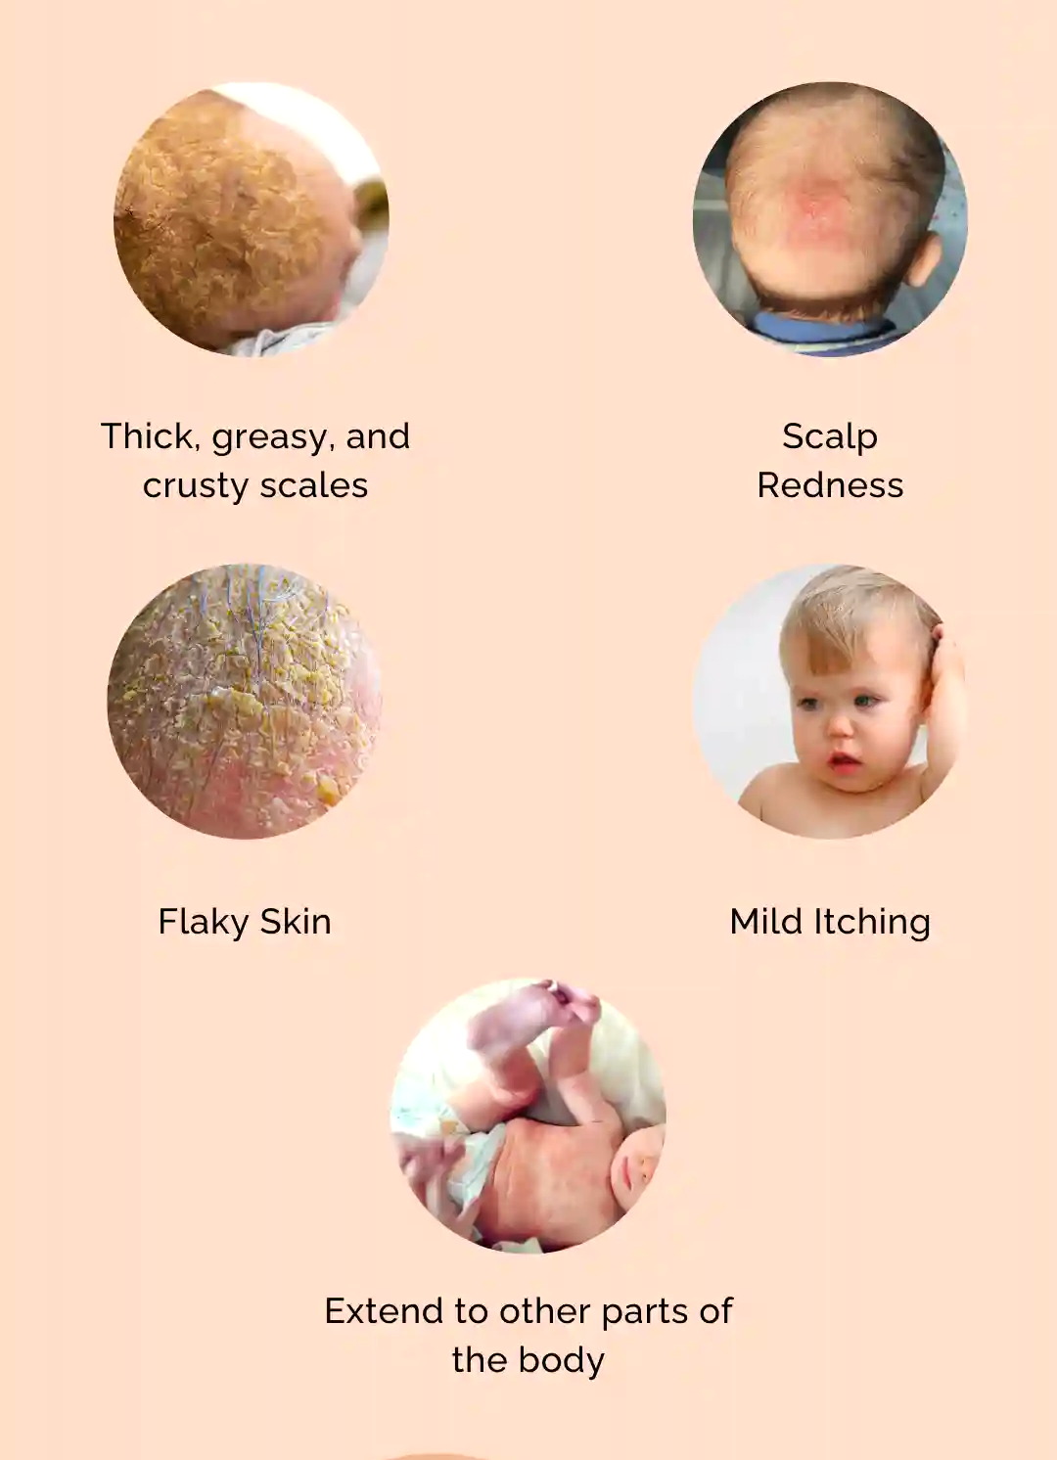
4
Symptoms and Diagnosis
Symptoms:
Greasy, yellow or brown scales on the scalp
Redness and possible mild inflammation
Flaky skin that may extend to the face, neck, and diaper area
Diagnosis:
Clinical examination
Differential diagnosis to rule out other conditions like seborrheic dermatitis , atopic dermatitis or psoriasis
Notes:
Cradle cap symptoms include greasy, yellow or brown scales on the scalp, with possible redness and mild inflammation. The flaky skin may also spread to the face, neck, and diaper area. Diagnosis is made through clinical examination and differential diagnosis to exclude conditions like atopic dermatitis or psoriasis.
4o mini

Slide 5
5
Step-by-Step Management Approach
Gentle Washing:
Wash the baby’s scalp with a mild, baby shampoo
Frequency: Daily or every other day to remove scales
Softening the Scales:
Apply mineral oil, baby oil, or petroleum jelly to soften the scales before washing
Leave the oil on the scalp for 15-30 minutes before washing
Removal of the Scales:
A soft cloth can be used to wipe out the scales
Medicated Shampoos:
For persistent cases, use a medicated shampoo containing ketoconazole, selenium sulfide, or zinc pyrithione
Notes:
To manage cradle cap, gently wash the baby's scalp with a mild baby shampoo daily or every other day to remove scales. Apply mineral oil, baby oil, or petroleum jelly to soften the scales before washing, and use a soft-bristled brush to remove them. For persistent cases, medicated shampoos with ketoconazole, selenium sulfide, or zinc pyrithione can be used.

Slide 6
6
Home Care Tips
Regular Scalp Care:
Maintain a regular scalp care routine with gentle washing and wiping of the scales with soft cloth
Avoid Harsh Products:
Use only mild, baby-specific shampoos and avoid harsh chemicals
Hydration:
Keep the baby’s skin hydrated with appropriate moisturizers
Monitor for Changes:
Observe for any changes in the condition, such as increased redness or spreading
Notes:
Maintain a regular scalp care routine with gentle washing and brushing, using mild, baby-specific shampoos. Keep the baby's skin hydrated with appropriate moisturizers and avoid harsh chemicals. Monitor the condition for any changes, such as increased redness or spreading, and adjust care accordingly.

Slide 7
7
When to Seek Medical Advice
Sign | Description
Severe/Persistent Cap | No improvement with home care
Signs of Infection | Pustules, oozing, increased redness
Spreading Rash | Extends to face, neck, diaper area
Baby's Discomfort | Excessive crying, scratching
Notes:
Severe/Persistent Cap shows no improvement with home care, while Signs of Infection include pustules, oozing, and increased redness. Spreading Rash extends to the face, neck, and diaper area, and Baby's Discomfort is indicated by excessive crying and scratching.

Slide 8
8
Red Flag: Underlying Conditions
Seborrheic Dermatitis:
Severe cradle cap may be a sign of more extensive seborrheic dermatitis
Look for involvement of other areas like eyebrows, behind ears, and diaper area
Psoriasis:
Consider psoriasis if there are thick, silvery scales and a family history of the condition
Look for joint pain or nail changes as additional indicators
Diagnostic Approach:
Detailed medical history and thorough physical examination
Referral to a dermatologist for further evaluation if necessary
Notes:
Severe cradle cap may indicate seborrheic dermatitis if it affects other areas like the eyebrows, behind the ears, and the diaper area. Psoriasis should be considered if there are thick, silvery scales and a family history of the condition, along with joint pain or nail changes. Diagnosis involves a detailed medical history, physical examination, and possibly a referral to a dermatologist for further evaluation.

Slide 9
9
Treatment of Severe Cases
Treatment | Description
Medicated Shampoos | Ketoconazole, selenium sulfide, zinc pyrithione
Topical Steroids | Mild steroids like hydrocortisone
Antifungal Treatments | Topical antifungal lotions
Specialist Referral | Dermatologist or pediatric specialist
Notes:
Here, we compare medicated shampoos and topical steroids for treating cradle cap. Medicated shampoos such as ketoconazole, selenium sulfide, and zinc pyrithione are effective for managing yeast and inflammation, while topical steroids like mild hydrocortisone specifically reduce inflammation and irritation. Antifungal treatments with topical creams address yeast-related symptoms, and a specialist referral may be necessary for advanced cases requiring dermatological or pediatric expertise.

Slide 10
10
Preventive Measures
Measure | Description
Regular Scalp Care | Gentle washing and wiping with soft cloth
Avoid Harsh Products | Use mild, baby-specific shampoos
Early Intervention | Recognize and treat early signs of cradle cap
Pediatric Check-ups | Routine monitoring and preventive care
Notes:
Here, we compare regular scalp care and avoiding harsh products for managing cradle cap. Regular scalp care involves gentle washing and brushing to maintain scalp health, while avoiding harsh products focuses on using mild, baby-specific shampoos to prevent irritation. Early intervention addresses cradle cap promptly to prevent worsening, whereas pediatric check-ups ensure ongoing monitoring and preventive care to manage skin conditions effectively.

Slide 11
11
Conclusion and Takeaways
Summary of Key Points:
Understanding the causes and symptoms of cradle cap is essential for effective management
A step-by-step approach ensures proper care and treatment
Recognizing and addressing underlying conditions like seborrheic dermatitis and psoriasis is crucial
Best Practices for Management:
Regular scalp care with gentle products
Use of medicated treatments for severe cases
Referral to specialists for persistent or complicated conditions
Notes:
Effective cradle cap management involves understanding its causes and symptoms, using a step-by-step care approach. Recognizing conditions like seborrheic dermatitis and psoriasis is key, and best practices include regular scalp care, medicated treatments, and specialist referrals. Healthcare providers should focus on prevention, early intervention, and comprehensive care.

