Slide 1

The Science of Baby Skin: Understanding the Dermatological Needs of Infants
Notes:
Welcome to "Role of Pneumococcal catch up vaccination in unvaccinated older people".

Slide 2

Dr Bhaskar, has confirmed that the presentation content is as per mainstream medical guidelines and medical academy guidelines and is not biased or in favor of any individual, group, product, or company.
DR. SRIDHAR GANAPATHY
MD DCH
Director Janani Children's Hospital, Mumbai
Notes:
I, Dr Bhaskar, consent to the recording and distribution of this video. The content is objective and adheres to the guidelines of the Indian Academy of Pediatrics (IAP). It is not biased or in favour of any party.

Slide 3
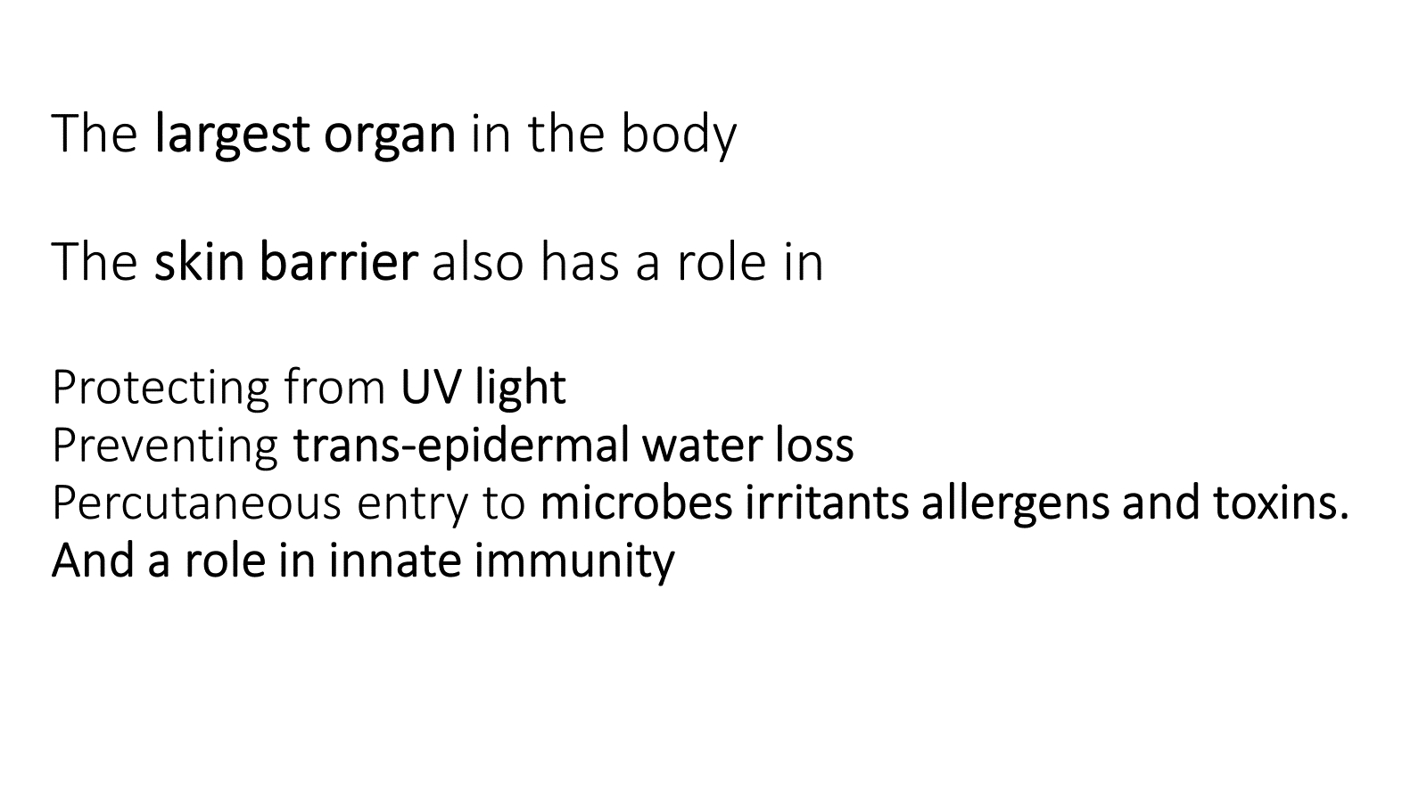

Slide 4


Slide 5
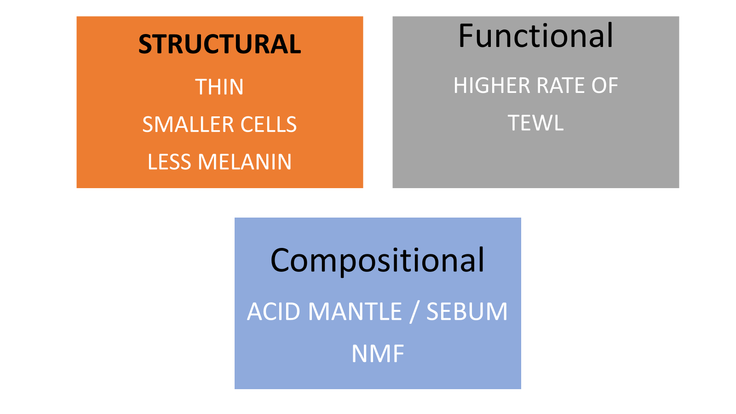

Slide 6
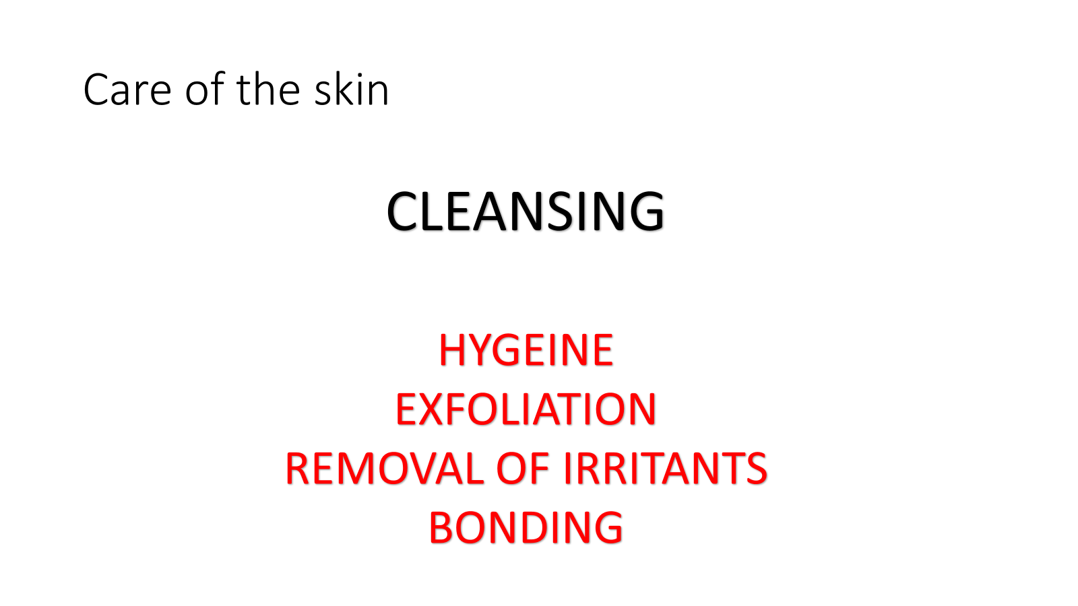

Slide 7
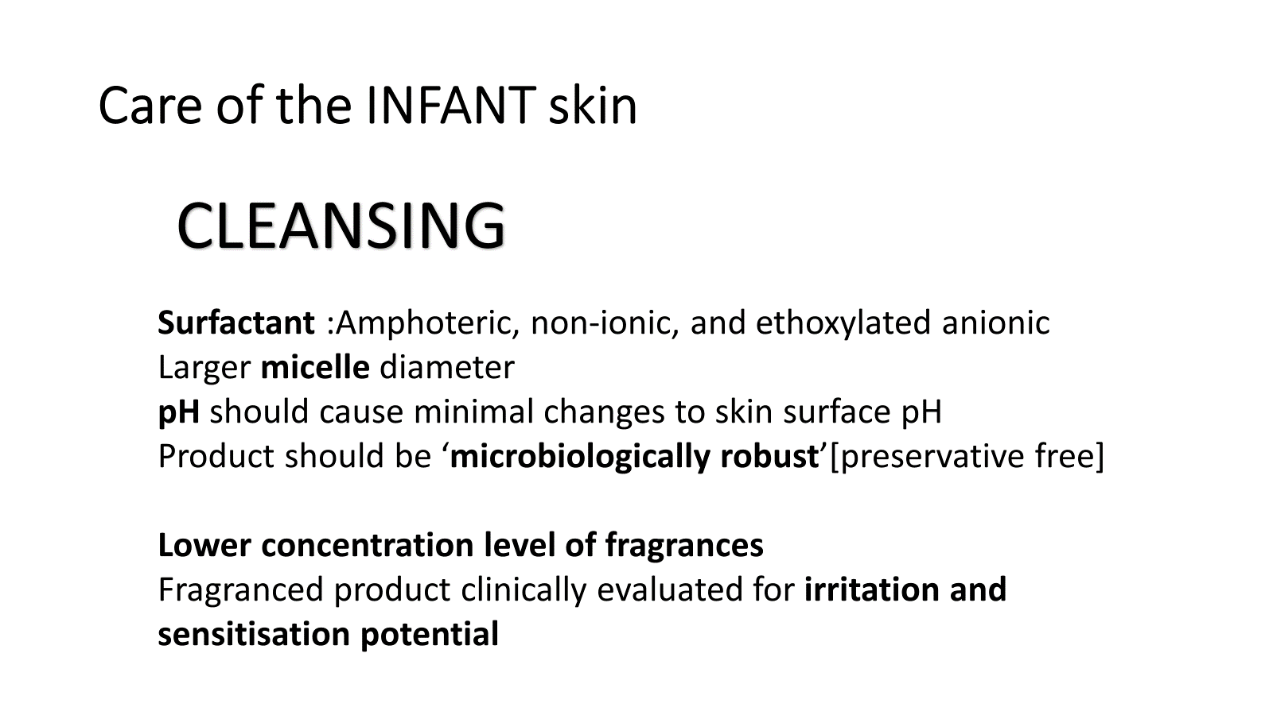

Slide 8
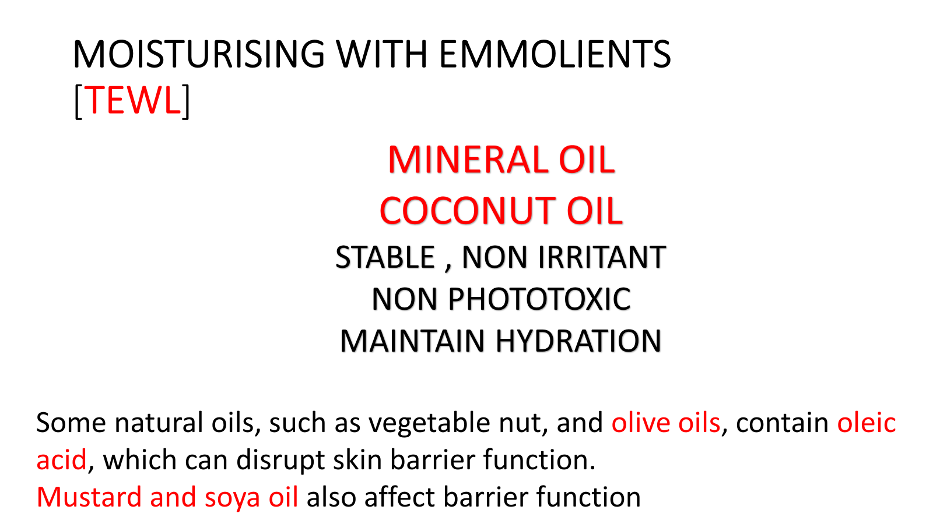

Slide 9
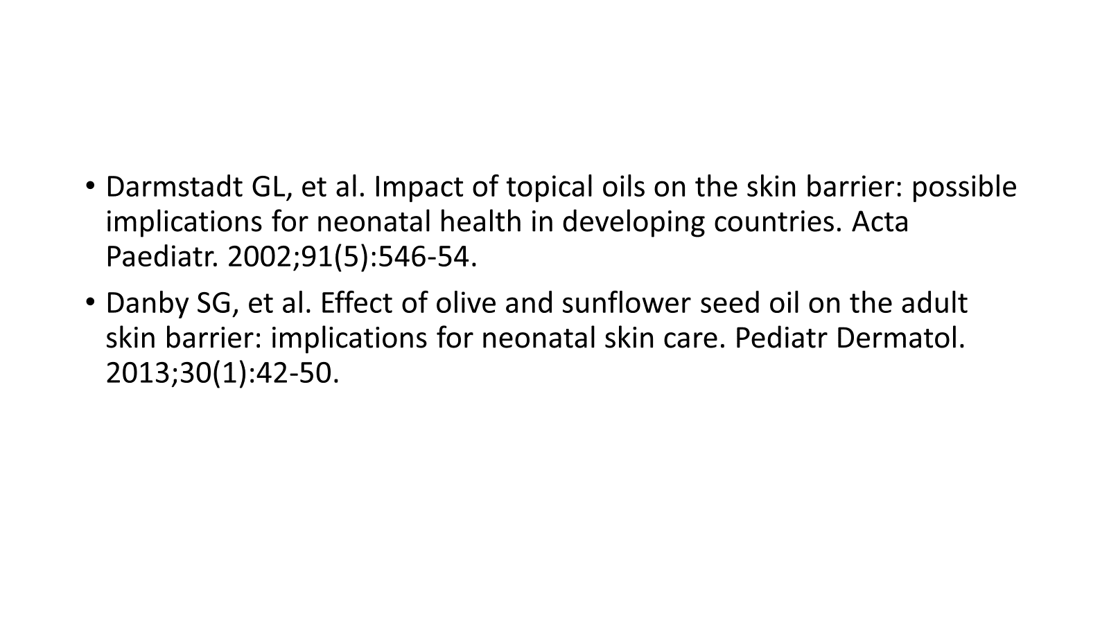

Slide 10
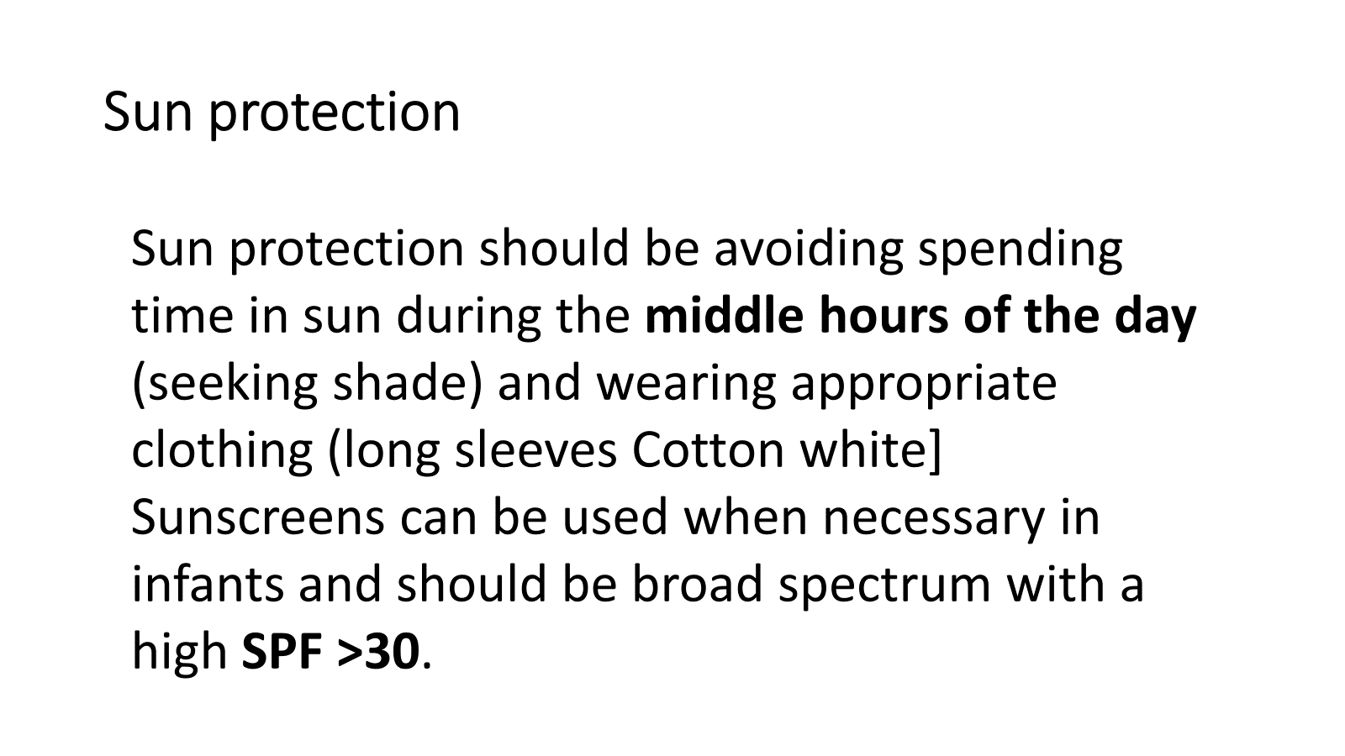

Slide 11

Case Study
Patient Profile:
6-month-old male from Mumbai
Healthy infant with no significant medical history
Presentation:
Redness, irritation, and mild swelling in the diaper area for 5 days
Increased fussiness and reduced feeding
Frequent urination and loose stools
Key Factors Contributing to Rash:
Friction and Occlusion: Prolonged moisture and heat due to diaper use
Urine and Stool Exposure: Ammonia from urine increases skin pH
Fecal Enzymes: Lipase and protease break down skin barrier
Changing pH: Disrupts natural acid mantle, promoting irritation
The content is by Dr. Bhaskar and adheres to medical academy guidelines and does not favor any individual, group, or product. This video is produced by Inditech Technology Services Pvt. Ltd. Distribution prohibited without permission.

Slide 12
Management Plan for Nappy Rash
Frequent Diaper Changes:
Every 2-3 hours or immediately after urination/defecation
Barrier Cream Application:
Use zinc oxide-based cream to protect skin and prevent further irritation
Gentle Cleansing:
Clean with lukewarm water and mild, fragrance-free cleanser; avoid abrasive wipes
Air Exposure:
Encourage diaper-free time to promote skin healing
Avoid Irritants:
Use fragrance-free and preservative-free products; avoid baby powder
The content is by Dr. Bhaskar and adheres to medical academy guidelines and does not favor any individual, group, or product. This video is produced by Inditech Technology Services Pvt. Ltd. Distribution prohibited without permission.

Slide 13
Outcome and Key Takeaways
Outcome:
Significant improvement in rash after one week
Reduced redness and irritation; no signs of secondary infection
Normalized feeding and comfort levels
Key Takeaways:
Importance of frequent diaper changes and proper hygiene
Use of barrier creams and gentle cleansing techniques
Awareness of environmental factors (humidity) in nappy rash management
Educating parents on preventative measures to reduce nappy rash incidents
The content is by Dr. Bhaskar and adheres to medical academy guidelines and does not favor any individual, group, or product. This video is produced by Inditech Technology Services Pvt. Ltd. Distribution prohibited without permission.

Slide 14
Conclusion
Summary of Key Points:
Understanding the unique needs of infant skin is crucial for effective dermatological care.
Differentiating between dry skin and eczema ensures proper treatment and management.
Identifying and managing underlying allergies is essential in treating eczema.
Call to Action:
Encourage healthcare providers to adopt comprehensive skincare strategies for infants.
Emphasize the importance of education and awareness among parents and caregivers.
The content is by Dr. Bhaskar and adheres to medical academy guidelines and does not favor any individual, group, or product. This video is produced by Inditech Technology Services Pvt. Ltd. Distribution prohibited without permission.

