Slide 1
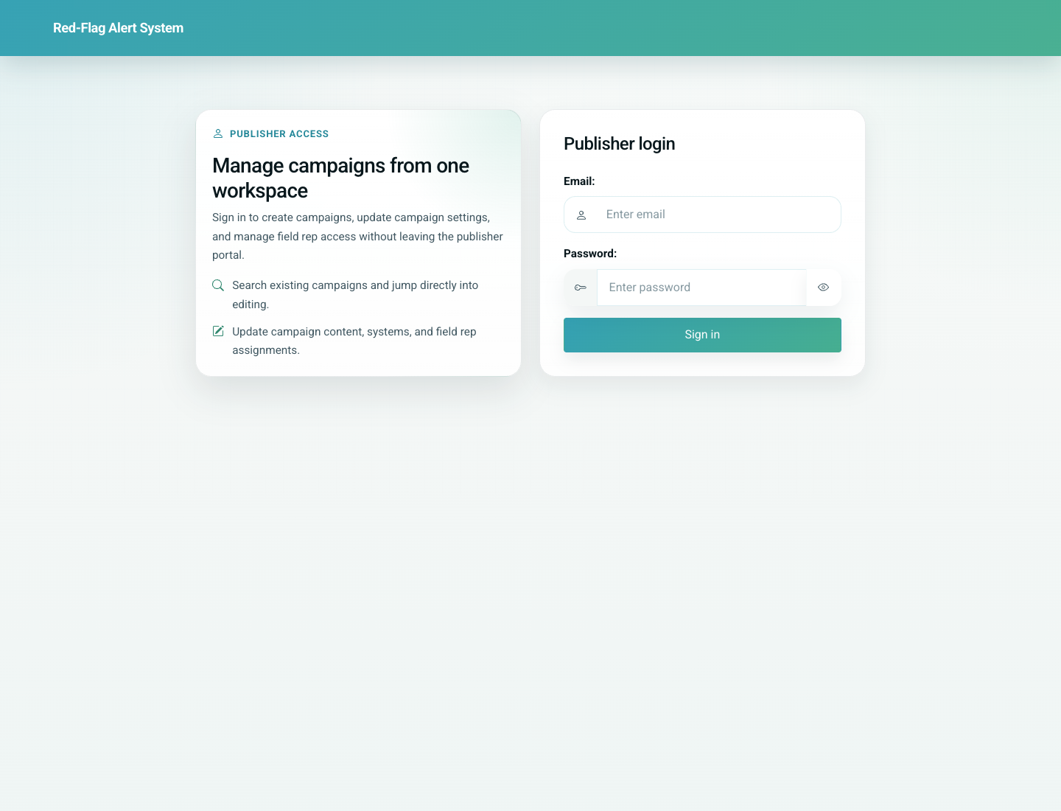
01
Platform Overview and Role Map
Platform Overview
The product is a pediatric vaccination system connecting partner onboarding, doctor registration, patient record management, parent self-service, reminders, and education content. The live app currently starts from a doctor/admin-oriented home page, while parent flows start from direct routes such as `/add/` and `/update/`.
Primary user: Internal trainers, product owners, partner leads, and new project team members
Entry point: Public home page `/` plus direct workflow URLs for parents, doctors, and partners
User-Flow Training Pack
platform-overview-and-role-map

Slide 2
Workflow At A Glance
Platform Overview and Role Map
What This Workflow Covers
The product is a pediatric vaccination system connecting partner onboarding, doctor registration, patient record management, parent self-service, reminders, and education content. The live app currently starts from a doctor/admin-oriented home page, while parent flows start from direct routes such as `/add/` and `/update/`.
Primary User
Internal trainers, product owners, partner leads, and new project team members
Entry Point
Public home page `/` plus direct workflow URLs for parents, doctors, and partners
Success Criteria
The trainer can explain which role enters at which route.
The audience understands how partner setup, doctor usage, parent access, reminders, and education fit together.
Known live-product mismatches are called out before role training begins.
Role Map
Partner/Admin -> Doctor/Clinic -> Parent/Patient -> Reminders & Education
Workflow summary
Platform Overview and Role Map

Slide 3
Step 1. Open the live landing page
Platform Overview and Role Map
What the user does
Open the public home page in a browser.
What the user sees
A simple landing page with Doctor Registration and Field Partner (Admin) actions.
Why this matters
This establishes the real starting point the product exposes today.
Expected result
The trainer can explain that the live landing page is provider/admin oriented.
Trainer note: Call out that this differs from the original expectation of a parent-first landing page.
Live home page showing the current public entry points
Step 1 of 3
Platform Overview and Role Map

Slide 4
Step 2. Map each role to its real entry point
Platform Overview and Role Map
What the user does
Review the product with role-based starting URLs: admin/partner, doctor, and parent.
What the user sees
A product where some roles start from the home page and others start from direct routes or shared links.
Why this matters
Role clarity prevents confusion during onboarding and training delivery.
Expected result
Users understand that parents, doctors, and partner/admin users do not all start from the same page.
Trainer note: Parent flows are best demonstrated from `/add/`, `/update/`, or a share link.
Home page reused as the anchor for the role-entry explanation
Step 2 of 3
Platform Overview and Role Map

Slide 5
Step 3. Explain the end-to-end handoff chain
Platform Overview and Role Map
What the user does
Image missing: 02-role-map-diagram.png
Walk through how partner setup enables doctor onboarding, which then enables patient registration, reminders, and parent access.
What the user sees
A connected service flow rather than isolated screens.
Why this matters
This is the mental model that makes the rest of the workflow pack coherent.
Expected result
The trainer can position each detailed workflow deck inside one shared operating model.
Trainer note: Use the role map slide in the deck for this step; there is no single live UI screen for the whole chain.
Role map diagram for the end-to-end service flow
Step 3 of 3
Platform Overview and Role Map

Slide 6
Common Issues and Trainer Tips
Platform Overview and Role Map
The home page currently exposes doctor registration and a Django admin link, not the parent actions described in the original brief.
Parent workflows are live, but trainers should take users directly to `/add/` or `/update/` until the home page is redesigned.
Use these notes to pre-empt confusion before the audience encounters the step live.
Trainer guidance
Platform Overview and Role Map

Slide 7
Platform Overview and Role Map
Related Documents
02-admin-partner-provisioning-and-field-rep-upload.md
03-doctor-self-registration-and-portal-access.md
08-parent-self-service-card-history-and-share-link.md
Orient trainers, internal teams, and new stakeholders to the product’s end-to-end operating model before they dive into role-specific workflows.
Validated against the local demo build on April 9, 2026. Documentation reflects live behavior; mismatches with older expectations are noted.
Training pack close
platform-overview-and-role-map

