Slide 1
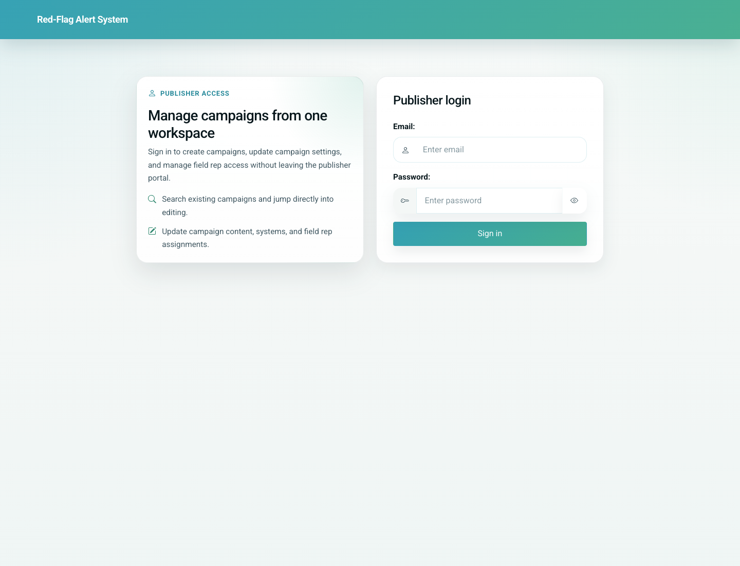
02
Admin Partner Provisioning and Field Rep Upload
Admin / Partner
The live product provides a lightweight admin password gate for partner setup. After access is granted, the admin can create a partner, upload field rep CSV data, and obtain a doctor registration link to circulate.
Primary user: Partner admin, field operations lead, or internal business operations owner
Entry point: Admin access gate at `/admin/access/`, followed by `/partners/new/`
User-Flow Training Pack
admin-partner-provisioning-and-field-rep-upload

Slide 2
Workflow At A Glance
Admin Partner Provisioning and Field Rep Upload
What This Workflow Covers
The live product provides a lightweight admin password gate for partner setup. After access is granted, the admin can create a partner, upload field rep CSV data, and obtain a doctor registration link to circulate.
Primary User
Partner admin, field operations lead, or internal business operations owner
Entry Point
Admin access gate at `/admin/access/`, followed by `/partners/new/`
Success Criteria
The admin can reach the partner workspace.
A partner record is created with field reps loaded from CSV.
A working doctor registration link is produced for onward sharing.
Workflow summary
Admin Partner Provisioning and Field Rep Upload

Slide 3
Step 1. Pass the admin access gate
Admin Partner Provisioning and Field Rep Upload
What the user does
Open the admin access page and enter the configured admin password.
What the user sees
A focused password gate that protects the partner provisioning workspace.
Why this matters
This is the first gate that separates general users from partner administrators.
Expected result
The session is authorized for partner creation.
Trainer note: In the local demo build, the admin quick password is derived from the local secret key.
Admin access gate before partner setup
Step 1 of 3
Admin Partner Provisioning and Field Rep Upload

Slide 4
Step 2. Create the partner workspace
Admin Partner Provisioning and Field Rep Upload
What the user does
Open the partner creation screen after access is granted.
What the user sees
A form with Partner Name and Field Reps CSV upload fields.
Why this matters
This is where the whitelabel / partner shell and field rep import are initiated.
Expected result
The admin is ready to create the partner record.
Trainer note: The field rep CSV expects `rep_code` and `full_name` columns.
Partner creation form with CSV upload
Step 2 of 3
Admin Partner Provisioning and Field Rep Upload

Slide 5
Step 3. Generate and share the doctor registration link
Admin Partner Provisioning and Field Rep Upload
What the user does
Submit the partner form with the field rep CSV.
What the user sees
A success message showing the generated doctor registration link.
Why this matters
This link is the handoff artifact used by field teams and partner operators to onboard doctors.
Expected result
The partner exists and its registration link can be shared.
Trainer note: Treat the link as the official onboarding URL for partner-led doctor registration.
Partner creation success state with the generated onboarding link
Step 3 of 3
Admin Partner Provisioning and Field Rep Upload

Slide 6
Common Issues and Trainer Tips
Admin Partner Provisioning and Field Rep Upload
The public home page links to Django admin, but the actual partner provisioning flow is the custom `/admin/access/` -> `/partners/new/` path.
Use these notes to pre-empt confusion before the audience encounters the step live.
Trainer guidance
Admin Partner Provisioning and Field Rep Upload

Slide 7
Admin Partner Provisioning and Field Rep Upload
Related Documents
04-partner-led-doctor-onboarding.md
03-doctor-self-registration-and-portal-access.md
Show how a partner administrator opens the partner workspace, creates a partner profile, uploads field representatives, and generates a doctor registration link.
Validated against the local demo build on April 9, 2026. Documentation reflects live behavior; mismatches with older expectations are noted.
Training pack close
admin-partner-provisioning-and-field-rep-upload

