Slide 1
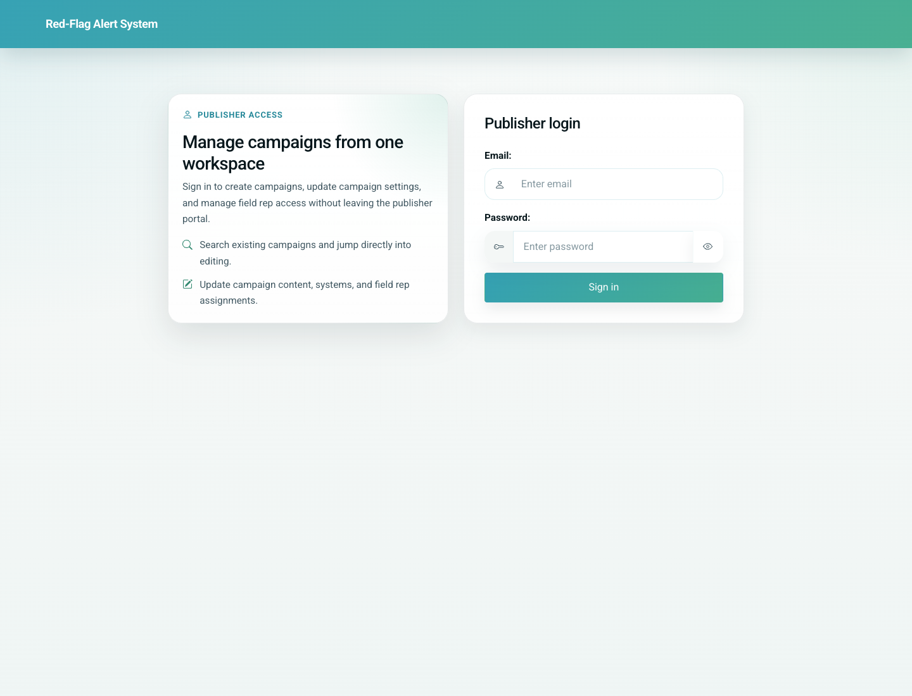
03
Doctor Self Registration and Portal Access
Doctor / Clinic
Doctors can self-register through a public registration form. After submission, the current product opens WhatsApp with a prefilled portal message, and the doctor then uses the portal link to reach the clinic workspace.
Primary user: Doctor or clinic lead registering directly
Entry point: Doctor self-registration form at `/doctor/register/`
User-Flow Training Pack
doctor-self-registration-and-portal-access

Slide 2
Workflow At A Glance
Doctor Self Registration and Portal Access
What This Workflow Covers
Doctors can self-register through a public registration form. After submission, the current product opens WhatsApp with a prefilled portal message, and the doctor then uses the portal link to reach the clinic workspace.
Primary User
Doctor or clinic lead registering directly
Entry Point
Doctor self-registration form at `/doctor/register/`
Success Criteria
The doctor can complete the registration form.
The doctor understands that submission hands off to WhatsApp with the portal link.
The doctor recognizes the portal home once authenticated.
Workflow summary
Doctor Self Registration and Portal Access

Slide 3
Step 1. Open the doctor registration form
Doctor Self Registration and Portal Access
What the user does
Browse to the self-registration page.
What the user sees
A detailed doctor registration form covering identity, clinic details, languages, contact numbers, and IMC number.
Why this matters
This is the doctor’s main onboarding form when no partner-issued link is involved.
Expected result
The doctor can review the data required to register.
Trainer note: The form enforces Gmail-format email addresses in the current build.
Doctor self-registration form
Step 1 of 3
Doctor Self Registration and Portal Access

Slide 4
Step 2. Submit and hand off to WhatsApp
Doctor Self Registration and Portal Access
What the user does
Complete the form and click Register.
What the user sees
The browser is redirected to WhatsApp with a prefilled message containing the doctor portal link.
Why this matters
This is how the product currently distributes the personalized portal URL.
Expected result
The doctor receives a reusable portal link message.
Trainer note: The current implementation opens WhatsApp rather than using a server-side messaging gateway.
Registration form immediately before submission
Step 2 of 3
Doctor Self Registration and Portal Access

Slide 5
Step 3. Recognize the clinic portal home
Doctor Self Registration and Portal Access
What the user does
Open the doctor portal link and sign in.
What the user sees
A doctor portal home page with actions for Add-a-patient, Update a patient record, Reminders, and Edit doctor/clinic profile.
Why this matters
This is the control center the doctor returns to for daily clinic use.
Expected result
The doctor can navigate to the main clinic workflows from one landing page.
Trainer note: The documentation screenshots use a local demo session to bypass unavailable Google OAuth credentials.
Doctor portal home after successful access
Step 3 of 3
Doctor Self Registration and Portal Access

Slide 6
Common Issues and Trainer Tips
Doctor Self Registration and Portal Access
Production behavior expects Google/Gmail sign-in for portal use.
The local documentation build captures the portal home using a demo session because local OAuth credentials are placeholders.
Use these notes to pre-empt confusion before the audience encounters the step live.
Trainer guidance
Doctor Self Registration and Portal Access

Slide 7
Doctor Self Registration and Portal Access
Related Documents
05-doctor-portal-add-patient-and-share-link.md
06-doctor-portal-update-card-and-profile.md
Train a doctor or clinic lead to self-register, understand the expected WhatsApp handoff, and recognize the portal landing page they use after sign-in.
Validated against the local demo build on April 9, 2026. Documentation reflects live behavior; mismatches with older expectations are noted.
Training pack close
doctor-self-registration-and-portal-access

