Slide 1
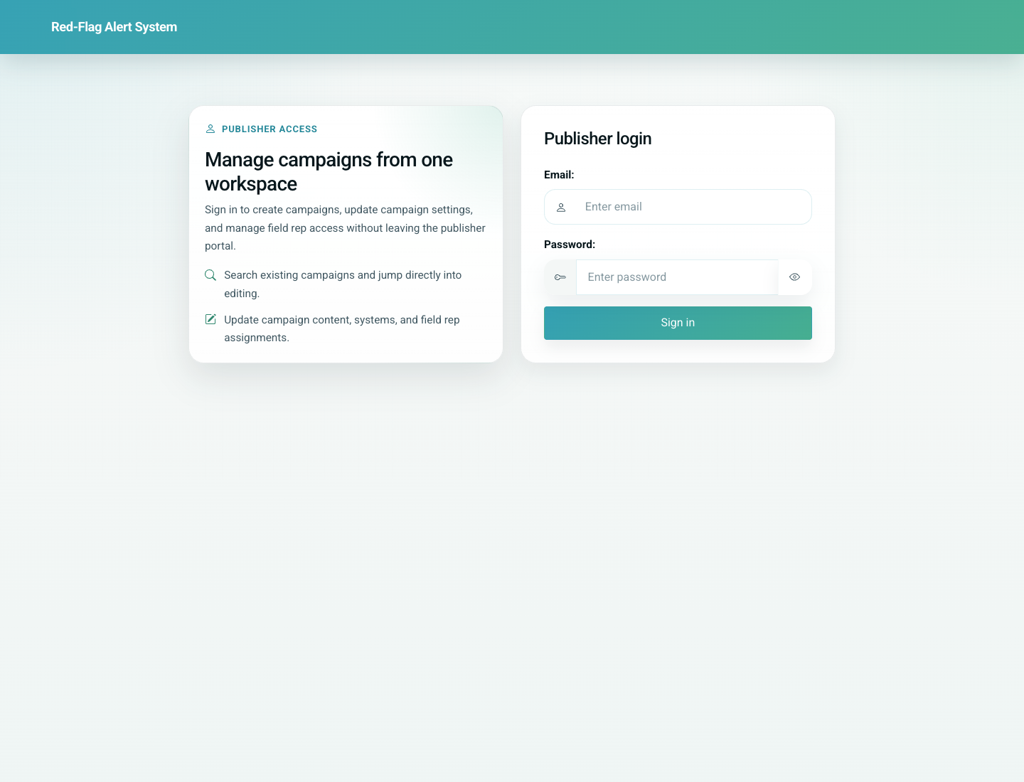
04
Partner-Led Doctor Onboarding
Admin / Partner
Partner-led onboarding uses a tokenized doctor registration link. The form is similar to self-registration but adds field rep code and field rep name to attribute the onboarding to the partner team.
Primary user: Field team member, partner coordinator, or doctor onboarding via partner link
Entry point: Partner registration URL at `/doctor/register/<token>/`
User-Flow Training Pack
partner-led-doctor-onboarding

Slide 2
Workflow At A Glance
Partner-Led Doctor Onboarding
What This Workflow Covers
Partner-led onboarding uses a tokenized doctor registration link. The form is similar to self-registration but adds field rep code and field rep name to attribute the onboarding to the partner team.
Primary User
Field team member, partner coordinator, or doctor onboarding via partner link
Entry Point
Partner registration URL at `/doctor/register/<token>/`
Success Criteria
The doctor can open the partner-specific registration form.
The form captures the required field rep information.
The doctor reaches the same portal destination after the WhatsApp handoff.
Workflow summary
Partner-Led Doctor Onboarding

Slide 3
Step 1. Open the partner-issued registration link
Partner-Led Doctor Onboarding
What the user does
Open the doctor registration URL received from the partner/admin team.
What the user sees
The doctor registration form with additional Field Rep Code and Field Rep Name inputs.
Why this matters
This route distinguishes partner-led onboarding from self-registration.
Expected result
The doctor is in the correct registration context for partner attribution.
Trainer note: If the token is invalid or expired, the product redirects back to the home page with an error.
Partner-led doctor registration form with field rep fields
Step 1 of 3
Partner-Led Doctor Onboarding

Slide 4
Step 2. Complete registration with field rep details
Partner-Led Doctor Onboarding
What the user does
Enter doctor details plus the partner field rep code/name and submit the form.
What the user sees
The same WhatsApp redirect behavior used for self-registration, now tied to the partner and field rep.
Why this matters
This preserves partner attribution while still delivering the portal link to the doctor.
Expected result
The doctor is stored with the linked partner and field rep association.
Trainer note: The live validation checks the field rep code against the selected partner.
Partner-led registration form before submission
Step 2 of 3
Partner-Led Doctor Onboarding

Slide 5
Step 3. Confirm the partner doctor portal landing
Partner-Led Doctor Onboarding
What the user does
Open the personalized portal link after sign-in.
What the user sees
The same doctor portal home used in self-registration-based onboarding.
Why this matters
This confirms that partner-led onboarding still leads into the shared clinic operating workflow.
Expected result
The partner-onboarded doctor can continue with routine clinic tasks.
Trainer note: The downstream portal experience is shared; the main difference is the onboarding attribution.
Partner-onboarded doctor landing in the clinic portal
Step 3 of 3
Partner-Led Doctor Onboarding

Slide 6
Common Issues and Trainer Tips
Partner-Led Doctor Onboarding
The partner token is the mechanism that scopes the doctor to the partner.
A valid field rep code is required for this path.
Use these notes to pre-empt confusion before the audience encounters the step live.
Trainer guidance
Partner-Led Doctor Onboarding

Slide 7
Partner-Led Doctor Onboarding
Related Documents
02-admin-partner-provisioning-and-field-rep-upload.md
03-doctor-self-registration-and-portal-access.md
Show how a partner-issued registration link adds field rep attribution to the doctor onboarding process and leads into the same portal experience.
Validated against the local demo build on April 9, 2026. Documentation reflects live behavior; mismatches with older expectations are noted.
Training pack close
partner-led-doctor-onboarding

