Slide 1
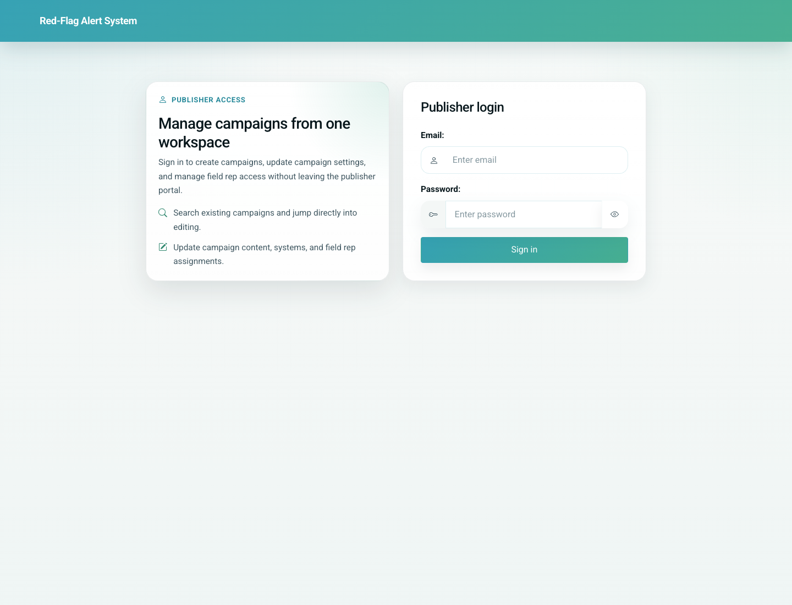
05
Doctor Portal Add Patient and Share Link
Doctor / Clinic
From the portal, the doctor can add a patient by recording child details and the parent’s WhatsApp number. The portal supports a standard submit path and also shows a Register & Send to Patient action that opens WhatsApp Web with a shareable card link.
Primary user: Doctor or clinic staff member working inside the portal
Entry point: Doctor portal home `/d/<token>/` -> Add-a-patient
User-Flow Training Pack
doctor-portal-add-patient-and-share-link

Slide 2
Workflow At A Glance
Doctor Portal Add Patient and Share Link
What This Workflow Covers
From the portal, the doctor can add a patient by recording child details and the parent’s WhatsApp number. The portal supports a standard submit path and also shows a Register & Send to Patient action that opens WhatsApp Web with a shareable card link.
Primary User
Doctor or clinic staff member working inside the portal
Entry Point
Doctor portal home `/d/<token>/` -> Add-a-patient
Success Criteria
The clinic can open the add-patient form.
Submitting the form creates the child vaccination card.
Staff understand that the optional send action opens WhatsApp Web with a share link.
Workflow summary
Doctor Portal Add Patient and Share Link

Slide 3
Step 1. Open the add-patient form
Doctor Portal Add Patient and Share Link
What the user does
Choose Add-a-patient from the portal home.
What the user sees
The child registration form with Submit and Register & Send to Patient actions.
Why this matters
This is the clinic-side starting point for bringing a new child into the system.
Expected result
The clinic user can record patient details and decide whether to also hand off a share link.
Trainer note: The send button is only shown inside the doctor portal, not on the public parent add flow.
Doctor portal add-patient form with both action buttons
Step 1 of 3
Doctor Portal Add Patient and Share Link

Slide 4
Step 2. Create the patient record
Doctor Portal Add Patient and Share Link
What the user does
Submit the child details and parent WhatsApp number.
What the user sees
The child’s vaccination card inside the doctor portal.
Why this matters
This confirms that the patient record and linked vaccination schedule were created successfully.
Expected result
The doctor can immediately review and update the child card.
Trainer note: The child is scoped to the doctor’s clinic for later update and reminder workflows.
Doctor view of the vaccination card after adding a patient
Step 2 of 3
Doctor Portal Add Patient and Share Link

Slide 5
Step 3. Use the optional share-link path
Doctor Portal Add Patient and Share Link
What the user does
Choose Register & Send to Patient instead of the standard submit action when appropriate.
What the user sees
WhatsApp Web opens with a bilingual message and the parent share link.
Why this matters
This enables the clinic to hand off self-service access to the parent at the moment of registration.
Expected result
The parent receives a direct verification link to the child card.
Trainer note: The final messaging step happens outside the app in WhatsApp Web.
The add-patient screen where the share-link handoff is initiated
Step 3 of 3
Doctor Portal Add Patient and Share Link

Slide 6
Common Issues and Trainer Tips
Doctor Portal Add Patient and Share Link
The product currently opens WhatsApp Web rather than sending through a business messaging gateway.
Use these notes to pre-empt confusion before the audience encounters the step live.
Trainer guidance
Doctor Portal Add Patient and Share Link

Slide 7
Doctor Portal Add Patient and Share Link
Related Documents
06-doctor-portal-update-card-and-profile.md
08-parent-self-service-card-history-and-share-link.md
Teach clinic staff how to register a patient, create the patient vaccination card, and understand the optional share-link handoff to the parent.
Validated against the local demo build on April 9, 2026. Documentation reflects live behavior; mismatches with older expectations are noted.
Training pack close
doctor-portal-add-patient-and-share-link

