Slide 1
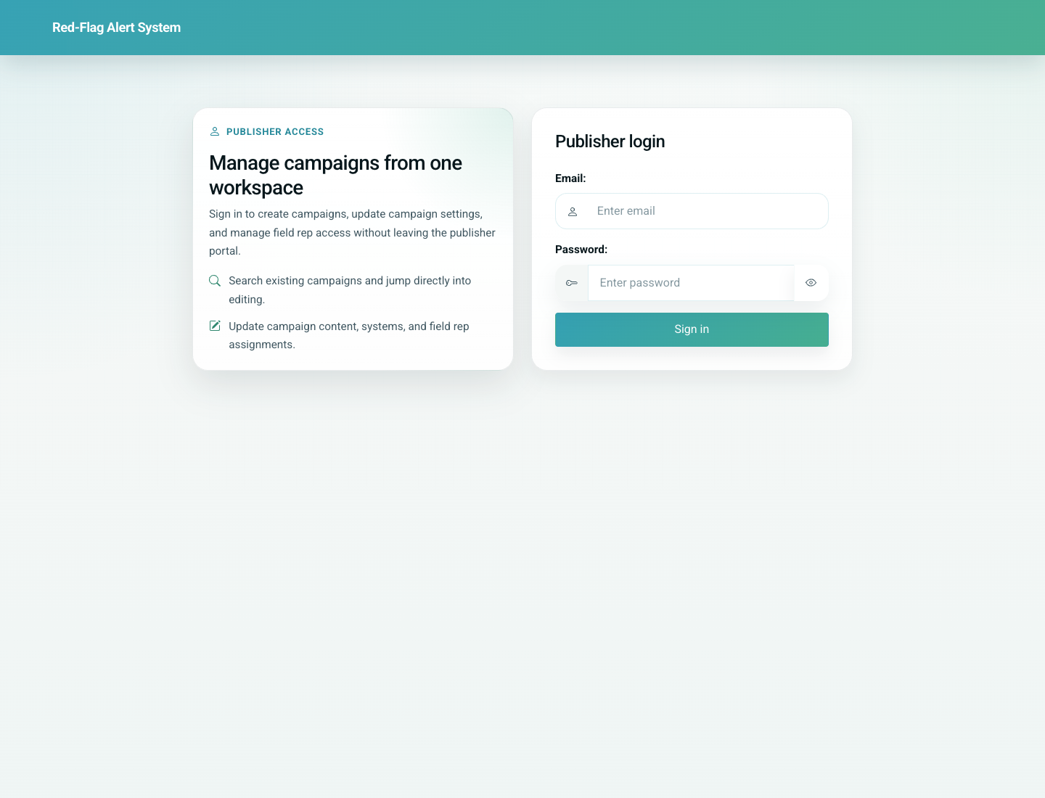
06
Doctor Portal Update Card and Profile
Doctor / Clinic
This workflow covers the day-to-day clinic maintenance path: look up a parent by WhatsApp number, select the correct child, open the vaccination card, and update clinic profile details as needed.
Primary user: Doctor or clinic staff member
Entry point: Doctor portal home -> Update a patient record, plus Edit doctor/clinic profile
User-Flow Training Pack
doctor-portal-update-card-and-profile

Slide 2
Workflow At A Glance
Doctor Portal Update Card and Profile
What This Workflow Covers
This workflow covers the day-to-day clinic maintenance path: look up a parent by WhatsApp number, select the correct child, open the vaccination card, and update clinic profile details as needed.
Primary User
Doctor or clinic staff member
Entry Point
Doctor portal home -> Update a patient record, plus Edit doctor/clinic profile
Success Criteria
The clinic can find patients by parent WhatsApp number.
The correct child record is opened within the clinic scope.
The doctor/clinic profile can be updated from the same portal.
Workflow summary
Doctor Portal Update Card and Profile

Slide 3
Step 1. Search by parent WhatsApp number
Doctor Portal Update Card and Profile
What the user does
Open Update a patient record and enter the parent’s WhatsApp number.
What the user sees
A WhatsApp lookup form specific to the doctor portal.
Why this matters
This is the quickest way to retrieve a family’s children already linked to the clinic.
Expected result
The system is ready to show the matching child list.
Trainer note: The number lookup is based on the stored WhatsApp number.
Doctor-side lookup form for an existing patient
Step 1 of 4
Doctor Portal Update Card and Profile

Slide 4
Step 2. Choose the correct child
Doctor Portal Update Card and Profile
What the user does
Submit the lookup and review the matching children.
What the user sees
A child-selection screen with actions for Open Vaccination Card, Full Schedule, and Send Reminders.
Why this matters
A single parent may have multiple children, so the clinic must choose the right record before editing anything.
Expected result
The clinic can continue into the correct child workflow.
Trainer note: Only children in the current clinic appear in this list.
Doctor-facing child selection after WhatsApp lookup
Step 2 of 4
Doctor Portal Update Card and Profile

Slide 5
Step 3. Open and update the vaccination card
Doctor Portal Update Card and Profile
What the user does
Open the due-only or full vaccination card and record given dates where needed.
What the user sees
The doctor-facing vaccination card with due, overdue, given, and future status states.
Why this matters
This is the operational heart of the clinic workflow: maintaining the child’s vaccination record.
Expected result
The card reflects the latest known vaccination dates.
Trainer note: The product automatically recalculates dependent doses when a given date changes.
Doctor view of the patient vaccination card
Step 3 of 4
Doctor Portal Update Card and Profile

Slide 6
Step 4. Maintain the clinic profile
Doctor Portal Update Card and Profile
What the user does
Open Edit doctor/clinic profile from the portal home.
What the user sees
A profile form for doctor details, clinic contact data, languages, and IMC number.
Why this matters
Clinic identity, language settings, and contact details need to stay current for patient communication to work well.
Expected result
The clinic profile can be updated without leaving the portal.
Trainer note: Preferred languages influence downstream patient-facing messaging.
Doctor and clinic profile maintenance screen
Step 4 of 4
Doctor Portal Update Card and Profile

Slide 7
Common Issues and Trainer Tips
Doctor Portal Update Card and Profile
Patient lookup is clinic-scoped in the doctor workflow, even if the parent has records elsewhere.
Use these notes to pre-empt confusion before the audience encounters the step live.
Trainer guidance
Doctor Portal Update Card and Profile

Slide 8
Doctor Portal Update Card and Profile
Related Documents
05-doctor-portal-add-patient-and-share-link.md
07-reminders-and-education-workflows.md
Train clinic users on finding an existing patient, opening the card, updating vaccine dates, and maintaining the doctor/clinic profile.
Validated against the local demo build on April 9, 2026. Documentation reflects live behavior; mismatches with older expectations are noted.
Training pack close
doctor-portal-update-card-and-profile

