Slide 1
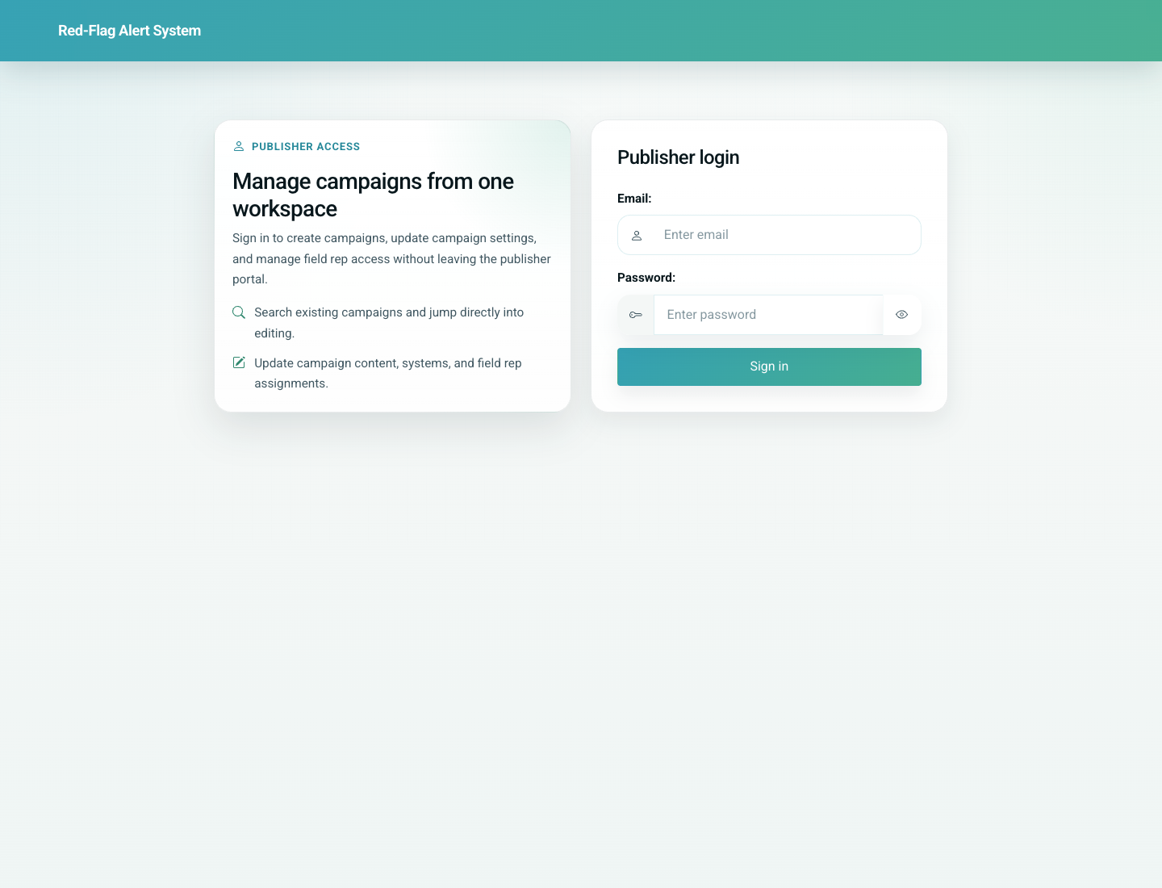
07
Reminders and Education Workflows
Doctor / Clinic
The clinic can review due and overdue doses, open child-level reminder schedules, and use linked education pages to reinforce communication with families. Reminder sending currently hands off to WhatsApp with a prefilled message.
Primary user: Doctor or clinic staff member managing patient follow-up
Entry point: Doctor portal -> Reminders, child reminder screens, and education pages
User-Flow Training Pack
reminders-and-education-workflows

Slide 2
Workflow At A Glance
Reminders and Education Workflows
What This Workflow Covers
The clinic can review due and overdue doses, open child-level reminder schedules, and use linked education pages to reinforce communication with families. Reminder sending currently hands off to WhatsApp with a prefilled message.
Primary User
Doctor or clinic staff member managing patient follow-up
Entry Point
Doctor portal -> Reminders, child reminder screens, and education pages
Success Criteria
The clinic can read the reminder dashboard filters and eligible actions.
Staff can inspect reminder status for one child.
Provider and patient education pages can be opened from the workflow.
Workflow summary
Reminders and Education Workflows

Slide 3
Step 1. Review the clinic-wide reminder dashboard
Reminders and Education Workflows
What the user does
Open Reminders from the portal home.
What the user sees
A reminder dashboard with status filters, vaccine filter, search, and Send Reminder actions.
Why this matters
This is the clinic’s queue view for follow-up work across all patients.
Expected result
The clinic can identify who is due, overdue, upcoming, or already reminded.
Trainer note: Search accepts child text and mobile-number lookups.
Clinic-wide reminders dashboard
Step 1 of 4
Reminders and Education Workflows

Slide 4
Step 2. Inspect one child’s reminder schedule
Reminders and Education Workflows
What the user does
Open the reminder detail screen for a specific child.
What the user sees
A child-level table showing vaccine reminder status and eligibility.
Why this matters
This narrows the follow-up conversation to one patient when the clinic needs detail.
Expected result
The clinic can see exactly which reminder actions are available for the child.
Trainer note: The child-level page is especially useful before sending a reminder manually.
Child-level reminder schedule in the doctor portal
Step 2 of 4
Reminders and Education Workflows

Slide 5
Step 3. Open doctor-facing vaccine education
Reminders and Education Workflows
What the user does
Open a vaccine education page from the reminder or card workflow.
What the user sees
The provider education page for that vaccine.
Why this matters
Doctors may need refresher content or supporting material before discussing the vaccine with families.
Expected result
The provider can access vaccine education without leaving the workflow context.
Trainer note: This page is provider-focused, separate from the simplified patient education page used in reminder links.
Doctor-facing vaccine education page
Step 3 of 4
Reminders and Education Workflows

Slide 6
Step 4. Understand the patient education destination
Reminders and Education Workflows
What the user does
Open the simplified patient education page used in reminder messaging.
What the user sees
A patient-friendly video page with language-aware vaccine education content.
Why this matters
This is the educational destination parents reach from reminder messages.
Expected result
The clinic understands what families see after clicking an education link.
Trainer note: This page is public and optimized for parent-facing education consumption.
Simplified patient education page used by reminder links
Step 4 of 4
Reminders and Education Workflows

Slide 7
Common Issues and Trainer Tips
Reminders and Education Workflows
Reminder sending opens WhatsApp rather than pushing through a backend messaging integration.
The dashboard combines due-today / overdue logic with a retention window on recently overdue items.
Use these notes to pre-empt confusion before the audience encounters the step live.
Trainer guidance
Reminders and Education Workflows

Slide 8
Reminders and Education Workflows
Related Documents
06-doctor-portal-update-card-and-profile.md
08-parent-self-service-card-history-and-share-link.md
Train clinic users on monitoring due doses, sending reminders, and opening the supporting vaccine education pages for providers and parents.
Validated against the local demo build on April 9, 2026. Documentation reflects live behavior; mismatches with older expectations are noted.
Training pack close
reminders-and-education-workflows

