Slide 1
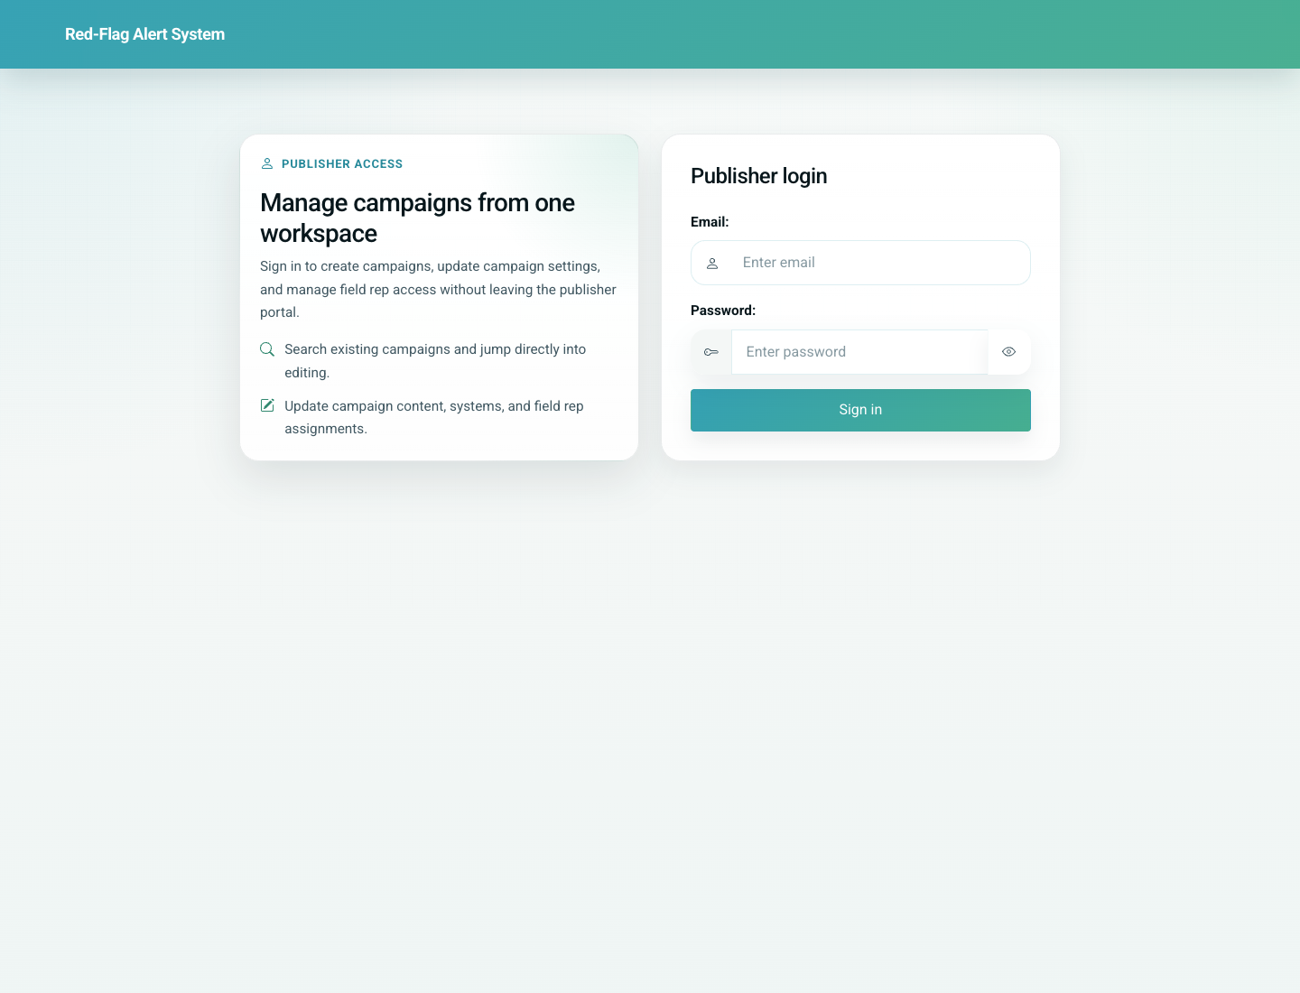
08
Parent Self-Service Card, History, and Share Link
Parent / Patient
Parents can add a child, look up existing records by WhatsApp number, open the vaccination card, review vaccination history, verify a shared link, and open the patient education view. These flows are active in the product even though they are not promoted on the current public home page.
Primary user: Parent or guardian
Entry point: Direct parent routes `/add/`, `/update/`, and shared link `/p/<token>/`
User-Flow Training Pack
parent-self-service-card-history-and-share-link

Slide 2
Workflow At A Glance
Parent Self-Service Card, History, and Share Link
What This Workflow Covers
Parents can add a child, look up existing records by WhatsApp number, open the vaccination card, review vaccination history, verify a shared link, and open the patient education view. These flows are active in the product even though they are not promoted on the current public home page.
Primary User
Parent or guardian
Entry Point
Direct parent routes `/add/`, `/update/`, and shared link `/p/<token>/`
Success Criteria
The parent can reach the correct entry route for self-service.
The parent can identify a child record and open the vaccination card.
The parent can verify a share link and review history or education content.
Workflow summary
Parent Self-Service Card, History, and Share Link

Slide 3
Step 1. Use the public add-record route when starting fresh
Parent Self-Service Card, History, and Share Link
What the user does
Open the public Add Record page and review the child + parent fields.
What the user sees
A simple add-record form for child details and the parent WhatsApp number.
Why this matters
This is the parent-side entry path when the family is not yet in the system.
Expected result
The parent can create a new child record without using the doctor portal.
Trainer note: This route now works in the local demo build after aligning the view with the live model fields.
Parent add-record form
Step 1 of 5
Parent Self-Service Card, History, and Share Link

Slide 4
Step 2. Look up existing children by WhatsApp number
Parent Self-Service Card, History, and Share Link
What the user does
Open Update Record, enter the parent WhatsApp number, and proceed.
What the user sees
A lookup form followed by the list of matching children for that number.
Why this matters
This is the fastest way for a returning family to re-enter the system.
Expected result
The parent can choose the correct child record.
Trainer note: One parent number can return multiple children.
Parent child-selection screen after WhatsApp lookup
Step 2 of 5
Parent Self-Service Card, History, and Share Link

Slide 5
Step 3. Open the vaccination card and history
Parent Self-Service Card, History, and Share Link
What the user does
Open the child vaccination card and then review the vaccination history page.
What the user sees
The due-only vaccination card plus a separate history page with status badges and clinic call actions.
Why this matters
These are the parent’s main operational views for monitoring and reviewing vaccination progress.
Expected result
The parent can see upcoming/due items and the historical record.
Trainer note: The history page also links into education content.
Parent vaccination history view
Step 3 of 5
Parent Self-Service Card, History, and Share Link

Slide 6
Step 4. Use a doctor-issued share link
Parent Self-Service Card, History, and Share Link
What the user does
Open the shared link from WhatsApp, verify the WhatsApp number, and continue into the child card.
What the user sees
A verification page followed by the child vaccination card once the number matches.
Why this matters
This is how clinics hand off the card to parents without asking them to search manually.
Expected result
The parent reaches the correct child record through the tokenized link.
Trainer note: The shared link stores the expected last ten digits and asks the parent to confirm the number.
Parent share-link verification screen
Step 4 of 5
Parent Self-Service Card, History, and Share Link

Slide 7
Step 5. Open parent-facing vaccine education
Parent Self-Service Card, History, and Share Link
What the user does
Open the parent education link from the history or card workflow.
What the user sees
A parent-facing education page with available vaccine video content.
Why this matters
Education supports understanding and follow-through, especially after reminders or history review.
Expected result
The parent can move from record review into learning content without leaving the product journey.
Trainer note: This uses the patient education library and language preference logic where content exists.
Parent-facing vaccine education page
Step 5 of 5
Parent Self-Service Card, History, and Share Link

Slide 8
Common Issues and Trainer Tips
Parent Self-Service Card, History, and Share Link
Parent workflows are live but currently accessed through direct URLs rather than the public home page.
Use these notes to pre-empt confusion before the audience encounters the step live.
Trainer guidance
Parent Self-Service Card, History, and Share Link

Slide 9
Parent Self-Service Card, History, and Share Link
Related Documents
05-doctor-portal-add-patient-and-share-link.md
07-reminders-and-education-workflows.md
Show how parents add or retrieve a child record, open the vaccination card, review history, use shared links, and access education content.
Validated against the local demo build on April 9, 2026. Documentation reflects live behavior; mismatches with older expectations are noted.
Training pack close
parent-self-service-card-history-and-share-link

