Slide 1


Zudo Works
ZOHO & CUSTOM SOFTWARE DEVELOPMENT
COMPANY OVERVIEW
Zoho and custom software, built around how your business actually runs
We design, build and connect business systems on Zoho, and write the custom software when Zoho is not the right tool. You talk to the engineers who build it.
Zoho Creator
Zoho CRM
Deluge
Integrations
AI automation
Custom software
zudoworks.com
US · UK · Australia · New Zealand · Middle East · India

Slide 2
Zudo Works
WHO WE ARE
WHO WE ARE
Engineers who build on Zoho every day
A Zoho and custom software development company based in Chennai, India. We replace manual processes with automated workflows, connect systems that don’t talk to each other, and build custom software when an off-the-shelf product can’t do the job.
OUR MISSION
OUR VISION
To give growing businesses software that fits how they actually work: Zoho where it fits, custom code where it earns its place, built by the engineers they talk to, and owned by them.
Every growing business running on one connected system, so its people spend their time on customers and craft instead of retyping and chasing.
20+
10+
40+
1 month
Projects our team has worked on
Client businesses supported
Zoho products used
Free support and onboarding after every build
Figures cover our team members’ project experience, much of it as developers at a previous organization.
zudoworks.com
02 / 08

Slide 3
Zudo Works
WHERE WE HELP
WHERE WE HELP
The problems we are usually called in to fix
1
Spreadsheets are running the business
2
The CRM is set up, but nobody trusts it
3
Systems that don’t talk to each other
Orders, approvals and job tracking live in shared sheets that break as soon as the team grows.
Duplicate records, skipped stages and reports that don’t match what the sales team says.
People re-key the same customer and order data between CRM, accounting and e-commerce.
4
A Zoho app that grew without a plan
5
Follow-ups depend on someone remembering
6
Off-the-shelf software almost fits
Creator apps and Deluge scripts that only one person understands, and nobody dares change.
Reminders, invoices, approvals and hand-offs that should happen automatically, but don’t.
One critical workflow that no product supports without awkward workarounds.
We start from how your business actually runs, then choose the technology. Never the other way round.
zudoworks.com
03 / 08

Slide 4
Zudo Works
WHAT WE BUILD
WHAT WE BUILD
Seven services, one connected system
01
Zoho Creator development
02
Zoho CRM implementation
03
Deluge development
Custom apps: data models, forms, client portals, dashboards and Deluge workflows, documented so your team can own them.
Pipelines and blueprints that match how you sell, custom modules, data migration and training.
Functions, scheduled jobs, buttons and API calls across CRM, Creator and Books, plus reviews and fixes.
04
Zoho integrations
05
Business process automation
06
Custom software
Connect Zoho with accounting, e-commerce, payments and your own systems via APIs, webhooks, Zoho Flow or middleware.
We map the process first, then remove the manual steps across sales, finance and operations.
Web apps, internal tools and dashboards where Zoho is the wrong tool, built to integrate with what you run.
07 Support and maintenance
Every build includes one month of free support and onboarding after launch. After that, optional monthly support: fixes, small changes, new users and Zoho updates.
zudoworks.com
04 / 08

Slide 5
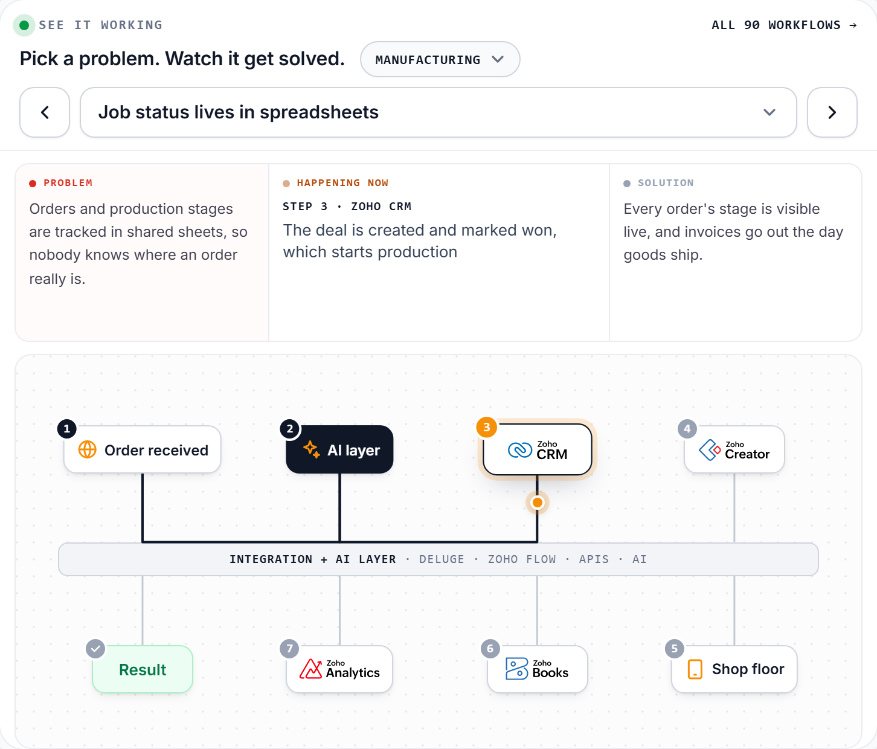
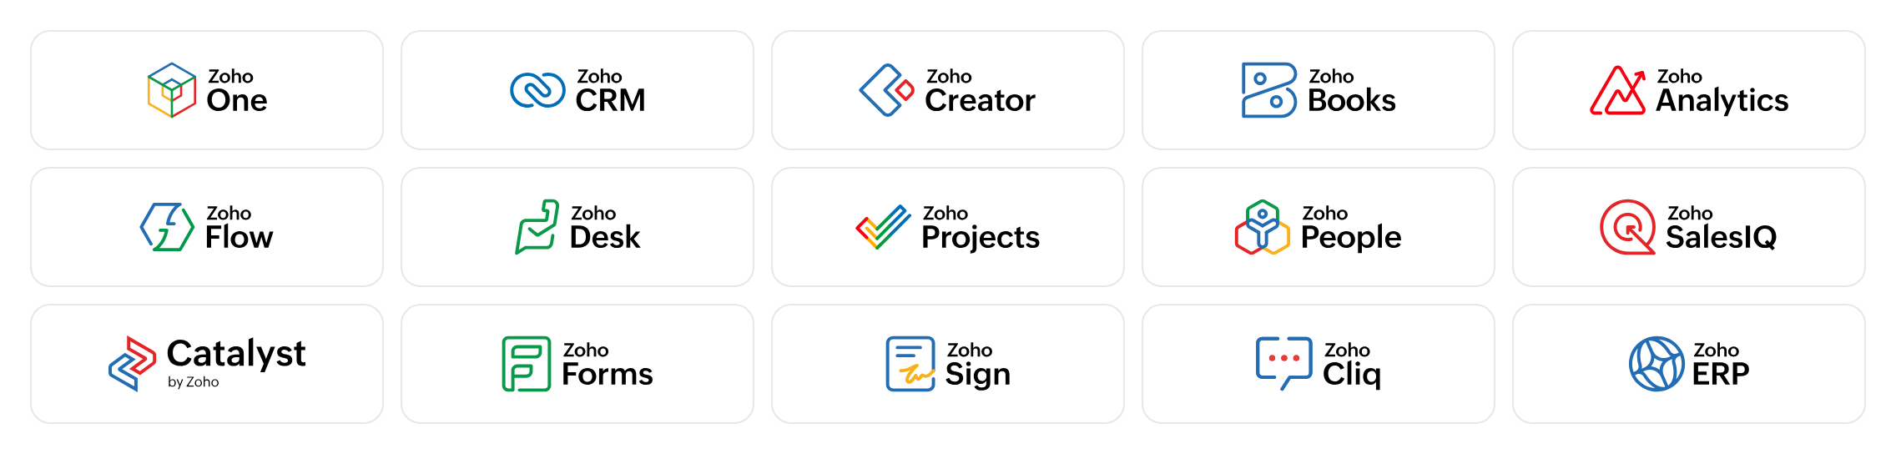
Zudo Works
HOW IT CONNECTS
HOW IT CONNECTS
From a tangle of tools to one integration and AI layer
1 Untangle
We map every app, sheet and hand-off, and decide which system owns which record.
2 Connect
Deluge, Zoho Flow and APIs link each app to the layer once, instead of to every other app.
3 Add AI where it is checkable
Zoho Zia, or Claude and ChatGPT through Zoho MCP, read documents and draft records. A person approves.
4 Sync back
Status, invoices and payments flow back to the record that started the work.
Example workflow from our interactive explorer. Not a client case study.
zudoworks.com
05 / 08

Slide 6
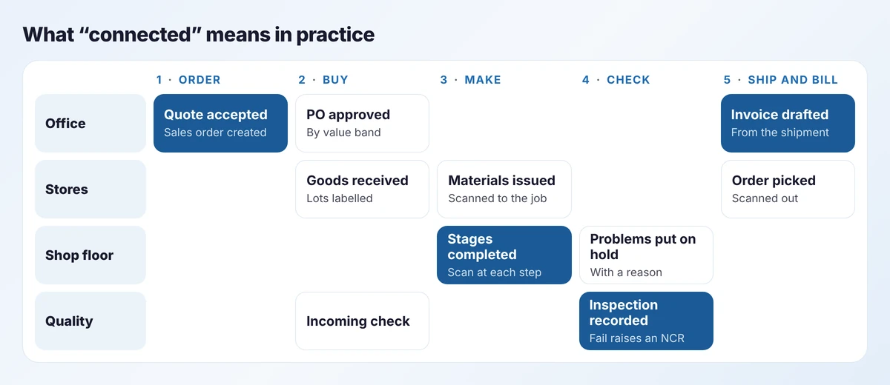
Zudo Works
HOW A PROJECT RUNS
HOW A PROJECT RUNS
From first call to a working system
1
2
3
4
Understand first
Agree a first step
Build and trial
Launch and stay
We follow real work from start to finish and note every retyping and hand-off.
A written proposal with scope, timeline and cost before any work starts.
Built in stages with regular demos, changed in response to the people using it.
Training, documentation and one month of free support after launch.
Every project includes
A written proposal before any work starts
Design, build and testing in stages, with demos
Documentation your team can maintain
Training for administrators and users
One month of free support after launch
Zoho licences and data in your own name
zudoworks.com
06 / 08

Slide 7
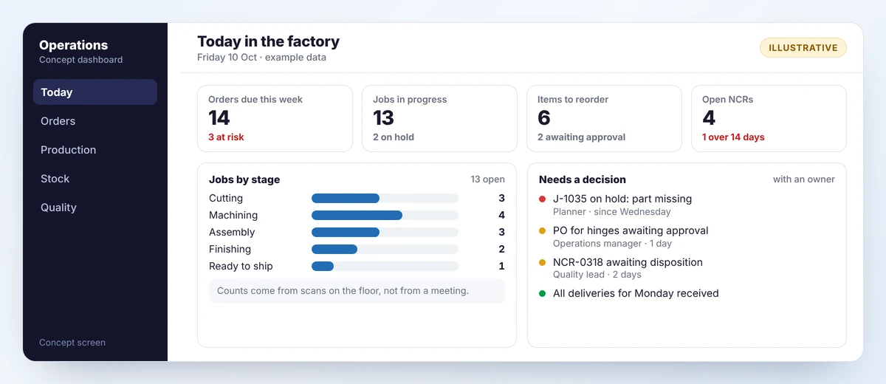
Zudo Works
SOLUTIONS BY INDUSTRY
SOLUTIONS BY INDUSTRY
90 example workflows across 18 industries
INDUSTRIES
Manufacturing
Real estate
Legal
Healthcare clinic
SPOTLIGHT · MANUFACTURING
Manufacturing software built around how your factory runs
Education & training
E-commerce
Agency & consulting
Customer support
Field service
Logistics
Construction
Recruitment & HR
Events & hospitality
Accounting firm
Nonprofit
Finance & lending
Marketing
Operations
Five common problems per industry, each solved on Zoho with integrations and AI. Explore them all at zudoworks.com/solutions. Example workflows, not client case studies.
Job and production tracking
Inventory and purchasing
Quality, NCR and traceability
Dashboards and AI order intake
zudoworks.com
07 / 08

Slide 8

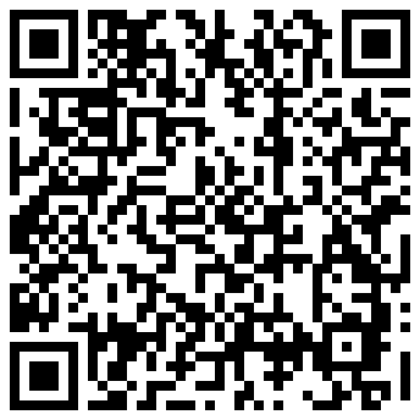
Zudo Works
08 / 08
GET STARTED
Tell us how your business runs today
Describe one process from start to finish. We will tell you what we would build first, what we would leave alone, and how long it would take.
1
2
3
We reply within 6 hours, guaranteed
A discovery call
A written proposal
With a few questions or times for a call.
About how the work flows today.
Scope, timeline and cost, before work starts.
Arunkumar V
Chief Technology Officer
WEBSITE
zudoworks.com
“Master of Creator (Global Winner)” award, Zoho Creator Partner Hackathon 2025
EMAIL
admin@zudoworks.com
BOOK A CALL
zudoworks.com/contact
Makes the technical decisions on every project. You talk to the people who build it.
BASED IN
Anna Nagar, Chennai, India
Scan to send details
zudoworks.com is the official and only website of Zudo Works.

