Slide 1
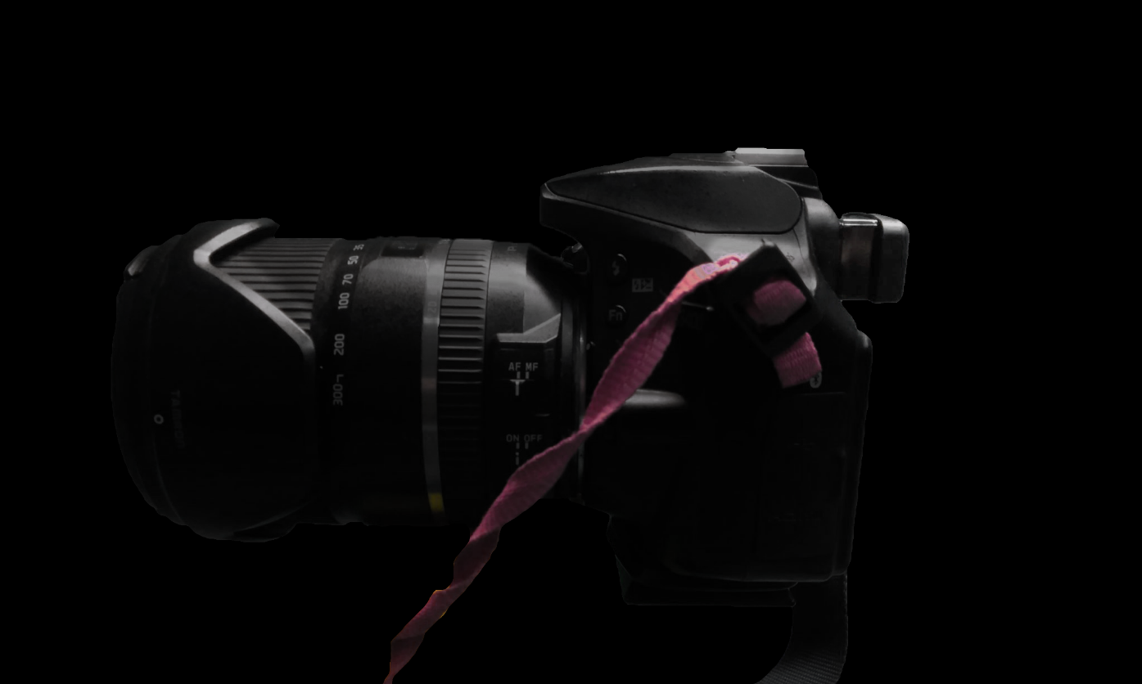
TIRED OF DISCOMFORT FROM YOUR CAMERA’S SHALLOW EYECUP?

Slide 2
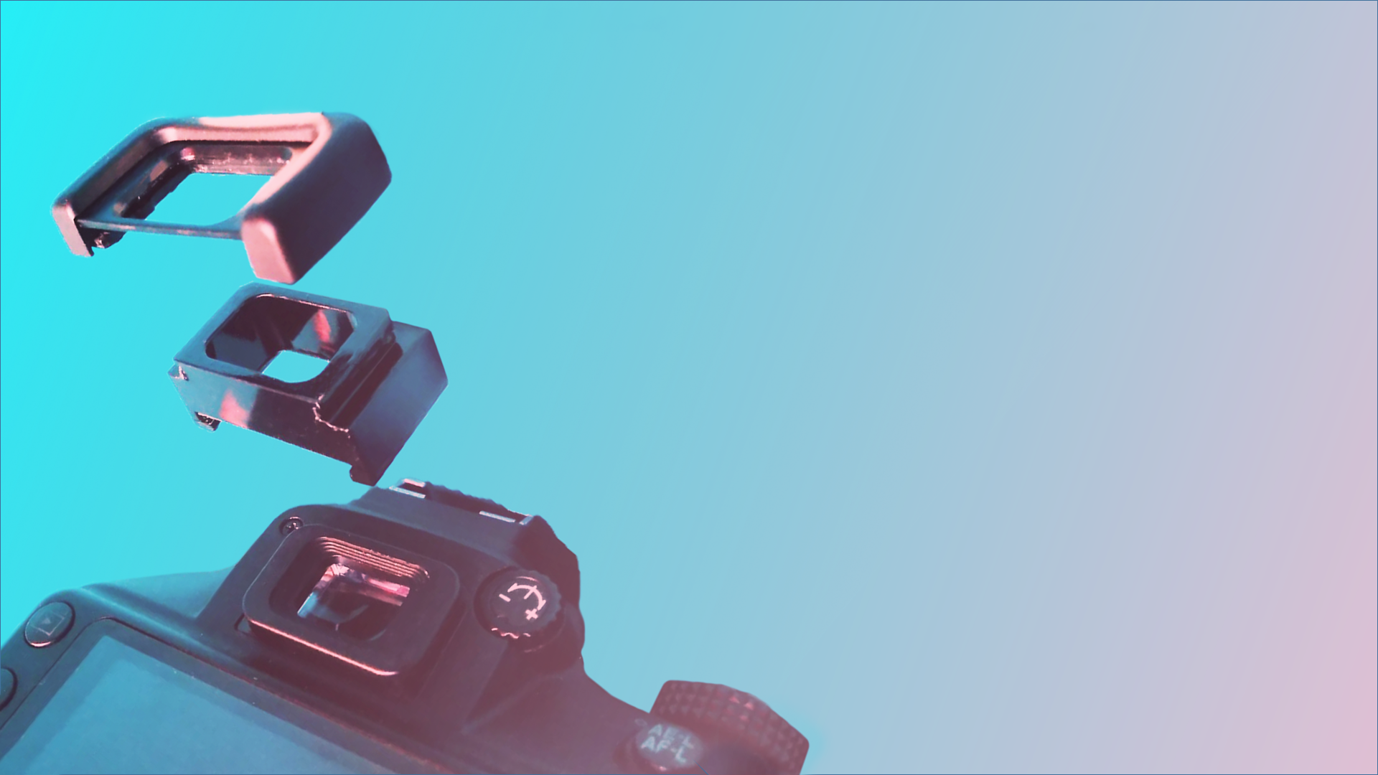
INTRODUCING:
THE SOLUTION
A VERSATILE EYECUP EXTENSION
FOR OPTIMAL COMFORT

Slide 3
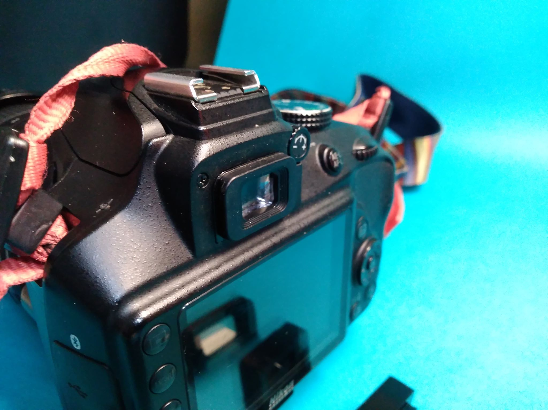
THE IDEA
Originally designed for the Nikon DK-25 eyecup mount, the eyecup extension allows you to extend the distance from your face to your camera’s screen while using your preferred eyecup. This extra space allows for a more comfortable shooting posture and reduces chances of an oily screen, making previewing photos more accurate.

Slide 4
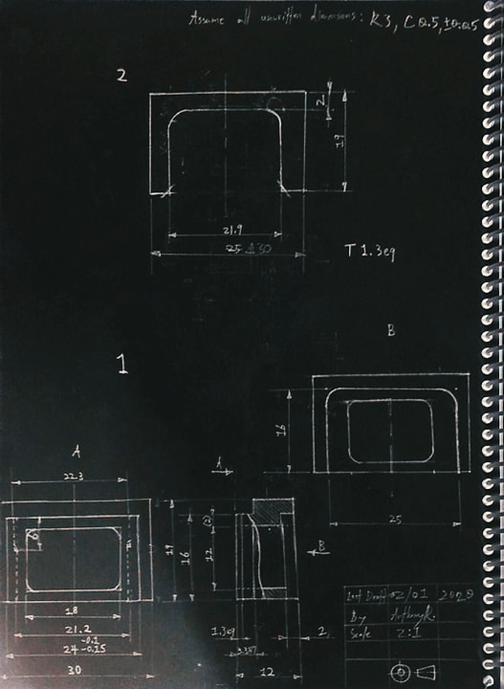

THE DESIGN
The eyecup extension was designed as an adapter, fitting between the camera’s eyecup mount and the eyecup itself. After carefully measuring both attachment surfaces, I was able to create a detailed drawing using Autodesk Inventor. From the drawing, I was able to machine the piece in 2 parts, creating the male and female ends separately.

Slide 5
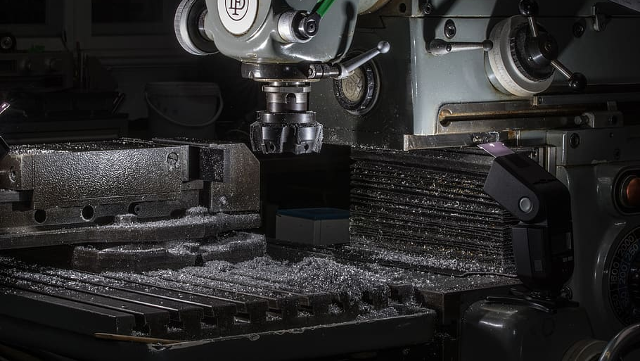
THE PROCESS
The eyecup extension is made of machined acrylic, the lightweight and shock-resistant transparent thermoplastic homopolymer commonly referred to as “plexiglass.” The acrylic was cut to size, machined and later coated with black paint.

Slide 6

ANTHONY REIMCHE
CREATED BY
VISUAL & MECHANICAL DESIGN

