Slide 1
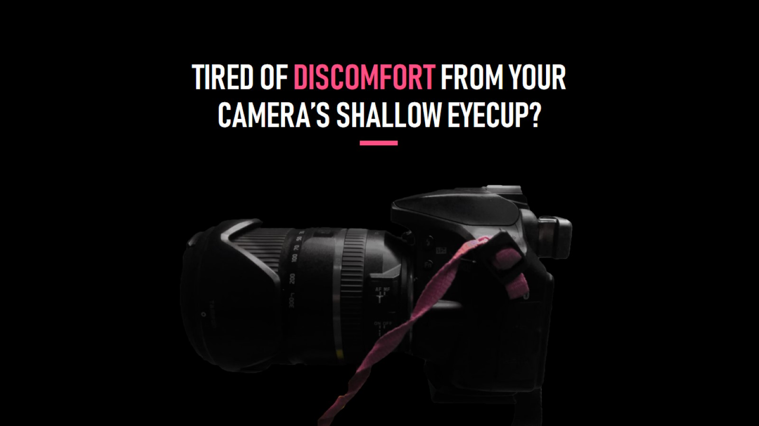
TIRED OF DISCOMFORT FROM YOUR CAMERA’S SHALLOW EYECUP?

Slide 2
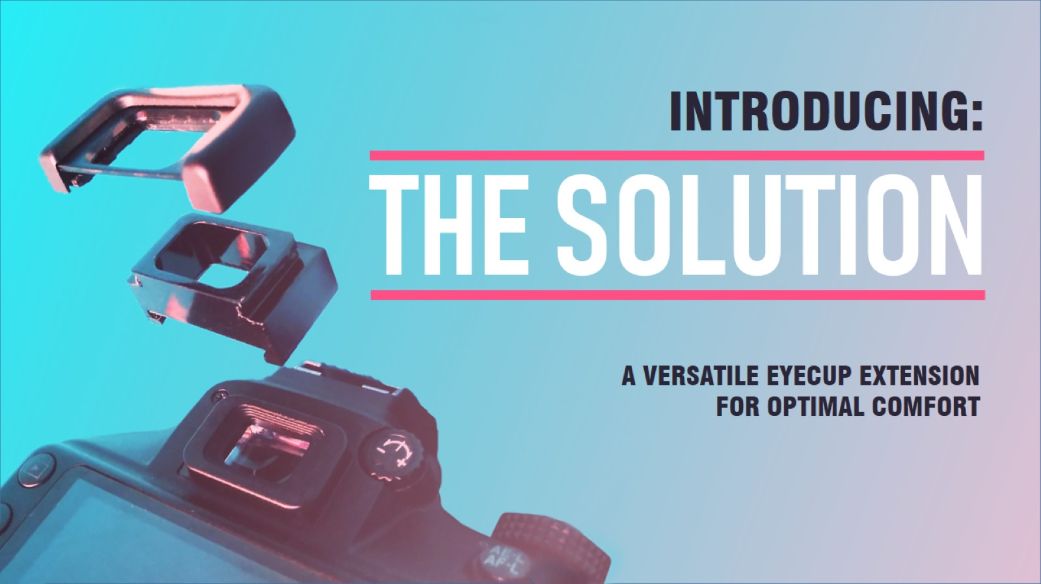

Slide 3
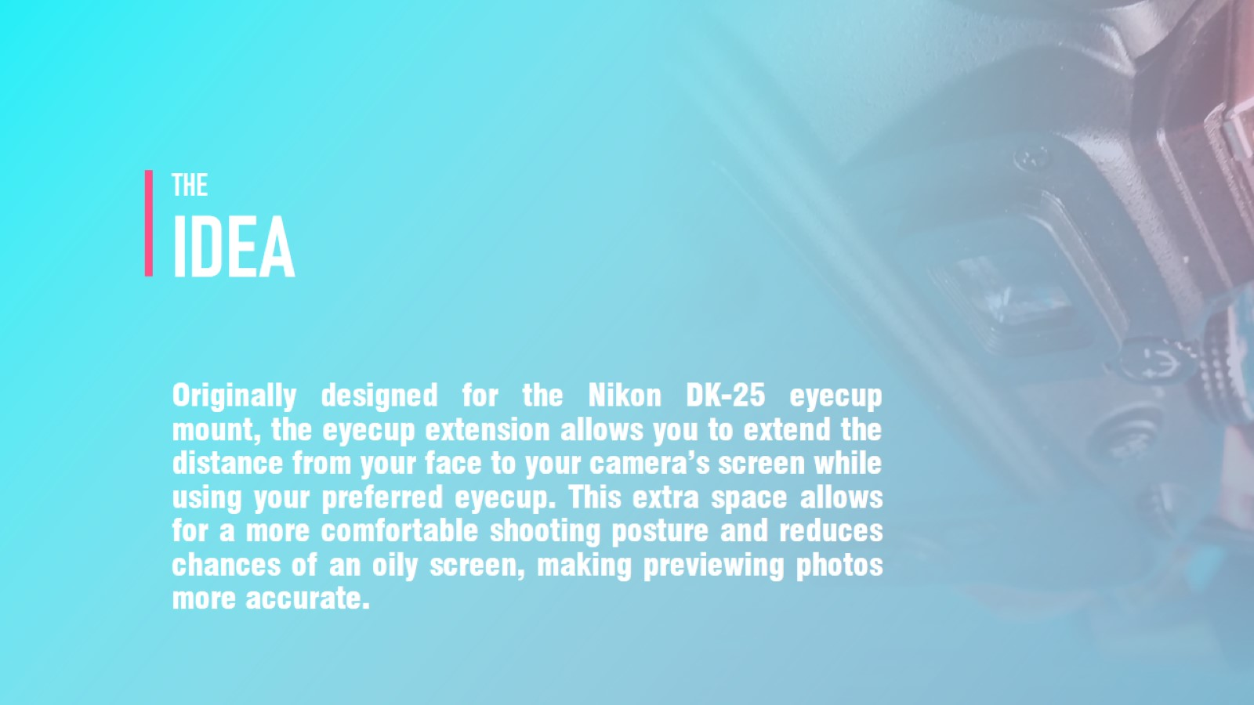
THE IDEA

Slide 4
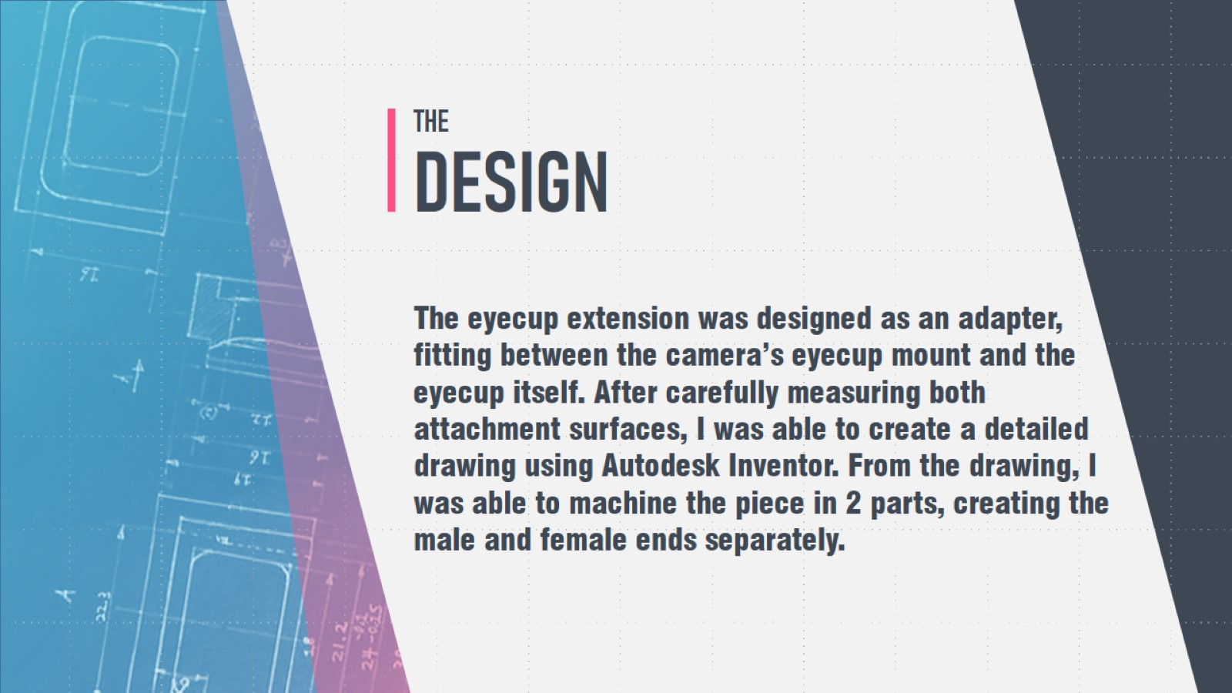
THE DESIGN

Slide 5
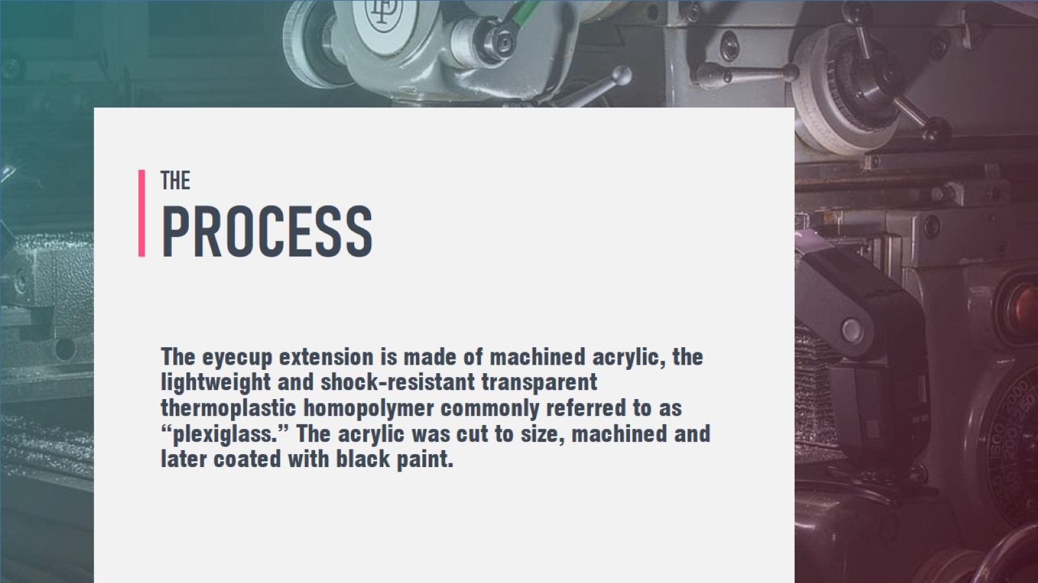
THE PROCESS

Slide 6
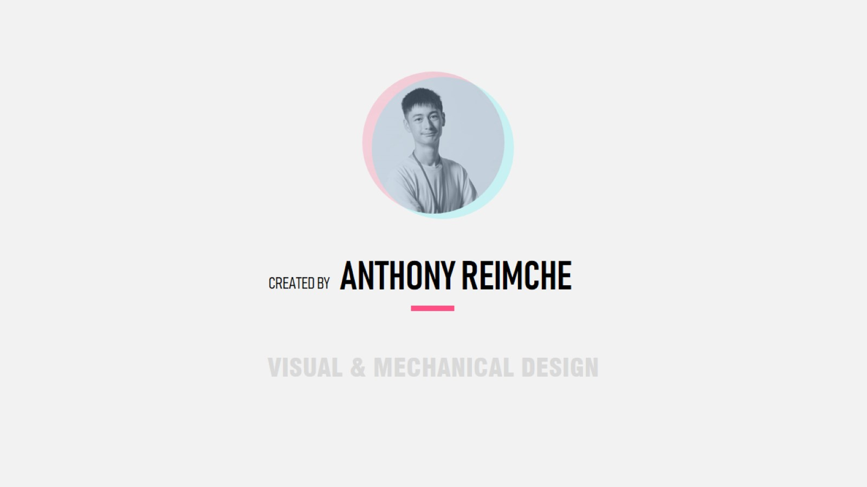
ANTHONY REIMCHE

