Slide 1
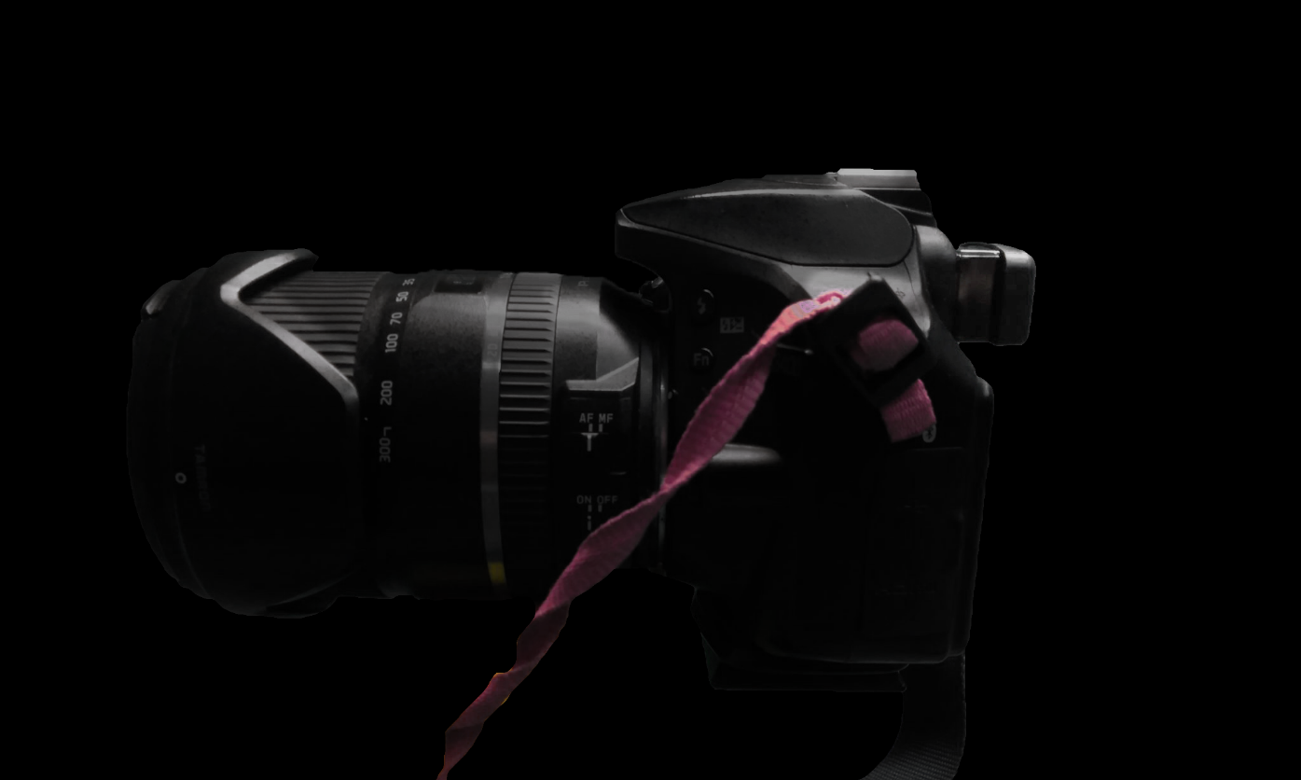
ARE YOU TIRED OF DISCOMFORT CAUSED BY YOUR CAMERA’S EYECUP?

Slide 2
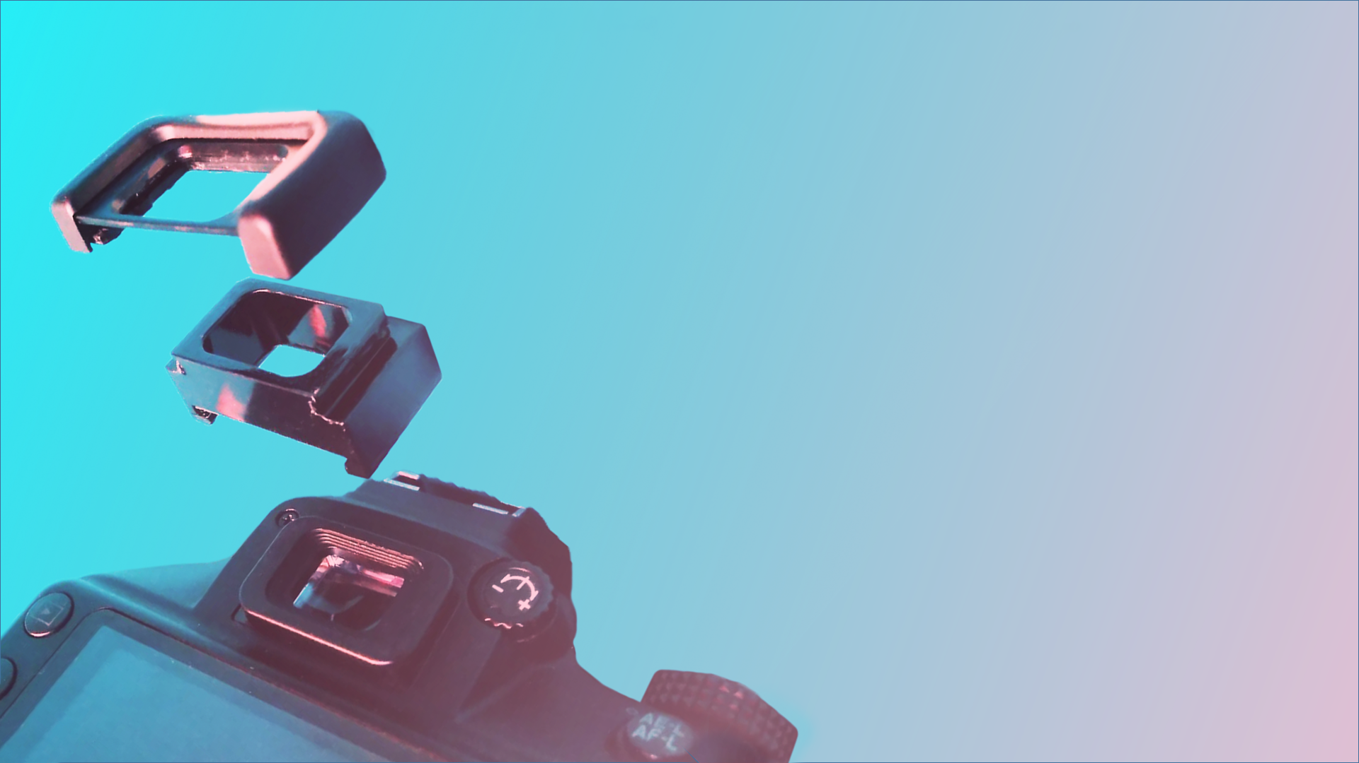
INTRODUCING:
THE SOLUTION
A VERSATILE EYECUP EXTENSION
FOR OPTIMAL COMFORT

Slide 3
INTRODUCING
THE SOLUTION
A PERSONALISED EYECUP FOR OPTIMAL COMFORT
2020

Slide 4
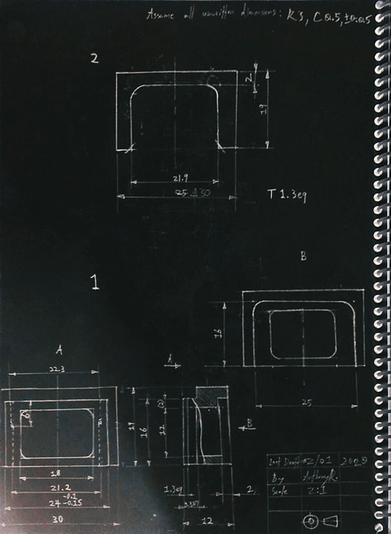
A PERSONALISED EYECUP FOR OPTIMUM COMFORT
Nikon DK-25 Extension
FITS NIKON DK-25

