Slide 1
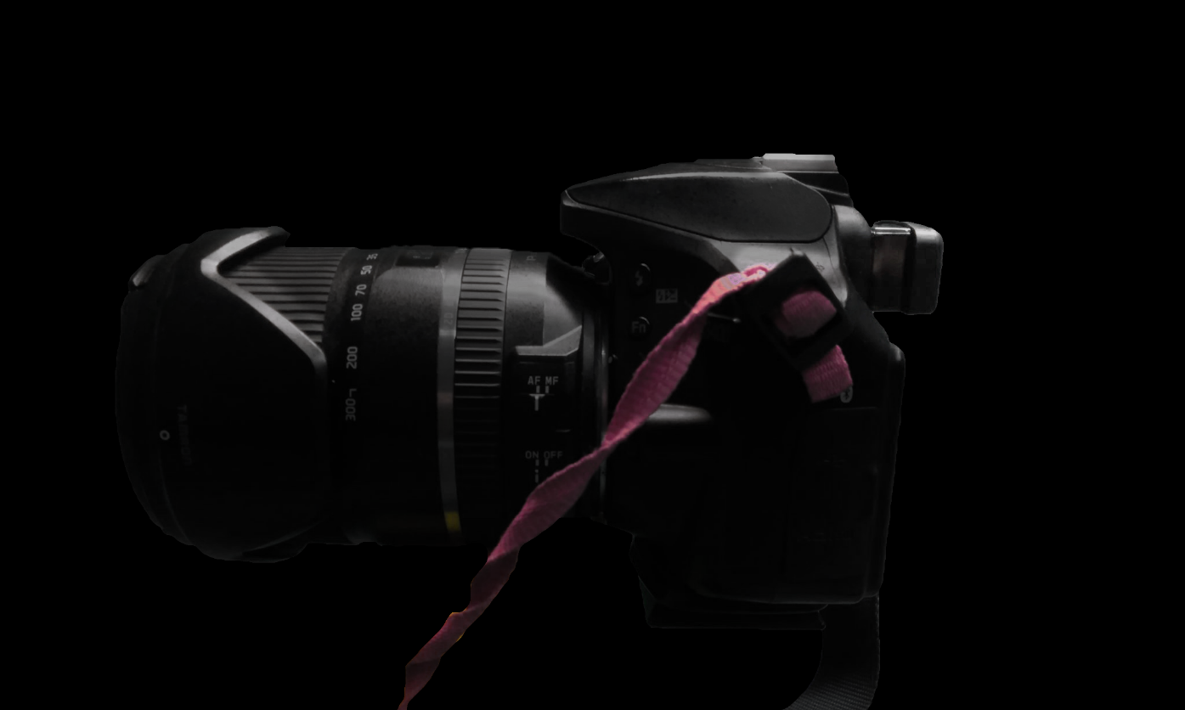
TIRED OF DISCOMFORT FROM YOUR CAMERA’S SHALLOW EYECUP?

Slide 2
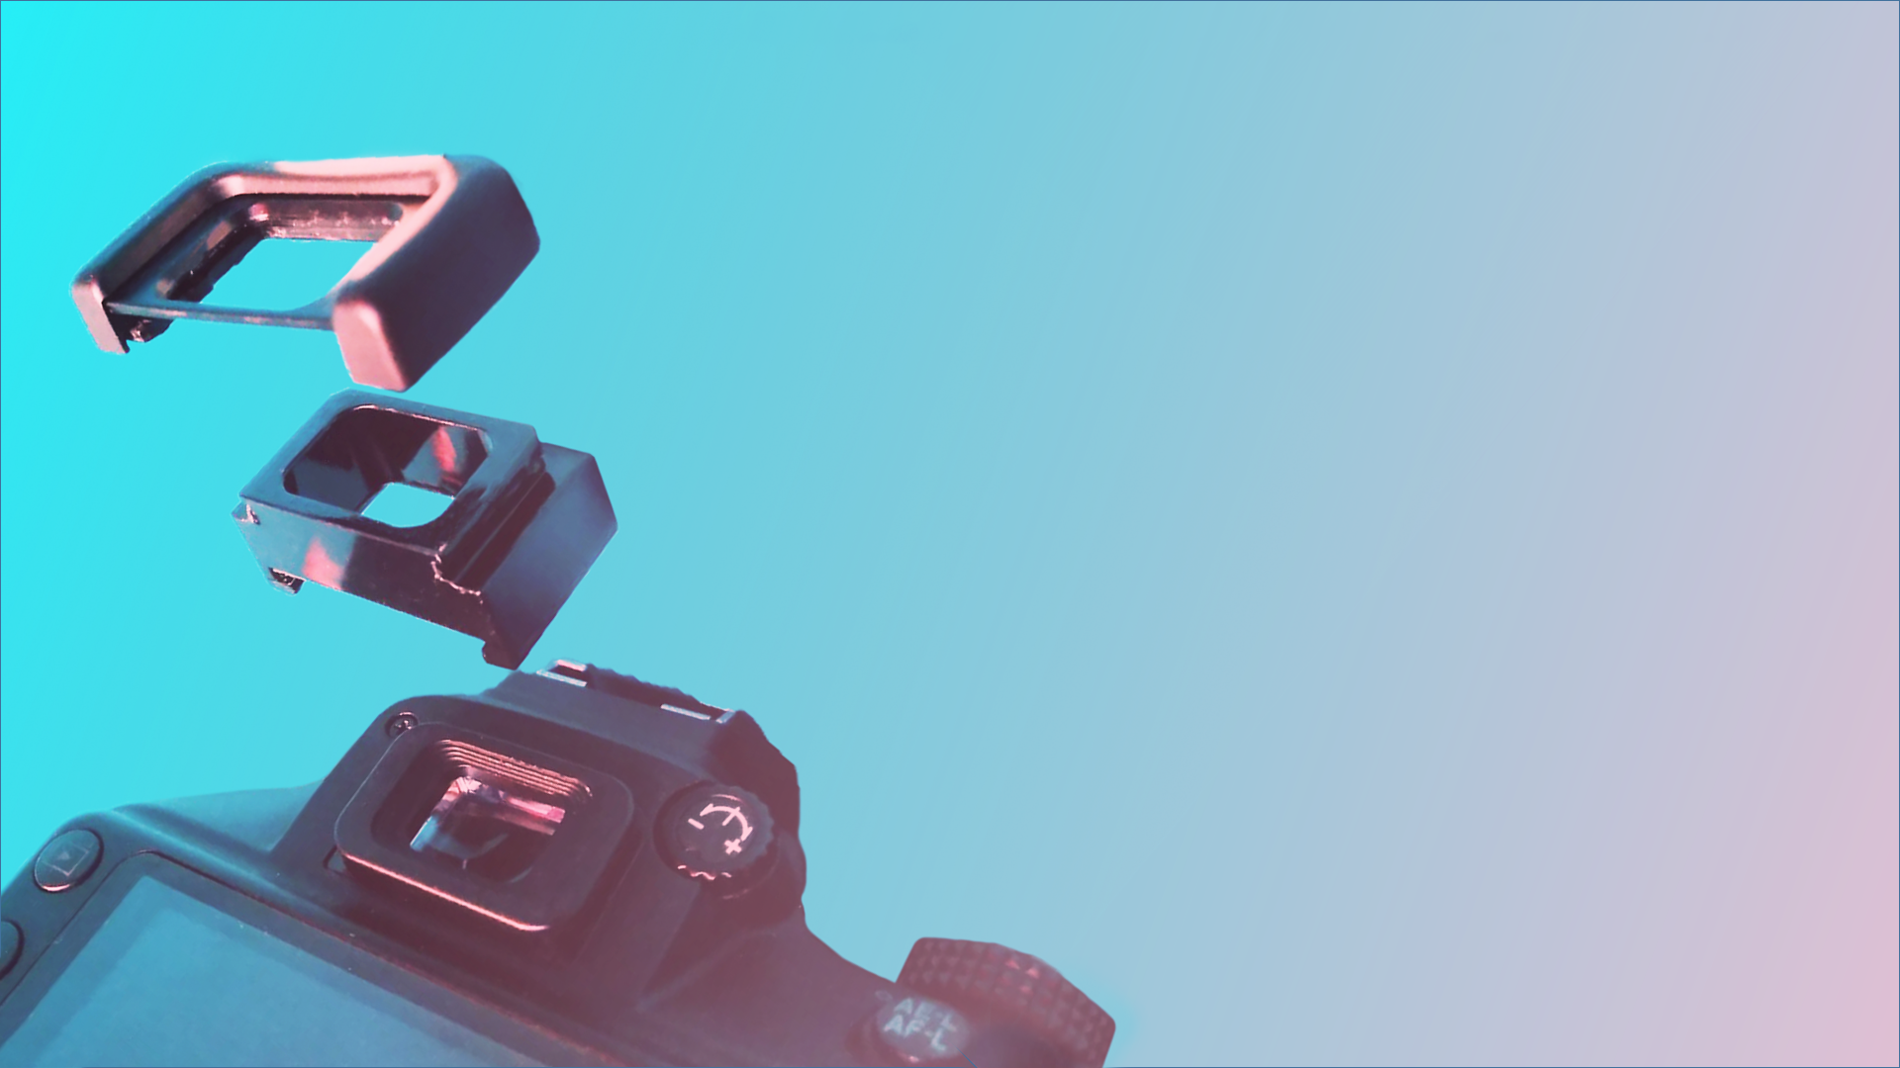
INTRODUCING:
THE SOLUTION
A VERSATILE EYECUP EXTENSION
FOR OPTIMAL COMFORT

Slide 3
INTRODUCING
THE SOLUTION
A PERSONALISED EYECUP FOR OPTIMAL COMFORT
2020

Slide 4
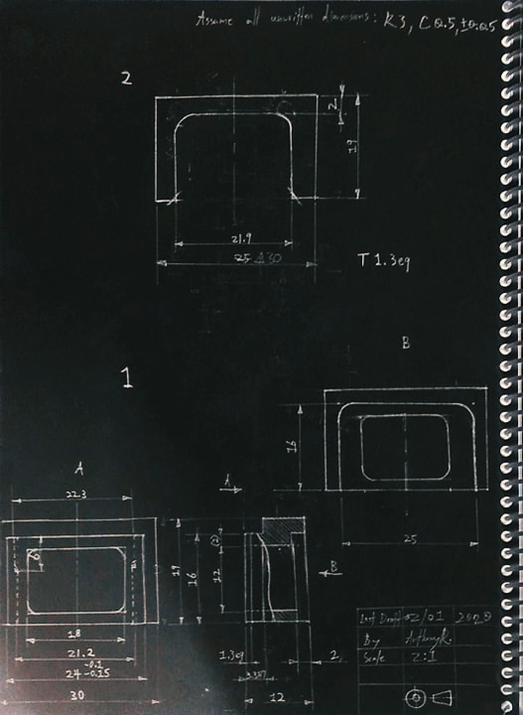
WHAT IT IS
Originally designed for the Nikon DK-25 eyecup mount, the eyecup extension allows you to extend the distance from your face to your camera’s screen while keeping your preferred eyecup. This extra space allows for a more comfortable shooting posture and reduces chances of an oily screen, which can make previewing photos less accurate.
Nikon DK-25 Extension

Slide 5
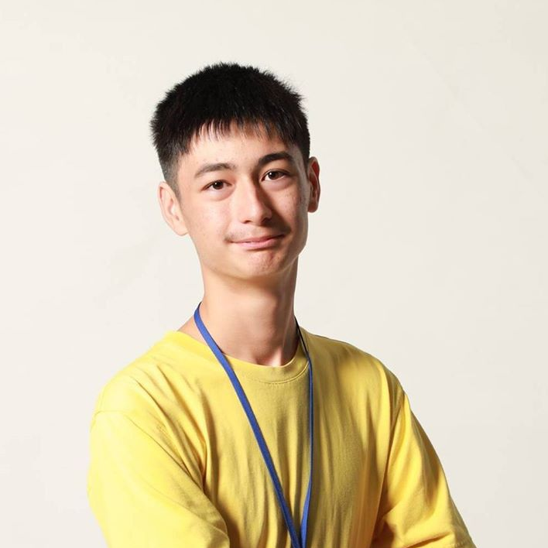
ANTHONY REIMCHE
CREATED BY
MECHANICAL & VISUAL DESIGN

