Slide 1

TIRED OF DISCOMFORT FROM YOUR CAMERA’S SHALLOW EYECUP?

Slide 2


Slide 3


Slide 4
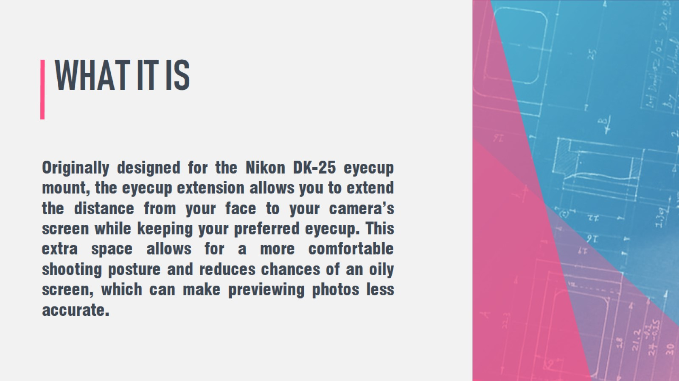
WHAT IT IS

Slide 5

ANTHONY REIMCHE

