Slide 1
Passsafe
By Thaddeus Koenig

Slide 2
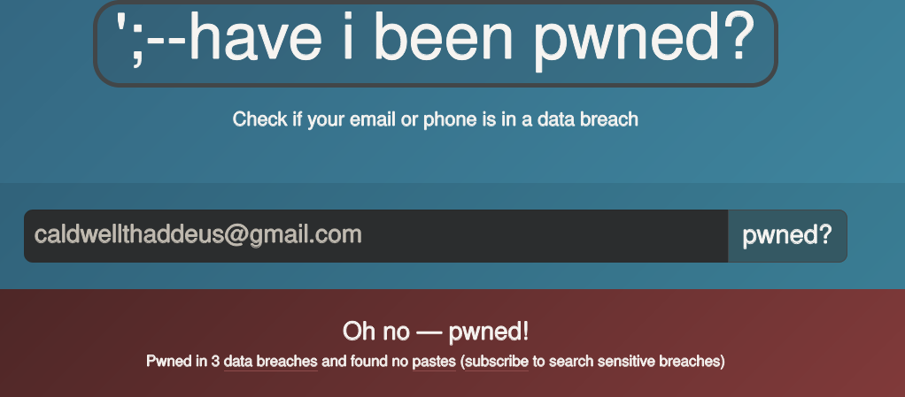
Why is this important
Password breaches are increasingly prevalent and password reuse creates an increased need for complex passwords and segregation of passwords.
An increased lack of confidence in corporations makes people weary to store their passwords in unknown datacenters.

Slide 3
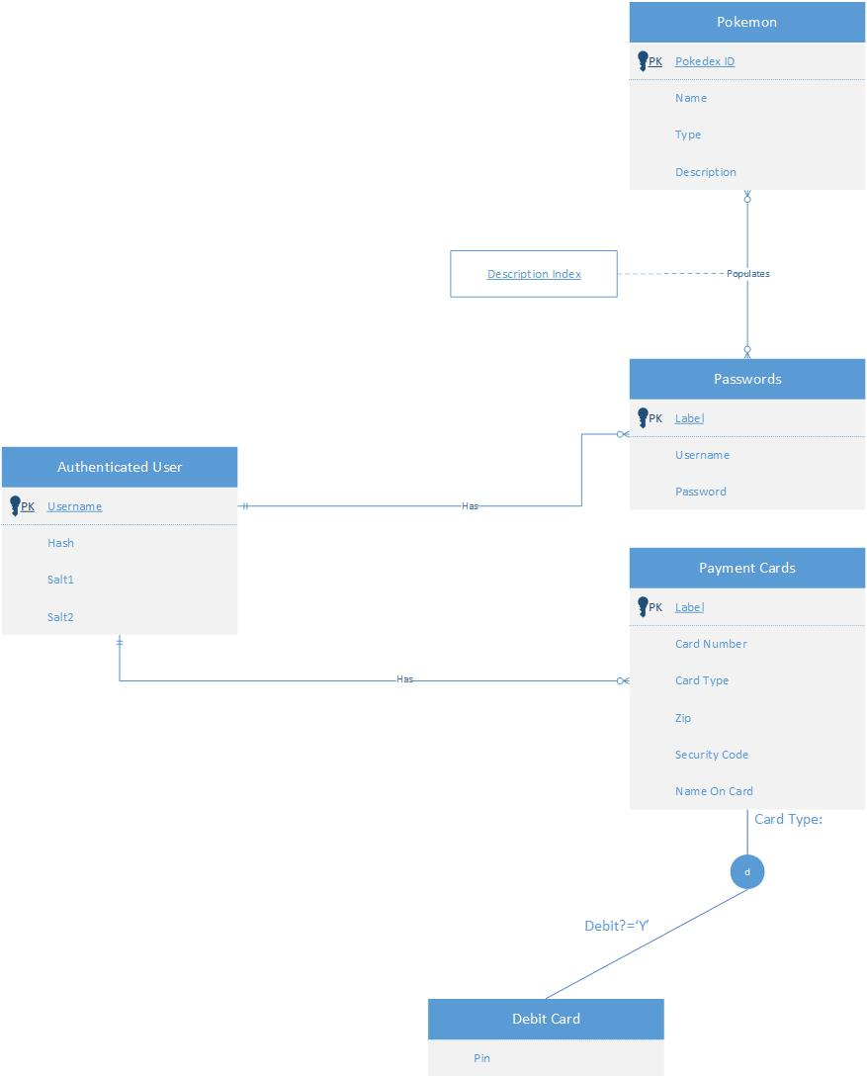
ER Diagram

Slide 4
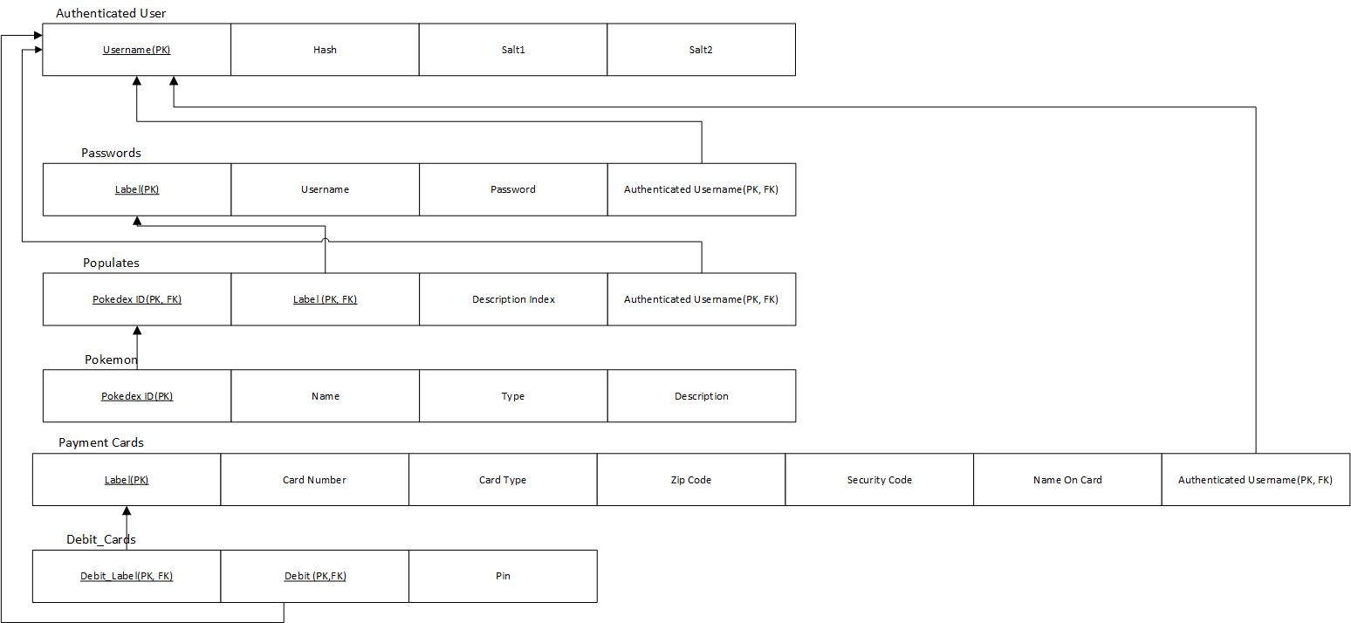
Relational Model

Slide 5
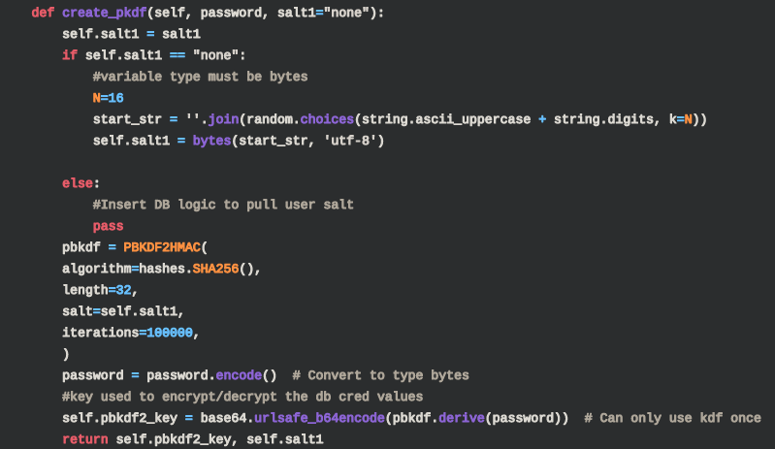
How it works (Create user)
Upon Creation Username is check against auth_user table
SELECT count(username) FROM auth_user WHERE username=\'{{username}}\'
The user is then given a pbkdf2 key that is based on
A string of their choosing (password)
A random 16byte salt
User hash and salt are then stored in the table
If you would like to learn more about PBKDF2

Slide 6
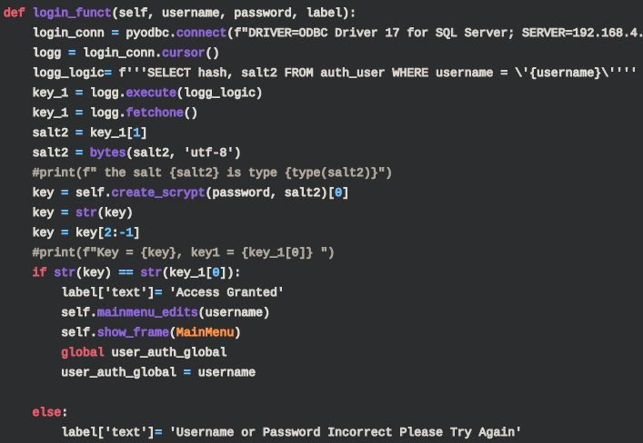
How it works (Login)
User's record is pulled from auth_user table
SELECT hash, salt2 FROM auth_user WHERE username = \'{username}\'
User's provided password is then resent through the hashing algorithm and compared against the one in the table
If keys match then the user is provided access to the app and username is stored as a global variable

Slide 7
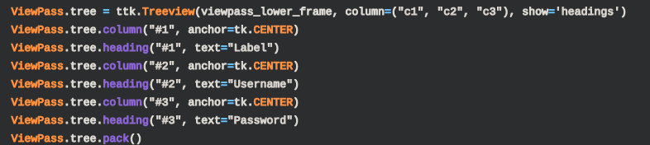
How it works (view Passwords)
Users credentials are queried via a SELECT query on the global variable
SELECT label,username,password from passwords WHERE auth_username=\'{username}\'
Credentials are presented in the tk.Tree structure

Slide 8
How it works (View Cards)
Since debit cards are a subtype of payment cards the two tables must be queried via join.
Card name is split into Fname/Last name due to a tk.Tree limitation

Slide 9
How it works (Modify/ Delete)
Delete and modification queries are done via the global variable using DELETE and UPDATE queries respectively
DELETE from passwords WHERE label=\'{label}\' AND auth_username=\'{user_auth_global}\'
UPDATE passwords SET username=\'{username}\', password=\'{password}\' WHERE label=\'{label}\' AND auth_username=\'{user_auth_global}\'

Slide 10
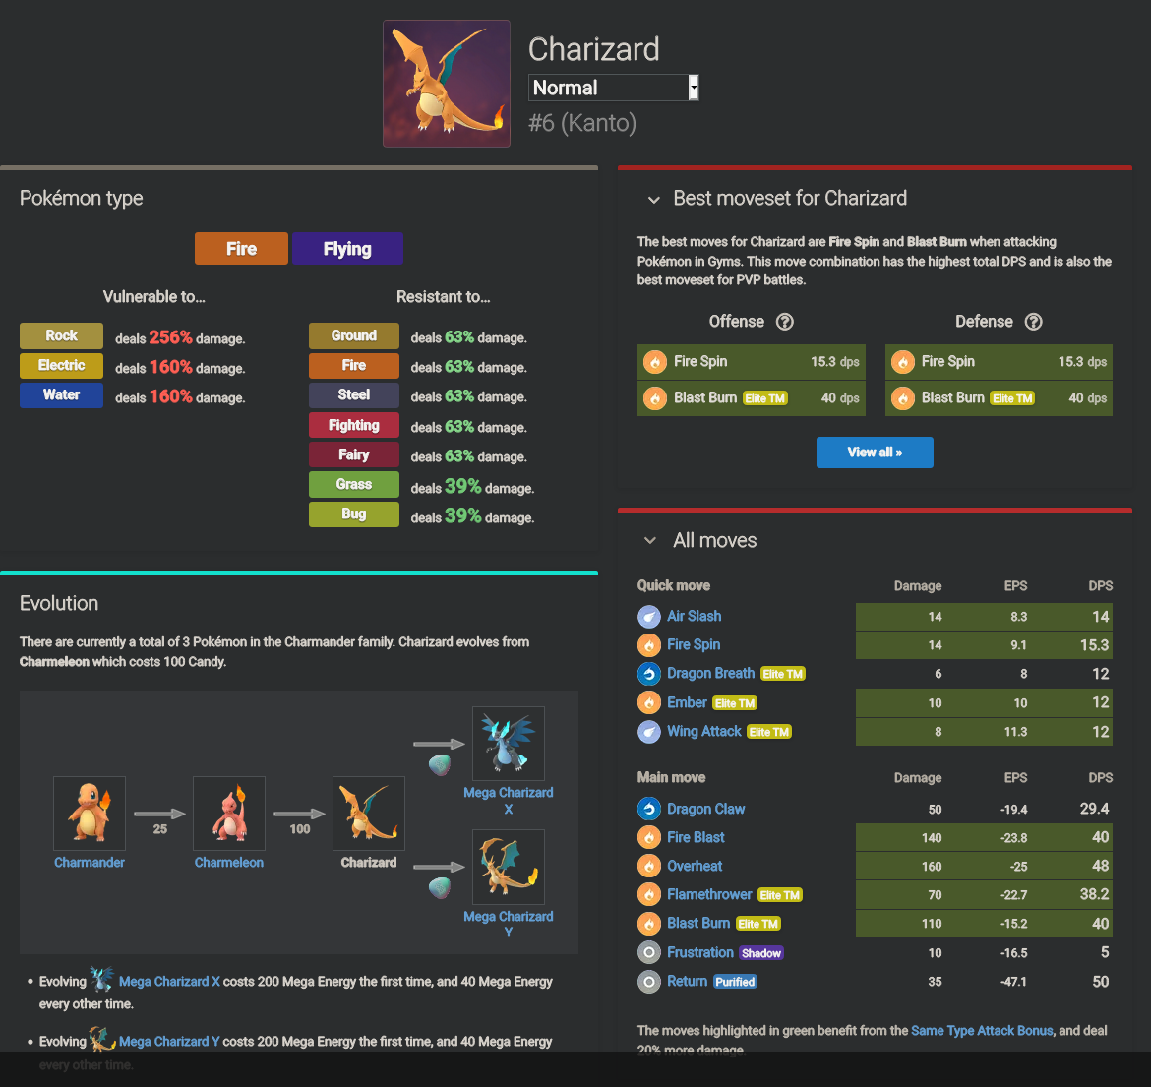
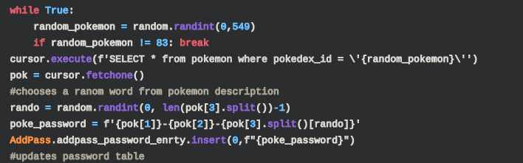
How it work (Poke_generate)
A passphrase is created via a random pokemon's name, type, and random word from their description
The passphrase is then populated in the password column and stored

Slide 11
SQL Logic
- Create USer:
- f" SELECT count(username) FROM auth_user WHERE username=\'{{username}}\' "
- f'INSERT INTO auth_user(username, hash, salt1, salt2) VALUES(\'{username}\', \'{hash}\', \'{salt1}\', \'{salt2}\')'
- Login
- f'''SELECT hash, salt2 FROM auth_user WHERE username = \'{username}\''''
- View Pass
- f" SELECT label,username,password from passwords WHERE auth_username=\'{username}\'"
- View Cards
- f""" SELECT payment_cards.label,payment_cards.card_number,payment_cards.card_type,payment_cards.zip_code,payment_cards.sec_code,payment_cards.card_name, debit_cards.pin
FROM payment_cards
Full Outer Join debit_cards on payment_cards.label=debit_cards.debit_label AND payment_cards.auth_username = \'{user_auth_global}\'"""
- Add Pass
- f"INSERT INTO passwords(label, username, password, auth_username) VALUES(\'{label}\', \'{username}\', \'{password}\', \'{user_auth_global}\')"
- Mod Pass
- f"UPDATE passwords SET username=\'{username}\', password=\'{password}\' WHERE label=\'{label}\' AND auth_username=\'{user_auth_global}\'"
- Del Pass
- f"DELETE from passwords WHERE label=\'{label}\' AND auth_username=\'{user_auth_global}\'"

Slide 12
Issues
Python Integration
Global Variables
' Or "
F-Strings
TKinter Learning Curve
SQLite
Beta Testing
Time/Working Alone
Migrating to the Cloud

Slide 13
Demo
Application Server
Database Server

