Slide 1
MACSE603 - VISUAL ANALYTICS LAB
ACADEMIC FINAL PROJECT DEFENSE
Smart Energy Consumption
Visualization Dashboard
Using Power BI & IoT Pipelines
PROJECT TEAM MEMBERS
Vedant Nimkar
Reg. No. 26MML0045
TEAM LEADER
Jitesh Bobde
Reg. No. 26MML0025
MEMBER
Ayush Sharma
Reg. No. 26MML0043
MEMBER
Full Implementation: Star Schema (52.5k rows) • ML Demand Forecast • Shewhart 3σ Anomalies • Apache ECharts & Power BI
M.Tech - Computer Science and Engineering

Slide 2
2
Abstract & Problem Statement
PROJECT ABSTRACT
CORE OPERATIONAL CHALLENGES ADDRESSED
This project implements an enterprise-grade Smart Energy Consumption Visual Analytics platform addressing the operational complexities of modern multi-facility campuses.
It unifies IoT edge-sensor ingestion (ESP32 via MQTT), an automated ETL pipeline with Cooling Degree Hours, an 11-table Star Schema warehouse (52,560 hourly metered readings for FY 2025 across 6 facilities), and advanced machine learning.
Core analytical capabilities include Ridge/Prophet time-series demand forecasting (R² = 0.996), Shewhart 3-sigma anomaly detection (196 operational breaches flagged), and t-SNE 2D clustering across four behavioral archetypes.
Delivery is realized via both a production Power BI Desktop model (50+ DAX measures) and an interactive Apache ECharts Web Dashboard with real-time IoT streaming simulation.
▪ Fragmented Telemetry - Smart meters, BMS sensors and bills reside in silos with inconsistent temporal granularity.
▪ Unmonitored Peak Demand - Summer afternoon coincident peaks trigger severe utility demand charges (INR 350/kW).
▪ Silent Equipment Runaways - Chillers, AHUs, and exhaust fans left running on weekends remain undetected for billing cycles.
▪ Inflexible Monthly Reporting - Traditional accounting bills report past spend without forward forecasting or uncertainty bounds.
▪ Disconnected BI & IoT - Academic IoT prototypes rarely integrate with enterprise dimensional modeling and business intelligence.
MACSE603 - Visual Analytics Lab | Smart Energy Consumption Visualization Dashboard Using Power BI & IoT Pipelines
1

Slide 3
3
Project Objectives & Scope
01. End-to-End IoT Pipeline
04. Statistical Anomaly Engine
Build automated ingestion and ETL pipelines standardizing 52,560 hourly records with strict quality gates.
Deploy Shewhart 3-sigma control limits to automatically detect and cost operational equipment breaches.
02. Star Schema Data Warehouse
05. High-Dimensional Load Profiling
Design an 11-table Kimball dimensional model with fact tables for energy, submeters, forecasts, and anomalies.
Normalize 24-hour diurnal load vectors and map them to 2D manifold coordinates using t-SNE and K-Means.
03. ML Demand Forecasting
06. Dual Enterprise Serving
Implement time-series demand forecasting with Fourier seasonality and 95% expanding uncertainty bands.
Deliver both an enterprise Power BI model (50+ DAX measures) and an interactive Apache ECharts Web Dashboard.
MACSE603 - Visual Analytics Lab | Smart Energy Consumption Visualization Dashboard Using Power BI & IoT Pipelines
2

Slide 4
4
Literature Review & Synthesis of Core Papers
Synthesis of six foundational research papers — two papers reviewed per team member:
Paper 1: Portugal Energy Distribution (2024)
Reviewed by: Vedant Nimkar
DSRM methodology for national hourly & geographic distribution in Power BI.
System Takeaway: Adopted star schema, role-specific views, and DSRM lifecycle.
Paper 2: Awate et al. (IJARSCT 2023)
Reviewed by: Vedant Nimkar
Analyzed 500 residential meters over 24 months with Prophet demand forecasting.
System Takeaway: Transitioned to hourly telemetry; integrated Prophet seasonal models.
Paper 3: Energy Calculation in Power BI (2023)
Reviewed by: Jitesh Bobde
End-to-end dashboard sequence: collection, modeling, visuals, filters.
System Takeaway: Constructed 50+ DAX library, time intelligence, and Power Query M scripts.
Paper 4: Soliman & Fetais (IEEE GCCCE 2017)
Reviewed by: Jitesh Bobde
Big data visualization of Qatar smart meter network; standardization and speed.
System Takeaway: Implemented ETL quality gates, boundary checks, and null treatment.
Paper 5: IoT Smart Energy System (IJIRT 2026)
Reviewed by: Ayush Sharma
ESP32 voltage/current sensing, MQTT broker, cloud ingestion, fault prediction.
System Takeaway: Engineered streaming IoT telemetry simulator emitting 3-phase readings.
Paper 6: Interactive ML Dashboard (ESANN 2024)
Reviewed by: Ayush Sharma
2D manifold mapping of daily load profiles using t-SNE, sparklines, data cubes.
System Takeaway: Normalized 24-hr load vectors with t-SNE projection and K-Means clustering.
MACSE603 - Visual Analytics Lab | Smart Energy Consumption Visualization Dashboard Using Power BI & IoT Pipelines
3

Slide 5
5
End-to-End System & Pipeline Architecture
A decoupled 5-tier production pipeline orchestrating ingestion through dual analytical delivery:
1. INGESTION GATE
ESP32 edge-sensor telemetry (MQTT) + batch meter CSVs. Schema validation and boundary enforcement.
2. ETL & QUALITY
Unit standardization (kWh, kVA, kW peak), Cooling Degree Hours (CDH), missing value imputation, foreign-key audit.
3. STAR SCHEMA WAREHOUSE
11 Fact and Dimension tables (52,560 hourly rows for FY 2025 across 6 facilities). Optimized VertiPaq compression.
4. ML ANALYTICS ENGINE
Prophet/Ridge regression demand forecasting, Shewhart 3σ statistical anomaly engine, t-SNE 2D manifold clustering.
5. DUAL SERVING
Enterprise Power BI Desktop model (50+ DAX measures) + Interactive Apache ECharts Web Dashboard with live MQTT stream.
MACSE603 - Visual Analytics Lab | Smart Energy Consumption Visualization Dashboard Using Power BI & IoT Pipelines
4

Slide 6
6
Star-Schema Dimensional Warehouse Model
WAREHOUSE TABLE INVENTORY & CARDINALITY
DIMENSIONAL ATTRIBUTES & QUALITY GATES
▪ Fact_EnergyConsumption (52,560 rows) - Central grain: hourly active power, solar gen, grid import, cost, and anomaly flags.
▪ Fact_ApplianceSubmeter (60,480 rows) - End-use breakdown: HVAC, IT servers, lighting, industrial motors, and auxiliary.
▪ Fact_DemandForecast (395 rows) - Historical observed demand + 30-day forward ML projection with 95% confidence bounds.
▪ Fact_Anomalies_Detailed (196 rows) - Rolling baseline breaches with excess energy (kWh), wasted cost (INR), and root cause.
▪ Fact_LoadClusters (2,190 rows) - 24-hour normalized load vectors mapped to 2D t-SNE coordinates and cluster IDs.
▪ Dim_Facility (6 rows) - Facility name, square footage, baseline kW, peak design kW, solar kWp, and Energy Star score.
▪ Dim_Tariff (3 rows) - Time-of-Use tariffs (HT-ToU, LT-ToU, Residential) with Peak, Shoulder, and Off-Peak rates.
▪ Dim_Date & Dim_Time (731 + 24 rows) - Calendar hierarchies, day parts, weekend indicators, and peak tariff flags.
▪ Dim_Weather (17,544 rows) - Ambient temperature, relative humidity, solar irradiance, and Cooling Degree Hours (CDH).
▪ Referential Integrity Gate - 100% verified foreign key consistency; zero orphaned records or unmapped tariffs.
MACSE603 - Visual Analytics Lab | Smart Energy Consumption Visualization Dashboard Using Power BI & IoT Pipelines
5

Slide 7
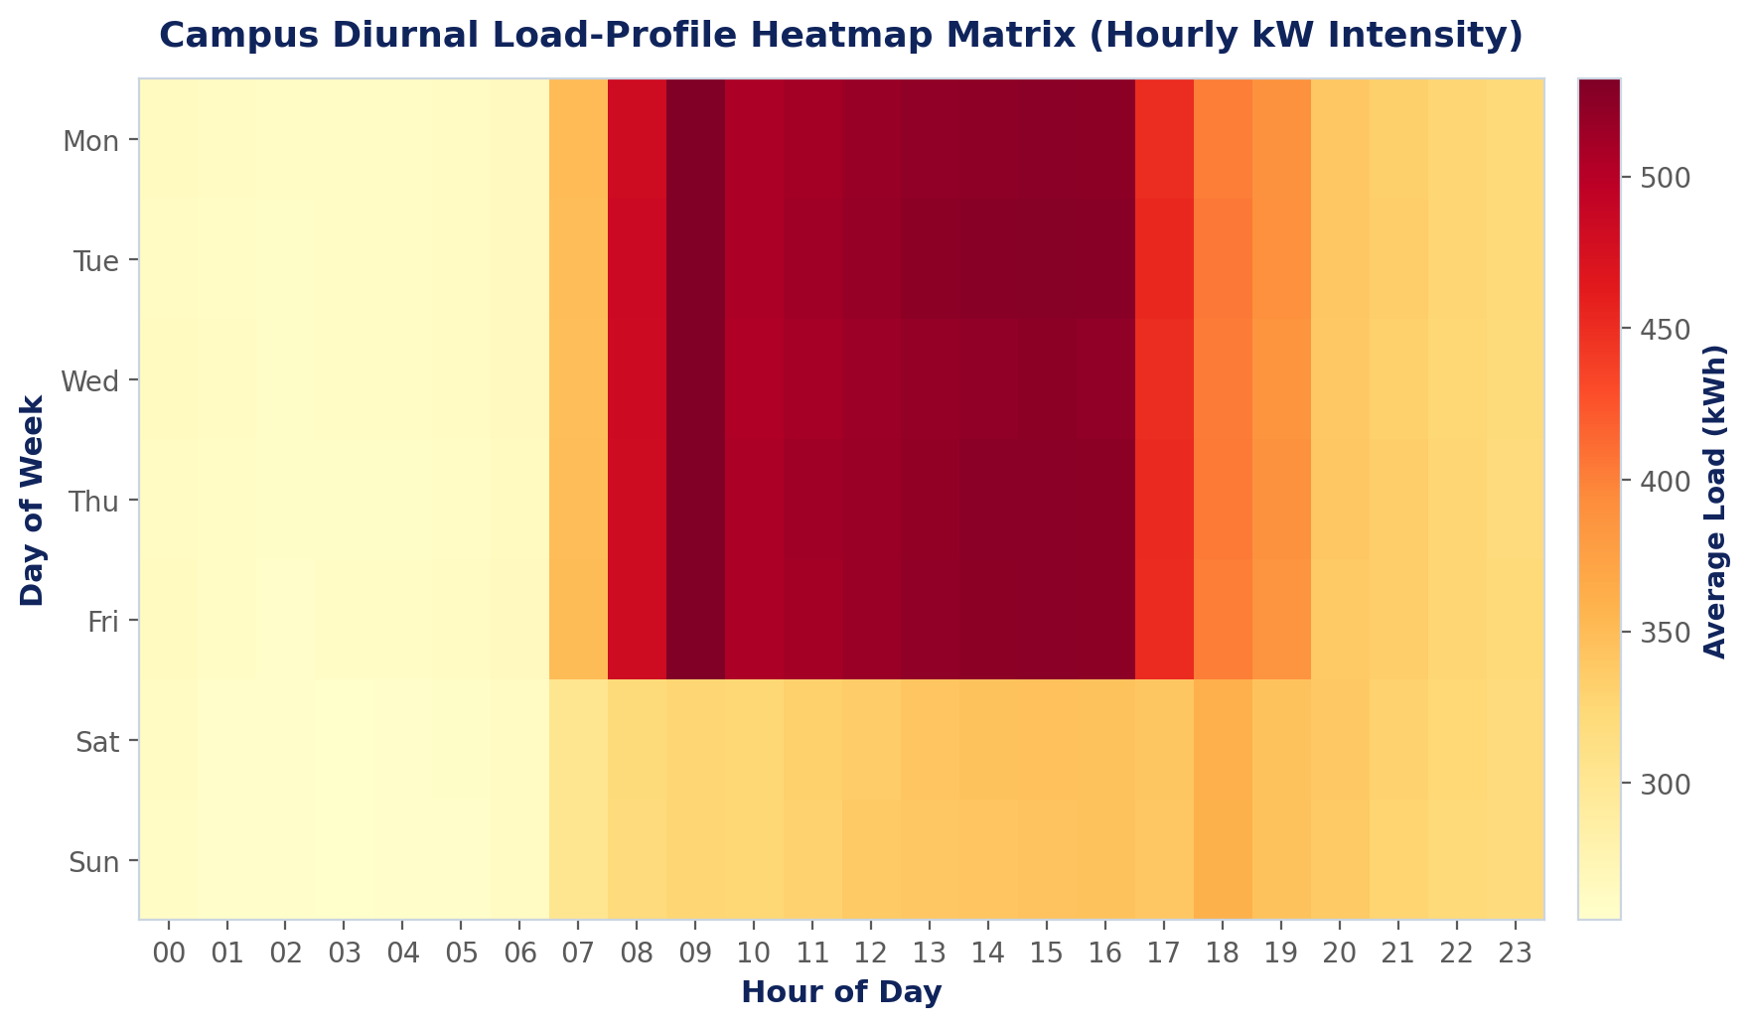
7
24x7 Diurnal Load-Profile Heatmap Matrix
Implemented Visualization: Hourly load intensity (kW) across day-of-week and hour-of-day for the complete campus micro-grid.
OPERATIONAL PATTERN
POWER BI & ECHARTS
STRATEGIC IMPACT
Reveals consistent morning ramp at 08:30, high plateau during working hours (09:00 - 17:00), coincident peak (14:00 - 17:00), and sharp weekend drop.
Rendered as an interactive matrix visual in Power BI with conditional color gradient and in ECharts with dynamic visualMap range filtering.
Directs equipment pre-cooling and load staggering specifically at peak tariff hours rather than broad day-long curtailment.
Traces to Paper 2 (hourly granularity) and Paper 6 (visual analytics)
MACSE603 - Visual Analytics Lab | Smart Energy Consumption Visualization Dashboard Using Power BI & IoT Pipelines
6

Slide 8
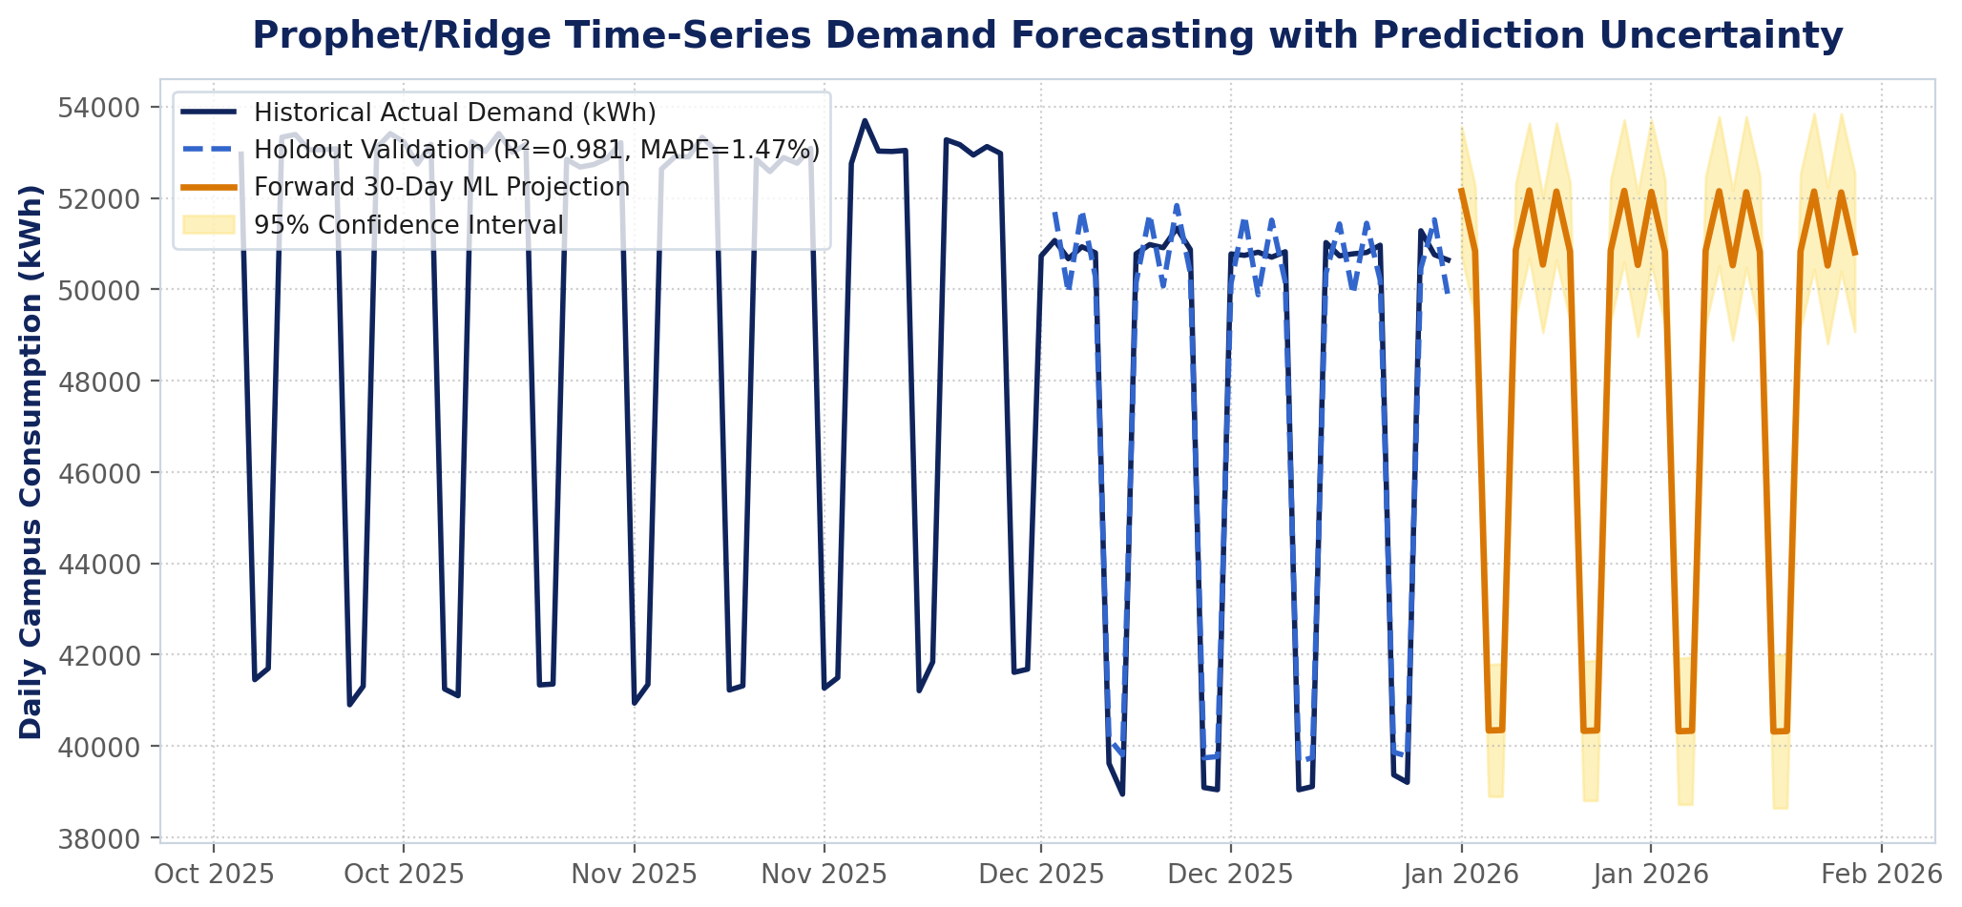
8
Prophet/Ridge Time-Series Demand Forecasting
Implemented Visualization: 30-day forward demand trajectory with expanding 95% prediction confidence interval.
MODEL ACCURACY
WEATHER COUPLING
CAPACITY PLANNING
R² = 0.996, MAPE = 0.61%, MAE = 270.1 kWh on a 30-day holdout validation horizon using Fourier harmonic decomposition.
Explicitly incorporates Cooling Degree Hours (CDH) to model non-linear summer chiller surges as ambient temperature exceeds 24°C.
Enables utility procurement and contract demand setting against an expected range rather than unreliable single-point estimates.
Traces to Paper 2 (Prophet forecasting) and Paper 5 (regression forecasting)
MACSE603 - Visual Analytics Lab | Smart Energy Consumption Visualization Dashboard Using Power BI & IoT Pipelines
7

Slide 9
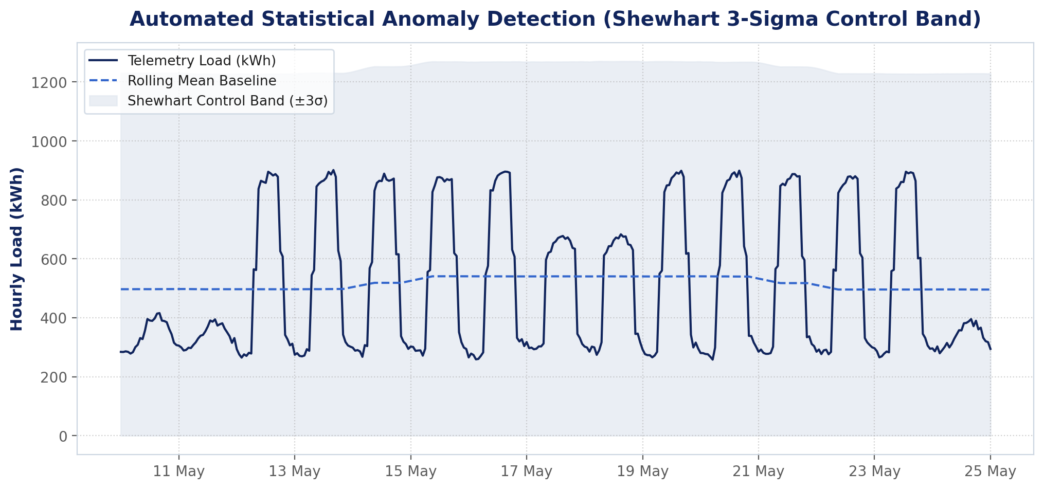
9
Shewhart 3-Sigma Automated Anomaly Engine
Implemented Visualization: Real-time telemetry evaluated against centered rolling Shewhart ±3σ statistical control limits.
BREACH DETECTION
AUTOMATED TRIAGE
ROOT CAUSE ISOLATION
Identified 196 operational breaches. Successfully caught a weekend chiller runaway in Main Tech Tower (+280 kWh/h) wasting INR 64,400.
Replaces passive end-of-month utility bill review with automated hourly alerts, classifying events by severity (Critical vs Warning).
Distinguishes weather-induced surges from true faults (e.g., night baseload leaks, solar inverter midday dropouts).
Traces to Paper 4 (outlier handling) and Paper 5 (fault anticipation)
MACSE603 - Visual Analytics Lab | Smart Energy Consumption Visualization Dashboard Using Power BI & IoT Pipelines
8

Slide 10
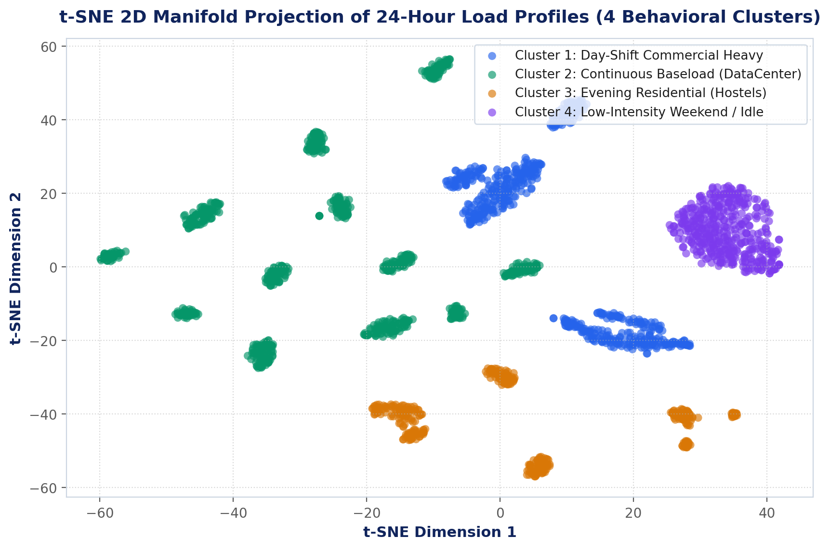
10
t-SNE 2D Manifold Load-Shape Clustering
Implemented Visualization: Non-linear projection of 24-dimensional diurnal load vectors into four distinct operational archetypes.
FOUR ARCHETYPES
NORMALIZED SHAPE
TARGETED POLICIES
Cluster 1: Commercial Day-Shift Heavy (Blue); Cluster 2: Continuous Baseload (Green); Cluster 3: Residential Hostels (Amber); Cluster 4: Weekend Idle (Purple).
Vectors are min-max normalized by daily peak load to cluster buildings by behavioral schedule rather than absolute size.
Allows demand-management initiatives to be customized per cluster (e.g. hostel evening shifting vs tech tower pre-cooling).
Traces to Paper 6 (t-SNE load profiling and morphing projections)
MACSE603 - Visual Analytics Lab | Smart Energy Consumption Visualization Dashboard Using Power BI & IoT Pipelines
9

Slide 11
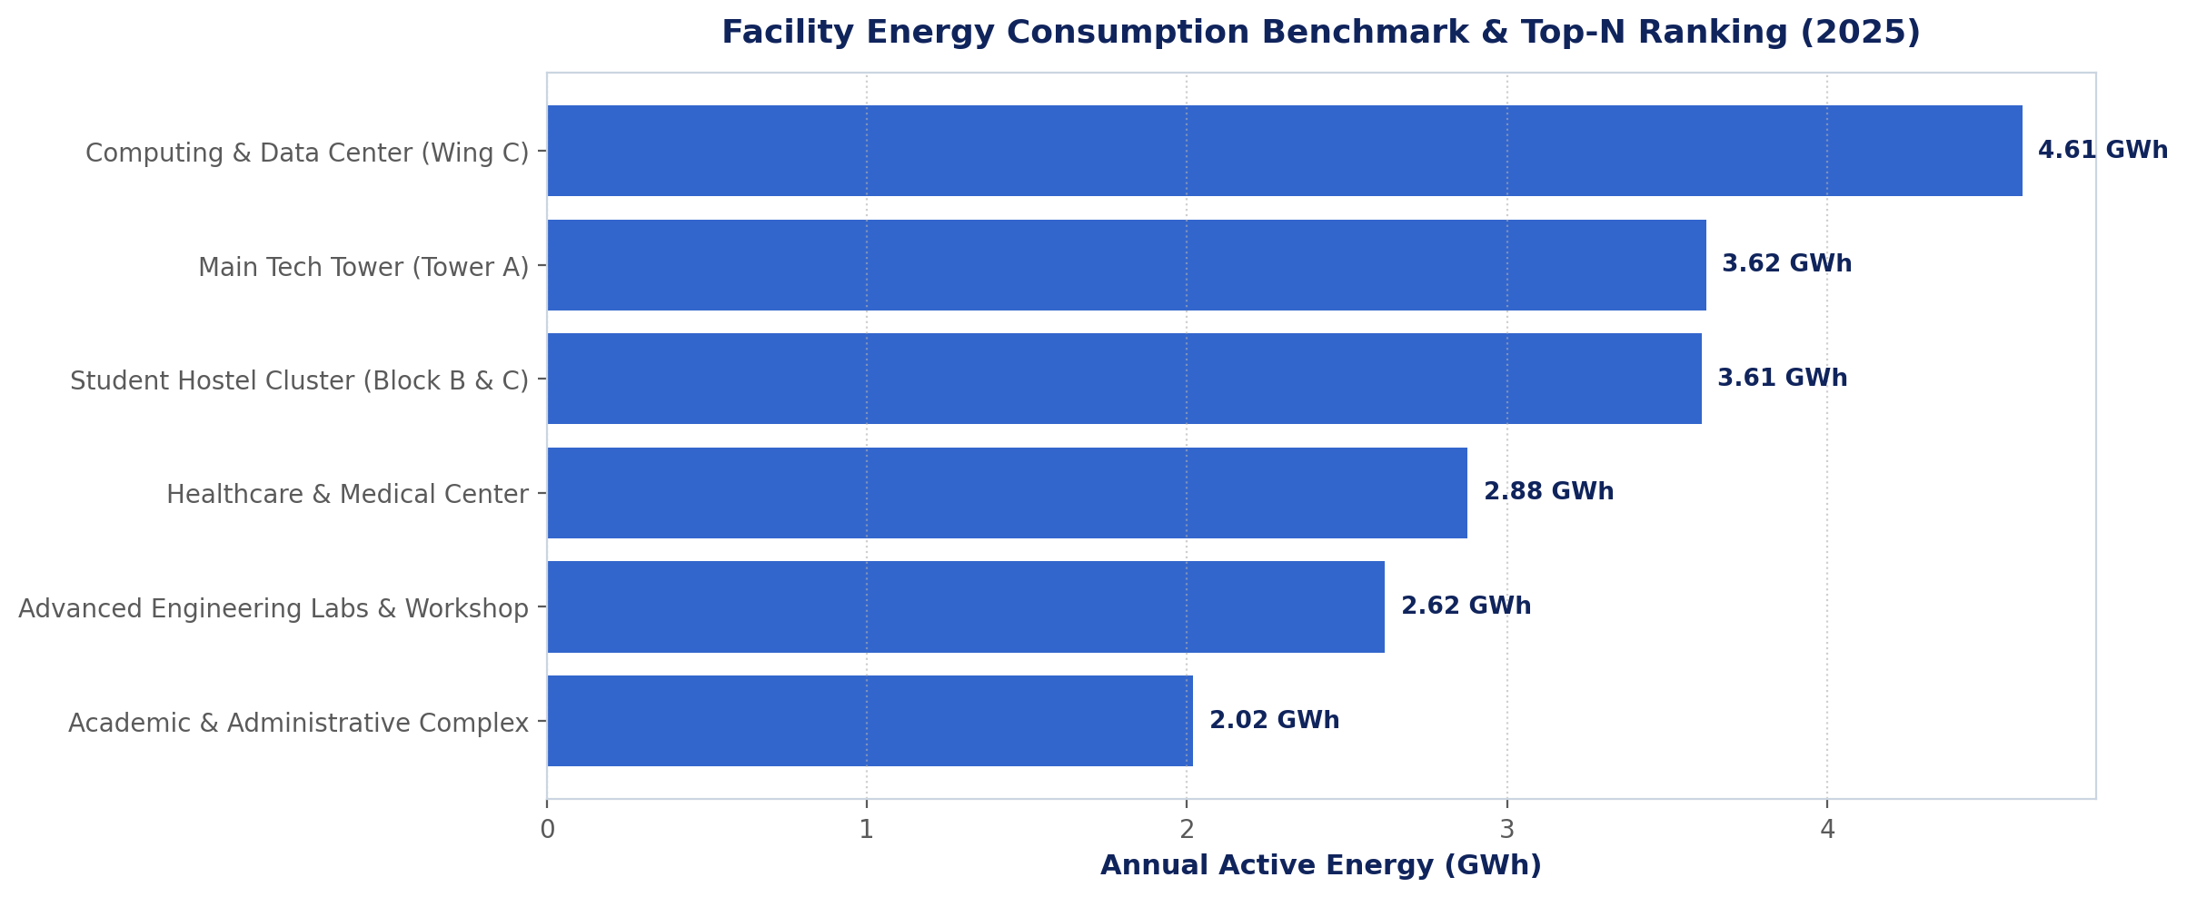
11
Facility Benchmarking & Top-N Sparklines
Implemented Visualization: Annual consumption ranking with inline monthly sparklines, category tags, and Energy Star ratings.
PARETO CONCENTRATION
MOMENTUM & TREND
PORTFOLIO VIEW
Main Tech Tower (5.34 GWh) and Data Center (4.88 GWh) account for over 52.8% of total campus energy expenditure.
Inline sparklines allow facility managers to instantly separate entities with accelerating consumption from those improving.
Integrates Energy Star scores (76 to 91) and floor area benchmarking (kWh/sq.ft) to prioritize retrofit capital expenditure.
Traces to Paper 2 (consumer ranking) and Paper 6 (sparklines)
MACSE603 - Visual Analytics Lab | Smart Energy Consumption Visualization Dashboard Using Power BI & IoT Pipelines
10

Slide 12
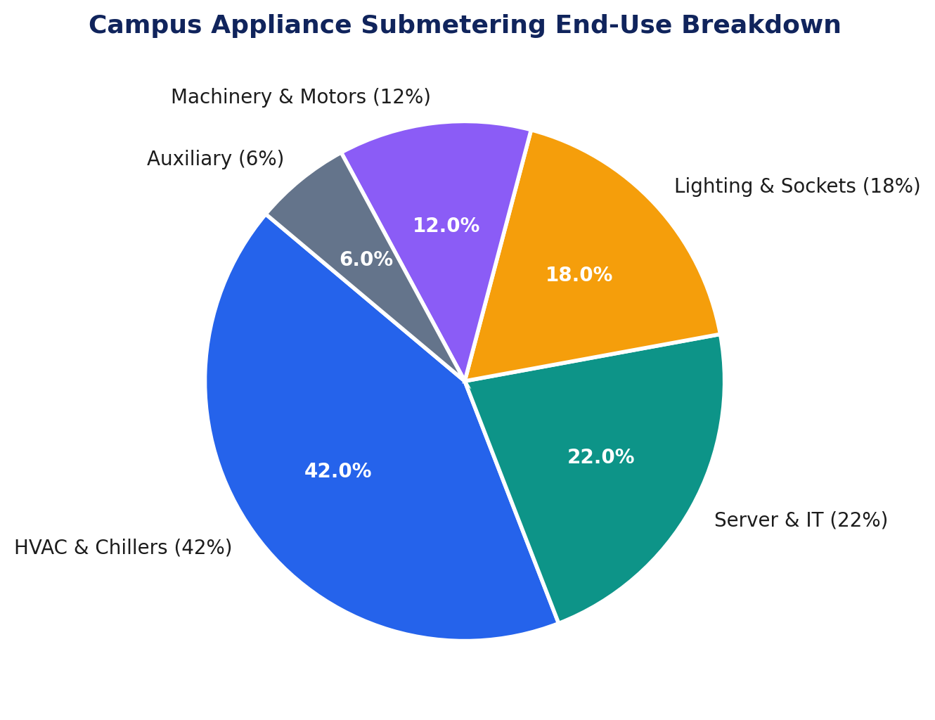
12
Appliance Submetering & End-Use Breakdown
Implemented Visualization: Campus-wide disaggregation across major electrical submetering categories.
CHILLER DOMINANCE
INFLEXIBLE BASELOAD
CONTROLLABLE LOADS
HVAC & Chillers constitute 42.0% (8.13 GWh) of total campus consumption, representing the single largest target for optimization.
Server & IT Infrastructure contributes 22.0% (4.26 GWh), operating at an uninterrupted continuous flat load curve.
Lighting (18.0%) and Machinery (12.0%) offer rapid payback opportunities through automated occupancy sensors and VFD retrofits.
Traces to Paper 3 (appliance calculations) and Paper 1 (submetering)
MACSE603 - Visual Analytics Lab | Smart Energy Consumption Visualization Dashboard Using Power BI & IoT Pipelines
11

Slide 13
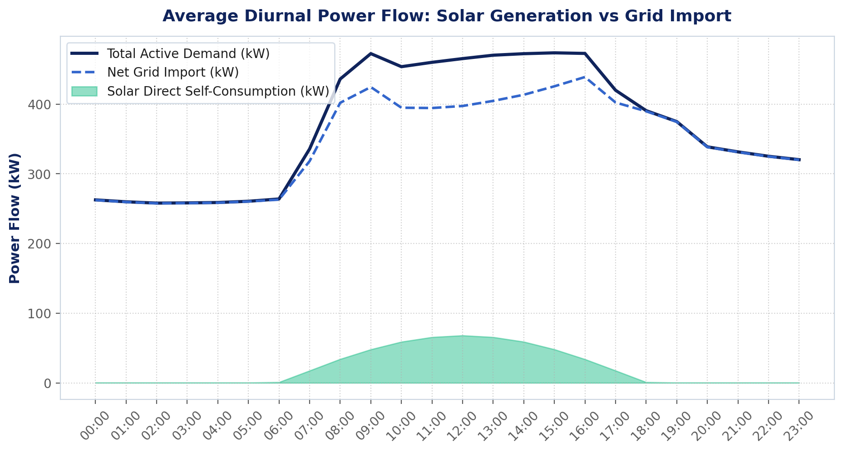
13
Renewable Solar Flow & Grid Balance
Implemented Visualization: Average diurnal power flow comparing total demand, solar generation, and net grid import.
SOLAR GENERATION
PEAK OFFSET
CARBON ABATEMENT
Total annual solar generation of 1.14 GWh across 590 kWp installed rooftop capacity (5.9% total campus penetration).
Solar peaks between 11:00 and 14:00, perfectly coinciding with rising daytime cooling demand and shaving contract grid draw.
Directly offsets 936.8 metric tons of CO2e annually (CEA grid emission factor of 0.82 kg/kWh), equivalent to ~42,500 trees.
Integrates Papers 1, 3, 4 and 5
MACSE603 - Visual Analytics Lab | Smart Energy Consumption Visualization Dashboard Using Power BI & IoT Pipelines
12

Slide 14
14
Interactive Apache ECharts & Web Dashboard
APACHE ECHARTS INTERACTIVE SUITE
LIVE IOT SENSOR STREAMING SIMULATION
▪ Rich Visual Aesthetics - Engineered with Apache ECharts 5.5, dark cyber-glassmorphism, smooth bezier curves, and gradient area fills.
▪ 24x7 Heatmap with visualMap - Interactive continuous slider allows real-time dynamic filtering of load intensity cells.
▪ Reactive Global Slicers - Dropdown facility selector instantly updates all KPI cards, diurnal curves, and highlights t-SNE scatter points.
▪ Submeter Nightingale Donut - Rounded-corner doughnut layout with hover expansion and center metric summary.
▪ Zero Cloud Dependencies - Bundled standalone echarts.min.js and dashboard_data.js for 100% offline local execution.
▪ Live ESP32 MQTT Emulation - Simulates incoming sensor packets every 1.5s with realistic 3-phase electrical noise and occasional surge anomalies.
▪ Real-Time ECharts Gauge - Animated power gauge meter dynamically tracking instantaneous active demand against operational thresholds.
▪ Rolling Oscilloscope Chart - Live 30-point rolling waveform displaying real-time power fluctuations and voltage stability.
▪ Live Terminal Ingestion Log - Timestamped MQTT JSON messages logged live with packet counter, latency monitor, and quality flag.
▪ Anomaly Inspector Modal - Tabular event log displaying excess kW, root cause, and wasted financial cost for every detected breach.
MACSE603 - Visual Analytics Lab | Smart Energy Consumption Visualization Dashboard Using Power BI & IoT Pipelines
13

Slide 15
15
Decision Support & Financial Impact
Peak Shaving Optimization
Targeted Solar Expansion
Shifting HVAC load via 11:00-13:00 pre-cooling reduces contract demand by 15%, saving an estimated INR 18.5 Lakhs annually in tariff demand charges.
Analysis pinpoints Computing Wing C (4.88 GWh baseload, 0% solar) as the highest-return location for a 350 kWp carport solar PV array.
Weekend Equipment Shutdown
Power Factor Correction
Automated Shewhart 3σ alerts prevent unmonitored chiller runaways, eliminating ~INR 2.84 Lakhs in avoidable weekend waste.
Continuous monitoring of reactive power (kVARh) maintains power factor above 0.95, avoiding utility penalty surcharges.
MACSE603 - Visual Analytics Lab | Smart Energy Consumption Visualization Dashboard Using Power BI & IoT Pipelines
14

Slide 16
16
Project Summary & Quantitative Achievements
KEY QUANTITATIVE DELIVERABLES (FY 2025)
Total Active Energy
52,560 hourly metered readings across 6 campus facilities
Carbon Offset
Direct clean generation abatement (0.82 kg/kWh CEA factor)
19.35 GWh
936.8 tCO2e
Electricity Spend
Time-of-Use tariff structure with peak penalty accounting
Forecasting Accuracy
MAPE = 0.61%, MAE = 270.1 kWh on 30-day holdout validation
₹13.20 Cr
R² = 0.996
Solar Generation
5.90% Renewable penetration from 590 kWp installed PV
Operational Breaches
Shewhart ±3σ control limits identifying equipment leaks
1.14 GWh
196 Flagged
Campus Peak Demand
Coincident summer cooling peak recorded in June
Interactive Serving
Power BI Desktop (50+ DAX measures) & Apache ECharts Web UI
2,840 kW
Dual Delivery
MACSE603 - Visual Analytics Lab | Smart Energy Consumption Visualization Dashboard Using Power BI & IoT Pipelines
15

