Slide 1
MACSE603 - VISUAL ANALYTICS LAB
PROJECT PRESENTATION
Smart Energy Consumption
Visualization Dashboard
Using Power BI
TEAM MEMBERS
Vedant Nimkar
Reg. No. 26MML0045
TEAM LEADER
Jitesh Bobde
Reg. No. 26MML0025
MEMBER
Ayush Sharma
Reg. No. 26MML0043
MEMBER
Literature review of six research papers - two papers per team member
M.Tech - Computer Science and Engineering

Slide 2
2
Abstract & Problem Statement
ABSTRACT
PROBLEM STATEMENT
This work reviews six studies on smart energy monitoring, electricity-consumption analytics, interactive visualization, forecasting and Power BI dashboards.
The literature shows that effective dashboards depend on reliable data collection, data cleaning, dimensional modeling, meaningful visual encoding, interactivity and actionable analytics.
These findings support the proposed project: a Power BI dashboard that helps users understand consumption trends, detect high-use periods, compare consumers or facilities, and support energy-efficiency decisions.
▪ Fragmented data - consumption readings are spread across smart meters, sensors and billing records with no common format.
▪ Poor standardisation - inconsistent units, missing values and outliers make raw energy data difficult to trust.
▪ No single view - stakeholders cannot easily see trends, peak periods or compare consumers in one place.
▪ Observation without action - most reports describe past usage but do not flag anomalies or forecast future demand.
▪ Disconnected solutions - existing work addresses Power BI reporting, IoT monitoring or machine learning separately, not together.
MACSE603 - Visual Analytics Lab | Smart Energy Consumption Visualization Dashboard Using Power BI
1

Slide 3
3
Objectives
01
Build the dashboard
Develop an interactive Power BI dashboard for smart energy consumption using a documented ETL and star-schema model.
04
Enable comparison
Compare consumers, buildings or facilities and rank the Top-N high-consumption entities.
02
Report core KPIs
Present total energy and cost KPIs with explainable DAX measures so every number can be traced to its source.
05
Add diagnostic analytics
Flag anomalies, provide forecast charts and show renewable-versus-grid contribution where data allows.
03
Reveal consumption patterns
Show daily, weekly, monthly and hourly trends and identify peak-demand periods and load profiles.
06
Support investigation
Provide slicers for date, location, consumer, tariff and appliance plus drill-through pages for detail.
MACSE603 - Visual Analytics Lab | Smart Energy Consumption Visualization Dashboard Using Power BI
2

Slide 4
4
Literature Review & Related Works
Six papers reviewed - two per team member - covering BI workflows, big-data visualization, IoT sensing and machine-learning analytics.
# | Paper / Study | Source | Key contribution | Reviewer
1 | Energy Consumption Distribution in Portugal: A Business Intelligence Solution | NOVA IMS, 2024 | Design Science Research Methodology; BI conceptual model and interactive Power BI dashboard over monthly, hourly and geographic data. Lesson: start from explicit business questions. | Vedant Nimkar
2 | Electricity Consumption using Big Data Analytics | Awate et al., IJARSCT 3(2), 2023 | 500 residential consumers over 24 months. Power BI visuals plus Prophet forecasting and consumer ranking. Limitation: monthly data restricts temporal granularity. | Vedant Nimkar
3 | Energy Calculation Using Power BI | IJRPR, 2023 | End-to-end workflow: collect, clean, transform, model, visualise, add slicers, test accuracy, publish. Emphasises usability and stakeholder-oriented layout. | Jitesh Bobde
4 | Visualization as a Means of Big Data Management: Qatar Electricity Consumption Data | Soliman & Fetais, IEEE GCCCE, 2017 | Visualization converts large inconsistent energy data into information. Identifies standardisation, integration, speed and outlier challenges. | Jitesh Bobde
5 | An IoT-Enabled Smart Energy Monitoring and Fault Prediction System | IJIRT, 2026 | ESP32 voltage/current sensing with calibration, MQTT to cloud, real-time dashboards, regression forecasting and fault anticipation. Dashboard is web-based, not Power BI. | Ayush Sharma
6 | Interactive Machine Learning-Powered Dashboard | ESANN Proceedings, 2024 | Machine learning with interactive visual analytics: t-SNE maps of daily demand profiles, data-cube filtering, sparklines and morphing projections. | Ayush Sharma
MACSE603 - Visual Analytics Lab | Smart Energy Consumption Visualization Dashboard Using Power BI
3

Slide 5
5
Research Gap Identified
RECURRING REQUIREMENTS ACROSS THE SIX PAPERS
THE GAP
1
Reliable and standardized data
Existing work focuses on either Power BI reporting, IoT monitoring, or machine-learning analytics in isolation.
No single study integrates all three layers into one practical, documented and evaluated dashboard.
2
A clear, documented ETL pipeline
3
A well-structured analytical model
OUR PROPOSED CONTRIBUTION
4
Interactive visuals that answer stakeholder questions
▪ Integrate reporting, IoT data and analytics in one dashboard
▪ Document explicit data-quality checks
▪ Provide role-specific views for different stakeholders
▪ Use explainable KPIs traceable to source data
▪ Evaluate on usability and decision usefulness
5
Predictive or diagnostic features that turn observation into action
Power BI suits the reporting and exploration layer, while Python, SQL, IoT platforms and ML services provide data preparation and advanced analytics.
MACSE603 - Visual Analytics Lab | Smart Energy Consumption Visualization Dashboard Using Power BI
4

Slide 6
6
Proposed System Design, Architecture & Methods
DATA SOURCES
Smart meters | IoT sensors (ESP32 via MQTT) | Billing records | Weather / tariff reference data
METHODS
▪ Design Science Research Methodology
▪ Business questions defined first
▪ Iterative build with user feedback
▪ Star-schema dimensional modeling
▪ Accuracy testing before publishing
INGESTION & ETL
Power Query cleaning | unit standardisation | missing-value treatment | outlier handling | scheduled refresh
ANALYTICAL MODEL
Star schema (fact: consumption readings; dimensions: date, consumer, location, tariff, appliance) | DAX measures
Forecasting (Prophet / regression) | anomaly detection | load-shape clustering with t-SNE | Top-N ranking
EVALUATION METRICS
ANALYTICS LAYER
▪ Refresh reliability
▪ Visual clarity and usability
▪ Forecast error where used
▪ Actionable energy-saving findings
PRESENTATION - POWER BI
KPI cards | trend & peak-demand charts | load heatmaps | comparisons | slicers | drill-through pages
MACSE603 - Visual Analytics Lab | Smart Energy Consumption Visualization Dashboard Using Power BI
5

Slide 7
APPENDIX
Visual Design Concepts
Illustrative renderings of the analytical visuals the dashboard will deliver
MACSE603 - Visual Analytics Lab | Smart Energy Consumption Visualization Dashboard Using Power BI
6

Slide 8
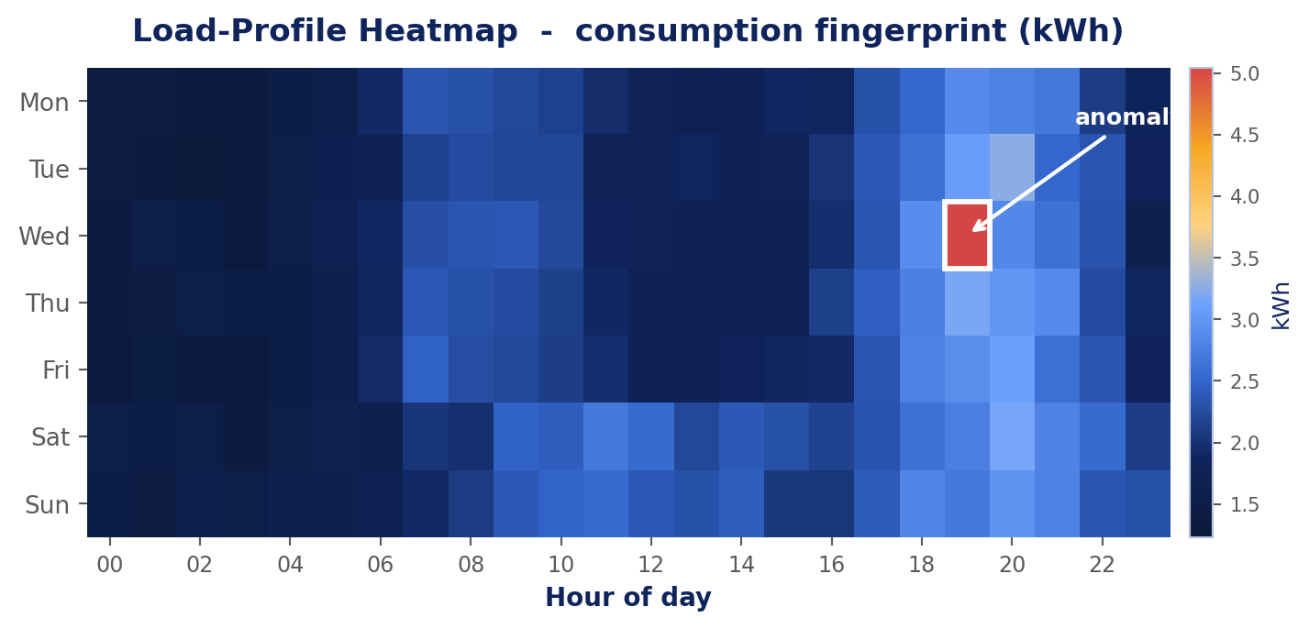
8
Load-Profile Heatmap
Synthetic illustration: hour-of-day against day-of-week consumption intensity, with one injected anomaly highlighted.
WHAT IT SHOWS
HOW IT IS BUILT
DECISION IT SUPPORTS
Each cell is average consumption for one hour on one weekday. Colour intensity exposes the building's daily rhythm at a glance - a morning ramp, a dominant evening peak, and a clearly different weekend pattern.
A matrix visual in Power BI over the consumption fact table, with hour and weekday pulled from the date dimension. Conditional formatting drives the colour scale from a DAX average measure.
Identifies exactly when peak demand occurs so tariff shifting, load staggering and equipment scheduling can be targeted at the right hours instead of the whole day.
Traces to Paper 2 (hourly granularity) and Paper 6 (load-profile visuals)
MACSE603 - Visual Analytics Lab | Smart Energy Consumption Visualization Dashboard Using Power BI
7

Slide 9
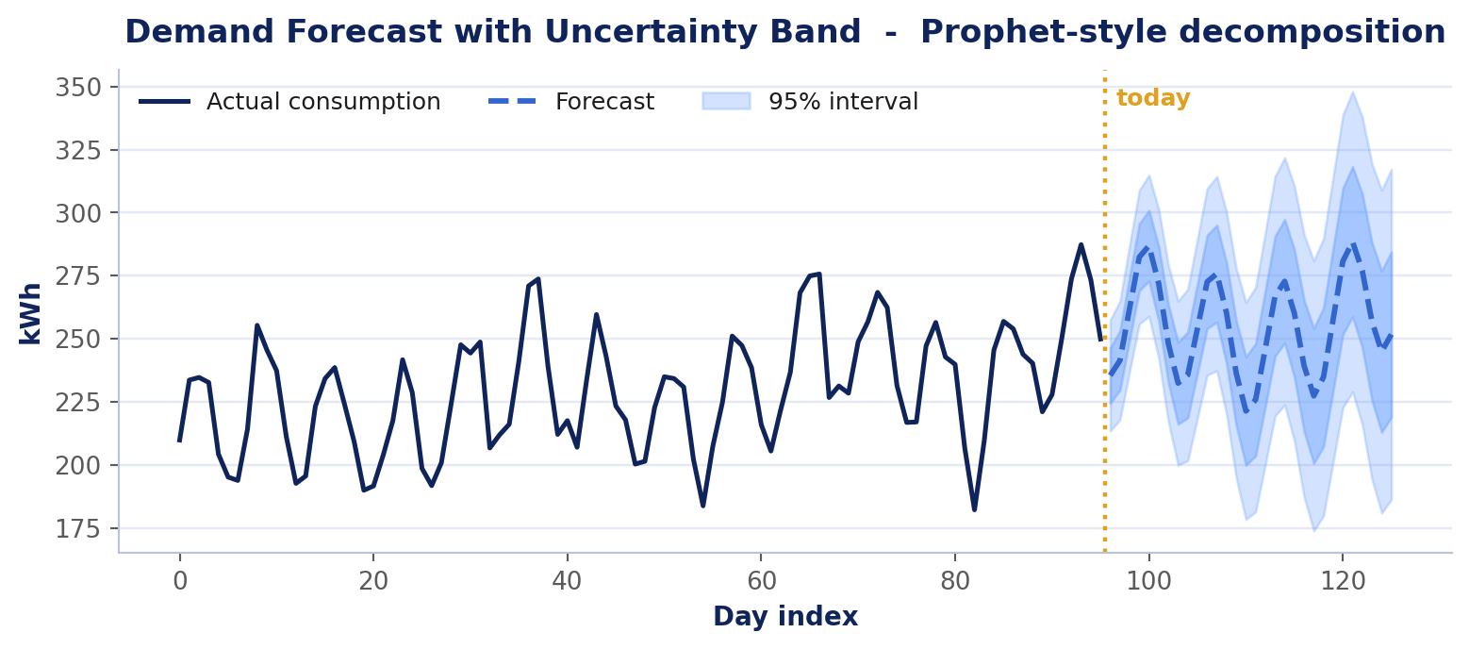
9
Demand Forecast with Uncertainty
Synthetic illustration: historical consumption with a forward forecast and 95% prediction interval.
WHAT IT SHOWS
HOW IT IS BUILT
DECISION IT SUPPORTS
The solid line is measured history; the dashed line projects future demand. The widening band communicates that confidence decays the further ahead the model predicts.
Prophet decomposes the series into trend plus weekly and monthly seasonality. Results are written back to the model and rendered as a Power BI line-and-area combination.
Enables procurement and capacity planning against an expected range rather than a single number, and makes forecast error measurable as an evaluation metric.
Traces to Paper 2 (Prophet forecasting) and Paper 5 (regression forecasting)
MACSE603 - Visual Analytics Lab | Smart Energy Consumption Visualization Dashboard Using Power BI
8

Slide 10
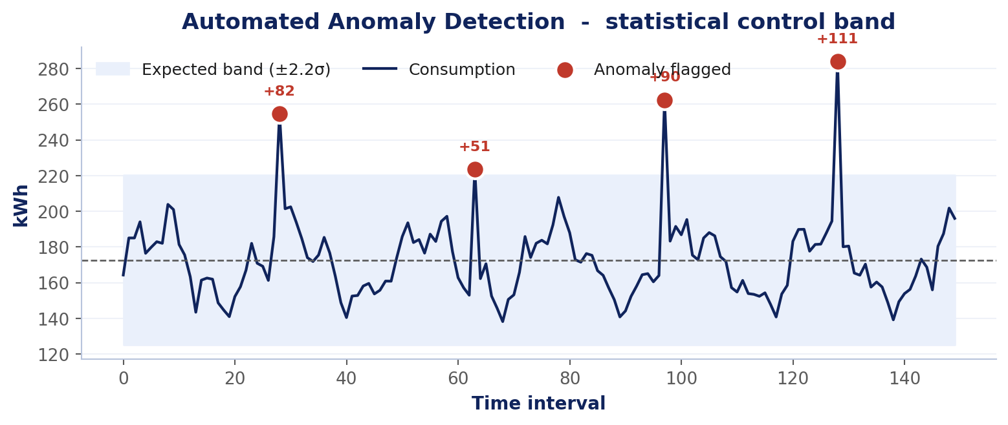
10
Automated Anomaly Detection
Synthetic illustration: consumption against a statistical control band, with deviations flagged and quantified.
WHAT IT SHOWS
HOW IT IS BUILT
DECISION IT SUPPORTS
The shaded band is expected behaviour derived from rolling statistics. Points breaching the threshold are marked in red and annotated with the size of the deviation in kWh.
A DAX measure computes a rolling mean and standard deviation; any reading beyond 2.2 sigma is flagged. The flag becomes a field that drives both the marker and an alert card.
Converts passive reporting into action - equipment faults, meter errors and wasteful overnight loads surface immediately instead of at the end of a billing cycle.
Traces to Paper 4 (outlier handling) and Paper 5 (fault prediction)
MACSE603 - Visual Analytics Lab | Smart Energy Consumption Visualization Dashboard Using Power BI
9

Slide 11
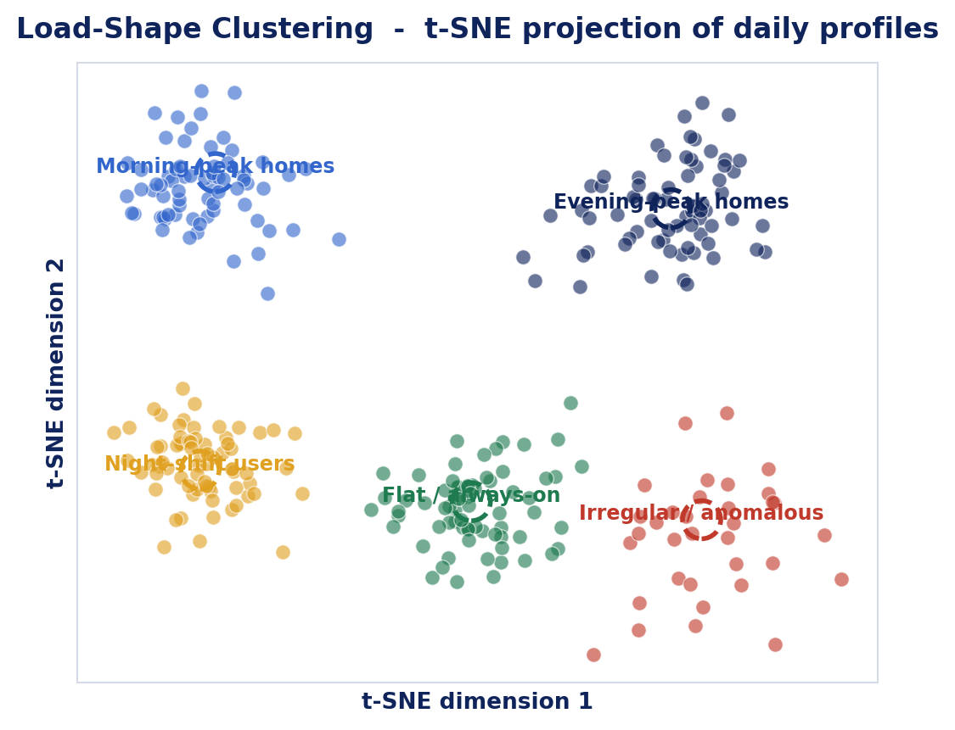
11
Load-Shape Clustering
Synthetic illustration: t-SNE projection grouping consumers by the shape of their daily demand curve.
WHAT IT SHOWS
HOW IT IS BUILT
DECISION IT SUPPORTS
Every point is one consumer-day compressed from 24 hourly readings into two dimensions. Points that sit together behave alike, so distinct usage personalities emerge as visible clusters.
Hourly profiles are normalised, then t-SNE reduces them to two dimensions in Python. Cluster labels return to Power BI as a dimension that every other visual can filter on.
Allows efficiency programmes to be tailored per segment, and makes the irregular cluster a natural watch-list for investigation.
Traces to Paper 6 (t-SNE maps, morphing projections)
MACSE603 - Visual Analytics Lab | Smart Energy Consumption Visualization Dashboard Using Power BI
10

Slide 12
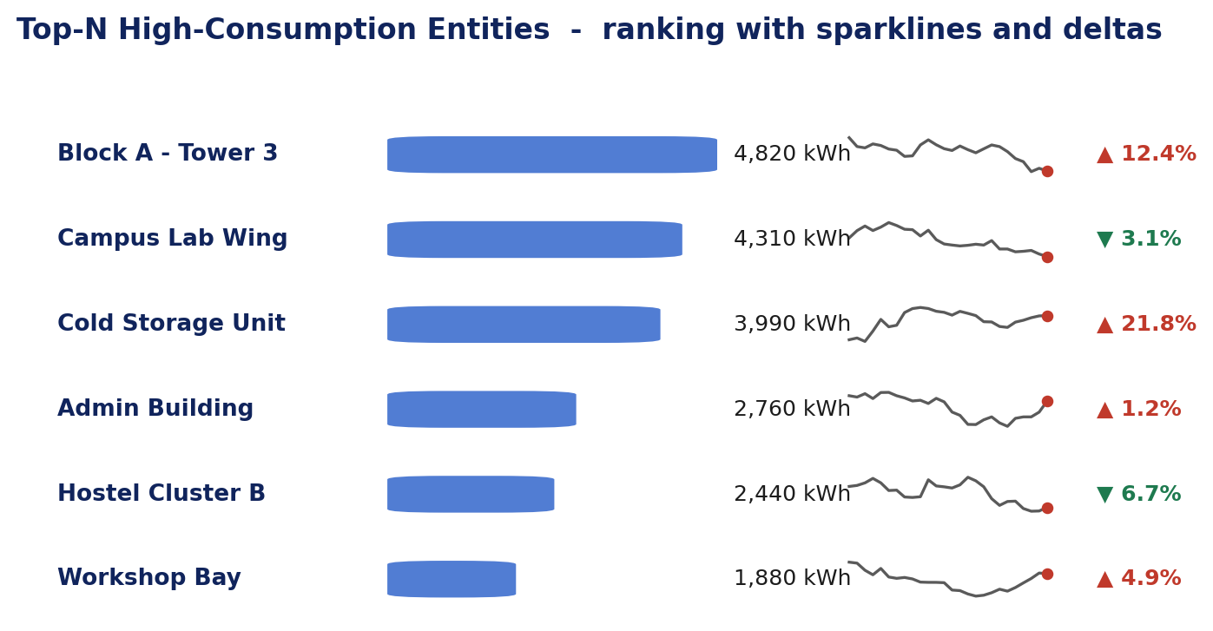
12
Top-N Ranking with Sparklines
Synthetic illustration: highest-consuming entities with inline trend sparklines and period-on-period change.
WHAT IT SHOWS
HOW IT IS BUILT
DECISION IT SUPPORTS
Rank, absolute consumption, a compact trend line and a directional delta sit on a single row, so magnitude and momentum are readable together without opening another page.
A Power BI table visual with data bars, native sparklines and a DAX time-intelligence measure for the percentage change. Top-N filtering is applied through a rank measure.
Directs limited engineering attention to the few entities that dominate the bill, and separates the ones getting worse from the ones already improving.
Traces to Paper 2 (consumer ranking) and Paper 6 (sparklines)
MACSE603 - Visual Analytics Lab | Smart Energy Consumption Visualization Dashboard Using Power BI
11

Slide 13
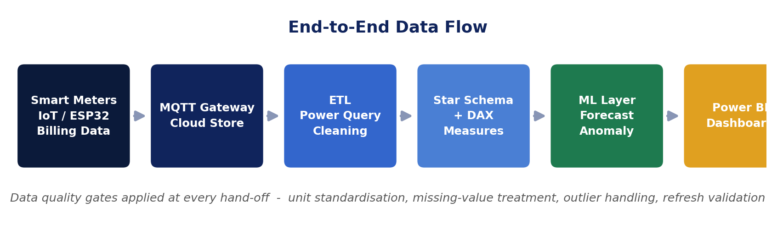
13
End-to-End Data Flow
Reference architecture: raw sensing through to the published Power BI dashboard, with quality gates at every hand-off.
INGESTION
PREPARATION & MODEL
ANALYTICS & DELIVERY
Smart meters, ESP32 sensors and billing extracts publish over MQTT into a cloud store, giving one landing zone regardless of source format.
Power Query standardises units and treats missing values, then loads a star schema whose DAX measures keep every KPI traceable to its source rows.
Forecasting, anomaly detection and clustering enrich the model before Power BI publishes role-specific pages with slicers and drill-through.
Integrates Papers 1, 3, 4 and 5
MACSE603 - Visual Analytics Lab | Smart Energy Consumption Visualization Dashboard Using Power BI
12

