Slide 1



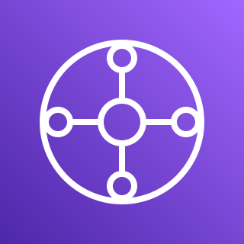
Terraform Module – Hub and Spoke with Transit Gateway
AWS Region
Shared Services VPC
DNS VPC
Ingress VPC
Internet gateway
Egress VPC
Inspection VPC
Internet gateway
AWS Transit Gateway

